Slide 1
Raisin
Group: digital_invention

Slide 2
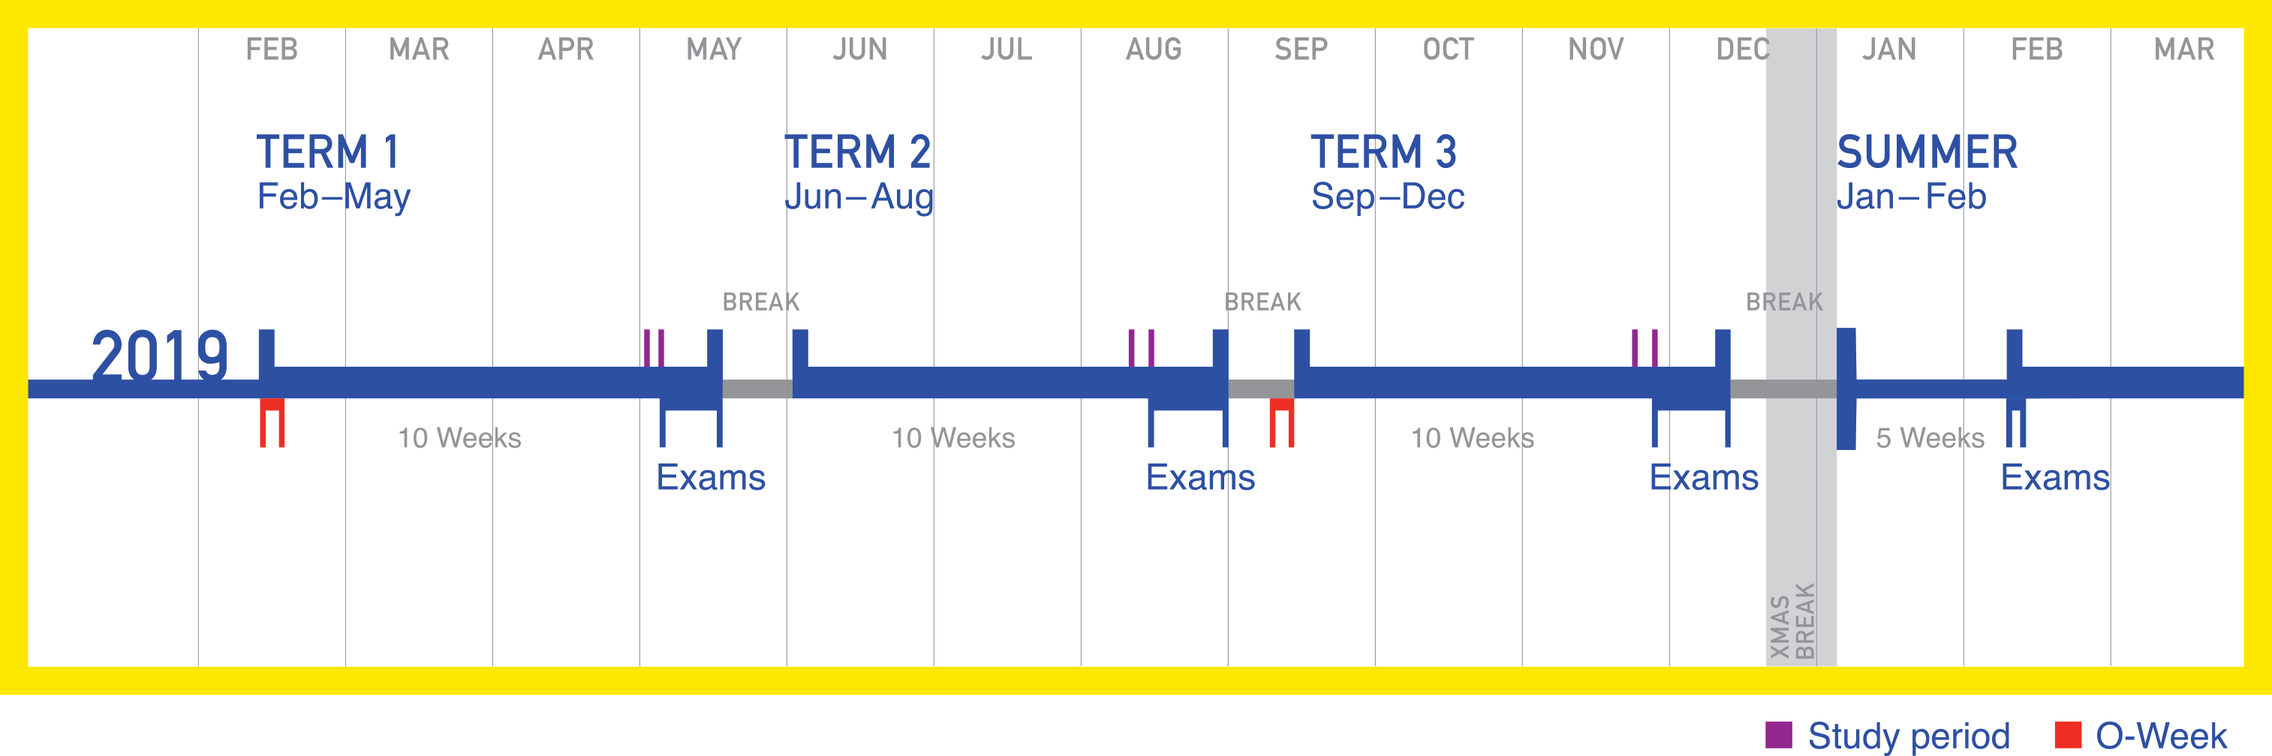


UNSW3+ Trisemesters

Slide 3
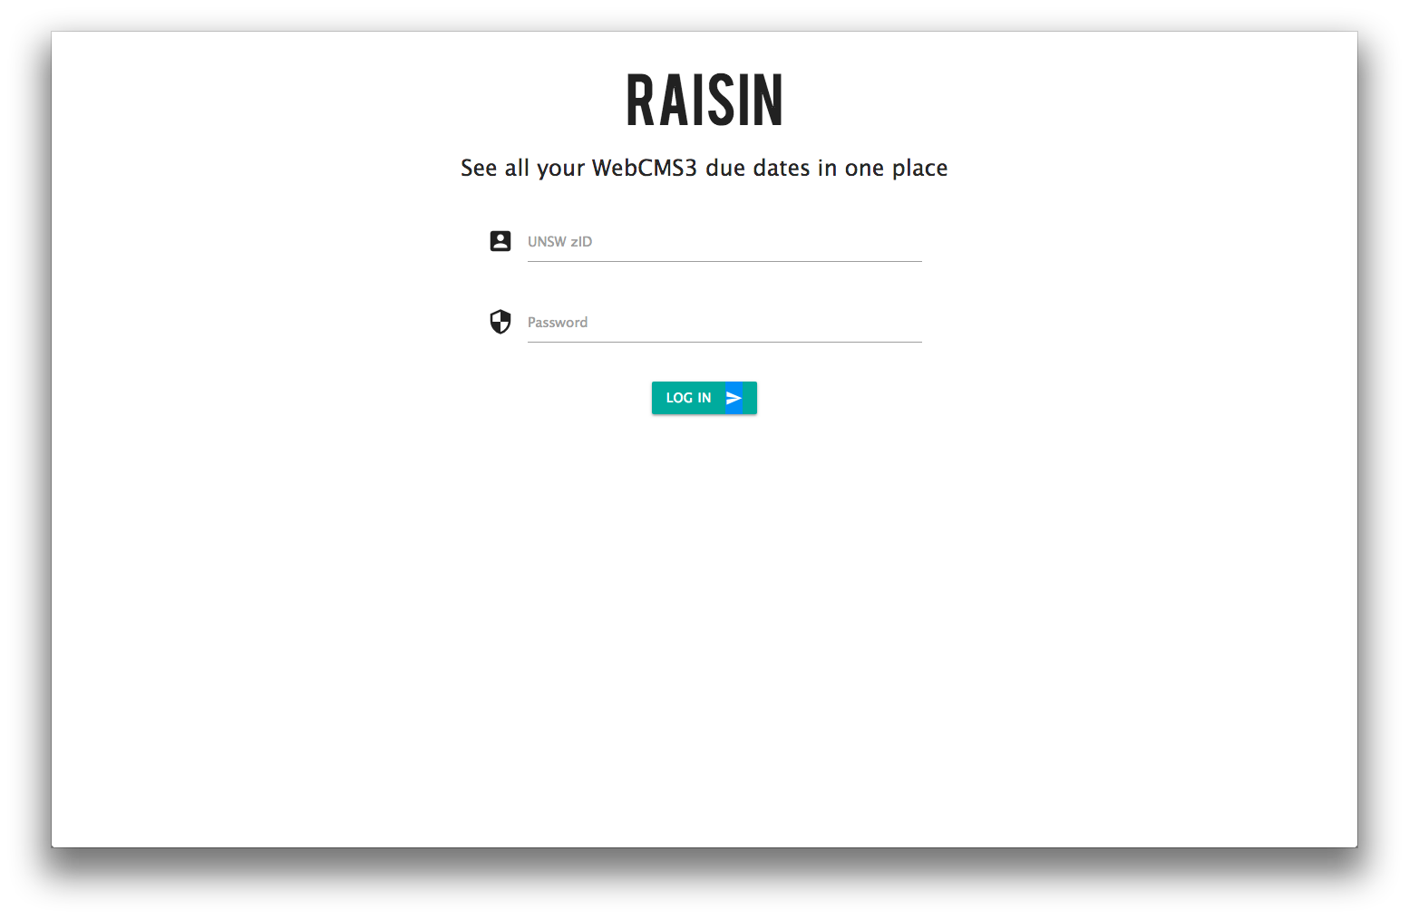


Raisin

Slide 4




Web Stack

Slide 5
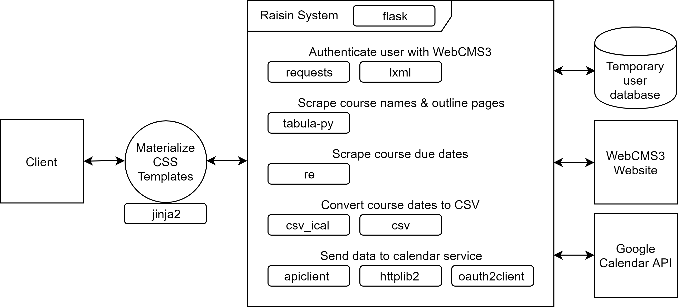
Software Architecture/Implementation
Legend:
Straight Edges = External Application/Entities
Rounded Edges = Python Modules
Circle = Web Interfaces/Templates
Cylinder = Database

