Slide 1
Raisin
Group: digital_invention

Slide 2
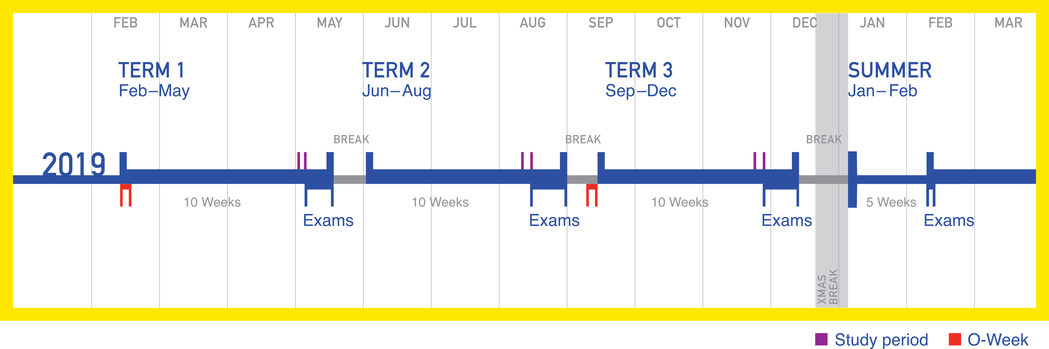
Trimesters
Theme: UNSW students with WebCMS3 courses
Balancing time commitments to work/personal life/study
Course outlines are used to envision the term

Slide 3

Raisin
Aims to assist a student starting a new term, to quick view all course commitments
Collects all course due dates onto 1 web page
Easily export course assessments to Google Calendar or iCal

Slide 4




Web Stack

Slide 5
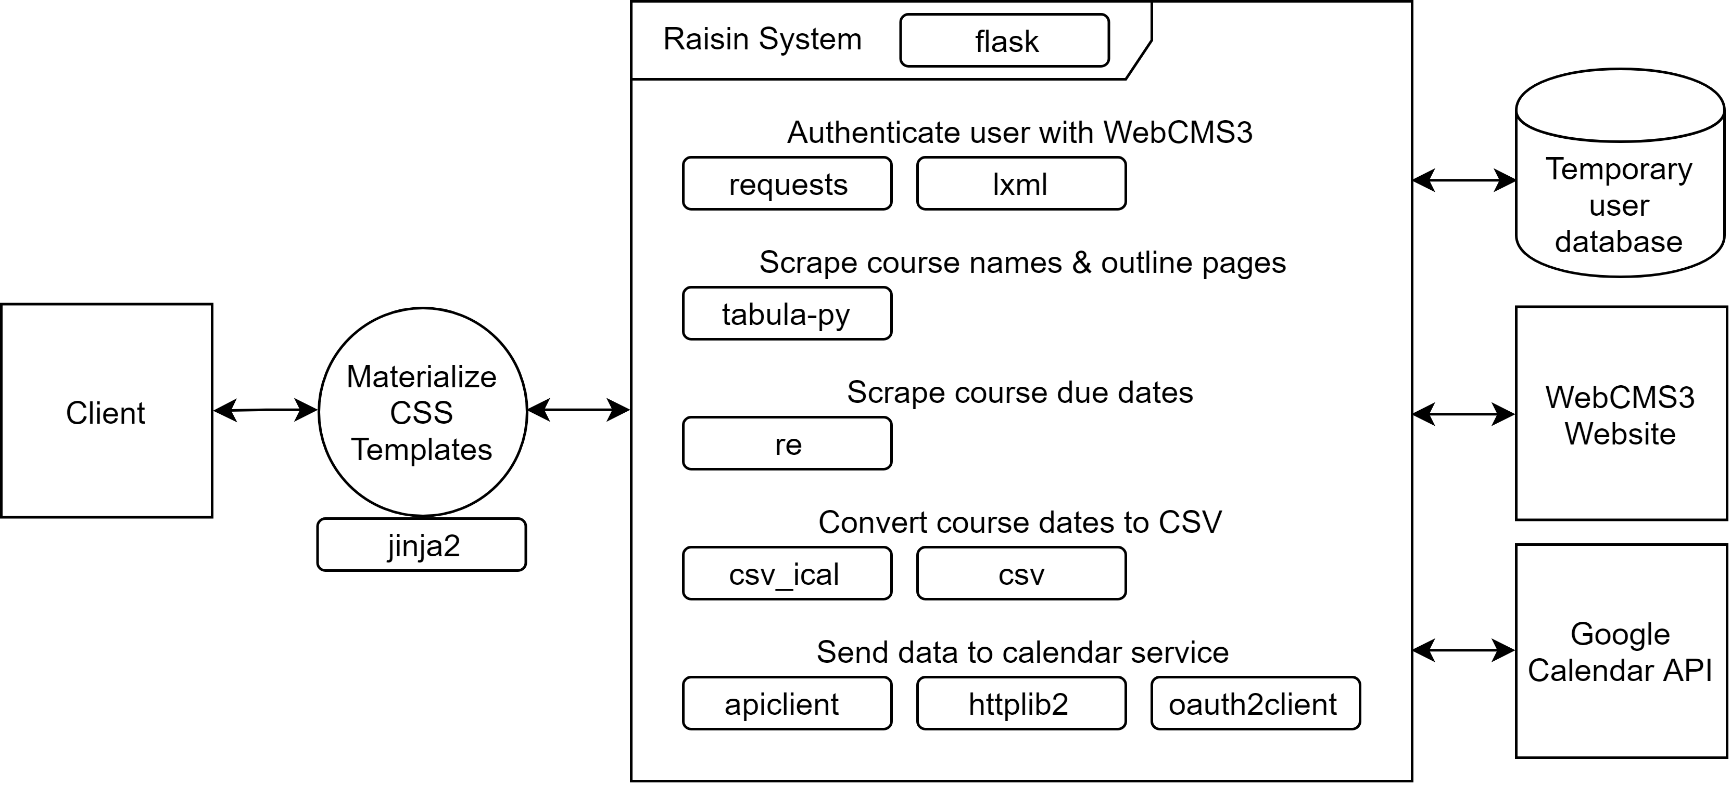
Software Architecture
Server handles accessing WebCMS3
Server uses a PDF scraper and a web scarper to extract information
Uses Google API

