Slide 1
Raisin
All your WebCMS3 due dates in one place.
Group: digital_invention

Slide 2
Our app
Designed for

Slide 3
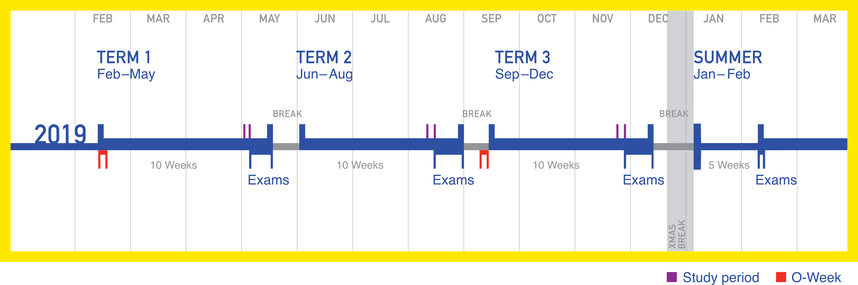
Trimesters
Courses are accelerated & due dates arrive surprisingly
Students already have enough commitments to manage
Course outlines can be dense and confusing

Slide 4

Raisin
Aims to assist a student starting a new term, to quick view all course commitments
Collects all course due dates onto 1 web page
Easily export course assessments to Google Calendar or iCal

Slide 5




Web Stack

Slide 6
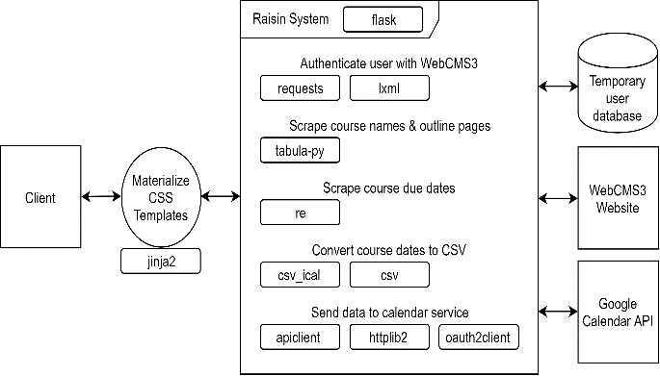
Software Architecture
Server handles accessing WebCMS3
Server uses a PDF scraper and a web scarper to extract information
Uses Google API

