Slide 1

LIBRARY CARPENTRY
SQL
University of North Texas Libraries Friday, August 20, 2021

Slide 2
Complete the pre-workshop survey:
https://carpentries.typeform.com/to/wi32rS?slug=2021-08-06-unt-online
Link to material covered today:
https://librarycarpentry.org/lc-sql/
Workshop attendees are expected to follow the Carpentries code of conduct: https://docs.carpentries.org/topic_folders/policies/code-of-conduct.html

Slide 3
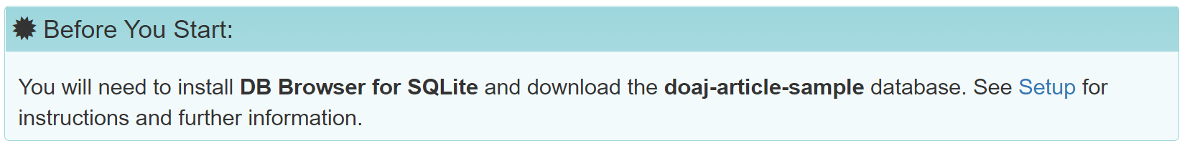
Setup
DB Browser for SQLite download page https://sqlitebrowser.org/dl/
Library Carpentry: SQL setup page https://librarycarpentry.org/lc-sql/setup.html
Notes:
https://librarycarpentry.org/lc-sql/10-other-tools/index.html
For this lesson, DB Browser, a free open source database tool was used, but there are other tools available, both proprietary and open. A helpful comparison of database tools is available via Wikipedia.

Slide 4
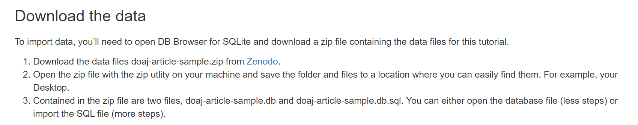
https://zenodo.org/record/2822005#.YRqN3YhKhaQ

Slide 5
INTRODUCTIONS
Name, pronouns if you choose, location
One thing you would like to automate in your work and/or what you hope to learn today

Slide 6

THIS IS ME:
Sarah Lynn Fisher, she/her, sarahlynn.fisher@unt.edu University of North Texas Libraries Program Coordinator – Digital Newspaper Unit
National Digital Newspaper Program – Texas
Texas Digital Newspaper Program
Gateway to Oklahoma History
Automate microfilm metadata database

Slide 7
WHY LIBRARY CARPENTRY?
Library Carpentry workshops teach people working in library- and information-related roles how to:
Cut through the jargon terms and phrases of software development and data science and apply concepts from these fields in library tasks;
Identify and use best practices in data structures;
Learn how to programmatically transform and map data from one form to another;
Work effectively with researchers, IT, and systems colleagues;
Automate repetitive, error prone tasks.

Slide 8
WORKSHOP GOALS
Teach skills
Get started and introduce what’s possible
Build confidence in using these skills
Encourage people to continue learning
Positive learning experience

Slide 9
WORKSHOP REMINDERS
Raise your hand or post questions in chat and the instructor or a helper will assist you
Mute yourself if you aren’t speaking
Post comments in chat - we will do our best to read these out loud at regular intervals
We will take a break at 10:30 a.m. CST

Slide 10
INTRODUCTION TO SQL
Structured Query Language, or SQL
Used to communicate with relational databases
Performs tasks like updating or retrieving data – optimized for handling large amounts of data
Not a general programming language – keeps data separate from analysis
SQL queries can be called from programming languages, like Python, to interact with databases
Several variants – all support the same basic statements
Notes:
https://librarycarpentry.org/lc-sql/01-introduction/index.html
Structured Query Language, or SQL (sometimes pronounced “sequel”), is a powerful language used to interrogate and manipulate relational databases. It is not a general programming language that you can use to write an entire program. However, SQL queries can be called from programming languages to let any program interact with databases. There are several variants of SQL, but all support the same basic statements that we will be covering today. SQL is well established and has been around since the 1970s. It is still widely used in a variety of settings.
SQL lets you keep the data separate from the analysis. There is no risk of accidentally changing data when you are analysing it. If the data is updated, a saved query can be re-run to analyse the new data.
SQL is optimised for handling large amounts of data. Data types help quality control of entries - you will receive an error if you try to enter a word into a field that should contain a number. Understanding the nature of relational databases, and using SQL, will help you in using databases in programming languages such as R or Python.
Many web applications (including WordPress and ecommerce sites like Amazon) run on a SQL (relational) database. Understanding SQL is the first step in eventually building custom web applications that can serve data to users.

Slide 11
RELATIONAL DATABASES
Consist of one or more tables of data
Tables have fields (columns) and records (rows)
Every field has a data type
Every value in the same field of each record has the same type
Tables are linked via matching fields, e.g. Title
Queries are commands that find information or make calculations
Notes:
Relational databases consist of one or more tables of data. These tables have fields (columns) and records (rows). Every field has a data type. Every value in the same field of each record has the same type. These tables can be linked to each other when a field in one table can be matched to a field in another table. SQL queries are the commands that let you look up data in a database or make calculations based on columns.

Slide 12
DATABASE MANAGEMENT SYSTEMS
SQL is the standard language for relational database management systems
Common examples: MySQL, MS Access, SQL Server, Oracle, Filemaker Pro
SQLite – what we will use in today’s workshop
Differences are only details of import/export of data and datatypes, proprietary extensions
First step in building custom web applications that serve data to uses
WordPress, ecommerce sites like Amazon run on an SQL databases
Notes:
http://www.sqlcourse.com/intro.html
SQL (pronounced "ess-que-el") stands for Structured Query Language. SQL is used to communicate with a database. According to ANSI (American National Standards Institute), it is the standard language for relational database management systems. SQL statements are used to perform tasks such as update data on a database, or retrieve data from a database. Some common relational database management systems that use SQL are: Oracle, Sybase, Microsoft SQL Server, Access, Ingres, etc. Although most database systems use SQL, most of them also have their own additional proprietary extensions that are usually only used on their system. However, the standard SQL commands such as "Select", "Insert", "Update", "Delete", "Create", and "Drop" can be used to accomplish almost everything that one needs to do with a database. This tutorial will provide you with the instruction on the basics of each of these commands as well as allow you to put them to practice using the SQL Interpreter.
There are a number of different database management systems for working with relational data. We’re going to use SQLite today, but basically everything we teach you will apply to the other database systems as well (e.g., MySQL, PostgreSQL, MS Access, Filemaker Pro). The only things that will differ are the details of exactly how to import and export data and possibly some differences in datatype.

Slide 13
INTRODUCTION TO DB BROWSER FOR SQLite
Open the database file
Open DB Browser for SQLite
Choose “File” > “Open Database” from the menu bar at the top of your screen.
Navigate to where you saved the doaj-article-sample folder and/or files. For example, your Desktop.
Select “doaj-article-sample.db”.
Notes:
https://librarycarpentry.org/lc-sql/setup.html

Slide 14
INTRODUCTION TO DB BROWSER FOR SQLite
See Tables on left side of the screen
To see contents of table, click on the table and click Browse Data
Write a query, click on Execute SQL tab
Two ways to add new data:
Enter data into a CSV file and append
Adding data from a CSV file: Choose “File” > “Import” > “Table” from CSV file
Click the “Browse Data” tab, then click the “New Record” button
Notes:
Let’s all open the database we downloaded via the setup in DB Browser for SQLite.
You can see the tables in the database by looking at the left hand side of the screen under Tables.
To see the contents of a table, click on that table and then click on the Browse Data tab above the table data.
If we want to write a query, we click on the Execute SQL tab.
There are two ways to add new data to a table without writing SQL:
Enter data into a CSV file and append
Click the “Browse Data” tab, then click the “New Record” button.
The steps for adding data from a CSV file are:
Choose “File” > “Import” > “Table” from CSV file…
DB Browser for SQLite will prompt you if you want to add the data to the existing table.
F1 for wiki: https://github.com/sqlitebrowser/sqlitebrowser/wiki

Slide 15
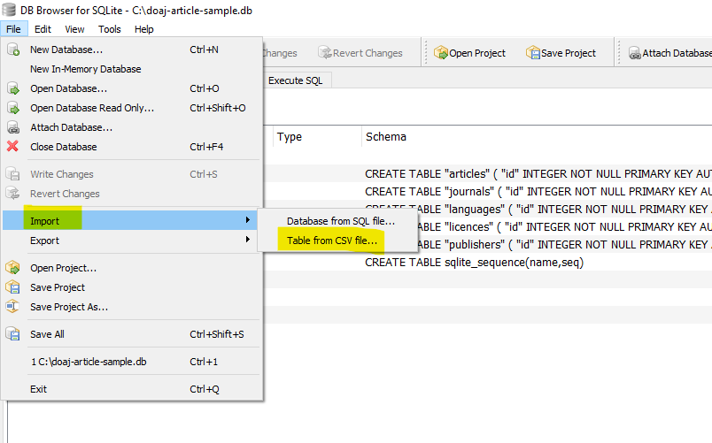

Slide 16
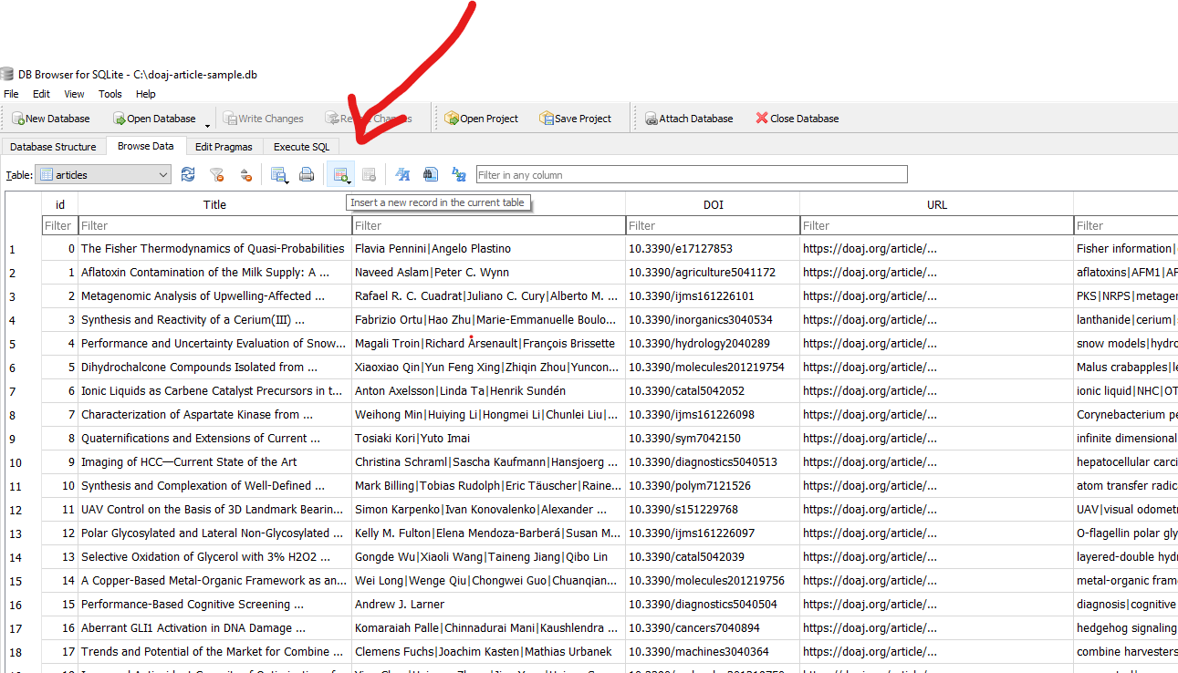

Slide 17
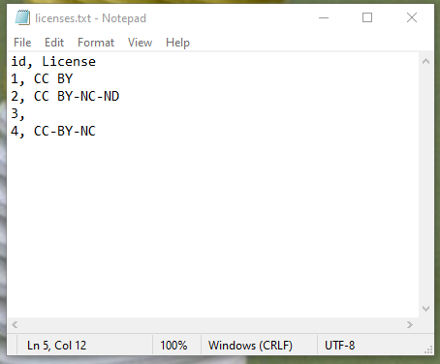
DATASET DESCRIPTION
5 CSV (comma-separate values) files: articles, journals, languages, licenses, publishers
The information in these tables are from a sample of 51 different journals published during 2015.
CSV - plain text file that stores tables and spreadsheet
Notes:
https://www.freecodecamp.org/news/what-is-a-csv-file-and-how-to-open-the-csv-file-format/

Slide 18
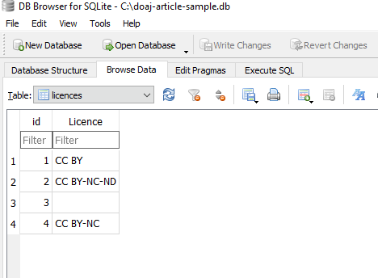

Slide 19
DATASET DESCRIPTION
articles
Contains individual article Titles and the associated citations and metadata
(16 fields, 1001 records)
Field names: id, Title, Authors, DOI, URL, Subjects, ISSNs, Citation, LanguageID, LicenseID, Author_Count, First_Author, Citation_Count, Day, Month, Year
journals
Contains various journal Titles and associated metadata.
(5 fields, 51 records)
Field names: id, ISSN-L,ISSNs, PublisherID, Journal_Title
languages
ID table which associates language codes with id numbers
(2 fields, 4 records)
Field names: id, Language
licenses
ID table which associates License codes with id numbers
(2 fields, 4 records)
Field names: id, Licence
publishers
ID table which associates Publisher names with id numbers
(2 fields, 6 records)
Field names: id, Publisher
Notes:
What field names are the same between these csv files?
Journals: The table also associates Journal Titles with ISSN numbers that are then referenced in the ‘articles’ table by the ISSNs field.
Languages: These id numbers are then referenced in the ‘articles’ table by the LanguageID field.
Licenses: These id numbers are then referenced in the ‘articles’ table by the LicenseID field.
Publishers: These id numbers are then referenced in the ‘journals’ table by the PublisherID field.

Slide 20
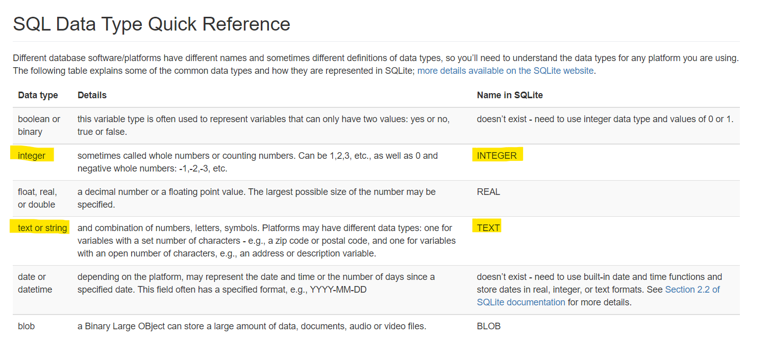
Highlighted are main data types in our doaj-article-sample database.
Notes:
The main data types that are used in doaj-article-sample database are INTEGER and TEXT which define what value the table column can hold.

Slide 21

MINI BREAK
Description: dog wearing sunglasses
Notes:
2021-08-16 Description: dog wearing sunglasses (photo by permission)

Slide 22
SELECTING AND SORTING DATA
A Query is a question or request for data
Query a database by asking the same question using a common language - SQL in this case
Queries can have multiple statements
SQL statement types can be grouped into five different categories:
Data definition language (DDL)
Data manipulation language (DML) – Managing data within tables
Data Control Language (DCL)
Transaction Control Statement (TCS)
Session Control Statements (SCS)
Notes:
https://librarycarpentry.org/lc-sql/02-selecting-sorting-data/index.html
A query is a question or request for data. For example, “How many journals does our library subscribe to?” When we query a database, we can ask the same question using a common language called Structured Query Language or SQL in what is called a statement. Some of the most useful queries - the ones we are introducing in this first section - are used to return results from a table that match specific criteria.
https://way2tutorial.com/sql/type-of-sql-statements.php#:~:text=Type%20of%20SQL%20statements%20are,Session%20Control%20Statements%20(SCS).
DML queries will be mostly what we cover today.

Slide 23
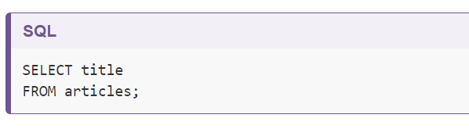
WRITE YOUR FIRST QUERY
Write a SQL query that selects only the “Title” column from the “articles” table.
#1
Notes:
Let’s start by opening DB Browser for SQLite and the doaj-article-sample database (see Setup). Choose Browse Data and the articles table. The articles table contains columns or fields such as Title, Authors, DOI, URL, etc.
Let’s write a SQL query that selects only the Title column from the articles table.
How many rows are returned?

Slide 24
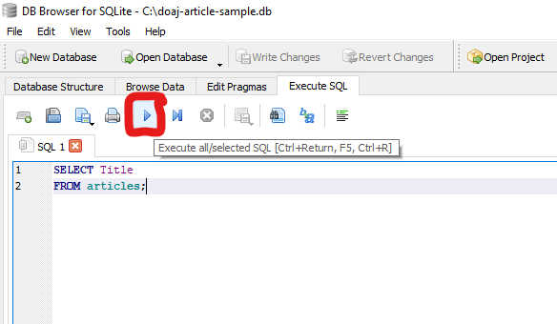
Capitalization of SELECT and FROM is only for readability and represents good style
Some tables and columns require capitalization and some do not
Final statement in query should end with a semi-colon (;)
Notes:
In the first query above, we have capitalized the words SELECT and FROM because they are SQL keywords. Even though capitalization makes no difference to the SQL interpreter, capitalization of these SQL terms helps for readability and is therefore considered good style. As you write and expand your own queries, it might be helpful to pick an option, such as CamelCase, and use that style when naming tables and columns. Some tables and columns require capitalization and some do not. An occasional change of capitalization for these table and column names may be needed.
Arrow down and hit enter as options pop up – this can avoid typo errors in your code that cause problems later on
Click “play” to execute – see also keyboard shortcuts

Slide 25
GOOD STYLE
Many variations in SQL queries
Good style makes your queries easier to read
Choose column names that are short (one or two words) when designing your tables
Spaces in column names will create errors, use CamelCase or An_Underscore
SQL keywords/commands are case-insenstitive, but it matters in some SQL programs. Check capitalization if your query isn’t working.
Notes:
https://librarycarpentry.org/lc-sql/Bonus_GoodStyle/index.html
There are many ways to write an SQL queries, but some look better than others. Abiding by good style guidelines will make your SQL queries easier to read, especially if you are sharing them with others. These are some quick tips for making your SQL look clean.
When choosing column names, it’s important to remember that a large part of what you type in your query will be composed of your column names. Choosing a column name that is one or two words (without any spaces!) will ensure that your queries are easier to type and read. If you include spaces in your column names, you will get an error message when you try to run your queries, so we would recommend using CamelCase, or An_Underscore.
In section two, we talked about SQL keywords/commands being case-insensitive (“We have capitalised the words SELECT and FROM because they are SQL keywords. This makes no difference to the SQL interpreter as it is case-insensitive, but it helps for readability and is therefore considered good style.”). But did you know that in some SQL programs, depending on the settings, table and column names are case sensitive? If your query isn’t working, check the capitalization.

Slide 26
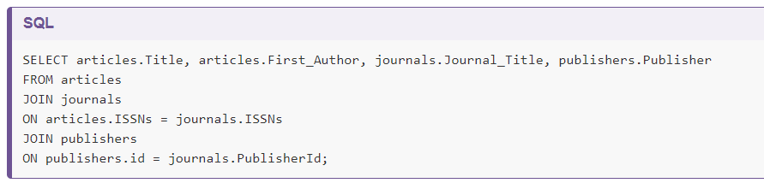
READABILITY
General consensus with SQL - if you can break it into components on multiple lines, queries become easier to read
Notes:
As you may have noticed, we are able to write our query on one line, or on many. The general consensus with SQL is that if you can break it into components on multiple lines, it becomes easier to read. Using multiple lines and indenting, you can turn something that looks like this:
Into something that looks like this:
In some programs (such as MySQL), there will be tools that can automatically “beautify” your code for better readability.
What is the difference between the two queries above?

Slide 27
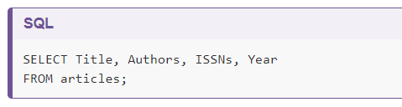
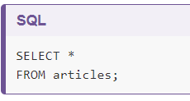
MORE SELECTION QUERIES
Add more fields to retrieve more information
#2
Use wildcard (*) to select all of the columns in a table
#3
Notes:
If we want more information, we can add a new column to the list of fields right after SELECT:
- Arrow down to select if you choose. For authors, ISSNs be sure to choose the correct field!
Or we can select all of the columns in a table using the wildcard *.
*Returns entire table

Slide 28
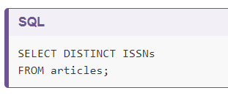
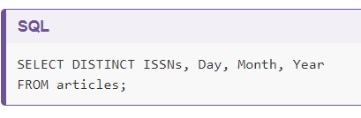
UNIQUE VALUES
Add DISTINCT to find only unique records
#4
If we select more than one column, then the distinct pairs of values are returned.
#5
Notes:
There may be a situation when you need to retrieve unique records and not multiple duplicate records. The SQL DISTINCT keyword is used after SELECT to eliminate duplicate records and fetch only unique records. Let’s return all of the unique ISSNs in a SQL query.
Note, some database systems require a semicolon ; after each SQL statement. If we select more than one column, then the distinct pairs of values are returned.
For Query 4 – how many rows are returned?
For Query 5 – DISTINCT applies only to the first field (ISSNs)

Slide 29
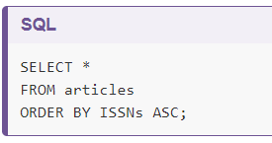
SORTING
Sort the results of queries using the keyword ORDER BY, also referred to as a clause
Create a query that sorts the articles table in ascending order by ISSNs using the ASC keyword in conjunction with ORDER BY.
#6
ASC is the default
Notes:
We can also sort the results of our queries by using the keyword ORDER BY. Let’s create a query that sorts the articles table alphabetically by ISSNs using the ASC keyword in conjunction with ORDER BY.

Slide 30
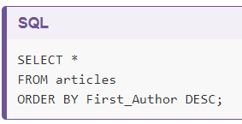
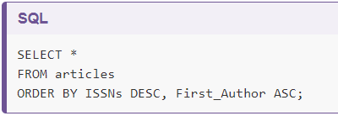
SORTING
Add DESC to sort in a different direction
Sort several fields in different directions
#7
#8
Notes:
The keyword ASC tells us to order it in ascending order. Instead, we can use DESC to get the descending order sorting by First_Author.
ASC is the default, so by omitting ASC or DESC, SQLite will sort ascending (ASC).
We can also sort on several fields at once, in different directions. For example, we can order by ISSNs descending and then First_Author ascending in the same query.
For query 7 – look at the first two lines in Authors field, compare to First_Authors
For query 8 – ISSNs sorts first, followed by First_Author (maybe switch these two fields)?

Slide 31
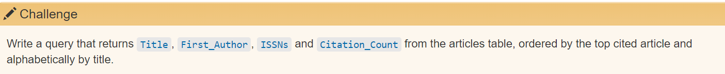
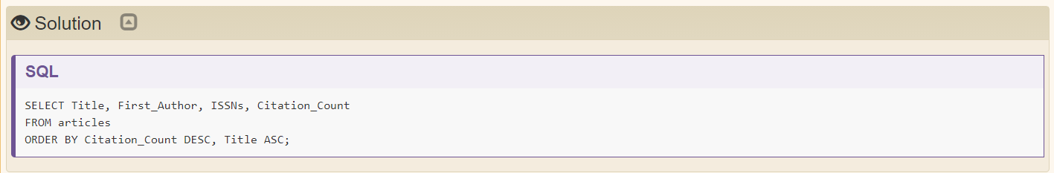
CHALLENGE
#8
Notes:
SQL queries have a basic query structure starting with SELECT field FROM table with additional keywords and criteria that can be used.

Slide 32

MINI BREAK
Description: Monkey hugging a kitten
https://gateway.okhistory.org/ark:/67531/metadc427038/
Notes:
Description: monkey hugging a kitten
https://gateway.okhistory.org/ark:/67531/metadc427038/

Slide 33
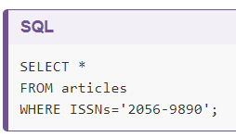
FILTERING
Find data for a specific set of conditions using the WHERE clause
Write a query that returns only articles from the journal Acta Crystallographica (ISSN 2056-9890).
#10
Notes:
SQL is a powerful tool for filtering data in databases based on a set of conditions. Let’s say we only want data for a specific ISSN, for instance, for the Acta Crystallographica journal from the articles table. The journal has an ISSN code 2056-9890. To filter by this ISSN code, we will use the WHERE clause.
How many rows are returned in query 10?

Slide 34
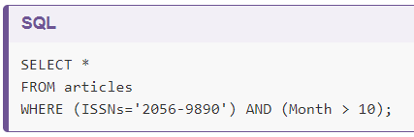
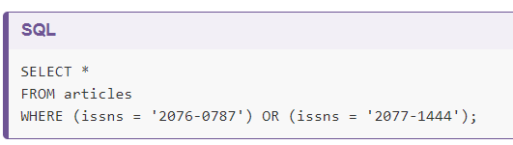
FILTERING
Add additional conditions using AND, OR, and/or NOT in clauses
11: Write a query that returns only articles from the journal Acta Crystallographica (ISSN 2056-9890) published after October. 12: Write a query that returns articles from Humanities and Religions journals (ISSNs “2076-0787” and “2077-1444”)
#11
#12
Parentheses are used merely for readability in this case but can be required by the SQL interpreter in order to disambiguate formulas.
Notes:
We can add additional conditions by using AND, OR, and/or NOT. For example, suppose we want the data on Acta Crystallographica published after October:
Parentheses are used merely for readability in this case but can be required by the SQL interpreter in order to disambiguate formulas.
If we want to get data for the Humanities and Religions journals, which have ISSNs codes “2076-0787” and “2077-1444”, we can combine the tests using OR:
For query 12 “ISSNs” is not capitalized, but you can see that it doesn’t cause an error in this case

Slide 35
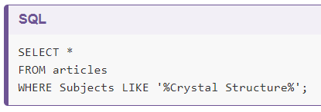
FILTERING
Use comparison keywords; such as LIKE, IN, BETWEEN … AND, IS NULL; when you do know the value you are searching for.
Write a query that returns all of the data where the subject contains “Crystal Structure.”
#13
The wildcard character “%” is used to match zero to many characters.
Notes:
If we want to get data for the Humanities and Religions journals, which have ISSNs codes “2076-0787” and “2077-1444”, we can combine the tests using OR:
When you do not know the entire value you are searching for, you can use comparison keywords such as LIKE, IN, BETWEEN...AND, IS NULL. For instance, we can use LIKE in combination with WHERE to search for data that matches a pattern.
For example, using the articles table again, let’s SELECT all of the data WHERE the Subject contains “Crystal Structure”:
You may have noticed the wildcard character %. It is used to match zero to many characters. So in the SQL statement above, it will match zero or more characters before and after ‘Crystal Structure’.
Let’s see what variations of the term we got. Notice uppercase and lowercase, the addition of ‘s’ at the end of structures, etc.
SELECT *
FROM articles
WHERE Subjects LIKE '%Crystal Structures%';
To learn more about other comparison keywords you can use, see Beginner SQL Tutorial on SQL Comparison Keywords.
https://beginner-sql-tutorial.com/sql-like-in-operators.htm

Slide 36
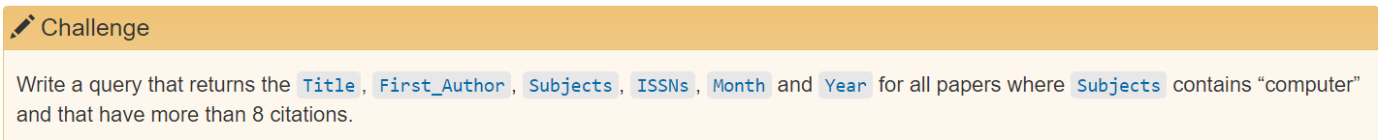
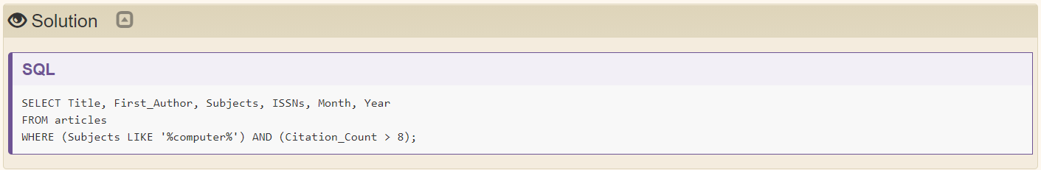
CHALLENGE
#14
Notes:
You can continue to add or chain conditions together and write more advanced queries.
Key Points:
Use WHERE to filter and retrieve data based on specific conditions.
Use AND, OR, and NOT to add additional conditions.
Use the comparison keyword LIKE and wildcard characters such as % to match patterns.

Slide 37

MINI BREAK
Description: circus ponies
https://gateway.okhistory.org/ark:/67531/metadc1474023/

Slide 38
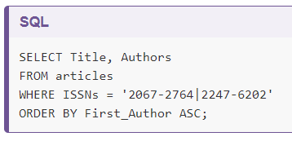
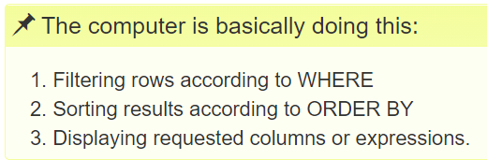
ORDERING
Order of execution
#14
It isn’t necessary to display the First_Author column in order to sort by it
Sorting occurs earlier in the computational pipeline
Clauses are written in a fixed order: SELECT, FROM, WHERE, then ORDER BY
Notes:
Let’s say we had the following query:
What is interesting to note about this query is that we don’t necessarily have to display the First_Author column in our results in order to sort by it.
We can do this because sorting occurs earlier in the computational pipeline than field selection.
Clauses are written in a fixed order: SELECT, FROM, WHERE, then ORDER BY. It is possible to write a query as a single line, but for readability, we recommend to put each clause on its own line.
| is not a pipe symbol but present in the table ISSNs column

Slide 39
COMPLEX QUERIES
SQL offers the flexibility of iteratively adding new conditions, but this can make them difficult to read and inefficient.
Make complex queries more readable by: 1. Rewriting so the logic is easy to follow 2. Adding comments for context and clarity
Start with a simple query, add clauses one by one to test effectiveness
Notes:
The goal is to make a query easy to read and understand, even when the logic becomes complex. This can be handled in two ways:
1. Rewriting the query so that the logic is easy to follow
2. Adding comments for context and clarity.
SQL offers the flexibility of iteratively adding new conditions but you may reach a point where the query is difficult to read and inefficient. For instance, we can use IN to improve the query and make it more readable:

Slide 40
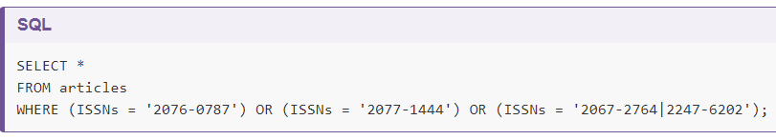
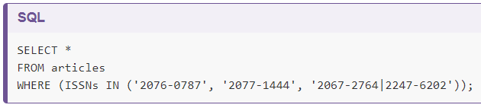
COMPLEX QUERIES
#15
Queries 15 and 16 return the same results; adding IN to the WHERE clause improves readability
#16
Notes:
We started with something simple, then added more clauses one by one, testing their effects as we went along. For complex queries, this is a good strategy, to make sure you are getting what you want. Sometimes it might help to take a subset of the data that you can easily see in a temporary database to practice your queries on before working on a larger or more complicated database.

Slide 41
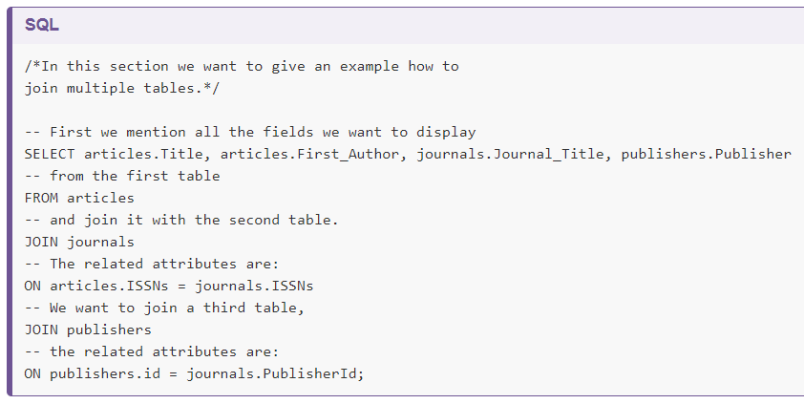
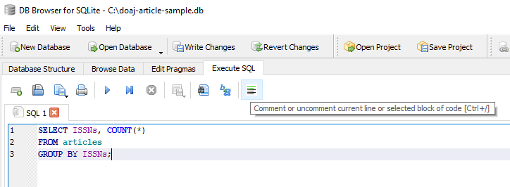
Comments explain the logic of a query and do not affect the executable code
Comments begin using – and end at the end of the line
Enclose a line in /* and */ to make an entire paragraph a comment
COMMENTING
#17
Notes:
When the queries become more complex, it can be useful to add comments to express to yourself, or to others, what you are doing with your query. Comments help explain the logic of a section and provide context for anyone reading the query. It’s essentially a way of making notes within your SQL. In SQL, comments begin using -- and end at the end of the line. To mark a whole paragraph as a comment, you can enclose it with the characters /* and */. For example, a commented version of the above query can be written as:

Slide 42

BREAK (10 minutes)
Description: Squirrel relaxing on bench on UNT Library Mall on a hot day
Notes:
2021-06-08
Description: Squirrel relaxing on bench on UNT Library Mall on a hot day
https://librarycarpentry.org/lc-sql/10-other-tools/index.html
For this lesson, DB Browser, a free open source database tool was used, but there are other tools available, both proprietary and open. A helpful comparison of database tools is available via Wikipedia.
SqliteOnline is the free online database tool offered as an alternative to DB Browser for this lesson. In addition to SqliteOnline, there is data.world which also allows you to work online with SQL and (library) datasets and includes a tutorial. SQL use in Google Sheets, a popular spreadsheet application, is even a possibility, demonstrated via Ben Collin’s tutorial. There is also a business standard software package called, MySQL, which has a community edition that can be downloaded free.
Using regular expressions in SQL: https://github.com/sqlitebrowser/sqlitebrowser/wiki/Regular-Expressions

Slide 43
AGGREGATING AND CALCULATING VALUES
Most common functions are MAX, MIN, AVG, COUNT, SUM
MAX (find the maximum value in a field)
MIN (find the minimum value in a field)
AVG (find the average value of a field)
COUNT (count the number of values in a field and present the total)
SUM (add up the values in a field and present the sum).
Notes:
SQL contains functions which allow you to make calculations on data in your database for reports. Some of the most common functions are MAX, MIN, AVG, COUNT, SUM, and they will: MAX (find the maximum value in a field), MIN (find the minimum value in a field), AVG (find the average value of a field), COUNT (count the number of values in a field and present the total), and SUM (add up the values in a field and present the sum).
Let’s say we wanted to get the average Citation_Count for each of the ISSNs. We can use AVG and the GROUP BY clause in a query:

Slide 44
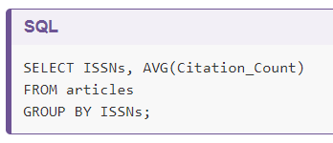
AGGREGATING AND CALCULATING VALUES
Write a query that returns the average Citation_Count for each journal in “articles”.
#18
GROUP BY is used by SQL to arrange identical data into groups
This process is also called aggregation – combining results based on value and calculating combined values in groups
Notes:
GROUP BY is used by SQL to arrange identical data into groups. In this case, we are arranging all the citation counts by ISSNs. AVG acts on the Citation_Count in parentheses. This process is also called aggregation which allows us to combine results by grouping records based on value and calculating combined values in groups.

Slide 45
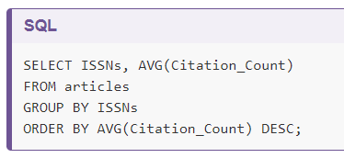
AGGREGATING AND CALCULATING VALUES
#19
Use ORDER BY clause to make results more useful
Notes:
As you can see, it is difficult to tell though what ISSN has the highest average citation count and the least. We can improve upon the query above by using ORDER BY and DESC.

Slide 46
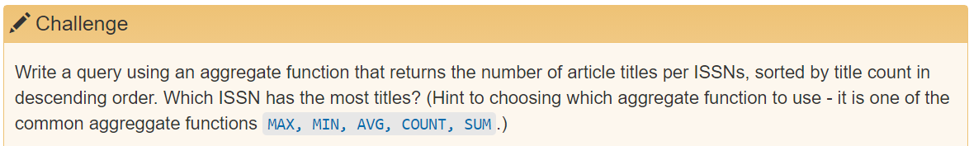
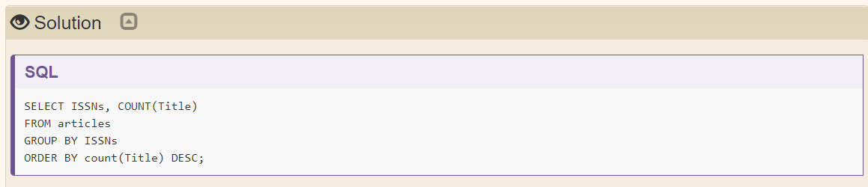
AGGREGATING AND CALCULATING VALUES

Slide 47
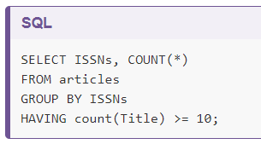
AGGREGATING AND CALCULATING VALUES
Having keyword filters results based on aggregate functions – works like WHERE clause
#20
Query #20 returns only information about journals with 10 or more published articles
Having appears after GROUP BY statement: the data are retrieved (SELECT), can be filtered (WHERE), then joined in groups (GROUP BY); finally, we only select some of these groups (HAVING).
Notes:
SQL offers a mechanism to filter the results based on aggregate functions, through the HAVING keyword.
For example, we can adapt the last request we wrote to only return information about journal ISSNs with 10 or more published articles:
The HAVING keyword works exactly like the WHERE keyword, but uses aggregate functions instead of database fields. When you want to filter based on an aggregation like MAX, MIN, AVG, COUNT, SUM, use HAVING; to filter based on the individual values in a database field, use WHERE.
Note that HAVING comes after GROUP BY. One way to think about this is: the data are retrieved (SELECT), can be filtered (WHERE), then joined in groups (GROUP BY); finally, we only select some of these groups (HAVING).

Slide 48
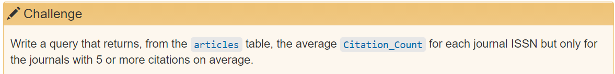
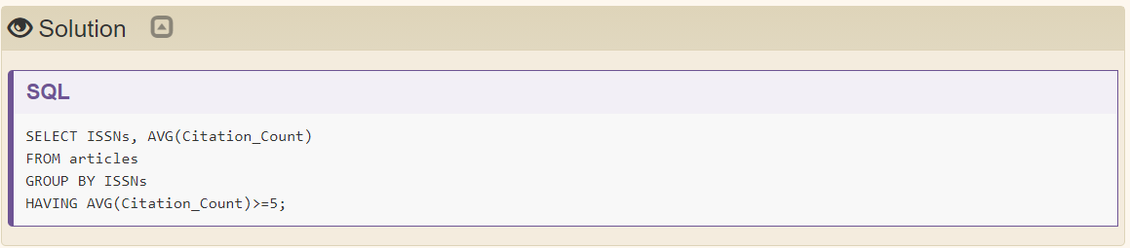
AGGREGATING AND CALCULATING VALUES

Slide 49
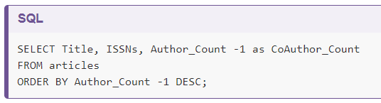
CALCULATIONS
Computed columns are calculations within queries
#21
Expressions on a column or columns get new values during a query
Arithmetic operators (like +, -, *, /, square root SQLRT or the modulo operator %) are also useful for calculating new values
Notes:
In SQL, we can also perform calculations as we query the database. Also known as computed columns, we can use expressions on a column or multiple columns to get new values during our query. For example, what if we wanted to calculate a new column called CoAuthor_Count:
In section 6. Joins and aliases we are going to learn more about the SQL keyword AS and how make use of aliases.
We can use any arithmetic operators (like +, -, *, /, square root SQLRT or the modulo operator %) if we would like.
If you would like to learn more about calculated values, the Software Carpentry Databases and SQL lesson includes a useful episode on Calculating New Values.
SQL can be used for reporting purposes.
Queries can do arithmetic operations on field values.

Slide 50

MINI BREAK
Description: photograph of miniature book and ruler
https://texashistory.unt.edu/ark:/67531/metadc3588/

Slide 51
JOINS AND ALIASES
JOIN clause allows us to combine columns from one or more tables in a database by using values common to each
Follows the FROM clause in a SQL statement
Tell the computer which columns provide the link between the two tables using the word ON
Creating aliases allows us to spend less time typing, and more time querying!
Notes:
The SQL JOIN clause allows us to combine columns from one or more tables in a database by using values common to each. It follows the FROM clause in a SQL statement. We also need to tell the computer which columns provide the link between the two tables using the word ON.

Slide 52
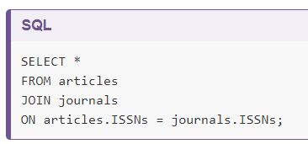
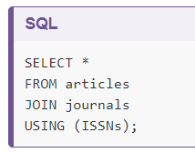
JOINS AND ALIASES
Write a query that joins the articles table with the journals table.
#22
#23
ISSNs columns in both these tables link them
ON, like WHERE filters, according to a test condition
Use the table.column format or the word USING
Notes:
ON is similar to WHERE, it filters things out according to a test condition. We use the table.colname format to tell the SQL manager what column in which table we are referring to.
We can represent this join using the following diagram. https://librarycarpentry.org/lc-sql/06-joins-aliases/index.html
Alternatively, we can use the word USING, as a short-hand. In this case we are telling DB Browser that we want to combine articles with journals and that the common column is ISSNs.
This figure shows the relations between the tables and helps to visualise joining or linking the tables in the database: https://librarycarpentry.org/lc-sql/assets/img/articles-erd-v02.png
We will cover relational database design in the next episode. In addition to visual above, SQL Join Types Explained Visually provides visual/animated examples to help convey to learners what is happening in SQL JOINs.
https://dataschool.com/how-to-teach-people-sql/sql-join-types-explained-visually/

Slide 53
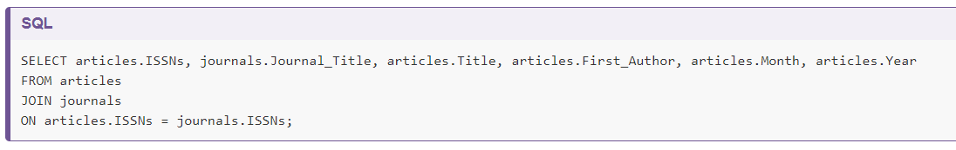
JOINS AND ALIASES
Use table.colname to join in the SELECT clause
#24
Notes:
When joining tables, you can specify the columns you want by using table.colname instead of selecting all the columns using *. For example

Slide 54
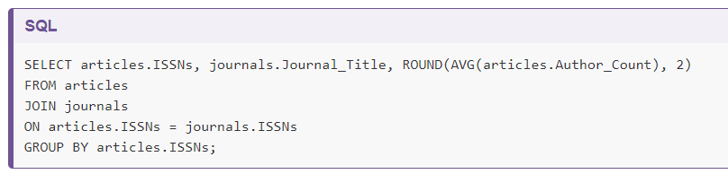
JOINS AND ALIASES
Joins can be combined with sorting, filtering, and aggregation
#25
ROUND function rounds the Author_Count number returned by the AVG function by 2 decimal places.
Notes:
Joins can be combined with sorting, filtering, and aggregation. So, if we wanted the average number of authors for articles on each journal, we can use the following query:
The ROUND function allows us to round the Author_Count number returned by the AVG function by 2 decimal places.

Slide 55
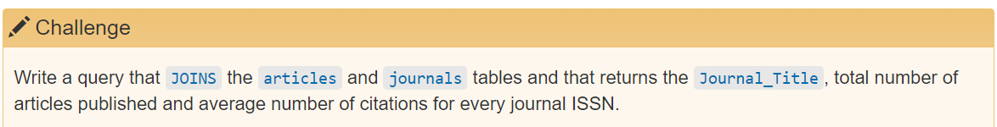
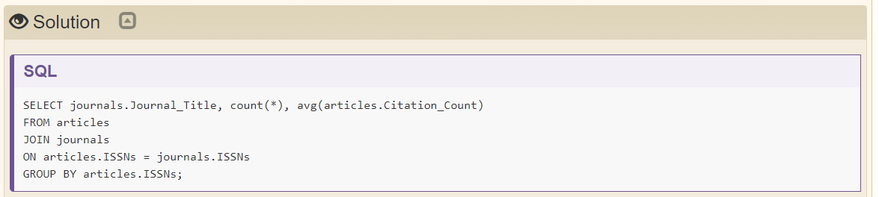
JOINS AND ALIASES

Slide 56
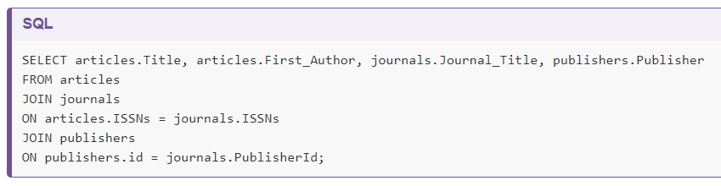
JOINS AND ALIASES
You can also JOIN multiple tables:
#26
Notes:
There are different types of joins which you can learn more about at https://www.w3schools.com/sql/sql_join.asp

Slide 57
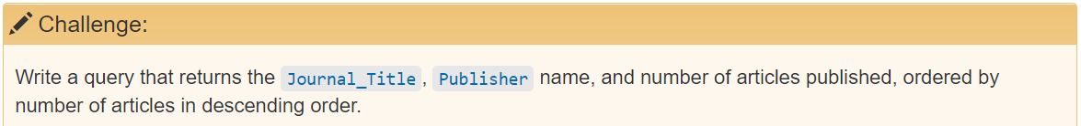
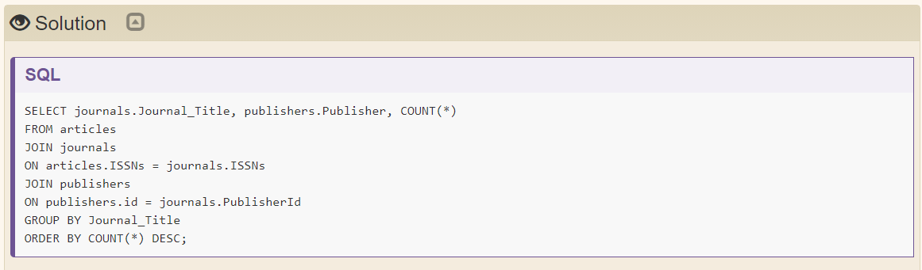
JOINS AND ALIASES

Slide 58
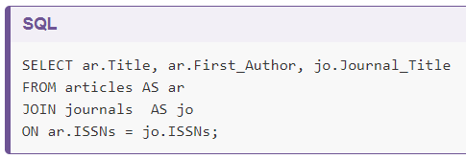
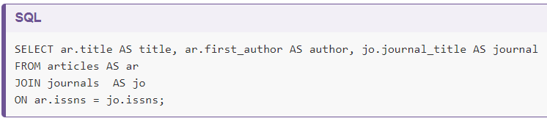
JOINS AND ALIASES
To make things clearer as queries become more complex, use aliases to assign new names to items in the query
#27
#28
Table names
Column names
AS is not required for the query to work but is an example of good style
Notes:
As queries get more complex, names can get long and unwieldy. To help make things clearer we can use aliases to assign new names to items in the query.
We can alias both table names:
And column names:
The AS isn’t technically required, so you could do:
SELECT a.Title t FROM articles a;
But using AS is much clearer so it is good style to include it.
Joining two tables in SQL is an good way to analyze datasets, especially when both datasets provide partial answers to questions you want to ask.
Creating aliases allows us to spend less time typing, and more time querying!

Slide 59

MINI BREAK
Description: orange and white cat inside a clothes dryer
https://texashistory.unt.edu/ark:/67531/metapth908662/
Notes:
Description: orange and white cat inside a clothes dryer

Slide 60

SAVING QUERIES
Views are queries saved in the database
Query a view as a (virtual) table that is populated every time you query it
#29
Saving a query requires you to add CREATE VIEW viewname AS before the query itself
Notes:
It is not uncommon to repeat the same operation more than once, for example for monitoring or reporting purposes. SQL comes with a very powerful mechanism to do this: views. Views are queries saved in the database. You query it as a (virtual) table that is populated every time you query it.
Creating a view from a query requires you to add CREATE VIEW viewname AS before the query itself. For example, if we want to save the query giving the number of journals in a view, we can write: https://stackoverflow.com/questions/1518729/change-sqlite-database-mode-to-read-write I had to run "DB Browser" as administrator.

Slide 61


SAVING QUERIES
Access the results of query #29 using shorter notation:
#30
Remove the above view from the database using DROP VIEW
#31
Notes:
Now, we will be able to access these results with a much shorter notation: Assuming we do not need this view anymore, we can remove it from the database.

Slide 62


SAVING QUERIES
Notes:
In DBBrowser for SQLite, you can also create a view from any query by omitting the CREATE VIEW viewname AS statement and instead, clicking the small Save icon at the bottom of the Execute SQL tab and then clicking Save as view. Whatever method you use to create a view, it will appear in the list of views under the Database Structure tab.
RUN the query
Save As button will become available – save as view
Specify name of view in dialog box
View will appear under Database Structure tab

Slide 63


SAVING QUERIES
Notes:
Saving queries as ‘Views’ allows you to save time and avoid repeating the same operation more than once.

Slide 64

MINI BREAK
Description: Photograph of Julia Muegge's dog sleeping on a dog bed and covered by a blanket.
https://texashistory.unt.edu/ark:/67531/metadc1752551/
Notes:
Description: Photograph of Julia Muegge's dog sleeping on a dog bed and covered by a blanket.

Slide 65


CREATING TABLES AND MODIFYING DATA
CREATE TABLE
Two words for a single command
Creates a new table
Arguments are names and types of the table’s columns
#32
#33
Removes a table
Use with care!
Notes:
So far we have only looked at how to get information out of a database, both because that is more frequent than adding information, and because most other operations only make sense once queries are understood. If we want to create and modify data, we need to know two other sets of commands.
The first pair are CREATE TABLE and DROP TABLE. While they are written as two words, they are actually single commands. The first one creates a new table; its arguments are the names and types of the table’s columns. For example, the following statement creates the table journals:
We can get rid of one of our tables using:
Be very careful when doing this: if you drop the wrong table, hope that the person maintaining the database has a backup, but it’s better not to have to rely on it.

Slide 66

CREATING TABLES AND MODIFYING DATA
Can specify several kinds of constraints on its columns when creating a table
#34
Notes:
We talked about data types earlier in Introduction to SQL: SQL Data Type Quick Reference.
When we create a table, we can specify several kinds of constraints on its columns. For example, a better definition for the journals table would be:
Once again, exactly what constraints are available and what they’re called depends on which database manager we are using.

Slide 67


CREATING TABLES AND MODIFYING DATA
Add, change or remove records using INSERT, UPDATE, and DELETE
#35
#36
Query 35 inserts rows into the “journals” table
Query 36 inserts values into one table directly from another
Notes:
Once tables have been created, we can add, change, and remove records using our other set of commands, INSERT, UPDATE, and DELETE.
Here is an example of inserting rows into the journals table:
We can also insert values into one table directly from another:

Slide 68


CREATING TABLES AND MODIFYING DATA
Use UPDATE to modify existing records – good for correcting typos
#37
Tell the database which table to update, what the values should be for the fields, and conditions WHERE values should be updated. (Otherwise all will be modified!)
#38
Use DELETE and WHERE clause to match records to discard
Notes:
Modifying existing records is done using the UPDATE statement. To do this we tell the database which table we want to update, what we want to change the values to for any or all of the fields, and under what conditions we should update the values.
For example, if we made a typo when entering the ISSNs of the last INSERT statement above, we can correct it with an update:
Be careful to not forget the WHERE clause or the update statement will modify all of the records in the database.
Deleting records can be a bit trickier, because we have to ensure that the database remains internally consistent. If all we care about is a single table, we can use the DELETE command with a WHERE clause that matches the records we want to discard. We can remove the journal Animals from the journals table like this:
But now the article Early Onset of Laying and Bumblefoot Favor Keel Bone Fractures from the table articles has no matching journal anymore. That’s never supposed to happen: Our queries assume there will be a row ISSNs in the table ‘journals’ matching every row ISSNs in the table articles.

Slide 69


CREATING TABLES AND MODIFYING DATA
Notes:
Use CREATE and DROP to create and delete tables.
Use INSERT to add data.
Use UPDATE to modify existing data.
Use DELETE to remove data.
It is simpler and safer to modify data when every record has a unique primary key.
Do not create dangling references by deleting records that other records refer to.

Slide 70

CREATING TABLES AND MODIFYING DATA

Slide 71
EXTRA CHALLENGES AND SURVEYS
https://librarycarpentry.org/lc-sql/11-extra-challenges/index.html
*POST WORKSHOP SURVEY: https://carpentries.typeform.com/to/UgVdRQ?slug=2021-08-06-unt-online
*SOFTWARE CARPENTRY SURVEY: https://unt.az1.qualtrics.com/jfe/form/SV_7a1WNVkwwPM8RjU
Notes:
https://librarycarpentry.org/lc-sql/11-extra-challenges/index.html
https://carpentries.typeform.com/to/UgVdRQ?slug=2021-08-06-unt-online
https://unt.az1.qualtrics.com/jfe/form/SV_7a1WNVkwwPM8RjU

