Slide 1

LIBRARY CARPENTRY
Navigating the Command Line (UNIX Shell/Bash)
University of North Texas Libraries Thursday, January 20, 2022

Slide 2
Complete the pre-workshop survey:
https://carpentries.typeform.com/to/wi32rS?slug=2022-01-20-unt-online
Link to material covered today:
https://librarycarpentry.org/lc-shell/
Workshop attendees are expected to follow the Carpentries code of conduct: https://docs.carpentries.org/topic_folders/policies/code-of-conduct.html

Slide 3
Setup
Library Carpentry: UNIX Shell setup page https://librarycarpentry.org/lc-shell/setup.html
To participate in this Library Carpentry lesson, you will need a working UNIX-like shell environment, specifically Bash (Bourne Again Shell).
Linux: Bash is often the default shell. Open the Terminal program via the applications menu to start. To check if Bash is the default, type “ echo $shell.” If Bash is not listed, type “bash” and press Enter.
macOS: Open the Applications Folder, and in Utilities select Terminal. For macOS Version 10.15 (Catalina) and above, zsh is the default shell. Follow these instructions to switch to Bash.
Windows: Download the latest Git for Windows at https://gitforwindows.org/. Once the application file has downloaded, double click the .exe file to run the installer using the default settings. Open the shell by selecting Git Bash from the start menu (in the Git folder). Check installation by typing “git – version” in the terminal window.
Notes:
https://support.apple.com/en-us/HT208050

Slide 4
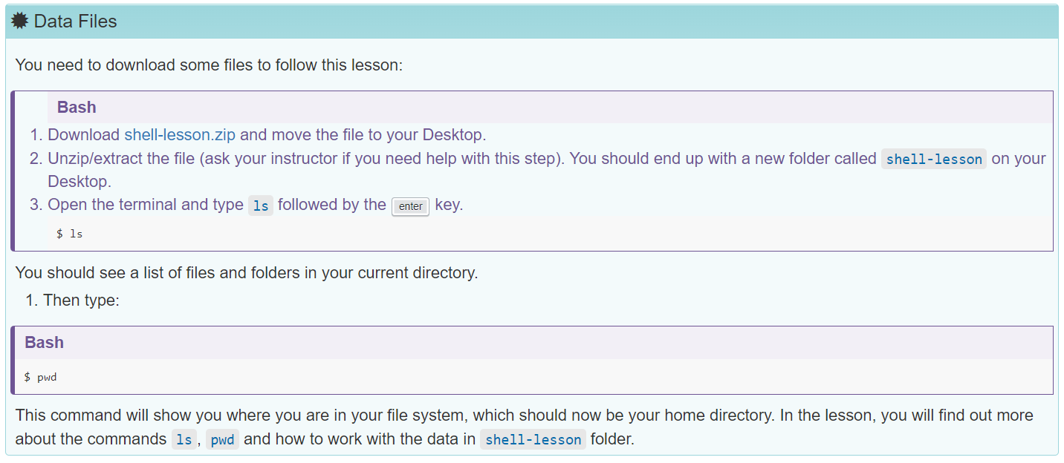
Data Files
https://librarycarpentry.org/lc-shell/data/shell-lesson.zip
Notes:
Make sure the “shell-lesson” folder is on your Desktop.

Slide 5
INTRODUCTIONS
Name, pronouns if you choose, location
One thing you would like to automate in your work and/or what you hope to learn today

Slide 6

THIS IS ME:
Sarah Lynn Fisher, she/her, sarahlynn.fisher@unt.edu University of North Texas Libraries Program Coordinator – Digital Newspaper Unit
National Digital Newspaper Program – Texas
Texas Digital Newspaper Program
Gateway to Oklahoma History
COMMAND LINE EXAMPLE “echo 19* | xargs –n 1 cp metadata.txt”
Notes:
https://www.tecmint.com/xargs-command-examples/
“Xargs is a great command that reads streams of data from standard input, then generates and executes command lines; meaning it can take output of a command and passes it as argument of another command.”

Slide 7
WHY LIBRARY CARPENTRY?
Library Carpentry workshops teach people working in library- and information-related roles how to:
Cut through the jargon terms and phrases of software development and data science and apply concepts from these fields in library tasks;
Identify and use best practices in data structures;
Learn how to programmatically transform and map data from one form to another;
Work effectively with researchers, IT, and systems colleagues;
Automate repetitive, error prone tasks.

Slide 8
WORKSHOP GOALS
Teach skills
Get started and introduce what’s possible
Build confidence in using these skills
Encourage people to continue learning
Positive learning experience

Slide 9
WORKSHOP REMINDERS
Raise your hand or post questions in chat and the instructor or a helper will assist you
Mute yourself if you aren’t speaking
Post comments in chat - we will do our best to read these out loud at regular intervals
We will take a break at 10:30 a.m. CST

Slide 10
What Is the Unix Shell?
A shell is a command interpreter that allows people or programs to interact with an operating system (outer layer metaphor). A shell hides the details of the underlying operating system.
In general, humans interact with an operating system using a graphical user interface (GUI) or a command-line interface (CLI).
The Unix shell is a command-line interface, where instructions are given to a computer by typing commands in a text window. The computer responds by generating an output, which may be displayed on a screen or directed to a file, among other actions.
Bash (acronym for Bourne Again Shell) is a widely-used Unix shell that has been the default on many operating systems.
Notes:
The shell (sometimes referred to as the “Unix shell”, for the operating system where it was first developed) is a program that allows you to interact with your computer using typed text commands.
http://www.catb.org/jargon/html/S/shell.html
Bash history: https://en.wikipedia.org/wiki/Bash_(Unix_shell). New version of a shell originally coded by Steven Bourne.

Slide 11
Why Should You Use a Unix Shell?
Ability to handle large volumes of data automatically with a few short text commands
Increase productivity through automation
Reproduceable commands that save time
Foundation for learning to program
Notes:
Using a shell sometimes feels more like programming than like using a mouse. Commands are terse (often only a couple of characters long), their names are frequently cryptic, and their output is lines of text rather than something visual like a graph. On the other hand, with only a few keystrokes, the shell allows you to combine existing tools into powerful pipelines and to handle large volumes of data automatically. This automation not only makes you more productive, but also improves the reproducibility of your workflows by allowing you to save and then repeat them with a few simple commands. Understanding the basics of the shell provides a useful foundation for learning to program, since some of the concepts you will learn here—such as loops, values, and variables—will translate to programming.

Slide 12
Today’s Lesson
The session will cover a small number of basic commands, which will constitute building blocks upon which more complex commands can be constructed to fit your data or project. We will:
Navigate the filesystem from the command-line
Copy, move, delete, and combine files and directories
Read and parse large text files
Use loops to repeat tasks
Manipulate, count, and mine data
Notes:
In this session we will introduce task automation by looking at how data can be manipulated, counted, and mined using the shell. The session will cover a small number of basic commands, which will constitute building blocks upon which more complex commands can be constructed to fit your data or project. Even if you do not do your own programming or your work currently does not involve the command line, knowing some basics about the shell can be useful.

Slide 13
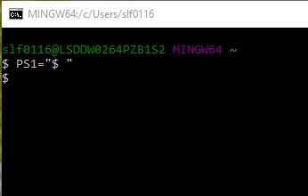
Navigating the File System – Opening the Shell
Command line – blank line and cursor on the screen
“$” = command prompt - indicates system is ready for input
PS =“$ ” – change default command prompt to “$ ” if desired (note space after the “$” character)
“clear” to clear the terminal screen
Notes:
Let’s start by opening the shell. This likely results in seeing a black window with a cursor flashing next to a dollar sign. This is our command line, and the $ is the command prompt to show that the system is ready for our input. The appearance of the prompt will vary from system to system, depending on how the set up has been configured, but it usually ends with a $
MINGW = Minimalist GNU for Windows
https://access.redhat.com/solutions/505983 - PS1 is a primary prompt variable

Slide 14
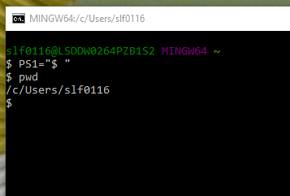

Navigating the File System – Finding Your Location
#1
First command: PWD = “print working directory”
Only enter the text after the “$_”
Hit “Enter” to execute the command
Output is most likely your “home” directory
Notes:
When working in the shell, you are always somewhere in the computer’s file system, in some folder (directory). We will therefore start by finding out where we are by using the pwd command, which you can use whenever you are unsure about where you are. It stands for “print working directory” and the result of the command is printed to your standard output, which is the screen.
Let’s type pwd and hit enter to execute the command (Note that the $ sign is used to indicate a command to be typed on the command prompt, but we never type the $ sign itself, just what follows after it.):
The output will be a path to your home directory.

Slide 15
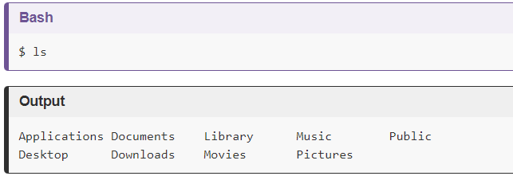
Navigating the File System – Listing Directory Contents
“ls” command lists the contents (folders) in your working directory
#2
Notes:
Let’s check if we recognize it by looking at the contents of the directory. To do that, we use the ls command. This stands for “list” and the result is a print out of all the contents in the directory

Slide 16
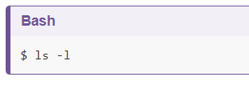

Navigating the File System – Flags
Flags, or options, modify commands resulting in a different output
#3
Options can be combined and run together. Note: these are often case-sensitive.
#4
What information can you find in the output of these commands? What changes after running #4?
Notes:
We may want more information than just a list of files and directories. We can get this by specifying various flags (also known as options, parameters, or, most frequently, arguments) to go with our basic commands. Arguments modify the workings of the command by telling the computer what sort of output or manipulation we want.
If we type ls -l and hit enter, the computer returns a list of files that contains information similar to what we would find in our Finder (Mac) or Explorer (Windows): the size of the files in bytes, the date it was created or last modified, and the file name.
In everyday usage we are more used to units of measurement like kilobytes, megabytes, and gigabytes. Luckily, there’s another flag -h that when used with the -l option, use unit suffixes: Byte, Kilobyte, Megabyte, Gigabyte, Terabyte and Petabyte in order to reduce the number of digits to three or less using base 2 for sizes.
Now ls -h won’t work on its own. When we want to combine two flags, we can just run them together. So, by typing ls -lh and hitting enter we receive an output in a human-readable format (note: the order here doesn’t matter).

Slide 17


Navigating the File System – Accessing the Help File
Git Bash (Windows) “--help” option displays more information on how to use the command or program
#5
#6
“man” command (Mac and Linux) will turn your terminal into a page with a description of the ls command and its options.
To navigate through the man pages, use ↑ and ↓ to move line-by-line, or B and Spacebar to skip up and down by a full page. To search for a character or word in the man pages, use / followed by the character or word you are searching for.
To quit the man pages, press Q.
Notes:
https://swcarpentry.github.io/shell-novice/02-filedir/index.html#exploring-other-directories
Most bash commands and programs that people have written to be run from within bash, support a --help option that displays more information on how to use the command or program. (Note: the help command may vary if not using Git Bash)
“man” command will turn your terminal into a page with a description of the ls command and its options.
To navigate through the man pages, you may use ↑ and ↓ to move line-by-line, or try B and Spacebar to skip up and down by a full page. To search for a character or word in the man pages, use / followed by the character or word you are searching for. Sometimes a search will result in multiple hits. If so, you can move between hits using N (for moving forward) and Shift+N (for moving backward).
To quit the man pages, press Q.

Slide 18
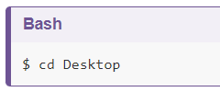
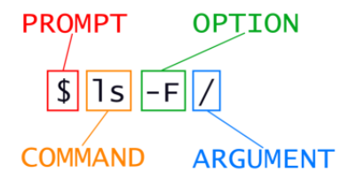
Navigating the File System – Changing Directories
Navigate to another directory using the “cd” or Change Directory command
#7
argument
The arguments given to any shell command are separated by spaces. Indicate that an argument is a single statement by combining multiple words in quotation marks.
Try navigating to a non-existent directory such as “things to learn about the shell.” What is the output?
Notes:
We’ve now spent a great deal of time in our home directory. Let’s go somewhere else. We can do that through the cd or Change Directory command: (Note: On Windows and Mac, by default, the case of the file/directory doesn’t matter On Linux it does.)
Knowing where you are in your directory structure is key to working with the shell. Notice that the command didn’t output anything. This means that it was carried out successfully. Let’s check by using pwd:
If something had gone wrong, however, the command would have told you. Let’s test that by trying to move into a non-existent directory
Notice that we surrounded the name by quotation marks. The arguments given to any shell command are separated by spaces, so a way to let them know that we mean ‘one single thing called “things to learn about the shell”’, not ‘six different things’, is to use (single or double) quotation marks.

Slide 19


Navigating the File System – Changing Directories
Use “cd ..” to move up one directory to the parent of your current directory
Use “cd –” to switch between two directories
#8
#9
Knowing where you are in your directory structure is key to working with the shell, so return to the “pwd” command frequently.
“cd” command without any arguments will take you back to the home directory
Notes:
.. is a special directory name meaning “the directory containing this one”, or more succinctly, the parent of the current directory.
Knowing where you are in your directory structure is key to working with the shell. Notice that the command didn’t output anything. This means that it was carried out successfully. Let’s check by using pwd:
We’ve now seen how we can go ‘down’ through our directory structure (as in into more nested directories). If we want to go back, we can type cd ... This moves us ‘up’ one directory, putting us back where we started. If we ever get completely lost, the command cd without any arguments will bring us right back to the home directory, the place where we started.

Slide 20
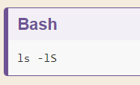
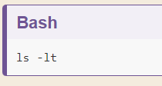
Navigating the File System – Tip and Challenges
Challenge 1: What command lists files in a directory ordered by file size?
Challenge 2: What command lists files in a directory ordered by last modification date?
Notes:
Find out, using the manual page, how to list the files in a directory ordered by their filesize. Try it out in different directories. Can you combine it with the -l argument you learned before?
Afterwards, find out how you can order a list of files based on their last modification date. Try ordering files in different directories.
To order files in a directory by their filesize, in combination with the -l argument: lS To order files in a directory by their filesize, in combination with the -l argument: lt

Slide 21

MINI BREAK
Description: dog wearing sunglasses
Notes:
2021-08-16 Description: dog wearing sunglasses (photo by permission)

Slide 22
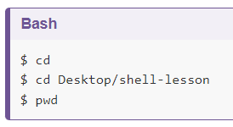
Working with Files and Folders
Through the command line, you can interact with files: read, run, open, and edit.
Shell commands enable you to automate work on multiple files, on the pages of a scanned book, for example.
Navigate to your home directory and verify your location.
#10
Tip: Try hitting the tab key after typing a few letters of the argument to auto-complete.
Notes:
As well as navigating directories, we can interact with files on the command line: we can read them, open them, run them, and even edit them. In fact, there’s really no limit to what we can do in the shell, but even experienced shell users still switch to graphical user interfaces (GUIs) for many tasks, such as editing formatted text documents (Word or OpenOffice), browsing the web, editing images, etc. But if we wanted to make the same crop on hundreds of images, say, the pages of a scanned book, then we could automate that cropping work by using shell commands.
Before getting started, we will use ls to verify where we are. Using ls periodically to view your options is useful to orient oneself.
We will try a few basic ways to interact with files. Let’s first move into the shell-lesson directory on your desktop.
Hitting tab at any time within the shell will prompt it to attempt to auto-complete the line based on the files or sub-directories in the current directory. Where two or more files have the same characters, the auto-complete will only fill up to the first point of difference, after which we can add more characters, and try using tab again. We would encourage using this method throughout today to see how it behaves (as it saves loads of time and effort!).

Slide 23
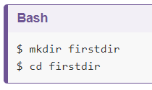
Working with Files and Folders – Creating a New Directory
“mkdir” command creates a new directory
Create a new directory called “firstdir” within the “shell-lesson” folder on your desktop and move to this location.
#11
Notes:
Here, we will create a new directory and move into it:
Here we used the mkdir command (meaning ‘make directories’) to create a directory named ‘firstdir’. Then we moved into that directory using the cd command.
But wait! There’s a trick to make things a bit quicker. Let’s go up one directory.
Instead of typing cd firstdir, let’s try to type cd f and then hit the Tab key. We notice that the shell completes the line to cd firstdir/.

Slide 24
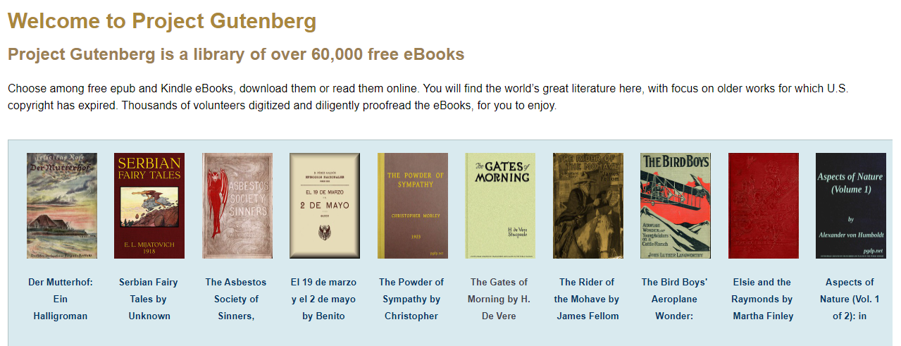
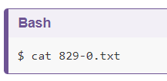
Reading Files
“cat” command shows the contents of a file
https://www.gutenberg.org/
Navigate back to the “shell-lesson” directory (use “pwd” if you are unsure of your current location) and list the detailed contents of that directory.
The files 829-0.txt and 33504-0.txt within this directory include the contents of two books downloaded from Project Gutenberg. Use the cat command to determine which books these files contain.
#12
Notes:
If you are in firstdir, use cd .. to get back to the shell-lesson directory.
Here there are copies of two public domain books downloaded from Project Gutenberg along with other files we will cover later.
The files 829-0.txt and 33504-0.txt holds the content of book #829 and #33504 on Project Gutenberg. But we’ve forgot which books, so we try the cat command to read the text of the first file:
https://www.gutenberg.org/

Slide 25
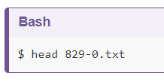
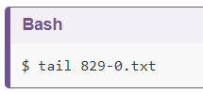
Reading Files
“head” and “tail commands print the first 10 or last 10 lines of a file, respectively
#13
#14
What command will print the first 20 lines of the file 829-0.txt?
head –n 20 829-0.txt
Notes:
The terminal window erupts and the whole book cascades by (it is printed to your terminal), leaving us with a new prompt and the last few lines of the book above this prompt.
Often we just want a quick glimpse of the first or the last part of a file to get an idea about what the file is about. To let us do that, the Unix shell provides us with the commands head and tail.
If ten lines is not enough (or too much), we would check man head (or head --help when using Windows) (q to “quit”) to see if there exists an option to specify the number of lines to get (there is: head -n 20 will print 20 lines).
Another way to navigate files is to view the contents one screen at a time. Type less 829-0.txt to see the first screen, spacebar to see the next screen and so on, then q to quit (return to the command prompt).

Slide 26
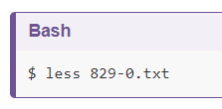
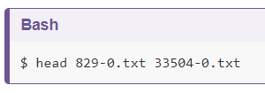
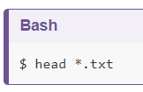
Reading Files
Use the “less” command to view the file contents one screen at a time. Use the spacebar to navigate to the next screen, and type “q” to quit and return to the command prompt.
#15
Use wildcards to run the command on all files in directory with the same extension
Commands for reading files can take more than one argument
#16
#17
“?” matches one character “*” matches 0 or more characters
Tip: Use the
arrow key to cycle though previously used commands
Notes:
Another way to navigate files is to view the contents one screen at a time. Type less 829-0.txt to see the first screen, spacebar to see the next screen and so on, then q to quit (return to the command prompt).
Like many other shell commands, the commands cat, head, tail and less can take any number of arguments (they can work with any number of files). We will see how we can get the first lines of several files at once. To save some typing, we introduce a very useful trick first.
On a blank command prompt, hit the up arrow key and notice that the previous command you typed appears before your cursor. We can continue pressing the up arrow to cycle through your previous commands. The down arrow cycles back toward your most recent command. This is another important labour-saving function and something we’ll use a lot.
All good so far, but if we had lots of books, it would be tedious to enter all the filenames. Luckily the shell supports wildcards! The ? (matches exactly one character) and * (matches zero or more characters) are probably familiar from library search systems. We can use the * wildcard to write the above head command in a more compact way:
Wildcards are a feature of the shell and will therefore work with any command. The shell will expand wildcards to a list of files and/or directories before the command is executed, and the command will never see the wildcards. As an exception, if a wildcard expression does not match any file, Bash will pass the expression as a parameter to the command as it is. For example typing ls *.pdf results in an error message that there is no file called *.pdf.

Slide 27
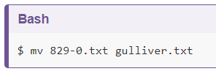
Moving Files
Our Project Gutenberg book files would be easier to navigate if the file names described the contents. Rename the books by renaming each file with a more descriptive file name.
The move command, “mv”, will rename a file or folder. The 1st argument is the source and the 2nd argument is the destination.
#18
1st
2nd
Notes:
We may also want to change the file name to something more descriptive. We can move it to a new name by using the mv or move command, giving it the old name as the first argument and the new name as the second argument:
This is equivalent to the ‘rename file’ function.
Afterwards, when we perform a ls command, we will see that it is now called gulliver.txt

Slide 28
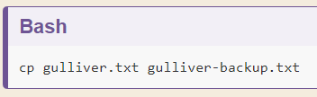
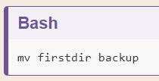
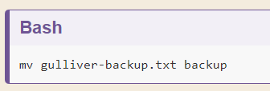
Copying Files
The “mv” command will not retain the previous file name. The “cp” (copy) command will create a duplicate file that can be renamed. It also takes two arguments as with the “mv” command.
#19
Rename the directory you created at the beginning of this episode (firstdir) “backup” and move gulliver-backup.txt into that directory.
Notes:
Instead of moving a file, you might want to copy a file (make a duplicate), for instance to make a backup before modifying a file. Just like the mv command, the cp command takes two arguments: the old name and the new name. How would you make a copy of the file gulliver.txt called gulliver-backup.txt? Try it!
Renaming a directory works in the same way as renaming a file. Try using the mv command to rename the firstdir directory to backup.
If the last argument you give to the mv command is a directory, not a file, the file given in the first argument will be moved to that directory. Try using the mv command to move the file gulliver-backup.txt into the backup folder.

Slide 29
Using history
Use the “history” command to list all the commands entered in your current Bash session.
Cntrl + r = reverse lookup. After pressing this key combination, type the beginning of the command you are searching for and the command will autocomplete. Hit Cntrl + r to cycle through commands. Press “enter” to run the selected command once more.
Press Cntrl + C to return to the prompt.
History > history.txt will output your session history into a .txt file that you can review and edit later. After this command is executed, typing “history” will bring up a numbered list. Select a command from the list by typing ! plus the associated number from the list, e.g. “!3”
Notes:
Use the history command to see a list of all the commands you’ve entered during the current session. You can also use Ctrl + r to do a reverse lookup. Hit Ctrl + r, then start typing any part of the command you’re looking for. The past command will autocomplete. Hit enter to run the command again, or press the arrow keys to start editing the command. If multiple past commands contain the text you input, you can Ctrl + r repeatedly to cycle through them. If you can’t find what you’re looking for in the reverse lookup, use Ctrl + c to return to the prompt. If you want to save your history, maybe to extract some commands from which to build a script later on, you can do that with history > history.txt. This will output all history to a text file called history.txt that you can later edit. To recall a command from history, enter history. Note the command number, e.g. 2045. Recall the command by entering !2045. This will execute the command.

Slide 30
Using the “echo” command
“echo” prints out the text you specify in the argument. (Reminder to enclose multiple words in a single argument in quotation marks.)
Print out “Library Carpentry is awesome!”
Use a shell variable to store information that can be recalled later on. Recall the variable by typing “$” before the name of the variable.
Type “NAME=” followed by your name to store the variable. Then print your name followed by “is doing awesome today!”
Notes:
The echo command simply prints out a text you specify. Try it out: echo 'Library Carpentry is awesome!'. Interesting, isn’t it?
You can also specify a variable. First type NAME= followed by your name, and hit enter. Then type echo "$NAME is a fantastic library carpentry student" and hit enter. What happens?
You can combine both text and normal shell commands using echo, for example the pwd command you have learned earlier today. You do this by enclosing a shell command in $( and ), for instance $(pwd).

Slide 31
Using the “echo” command
Combine text and shell commands by enclosing a shell command in $( and ), for example “$(pwd). “$” calls the variable value and treats it as a variable, not text.
Print out the text “Finally, it is nice and sunny on” followed by the current date and time. Hint: use the “date” command.
#20
The “echo” command has many useful applications. For example, it can be used to print the output of a command that does not itself give any text output.
Notes:
Now, try out the following: echo "Finally, it is nice and sunny on" $(date). Note that the output of the date command is printed together with the text you specified. You can try the same with some of the other commands you have learned so far.
You may think there is not much value in such a basic command like echo. However, from the moment you start writing automated shell scripts, it becomes very useful. For instance, you often need to output text to the screen, such as the current status of a script.
Moreover, you just used a shell variable for the first time, which can be used to temporarily store information, that you can reuse later on. It will give many opportunities from the moment you start writing automated scripts.

Slide 32
Mission Impossible: Deleting Files
We will not be executing the following command, but let it be known that the remove command, “rm”, will delete or remove files or directories.
Use wildcards to delete lots of files. Add the “-r” flag to delete folders with all their content.
Unlike deleting from a GUI, there is no warning, no recycling bin, or other undo options with this command!
Notes:
https://youtu.be/4y9NtHlJvbY
Finally, onto deleting. We won’t use it now, but if you do want to delete a file, for whatever reason, the command is rm, or remove.
Using wildcards, we can even delete lots of files. And adding the -r flag we can delete folders with all their content.
Unlike deleting from within our graphical user interface, there is no warning, no recycling bin from which you can get the files back and no other undo options! For that reason, please be very careful with rm and extremely careful with rm -r.

Slide 33
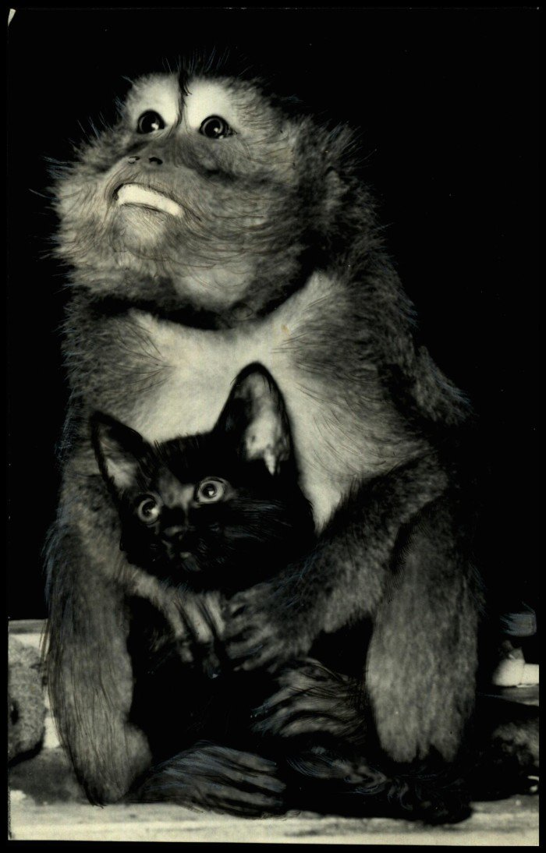
MINI BREAK
Description: Monkey hugging a kitten
https://gateway.okhistory.org/ark:/67531/metadc427038/
Notes:
Description: monkey hugging a kitten
https://gateway.okhistory.org/ark:/67531/metadc427038/

Slide 34
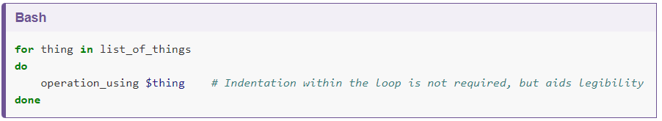
Automating With Loops – Definition and Syntax
Loops allow us to execute commands repetitively
Automation with loops can increase productivity, reduce the amount of lines needed to code, and avoid frustrating typographical errors in your code
General loop syntax:
“#” indicates a comment that explains something in the code but does not affect its operation
Words in green are keywords
Notes:
Loops are key to productivity improvements through automation as they allow us to execute commands repetitively. Similar to wildcards and tab completion, using loops also reduces the amount of typing (and typing mistakes). Suppose we have several hundred document files named project_1825.txt, project_1863.txt, XML_project.txt and so on. We would like to change these files, but also save a version of the original files, naming the copies backup_project_1825.txt and so on.
We can use a loop to do that. Here’s a simple example that creates a backup copy of four text files in turn.
Let’s first create those files:

Slide 35

Automating With Loops – Our Scenario
You have several documents (.txt files) that you need to edit. But first you need to create a backup version of the original files.
Use the “touch” command to create four .txt files that we will use as an example in the above scenario
“touch” command will create an file without any content with a specified name
Create the files “a.txt”, “b.txt”, “c.txt”, and “d.txt”
#21
Use the “ls” command to ensure the touch command executed correctly
Notes:
Now we will use a loop to create a backup version of those files. First let’s look at the general form of a loop:

Slide 36
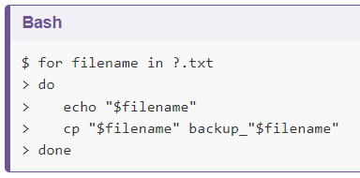
Automating With Loops
Keyword “for” indicates the shell should repeat the commands following the keyword “do” for each thing in the list
The name of each thing is sequentially assigned to the loop variable (“filename” in this case) and the commands are executed before moving on to the next thing in the list
The shell should print the filename and create a backup of each of the four “.txt” files in our directory before exiting the loop
#22
“$” calls for the loop variable’s value and tells the shell to treat the variable as a variable name and substitute its value place of the variable name
Notes:
When the shell sees the keyword for, it knows to repeat a command (or group of commands) once for each thing in a list. For each iteration, the name of each thing is sequentially assigned to the loop variable and the commands inside the loop are executed before moving on to the next thing in the list. Inside the loop, we call for the variable’s value by putting $ in front of it. The $ tells the shell interpreter to treat the variable as a variable name and substitute its value in its place, rather than treat it as text or an external command.
In this example, the list is four filenames: ‘a.txt’, ‘b.txt’, ‘c.txt’, and ‘d.txt’ Each time the loop iterates, it will assign a file name to the variable filename and run the cp command. The first time through the loop, $filename is a.txt. The interpreter prints the filename to the screen and then runs the command cp on a.txt, (because we asked it to echo each filename as it works its way through the loop). For the second iteration, $filename becomes b.txt. This time, the shell prints the filename b.txt to the screen, then runs cp on b.txt. The loop performs the same operations for c.txt and then for d.txt and then, since the list only included these four items, the shell exits the for loop at that point.
We have called the variable in this loop filename in order to make its purpose clearer to human readers. The shell itself doesn’t care what the variable is called.

Slide 37
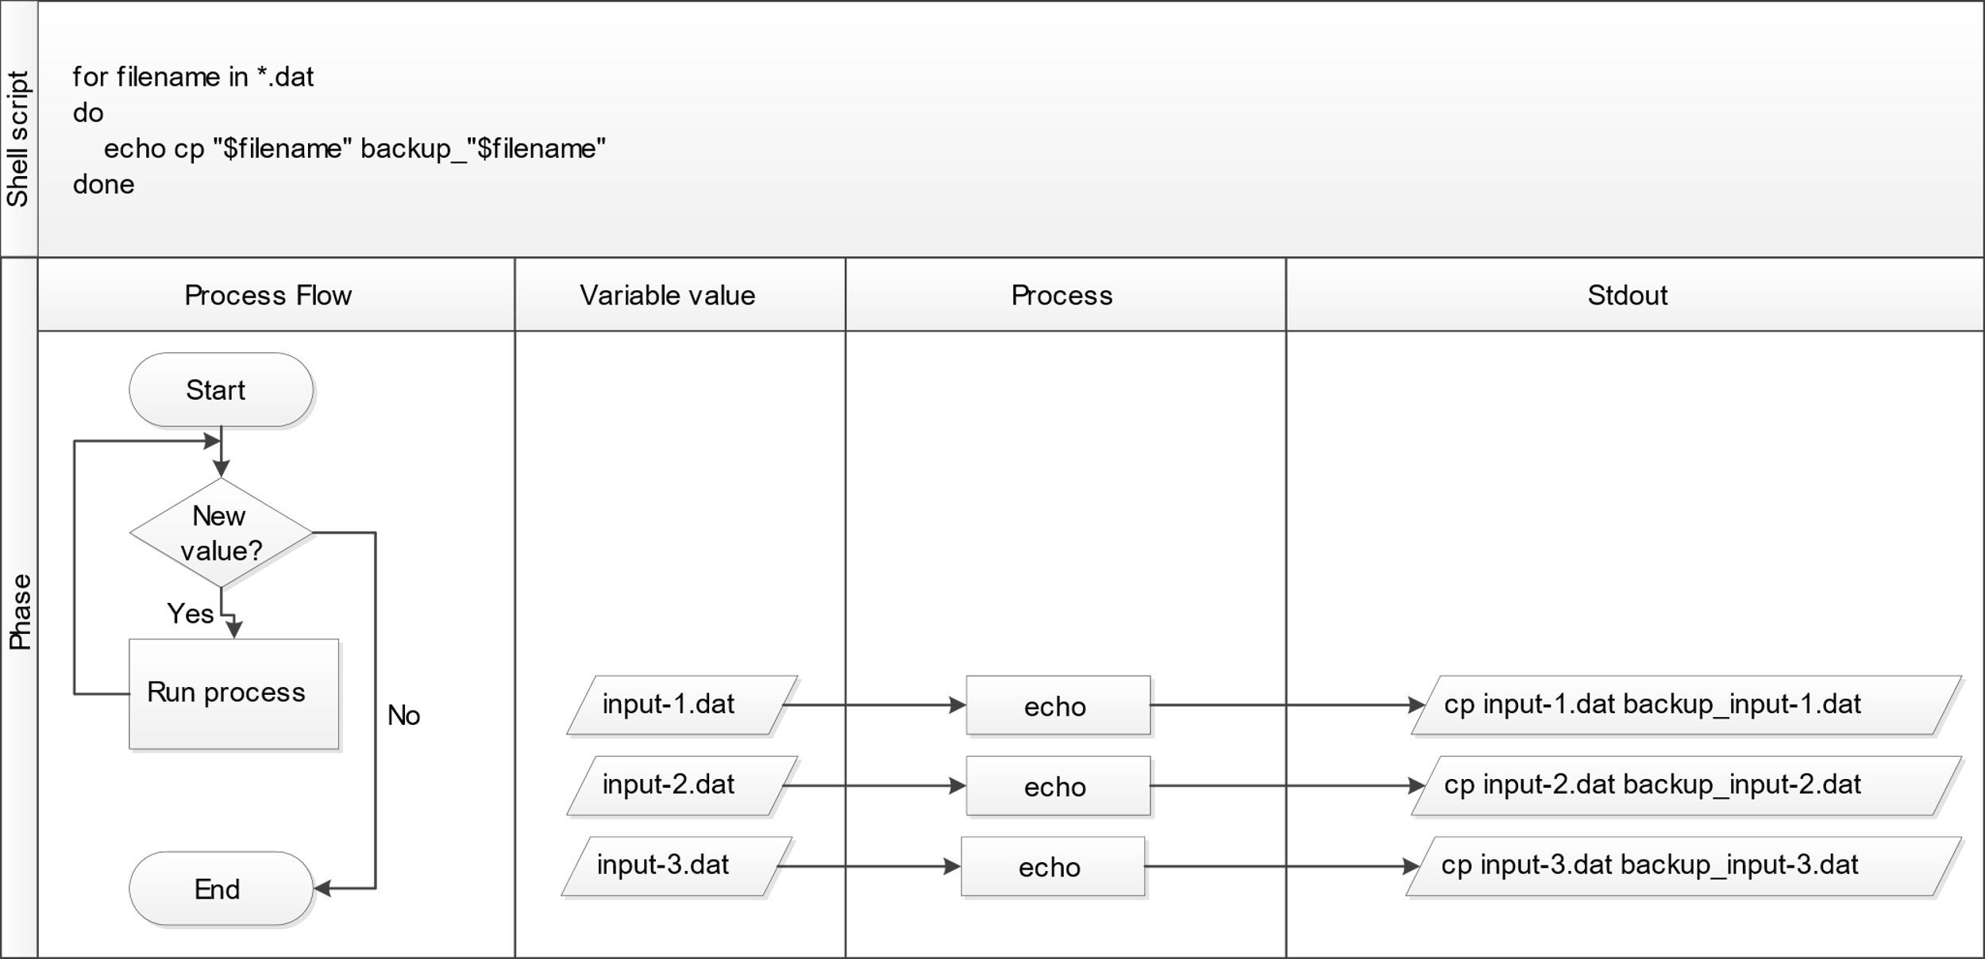
Automating With Loops

Slide 38
Automating With Loops – A Few Tips
Variable name can be any characters or keywords that don’t have a special meaning in the shell, but “filename” allows us to understand what the loop is executing
Using double quotes will avoid any errors caused by white spaces often found in file names. Without the quotes, the shell would treat file names with a white space as two separate file names
“>” in the shell prompt indicates something else is required to complete the command
“$” indicates the shell is ready for you to type a new command (prompt, not variable redirect)
Semi-colon “;” can be used to separate two commands on a single line
Notes:
Because real-world filenames often contain white-spaces, we wrap $filename in double quotes ("). If we didn’t, the shell would treat the white-space within a filename as a separator between two different filenames, which usually results in errors. Therefore, it’s best and generally safer to use "$..." unless you are absolutely sure that no elements with white-space can ever enter your loop variable (such as in episode 5).
The shell prompt changes from $ to > and back again as we were typing in our loop. The second prompt, >, is different to remind us that we haven’t finished typing a complete command yet. A semicolon, ;, can be used to separate two commands written on a single line.
Here we see > being used as a shell prompt, but > can also be used to redirect output from a command (i.e. send it somewhere else, such as to a file, instead of displaying the output in the terminal) — we’ll use redirection in episode 5. Similarly, $ is used as a shell prompt, but, as we saw earlier, it is also used to ask the shell to get the value of a variable.
If the shell prints > or $ then it expects you to type something, and the symbol is a prompt.
If you type > or $ yourself, it is an instruction from you that the shell to redirect output or get the value of a variable.

Slide 39
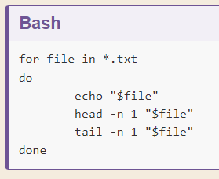
Automating With Loops - Exercise
Write a loop to print the name, first line, and last line of each “.txt” file in the current directory.

Slide 40
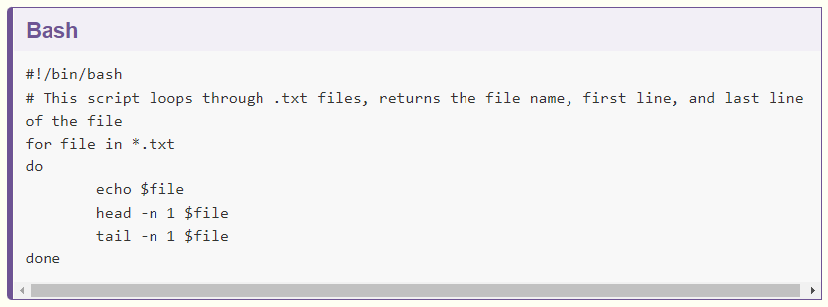
Automating With Loops – Running a Loop as a Script
A loop also can be saved as a script file that is run from the command line
Bash script = plain text file with a series of commands
#23
Notes:
Alternatively, rather than running the loop above on the command line, you can save it in a script file and run it from the command line without having to rewrite the loop again. This is what is called a Bash script which is a plain text file that contains a series of commands like the loop you created above.
In the example script, the first line of the file contains what is called a Shebang (#!) followed by the path to the interpreter (or program) that will run the rest of the lines in the file (/bin/bash). The second line demonstrates how comments are made in scripts. This provides you with more information about what the script does.
The remaining lines contain the loop you created above. You can create this file in the same directory you’ve been using for the lesson and by using the text editor of your choice (e.g. nano) but when you save the file, make sure it has the extension .sh (e.g. my_first_bash_script.sh). When you’ve done this, you can run the Bash script by typing the command bash and the file name via the command line (e.g. bash my_first_bash_script.sh).
For more on Bash scripts, see Bash Scripting Tutorial - Ryans Tutorials. https://ryanstutorials.net/bash-scripting-tutorial/

Slide 41
Automating With Loops – Running a Loop as a Script
Create the file in a text editor and save as “my_first_bash_script.sh” in the shell-lesson directory
Make sure the file extension is “.sh”
First line of the script contains a Shebang (#!) followed by the path to the interpreter or program that will run the rest of the lines in the file (/bin/bash)
“#” indicates a comment in the script
To run the script, type “bash my_first_bash_script.sh” and press enter
Notes:
In the example script, the first line of the file contains what is called a Shebang (#!) followed by the path to the interpreter (or program) that will run the rest of the lines in the file (/bin/bash). The second line demonstrates how comments are made in scripts. This provides you with more information about what the script does.
The remaining lines contain the loop you created above. You can create this file in the same directory you’ve been using for the lesson and by using the text editor of your choice (e.g. nano) but when you save the file, make sure it has the extension .sh (e.g. my_first_bash_script.sh). When you’ve done this, you can run the Bash script by typing the command bash and the file name via the command line (e.g. bash my_first_bash_script.sh).

Slide 42
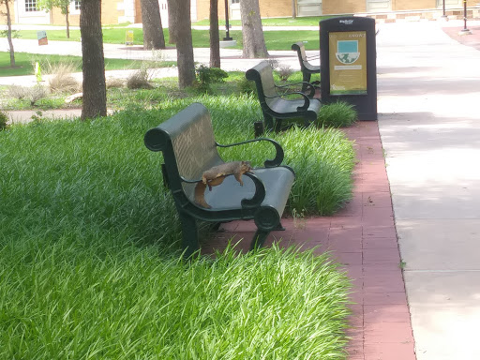
BREAK (10 minutes)
Description: Squirrel relaxing on bench on UNT Library Mall on a hot day
Notes:
2021-06-08
Description: Squirrel relaxing on bench on UNT Library Mall on a hot day

Slide 43

Counting and Mining with the Shell
Dataset “2014-01_JA.tsv”, in the shell-lesson directory, contains journal article metadata, and the three .tsv files derived from the original dataset.
Each of these three .tsv files includes all data where a keyword such as “Africa” or “America” appears in the ‘Title’ field of 2014-01_JA.tsv
“.tsv” file extension stands for “tab separated values” – a non-program-specific file type that, like .csv (comma separated values) files, is idea for archival data storage
From the shell-lesson directory, review the files in the directory and how large they are.
#24
Notes:
Now that you know how to navigate the shell, we will move onto learning how to count and mine data using a few of the standard shell commands. While these commands are unlikely to revolutionize your work by themselves, they’re very versatile and will add to your foundation for working in the shell and for learning to code. The commands also replicate the sorts of uses library users might make of library data.
We will begin by counting the contents of files using the Unix shell. We can use the Unix shell to quickly generate counts from across files, something that is tricky to achieve using the graphical user interfaces of standard office suites.
Let’s start by navigating to the directory that contains our data using the cd command
And let’s just check what files are in the directory and how large they are with ls -lhS:
In this episode we’ll focus on the dataset 2014-01_JA.tsv, that contains journal article metadata, and the three .tsv files derived from the original dataset. Each of these three .tsv files includes all data where a keyword such as africa or america appears in the ‘Title’ field of 2014-01_JA.tsv.
CSV and TSV Files
CSV (Comma-separated values) is a common plain text format for storing tabular data, where each record occupies one line and the values are separated by commas. TSV (Tab-separated values) is just the same except that values are separated by tabs rather than commas. Confusingly, CSV is sometimes used to refer to both CSV, TSV and variations of them. The simplicity of the formats make them great for exchange and archival. They are not bound to a specific program (unlike Excel files, say, there is no CSV program, just lots and lots of programs that support the format, including Excel by the way.), and you wouldn’t have any problems opening a 40 year old file today if you came across one.

Slide 44


Counting and Mining with the Shell
Write a command to return the largest file in the “shell-lesson” directory.
#25
Press “Ctrl + C” to end this process before it ends – cancels any ongoing process in the UNIX shell. Instead read the return the first 3 lines of “2014-01_JA.tsv”. What do you notice?
#26
Notes:
First, let’s have a look at the largest data file, using the tools we learned in Reading files:
Like 829-0.txt before, the whole dataset cascades by and can’t really make any sense of that amount of text. To cancel this on-going concatenation, or indeed any process in the Unix shell, press Ctrl+C.
In most data files a quick glimpse of the first few lines already tells us a lot about the structure of the dataset, for example the table/column headers:
In the header, we can see the common metadata fields of academic papers: Creator, Issue, Citation, etc.

Slide 45


Counting and Mining with the Shell – Counting Words
“wc” is the “word count” command = counts the number of lines, words, and bytes
Use the wildcard operator to generate word counts for all of the .tsv files in the current directory.
#27
#28
In #27, first three columns contain the number of lines, words and bytes. Adding the “-l” option generates only the number of lines.
Power of the shell comes from being able to combine commands
Notes:
Next, let’s learn about a basic data analysis tool: wc is the “word count” command: it counts the number of lines, words, and bytes. Since we love the wildcard operator, let’s run the command wc *.tsv to get counts for all the .tsv files in the current directory (it takes a little time to complete):
The first three columns contains the number of lines, words and bytes.
If we only have a handful of files to compare, it might be faster or more convenient to just check with Microsoft Excel, OpenRefine or your favourite text editor, but when we have tens, hundreds or thousands of documents, the Unix shell has a clear speed advantage. The real power of the shell comes from being able to combine commands and automate tasks, though. We will touch upon this slightly.
For now, we’ll see how we can build a simple pipeline to find the shortest file in terms of number of lines. We start by adding the -l flag to get only the number of lines, not the number of words and bytes:

Slide 46




Counting and Mining with the Shell - Pipes
Build a simple pipeline to find the shortest file in terms of number of lines.
#29
#31
Redirect the command output to a file using (>)
Return the first line of “sorted-lengths.txt”
#30
#32
Use a pipe (|) to send the output of the first command directly to the second
“Sort” command with “-n” option for numerical sorting
Notes:
The wc command itself doesn’t have a flag to sort the output, but as we’ll see, we can combine three different shell commands to get what we want.
First, we have the wc -l *.tsv command. We will save the output from this command in a new file. To do that, we redirect the output from the command to a file using the ‘greater than’ sign (>), like so:
There’s no output now since the output went into the file lengths.txt, but we can check that the output indeed ended up in the file using cat or less (or Notepad or any text editor).
Next, there is the sort command. We’ll use the -n flag to specify that we want numerical sorting, not lexical sorting, we output the results into yet another file, and we use cat to check the results:
Finally we have our old friend head, that we can use to get the first line of the sorted-lengths.txt:
But we’re really just interested in the end result, not the intermediate results now stored in lengths.txt and sorted-lengths.txt. What if we could send the results from the first command (wc -l *.tsv) directly to the next command (sort -n) and then the output from that command to head -n 1? Luckily we can, using a concept called pipes. On the command line, you make a pipe with the vertical bar character |. Let’s try with one pipe first:

Slide 47

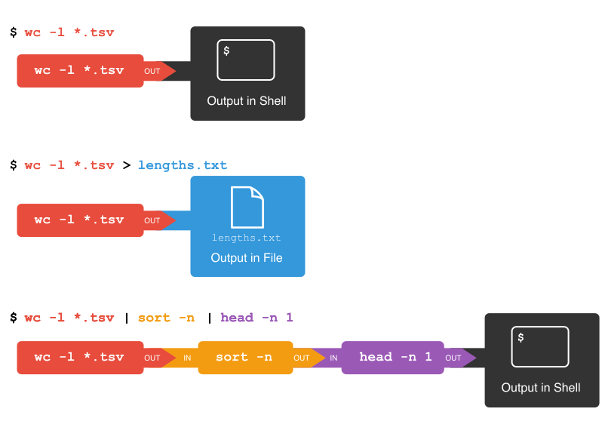
Counting and Mining with the Shell – Pipes and Filters
#33
Add another pipe to view the answer in the shell (same output that ended up in “sorted-lengths.txt” earlier)
UNIX shell includes simple tools that do one job well and work well with one another
Any program that reads lines of text from a standard input and writes lines to a standard out put can be combined with every other program that behaves this way
Notes:
Notice that this is exactly the same output that ended up in our sorted-lengths.txt earlier. Let’s add another pipe:
This simple idea is why Unix has been so successful. Instead of creating enormous programs that try to do many different things, Unix programmers focus on creating lots of simple tools that each do one job well, and that work well with each other. This programming model is called “pipes and filters”. We’ve already seen pipes; a filter is a program like wc or sort that transforms a stream of input into a stream of output. Almost all of the standard Unix tools can work this way: unless told to do otherwise, they read from standard input, do something with what they’ve read, and write to standard output.
The key is that any program that reads lines of text from standard input and writes lines of text to standard output can be combined with every other program that behaves this way as well. You can and should write your programs this way so that you and other people can put those programs into pipes to multiply their power.

Slide 48


Counting and Mining with the Shell - Examples
Count the total lines of every .tsv file in the “shell-lesson” directory, sort the results, and print the first line of the results.
Find the 10 files in “shell-lesson” directory that have the most words. (Hint: the “-w” [word] option when used with “wc” prints word counts.)
Notes:
To count the total lines in every tsv file, sort the results and then print the first line of the file we use the following:
Now let’s change the scenario. We want to know the 10 files that contain the most words. Fill in the blanks below to count the words for each file, put them into order, and then make an output of the 10 files with the most words (Hint: The sort command sorts in ascending order by default).
Here we use the wc command with the -w (word) flag on all tsv files, sort them and then output the last 11 lines (10 files and the total) using the tail command.

Slide 49

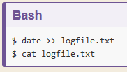
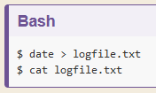
Counting and Mining with the Shell
Counting files: Find out how many files are in the shell-lesson directory.
#34
Writing to files: Write the current date and time to a new file named “logfile.txt”.
Appending to files: Append the current date and time to “logfile.txt. (Hint: “>>” appends a file.)
#35
#36
Notes:
Let’s make a different pipeline. You want to find out how many files and directories there are in the current directory. Try to see if you can pipe the output from ls into wc to find the answer.
The date command outputs the current date and time. Can you write the current date and time to a new file called logfile.txt? Then check the contents of the file.
To check the contents, you could also use less or many other commands. Beware that > will happily overwrite an existing file without warning you, so please be careful.

Slide 50
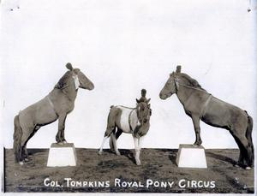
MINI BREAK
Description: circus ponies
https://gateway.okhistory.org/ark:/67531/metadc1474023/

Slide 51


Counting and Mining with the Shell – Searching
“grep” (global regular expressions print) enables searching for something in one or more files
#37
Create a new “results” directory within “shell-lesson”.
Search for the year “1999” in the *.tsv files in the “shell-lesson” directory and display the output in the shell. Why is this important in this context?
#38
Notes:
Searching for something in one or more files is something we’ll often need to do, so let’s introduce a command for doing that: grep (short for global regular expression print). As the name suggests, it supports regular expressions and is therefore only limited by your imagination, the shape of your data, and - when working with thousands or millions of files - the processing power at your disposal.
To begin using grep, first navigate to the shell-lesson directory if not already there. Then create a new directory “results”:
Now let’s try our first search:
Remember that the shell will expand *.tsv to a list of all the .tsv files in the directory. grep will then search these for instances of the string “1999” and print the matching lines.
The shell now prints the number of times the string 1999 appeared in each file. If you look at the output from the previous command, this tends to refer to the date field for each journal article.
Press the up arrow once in order to cycle back to your most recent action. Amend grep 1999 *.tsv to grep -c 1999 *.tsv and hit enter.

Slide 52


Counting and Mining with the Shell
Find all instances of the word ”revolution” in the *.tsv files in the “shell-lesson” directory. How can we save this data to a file?
#39
Export the results to a filename with today’s date as a subset of the original file.
#40
Note: $(date –l) may also work in some platforms
Notes:
We will try another search:
We got back the counts of the instances of the string revolution within the files. Now, amend the above command to the below and observe how the output of each is different:
This repeats the query, but prints a case insensitive count (including instances of both revolution and Revolution and other variants). Note how the count has increased nearly 30 fold for those journal article titles that contain the keyword ‘america’. As before, cycling back and adding > results/, followed by a filename (ideally in .txt format), will save the results to a data file.
So far we have counted strings in files and printed to the shell or to file those counts. But the real power of grep comes in that you can also use it to create subsets of tabulated data (or indeed any data) from one or multiple files.
This script looks in the defined files and prints any lines containing revolution (without regard to case) to the shell. We let the shell add today’s date to the filename:
This saves the subsetted data to a new file.
This way of writing dates is so common that on some platforms (not macOS X) you can get the same result by typing $(date -I) instead of $(date "+%Y-%m-%d").

Slide 53


Counting and Mining with the Shell
Add greater precision with the “-w” option added to the “grep” command
#41
Show the difference between the created files
#42
Notes:
However, if we look at this file, it contains every instance of the string ‘revolution’ including as a single word and as part of other words such as ‘revolutionary’. This perhaps isn’t as useful as we thought… Thankfully, the -w flag instructs grep to look for whole words only, giving us greater precision in our search.
This script looks in both of the defined files and exports any lines containing the whole word revolution (without regard to case) to the specified .tsv file.
We can show the difference between the files we created.

Slide 54

Counting and Mining with the Shell – Regular Expressions
Note: there are different ways of writing regular expressions. “grep” supports.
Always using the most advanced regular expressions your version of grep supports (-E flag on macOS X, -P on most other platforms) or when doing something more complex than searching for a plain string will avoid confusion.
The regular expression ‘fr[ae]nc[eh]’ will match “france”, “french”, but also “frence” and “franch”. Print out all lines matching this expression in *.tsv files in the “shell-lesson” directory.
#43
Notes:
There are, unfortunately, different ways of writing regular expressions. Across its various versions, grep supports “basic”, at least two types of “extended”, and “PERL-compatible” regular expressions. This is a common cause of confusion, since most tutorials, including ours, teach regular expressions compatible with the PERL programming language, but grep uses basic by default. Unless you want to remember the details, make your life easy by always using the most advanced regular expressions your version of grep supports (-E flag on macOS X, -P on most other platforms) or when doing something more complex than searching for a plain string.
The regular expression ‘fr[ae]nc[eh]’ will match “france”, “french”, but also “frence” and “franch”. It’s generally a good idea to enclose the expression in single quotation marks, since that ensures the shell sends it directly to grep without any processing (such as trying to expand the wildcard operator *).
The shell will print out each matching line.
We include the -o flag to print only the matching part of the lines e.g. (handy for isolating/checking results):

Slide 55
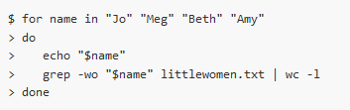

Counting and Mining with the Shell – Counting with Loops
Using the Little Women e-book from Project Gutenberg (pg514.txt), create a loop to count the instances of each of the “little women” (Jo, Beth, Amy, and Meg) in the text.
#44
#45
First rename the file:
Notes:
We will now use a loop to automate the counting of certain words within a document. For this, we will be using the Little Women e-book from Project Gutenberg. The file is inside the shell-lesson folder and named pg514.txt. Let’s rename the file to littlewomen.txt.
This renames the file to something easier to type.
Now let’s create our loop. In the loop, we will ask the computer to go through the text, looking for each girl’s name, and count the number of times it appears. The results will print to the screen.
What is happening in the loop?
echo "$name" is printing the current value of $name
grep "$name" littlewomen.txt finds each line that contains the value stored in $name. The -w flag finds only the whole word that is the value stored in $name and the -o flag pulls this value out from the line it is in to give you the actual words to count as lines in themselves.
The output from the grep command is redirected with the pipe, | (without the pipe and the rest of the line, the output from grep would print directly to the screen)
wc -l counts the number of lines (because we used the -l flag) sent from grep. Because grep only returned lines that contained the value stored in $name, wc -l corresponds to the number of occurrences of each girl’s name.
In episode 4 we learned to use "$..." as a safeguard against white-space being misinterpreted. Why could we omit the "-quotes in the above example?
Because we are explicitly listing the names after in, and those contain no white-space. However, for consistency it’s better to use rather once too often than once too rarely.

Slide 56
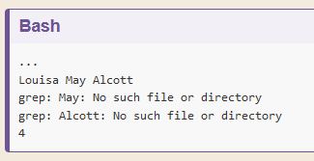
Counting and Mining with the Shell
What happens if you add "Louisa May Alcott" to the first line of the loop and remove the " from $name in the loop’s code?
Notes:
What happens if you add "Louisa May Alcott" to the first line of the loop and remove the " from $name in the loop’s code?
Without "-quoting $name, the last loop will try to execute grep Louisa May Alcott littlewomen.txt. grep interprets only the first word as the search pattern, but May and Alcott as filenames. This produces two errors and a possibly untrustworthy count:

Slide 57


Counting and Mining with the Shell
Select the columns Issue, Volume, Language, Publisher from “2014-01_JA.tsv” and direct the output into a new file. You can name it something like 2014-01_JA_ivlp.tsv.
Notes:
Select the columns Issue, Volume, Language, Publisher from 2014-01_JA.tsv and direct the output into a new file. You can name it something like 2014-01_JA_ivlp.tsv.
When you receive data it will often contain more columns or variables than you need for your work. If you want to select only the columns you need for your analysis, you can use the cut command to do so. cut is a tool for extracting sections from a file. For instance, say we want to retain only the Creator, Volume, Journal, and Citation columns from our article data. With cut we’d:
Above we used cut and the -f flag to indicate which columns we want to retain. cut works on tab delimited files by default. We can use the flag -d to change this to a comma, or semicolon or another delimiter. If you are unsure of your column position and the file has headers on the first line, we can use head -n 1 <filename> to print those out.
First, let’s see where our desired columns are:
Ok, now we know Issue is column 3, Volume 4, Language 11, and Publisher 12. We use these positional column numbers to construct our cut command:
We can confirm this worked by running head on the file:

Slide 58
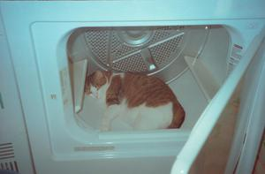
MINI BREAK
Description: orange and white cat inside a clothes dryer
https://texashistory.unt.edu/ark:/67531/metapth908662/
Notes:
Description: orange and white cat inside a clothes dryer

Slide 59
MORE EXERCISES AND SURVEY
https://librarycarpentry.org/lc-shell/05-counting-mining/index.html *Begin with “Case-Sensitive Search”
*POST WORKSHOP SURVEY: https://carpentries.typeform.com/to/UgVdRQ?slug=2022-01-20-unt-online
Notes:
The shell can be used to count elements of documents
The shell can be used to search for patterns within files
Commands can be used to count and mine any number of files
Commands and flags can be combined to build complex queries specific to your work

