Slide 1

Future of Work and Organizations
Topic 3: Decision Making in Individuals
Dr. Mary Parkinson
Notes:
90-minute pacing: 0–7 opening problems; 7–20 decision approaches; 20–43 biases; 43–61 BioPasteur group work; 61–73 debrief; 73–84 debiasing; 84–90 synthesis.
[Sources]

Slide 2
Problem 1
A bat and a ball cost 1.10 in total. The bat costs 1.00 more than the ball. How much does the ball cost?
(Bourgeois-Gironde and Van Der Henst, 2009; Frederick, 2005)
Notes:
Although this response intuitively springs to mind, it is incorrect. If the ball cost 10 cents and the bat costs $1.00 more than the ball, then the bat would cost $1.10 for a grand total of $1.20. The correct answer to this problem is that the ball costs 5 cents and the bat costs — at a dollar more — $1.05 for a grand total of $1.10.

Slide 3

“A machine for jumping to conclusions”
(Kahneman, 2011)
Notes:
Failures of critical thinking leave you vulnerable to (cites):
Pseudo-profound bullsh*t (Pennycock et al., 2015)
Bad arguments and manipulation
Being unable to find good solutions to problems
Decisions based on bad information
Pareidolia- patterns in clouds, e.g. Jim Carey film the number 23.
http://journal.sjdm.org/15/15923a/jdm15923a.pdf
Infodemic- fake news and conspiracy theories.
2016- Brexit, US presidential election. Facebook.
Two main explanations for believing fake news stories- one is bias, other is laziness. Either way- critical thinking is key.
Failures of critical thinking leave you vulnerable to (cites):
Pseudo-profound bullsh*t (Pennycock et al., 2015)
Bad arguments and manipulation
Being unable to find good solutions to problems
Decisions based on bad information
Pareidolia- patterns in clouds, e.g. Jim Carey film the number 23.
http://journal.sjdm.org/15/15923a/jdm15923a.pdf
Majority of students (in US) struggle with media literacy (Wineburg et al., 2016)
Ghebreyesus T.A. (2020) Speech to the Munich Security Conference. 15th February 2020. Munich. Availablbe: https://www.who.int/dg/speeches/detail/munich-security-conference
Science communication :conspiracy theories, (large events require large causes). Psychological needs are frustrated: Belief in conspiracy theories appears to be driven by motives that can be characterized as epistemic (understanding one’s environment), existential (being safe and in control of one’s environment), and social (maintaining a positive image of the self and the social group).
https://www.pexels.com/photo/not-today-covid19-sign-on-wooden-stool-3952231/
#https://www.pexels.com/photo/white-and-black-letter-blocks-3989901/
Fake news and Gordon Pennycook stuff:
Gordon Pennycook:
Lazy-not biased; inattention based view:
Delusional beliefs; dogmatism
Prior exposure
https://www.sciencedirect.com/science/article/pii/S001002771830163X?casa_token=d1t7y4ZHEUoAAAAA:8UUfFkLY4XFHIdyTCWeHyeWkkvBgTey1TotRQsys7nI7hPlvLqumKS0N5hPwwYXP4m9w2ILB
https://journals.sagepub.com/doi/pdf/10.1177/0956797620939054
https://www.sciencedirect.com/science/article/abs/pii/S2211368118301050?casa_token=5RK6zz3dMWgAAAAA:zl1AXzVcimhPlSph7-mTE6rWN_I-Br5ZPSSDpQbDl2PtNtIsXj1tJKvoaIZN5BFUshotxWFm#bib0190
https://www.ncbi.nlm.nih.gov/pmc/articles/PMC6279465/
Analytical thinking works: https://www.sciencedirect.com/science/article/pii/S0010027714001632?casa_token=2D8x0JbZegwAAAAA:6ReK0zRXPrsZqsN6QlNycK982UY85x_g5uakJ0zZpeddIsO2_ae8yAh35NxNjNcqKVA98Y0z

Slide 4
Rational decision-making model
A model of how individuals should behave to maximize an outcome.
Key assumptions
Complete information is available.
All relevant options can be identified without bias.
The option with the highest utility is chosen.
Example: A procurement team compares every eligible AI platform against agreed cost, accuracy, security and service criteria, then selects the highest-scoring option.
Notes:
Teaching emphasis: this is a normative benchmark—how a fully informed utility-maximizer should decide—not a claim that people normally decide this way.
Prompt: Which assumption is least realistic in contemporary organizational decisions?
[Sources]
- Robbins, S. P., & Judge, T. A. Organizational Behavior, 19th ed. Pearson.
- https://www.pearson.com/en-us/subject-catalog/p/organizational-behavior/P200000007044/9780137687206

Slide 5
Bounded rationality
A simplified process that captures essential features without representing full complexity.
Key assumptions
Information-processing capacity is limited—even when information is available.
Complex problems cannot be solved with full rationality.
Decision makers simplify, search sequentially and often satisfice.
Example: Under time pressure, a manager reviews applicants in order and appoints the first person who meets an acceptable skills threshold.
Notes:
Teaching emphasis: bounded rationality does not mean irrationality. It means purposeful choice under cognitive, informational and time constraints.
Prompt: What did the manager exclude by using an acceptable threshold?
[Sources]

Slide 6
Intuitive decision making
An unconscious process created from distilled experience. This can lead to unconscious bias and be expressed in heuristics.
Key features
Occurs outside conscious thought.
Uses holistic associations between pieces of information.
Is fast and affectively charged.
Works best when experience is relevant and patterns are learnable.
Example: An experienced cybersecurity analyst senses danger in an unusual activity pattern and escalates before formal indicators are conclusive.
Notes:
Teaching emphasis: intuition is neither magic nor automatically trustworthy. Its quality depends on relevant experience, recurring patterns and feedback.
Prompt: When should the analyst’s intuition trigger investigation rather than determine the final decision?
[Sources]

Slide 7
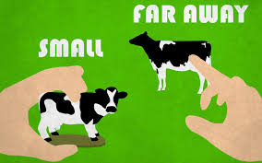
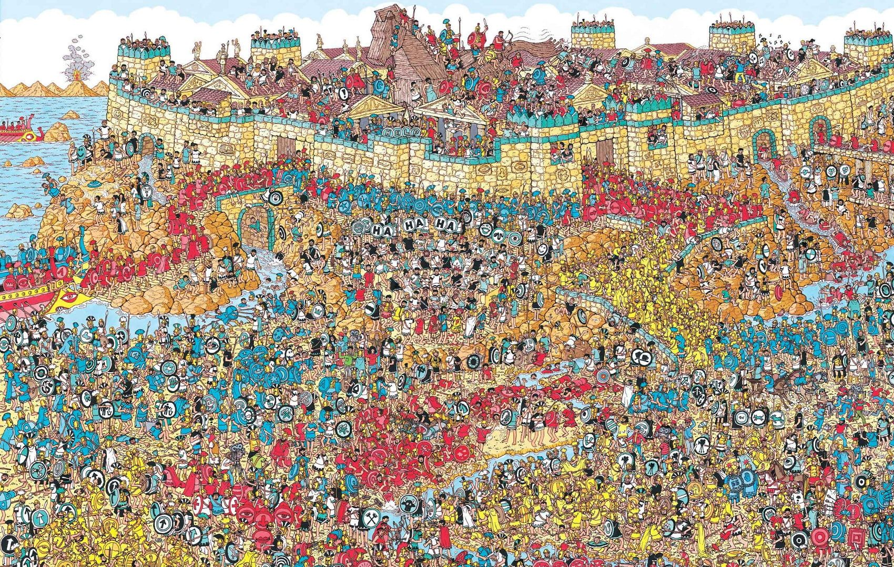
System 1 and System 2
System 1: automatic, quick, effortless, no sense of voluntary control.
System 2 allocates attention to the effortful mental activities that demand it.
(Stanovich & West, 2000)
Notes:
System 1 operates automatically and quickly, with little or no effort and no sense of voluntary control.
System 2 allocates attention to the effortful mental activities that demand it, including complex computations. The operations of System 2 are often associated with the subjective experience of agency, choice, and concentration. Limited attention- Eye witness testimony and selective attention, moonwalking gorilla. We don’t see what we don’t attend to, and this applies to processing information too. Because we have limited attention, we need to be selective in how we allocate attention. And we really only do this for things that require it- we are often described as cognitively lazy meaning that we conserve mental resources as much as we can.
Kahneman, D. ( 2011)
System 1 can :
Orient to the source of a sudden sound.
Complete the phrase “bread and …”
Detect hostility in a voice.
Answer to 2 + 2 = ?
Drive a car on an empty road.
Understand simple sentences.
System 2 can:
Focus on the voice of a particular person in a crowded and noisy room.
Look for a woman with white hair.
Search memory to identify a surprising sound.
Maintain a faster walking speed than is natural for you.
Monitor the appropriateness of your behavior in a social situation.
Tell someone your phone number.
Park in a narrow space (for most people except garage attendants).
Compare two washing machines for overall value.
Check the validity of a complex logical argument.

Slide 8
Decision making when AI joins the team
AI can expand the information and options considered—but it does not remove bounded rationality or bias.
New risks
Defaults- if we are cognitively lazy, are we really evaluating the quality of recommendations effectively?
Confirmation bias: if AI recommendations are consistent with what we already think, do we question them?
Anchoring on an algorithmic score or forecast.
Scaling biased assumptions, data or criteria.
Better human–AI decisions: Use AI to generate and test options; require people to challenge assumptions, inspect contrary evidence and retain accountability.
Notes:
Future-of-work connection: AI may extend search and calculation, but humans still select objectives, interpret outputs and decide when to rely on them.
Ask students to compare: Which part resembles rational analysis? Where does bounded rationality remain? When might expert intuition appropriately override an AI recommendation?
[Sources]
- https://nvlpubs.nist.gov/nistpubs/ai/NIST.AI.100-1.pdf
- https://nvlpubs.nist.gov/nistpubs/ai/NIST.AI.600-1.pdf

Slide 9
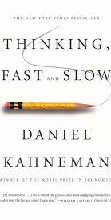
Common Cognitive Biases
Framing effects
Anchoring effect
The Availability Heuristic
Confirmation bias
Sunk-cost effect
Notes:
There are so many biases that I couldn’t possibly go into all of them. Here are some of the most influential ones (if you’re interested in this further go and look at Daniel Kahneman’s book Thinking Fast and Slow.
The representativeness heuristic
Sunk costs

Slide 10
Framing
Singapore is preparing for the outbreak of an unusual flu epidemic that is expected to kill 600 people. Two alternative programs are being considered. Which would you favor?
Notes:
This is called gain loss framing and it affects how people make decisions involving risks.
Note- I know everyone is sick of hearing about epidemics!!! But this is a very classic example.

Slide 11
Gain/Loss Framing
If Alternative A is adopted, 400 people will die.
If Alternative B is adopted, there is a 1/3 chance that no one will die and a 2/3 chance that all 600 will die.
If Alternative A is adopted, 200 people will be saved.
If Alternative B is adopted, there is a 1/3 chance that all 600 will be saved and a 2/3 chance that no one will be saved.
60%
60%

Slide 12
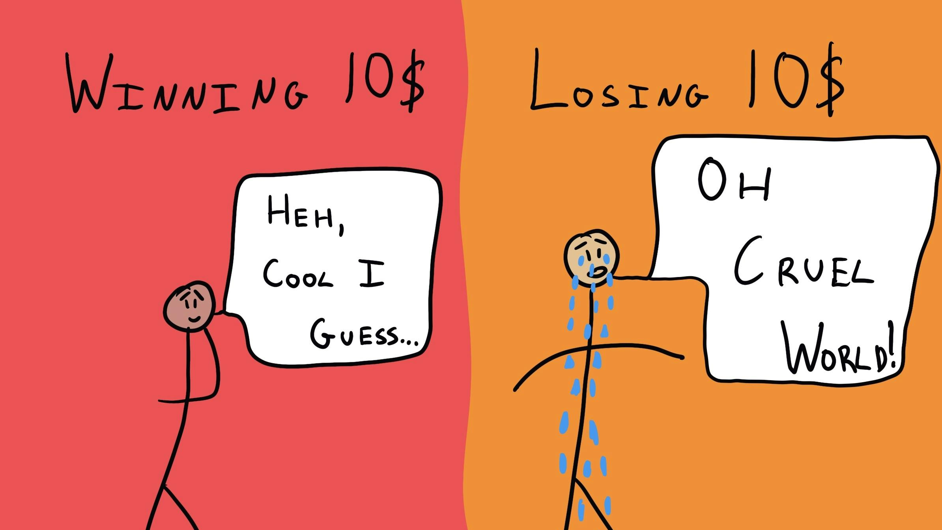

Slide 13
Framing Bias
Framing effects: Tendency to react to a particular choice based on how it is presented.
Loss-risk seeking
Gain- risk averse
Deal or no deal! – Loss aversion and prospect theory
TIP: look at it from both perspectives.
Notes:
People tend to become more risk-seeking when a situation is framed as a loss; they tend to become more risk-averse when a situation is framed as a gain.
This is problematic because it indicates inconsistency in decision making.
They way that the options are presented shouldn’t really matter- it’s just semantics.
Deal or no deal- he started to get really fixated on the top prize ($1 million). We know this because he’s talked about it quite a bit in subsequent interviews. He started to feel like he was losing the million by settling. This is called loss aversion, which is a part of prospect theory. We really hate losses, so we will take big risks to avoid losses.
Luis Green- https://www.youtube.com/watch?v=qEja2TpwFGE

Slide 14
Anchors
This two-part question has to do with the number of cattle in Ireland.
a. Do you estimate the number of cattle in Ireland to be over 1,000,000?
b. What is your estimate of the number of cattle in Ireland?
(there are really 7.5 million!)
Anchoring effects: Tendency to rely too heavily on the first piece of information offered (the "anchor").
TIP: ignore irrelevant and biased data.
Notes:
Example- negotiations- salaries (employers ask what your last salary was). Women and people of colour tend to be paid less- which creates a an anchor that perpetuates a cycle of discrimination.
for a lot of firms 2019’s sales figures may have been used as an anchor for 2020’s predicted sales.
Although many people know that there are more cattle than humans in Ireland.
If you have an anchor in mind you might go up or down 20% but you probably won’t deviate hugely.

Slide 15
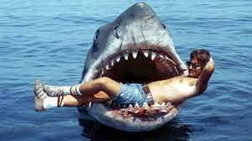
Availability Heuristic
Which is true? There are more words in the English language that:
start with the letter K
have K as the third letter
Availability heuristic- the tendency to form judgments about the commonness of an event based on ease of recall.
TIP: hunt for less flashy information.
Notes:
e.gFor managers tend to be overly . kangaroo, kind vs. bike, cake, acknowledge
influenced by successes, successes are often recalled more clearly and vividly than failures.
Don’t just think about the easiest examples, look for the right examples.
Basically, when we try to figure out how common something is or how likely something is to happen, we try to think of an example of that thing. If that example comes to us easily, then that thing must be common or likely to happen. If we struggle to come up with an example, then that thing must be uncommon or unlikely to happen.
#e.g. college dropouts that became famous entrepreneurs
As managers we tend to recall successes better than failures….
The wonderful thing about it is that it very, very often works. Particularly it works in the environment in which our brains evolved, which is on the plains of Africa living as hunter-gatherers. If you imagine that environment, the availability heuristic really works well. You’re walking along, you see a shadow in the long grass, you think to yourself, should I be worried about lions? You will immediately try to think of an example of a lion emerging from the long grass and dragging somebody to a screaming death.

Slide 16
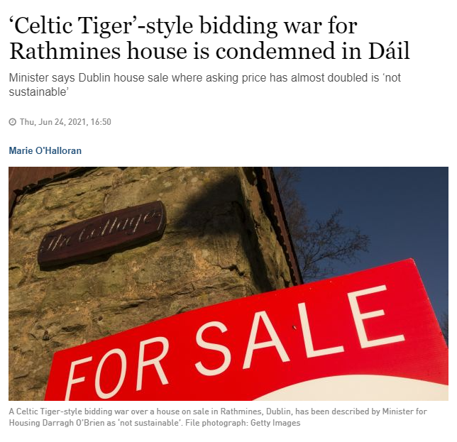
Escalation of Commitment (Sunk Cost Effect)
Tendency for people to escalate commitment to a course of action in which they have made substantial prior investments of time, money, or other resources (investments that are irreversible).
TIP: Look for signs that you are overly committed to a failing venture. Remind yourself that sunk costs shouldn’t influence your decisions.
Notes:
https://www.schwab.com/resource-center/insights/content/choiceology-episode-3
Bidding wars in housing.
First year students- a couple of months into a course feel committed to a four year course.
Investing additional funds in a flawed IT project that is far behind schedule and is over budget.
Plowing more money into turning around a failed acquisition rather than divesting.

Slide 17
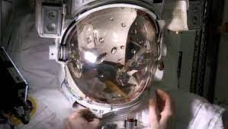
Confirmation Bias
Confirmation bias: The tendency to seek information which confirms our theories or hypotheses, even when disconfirming evidence would be helpful.
Luca Parmitano- ESA
TIP: seek disconfirming information.
Notes:
Luca Parmitano’s second space walk- ESA (European space agency; spacewalk July 2013 First Italian to do a space walk for the ESA. If you look at his helmet you can see water on the inside.
Space is basically trying to kill you at all times: In the sun it’s 200c, in the shade its -200, and it’s a vacuum. So if anything happens to your space suit you will burn, freeze and evaporate at the same time; to the integrity of the space suit is very important.
Spacewalk 1- report that it’s probably a waterbag leak to ground control. Colleagues laugh it off- think he didn’t seal his water bottle properly- a rookie mistake. Ground control assumes it’s a water bottle issue and has it replaced.
Spacewalk 2: this is often referred to as the most dangerous spacewalk incident experienced by any agency. He’s out there and his helmet starts filling up with bubbles of water, his nose his eeyes fill with water, he just makes it back inside the hatch- he was very close to drowning. Everyone had assumed that it was a water bottle. Someone at ground control should have said- how do we know it’s the water bottle? Check it for leaks, check the other systems. A problem with the space suit’s water-cooling filtration system. They didn’t seek disconfirming evidence- and that created a very dangerous situation. The innocence project examples. Second opinions on diagnosis.
Marvin Pipkin was a scientist with the United States Army in the early part of the 20th century. He returned to civilian life in the 1920s and joined General Electric. When he started at GE, he was given a job that was considered a fool’s errand, the supposedly impossible task of designing a light bulb that could be frosted on the inside to help diffuse the harsh light of incandescent bulbs. This assignment was often handed out to new hires as something of a joke, but Marvin didn’t know that the project was considered impossible. He set about to solve the problem as if it were possible. He completed work on the new internally frosted light bulb in 1925. GE later mass produced it, and the ubiquitous soft white light bulb was born.

Slide 18
BioPasteur
Discuss the case (including the Wes Anderson’s sampling procedure).
Decide as a group- Would you recommend that Thompson & Co. introduce Diastop?
  Why or why not?
Do you think you see any decision-making biases in there?
Notes:
Note- Thompson asks Wes Anderson to put together information (run additional tests)
Assume that the Y axis of the plots is raw numbers of complications
Protect 18 minutes for group analysis. Require groups to identify the decision approach, at least three biases, their consequences, and two debiasing interventions.
[Sources]

Slide 19
BREAK

Slide 20
BioPasteur Debrief
Diastop is probably not worth the risk.
  It may be risky for older patients- data is unclear and suggests risk.
    None of the tests give us good data on the interactions between age and dosage.
    FDA’s test request (100 30 years with moderate diabetes)- does not assess the most high-risk groups. With varied dosage, sample would be small and unreliable. What we need are interactions between age, pre-existing conditions, and dosage in a larger sample.
    Long-term effects?
  An FDA recall would seriously negatively affect BioPasteur’s reputation. And FDA have previously recalled drugs for 1% hospitalization. Base rate of hospitalizations on initial trials is 3/1000, but risks for older people could be much higher.
Notes:
Use 12 minutes across slides 20–22 for debrief. Ask groups to connect each claimed bias to specific evidence from the case.
[Sources]

Slide 21
BioPasteur Debrief- Biases Present
Confirmation bias- FDA request for a second trial follows findings of initial trial (and is basically confirmatory), approval follows initial trials on a general population, Waitz and Hand follow FDA.
Sunk costs/escalation of commitment- R&D investment, marketing campaign has begun, already paid for initial operational costs.
Anchoring effects- an expected $70 million profit…
Notes:
Also: Availability Heuristic- prior successes (LobLoprin)
Motivated cognition- Waitz wants to get as much out of the company as possible before MIT takes it over in 2019.

Slide 22
Wes Anderson Sampling Procedure.
Age | Number of subjects | N Complications | % Complications
20-25 | 200 | 6 | 3
25-30 | 200 | 4 | 2
30-35 | 200 | 4 | 2
35-40 | 200 | 3 | 1.5
40-45 | 70 | 3 | 4.3
45-50 | 30 | 3 | 10
50-55 | 20 | 4 | 20
55-60 | 20 | 4 | 20
60-65 | 20 | 5 | 25
65-70 | 20 | 4 | 20
70-75 | 20 | 5 | 25

Slide 23
Making Better Decisions
Harness System 1
  Nudges (Thaler & Sunstein, 2008)
    Use emotions to improve motivation and decisions
    Harness cognitive bias to improve decisions
Notes:
Debiasing synthesis: individual reflection helps, but decision architecture, independent challenge, diverse information and accountable processes are generally more reliable than simply asking people to “be less biased.”
[Sources]

Slide 24
Making Better Decisions
Leverage System 2 thinking
  Use joint evaluation (this also works in combatting hiring discrimination)
  Reflect
  Get feedback
  Increase accountability

Slide 25
Making Better Decisions
Bypass System 1 and System 2
  Create defaults that are more effective
  Create choice architecture systems to combat bias

Slide 26
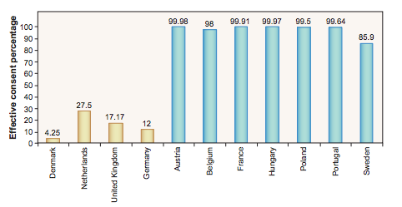
Organ Donation
Opt-in
Opt-out
(Johnson & Goldstein,2003)

Slide 27
References
Allport, G. W., Clark, K., & Pettigrew, T. (1954). The nature of prejudice. MA: Addison-Wesley
Bourgeois-Gironde, S., & Van Der Henst, J.-B. (2009). How to open the door to System 2: Debiasing the bat-and-ball problem. In S. Watanabe, A. P. Blaisdell, L. Huber, & A. Young (Eds.), Rational animals, irrational humans (pp. 235–252). Keio University.
Bowers, C. A., Pharmer, J. A., & Salas, E. (2000). When member homogeneity is needed in work teams: A meta-analysis. Small group research, 31(3), 305-327.
Correll, J., Park, B., Judd, C. M., & Wittenbrink, B. (2007). The influence of stereotypes on decisions to shoot. European Journal of Social Psychology, 37(6), 1102-1117.
Fiske, S. T. (1993). Controlling other people: The impact of power on stereotyping. American psychologist, 48(6), 621.

Slide 28
References
Harrison, D. A., Price, K. H., & Bell, M. P. (1998). Beyond relational demography: Time and the effects of surface-and deep-level diversity on work group cohesion. Academy of management journal, 41(1), 96-107.
Johnson, E. J., & Goldstein, D. (2003). Do defaults save lives?. Science, 302(5649), 1338-1339.
Kahneman, D., & Tversky, A. (1972). Subjective probability: A judgment of representativeness. Cognitive psychology, 3(3), 430-454.
Phillips, K. W., & Loyd, D. L. (2006). When surface and deep-level diversity collide: The effects on dissenting group members. Organizational behavior and human decision processes, 99(2), 143-160.
Rosenthal, R., & Jacobson, L. (1968). Pygmalion in the classroom. The urban review, 3(1), 16-20.

Slide 29
References
Simon, H. A. (1956). Rational choice and the structure of the environment. Psychological review, 63(2), 129.
Simon, H. A. (1979). Rational decision making in business organizations. The American economic review, 69(4), 493-513.
Stanovich, K. E., & West, R. F. (2000). Individual differences in reasoning: Implications for the rationality debate?. Behavioral and brain sciences, 23(5), 645-665.
Thaler, R. H., & Sunstein, C. R. (2009). Nudge: Improving decisions about health, wealth, and happiness. Penguin.

Slide 30
References
Tversky, A., & Kahneman, D. (1981). The framing of decisions and the psychology of choice. science, 211(4481), 453-458.
Tversky, A., & Kahneman, D. (1991). Loss aversion in riskless choice: A reference- dependent model. The quarterly journal of economics, 106(4), 1039-1061.
Van Dijk, H., Van Engen, M. L., & Van Knippenberg, D. (2012). Defying conventional wisdom: A meta-analytical examination of the differences between demographic and job-related diversity relationships with performance. Organizational Behavior and Human Decision Processes, 119(1), 38-53.
Wittenbrink, B., Judd, C. M., & Park, B. (2001). Spontaneous prejudice in context: Variability in automatically activated attitudes. Journal of personality and social psychology, 81(5), 815.

Slide 31
END

Slide 32
Question 4. Overconfidence
TIP: look at it from both perspectives.
Did your answers encompass the quantities below?
Correct Answer
73 | Rank of Kia Motors on the Financial Times 2014 Global 500 list
491 | Rank of the McDonald's corporation on the Financial Times 2014 Global 500 list
4.1 billion | Market value of BlackBerry Limited as of February 2016 (in USD)
80 million | Number of grandparents in the United States as of May 2010, according to the 2010 US Census Bureau Report
1.36 billion | The current population of India.
TIP: actively question yourself and seek objective feedback.
Notes:
Most people only get 2 or 3 right.
Overconfidence is unjustified confidence (no basis in objective fact or circumstance).

Slide 33
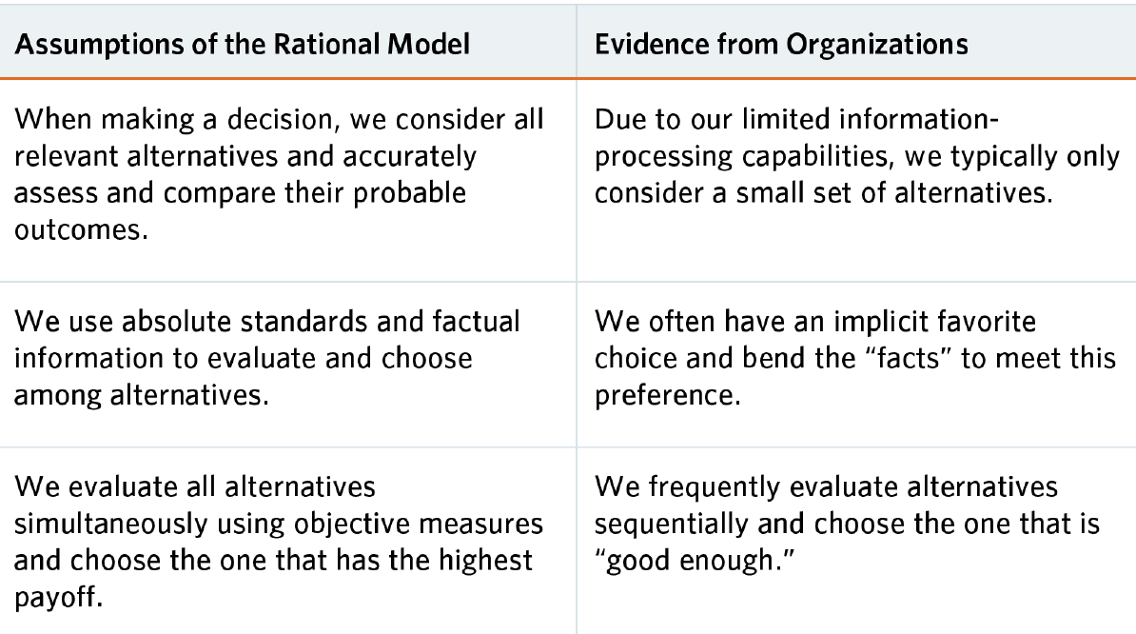
How we should behave vs. how we do behave
Bounded rationality (Simon, 1956)
Cognitive bias and heuristics (Tversky & Kahneman, 1972)
Satisficing (Simon,1979)
Notes:
Rational actor model
Historically the approach is the rational actor model, people take into account all relevant alternatives, they are accurate assessors, and that they make decisions in their own best interests and choose the best possible option.
In the 1950’s Bounded rationality (Herbert Simon, 1956). We are capable of rationality but there are limits to our capacity for rationality because we don’t have infinte processing power. If we were a computer, we would have limited RAM.
In the 1970s Amos Tversky and Daniel Kahneman started working on deviations from rationality as they saw them. They came up with the idea that people rely on intuition, gut feelings, rather than deliberating through every decision. They identified a number of systematic ways in which our gut leads us to deviate from strict rationality. These gut feelings come from our monkey brain- and chimpanzees have even shown some of the same biases in decision making that we do. For example, when you chimpanzees money, they show loss aversion- which we’ll discuss in a couple of minutes. Implicit preferences that we may not be aware of. They later won a Nobel Prize for this work.
We often survey alternatives sequentially, and often are aiming for good enough rather the absolute best answer.
System 1 and System 2 (Stanovich & West, 2000)
Satisficing (Herbert)
Heuristics
Biases
Simon, H. A. (1979). Rational decision making in business organizations. The American economic review, 69(4), 493-513.

