Slide 1
Adversarial Training of CNN for Aerial Imagery Object Detection
By: Luke Unterman, Jannat Lnu, Jimmy Le, My Nguyen

Slide 2
Introduction and Background
Deep Neural Networks (DNNs) have become the de facto standard for object detection in aerial imagery
Multiple levels of nonlinear operations for progressive feature learning
Excellent performance on computer vision, NLP, and audio processing tasks
DNNs are vulnerable to adversarial attacks that alter input images
Ex: FGSM caused GoogleNet CNN to misclassify a panda as a gibbon with 99.3% confidence
Vulnerability poses serious threats to military and intelligence applications
Affects UAV and satellite imagery used to identify military land vehicles
Our focus: Enhancing YOLOv11n object detection model’s robustness against adversarial attacks
Architecture selected for its speed and accuracy

Slide 3
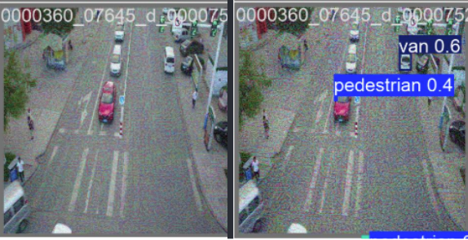
Visual Example of Adversarial Attacks
Left: Original image with clear objects (cars, pedestrians)
Right: C&W attack causing misclassification of red car as pedestrian
Key Insight:
Imperceptible perturbations to human eyes can completely fool state-of-the-art object detectors
Figure 5. Left: Adversarial image generated by FGSM. Right: Adversarial image generated by modified C&W algorithm.

Slide 4
Problem Statement
DNNs for aerial imagery are susceptible to adversarial attacks that:
Alter images using optimized noise patterns
Exploit intrinsic “blind spots” in trained NNs
These attacks cause object detection models to make incorrect predictions:
Missing critical objects entirely (false negatives)
Detect non-existent objects (false positives)
Misclassifying objects (class error)
Critical security implications for:
Military intelligence gathering, autonomous surveillance systems, automated threat detection, and civilian UAV applications (autonomous driving, face recognition)
Need for robust models that maintain accuracy despite adversarial manipulations

Slide 5
Adversarial Attacks on DNNs:
Fast Gradient Sign Method vs. Carlini-Wagner Method
FGSM
C&W
Single gradient computation
Extemely fast computation
Highest performance degradation
More visible distortion
Easily implemented
Defense against FGSM generalizes to other attacks
Iterative optimization process
10x slower than FGSM
More sophisticated, targeted attack
Near-imperceptible perturbations
Complex implementation
Bypasses many defensive techniques including distillation

Slide 6
Proposed Solution
Objective: Develop robust object detection model for aerial imagery security applications
Approach:
Evaluate YOLOv11n model’s vulnerability to different adversarial attacks
Fine-tune the pre-trained model using adversarial examples from DNN attacks
Create a robust model that maintains high accuracy, improve resilience against adversarial inputs, generalizes well across multiple datasets
Compare performance metrics
Expected outcome: Minimized negative impacts of adversarial attacks while maintaining detection accuracy

Slide 7
Methodology & Implementation
Model Selection: YOLOv11n
Speed: Low processing time, critical for real-time aerial surveillance
Accuracy: Better balance of precision and recall than alternatives
Efficiency: Low compute requirements
Accessibility: Fully supported by Ultralytics AI platform (8.3.106)
Previous benchmarks shows YOLO models outperform Faster R-CNN and SSD on aerial datasets
FIne-tuning Process:
Pre-trained YOLOv11n model fine-tuned for 2 additional epochs
Hyperparameters:
Image size: 640x640
Batch size: 16
Learning rate: 0.01
Weight decay: 0.0005
IoU threshold for NMS: 0.7

Slide 8
Methodology
Adversarial Training Approach:
Generate adversarial examples using both FGSM and C&W methods
FGSM: Varying ε values (0.1, 0.2, 0.5, 0.4)
C&W: Modified implementation with α=1, β=1, c-2
Include adversarial examples in training dataset
Validate on both clean and adversarial examples
Create two specialized models: YOLO-FGSM and YOLO-CW
Hardware:
Windows 11, AMD Ryzen 5600x, NVIDIA RTX 3070, 32 GB RAM

Slide 9
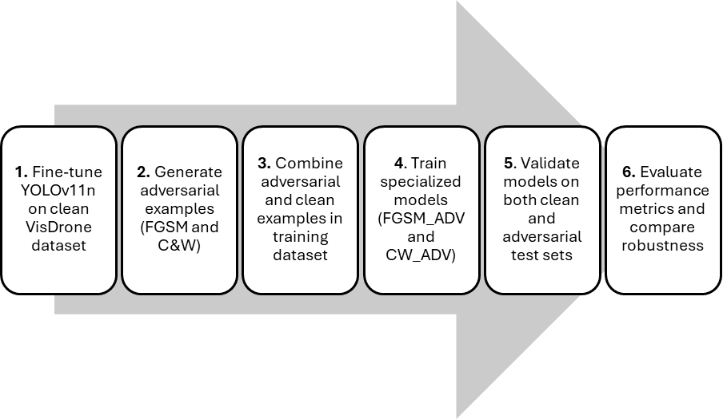
Training Workflow

Slide 10
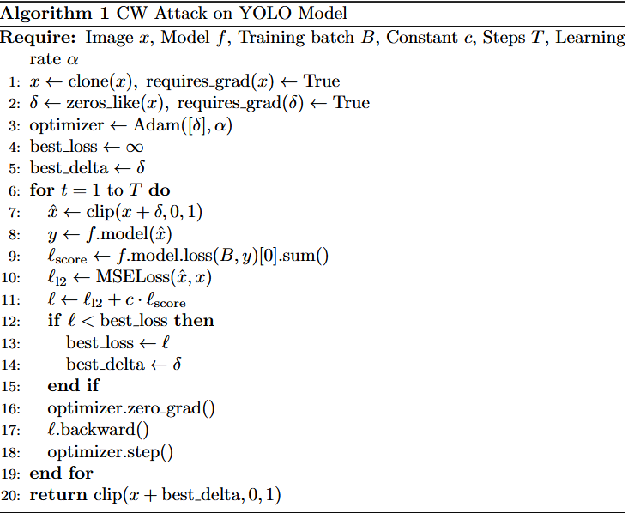
Modified C&W Attack Implementation
Key modifications:
Single parameter c instead of two separate parameters (α, β)
Untargeted approach instead of target misclassification
Optimized for object detection rather than classification
Our approach uses c as tradeoff between minimizing image distance and maximizing adversarial impact
Implementation reduces complexity while maintaining attack effectiveness

Slide 11
Datasets
Primary: *VisDrone-DET2019
Secondary: DOTA-v2.0
Distribution:
6,471 training images, 548 validation images, 3,190 testing images
Advantages:
Diverse, sufficient data volume, detailed annotations
Disadvantages:
Class imbalance, focus on Chinese environments, no object orientation
Distribution:
11,268 images with 1,793,658 object instances across 18 categories
Advantages:
Oriented bounding boxes annotations, broader categories
Disadvantages:
Higher-resolution increases computational requirements, bias to structured objects rather than vehicles

Slide 12
Metrics
Primary Metric:
Mean Average Precision (mAP) with IoU threshold of 0.5
Industry standard for object detection evaluation
Formula: mAP = (1/N) ∑ APᵢ
N is number of classes
AP combines precision and recall into single value
Intersection over Union (IoU)
Measures overlap between predicted and ground-truth bounding box
Formula: IoU = Area of Intersection / Area of Union
Threshold of 0.5 considered standard benchmark in aerial imagery detection
Why these metrics matter for aerial imagery:
Class imbalance is common in aerial datasets (many vehicles, few pedestrians)
Small objects require higher localization precision
Security applications need reliable confidence scores for decision-making

Slide 13
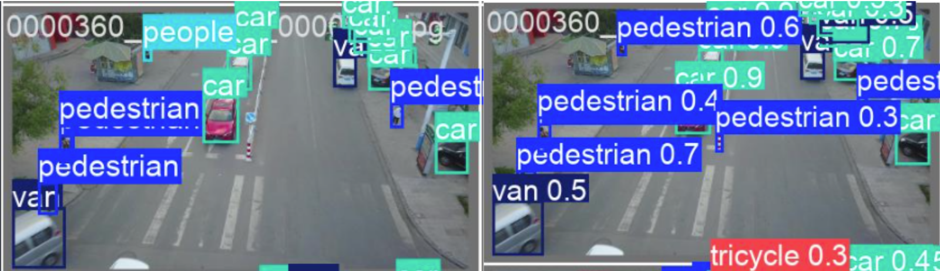
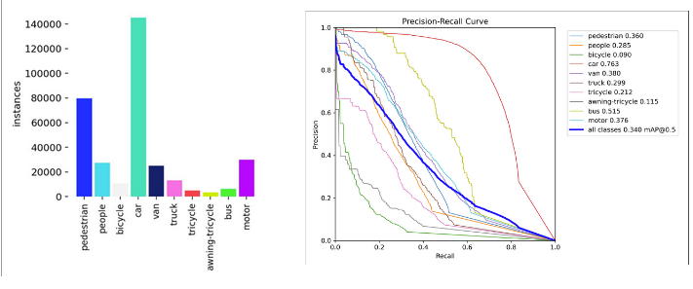
Results: Original Model Performance
YOLOv11n baseline performance on VisDrone:
mAP@0.5: 0.34
Objects with high AP scores:
Cars: 0.763
Bus: 0.515
Pedestrians: 0.360
Motors: 0.376
Strong performance on larger objects (cars, vans)
Lower performance on smaller objects (pedestrians, bicycles)
Figure 2. Left: Ground truth aerial image from validation set, annotated with labels. Right: Original fine-tuned model’s predictions for bounding box coordinates, class label, and confidence values.
Figure 3. Left: Class label distribution across all the objects in the VisDrone2019-DET training set. Right: Precision-Recall curve from original model’s predictions for each of the classes in the VisDrone dataset.

Slide 14
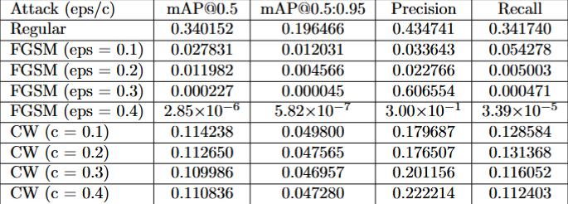
Results: Adversarial Attack Effects
FGSM Attack Performance Degradation:
ε=0.1: 91.8% mAP reduction
ε=0.2: 96.5% mAP reduction
ε=0.3: 99.9% mAP reduction
ε=0.4: >99.9% mAP reduction
C&W Attack Performance Degradation:
ε=0.1: 66.4% mAP reduction
ε=0.2: 66.9% mAP reduction
ε=0.3: 67.4% mAP reduction
ε=0.4: 67.4% mAP reduction
Example calculation for FGSM (ε=0.1):
Reduction % = (Original mAP - Attack mAP)/Original mAP × 100%
= (0.34015 - 0.027831)/0.34015 × 100%
= 0.312319/0.34015 × 100%
= 91.8%
Figure 4. Table detailing the mAP@0.5, mAP@0.5:0.95, precision, and recall values for the fine-tuned YOLO model on the regular, FGSM, and CW validation splits. Each adversarial attack was tested with a range of eps/c values, from [0.1, 0.4] with an increase of 0.1 for each step.

Slide 15
Effectiveness of Adversarial Training
Original model:
91.8% mAP reduction under FGSM (ε=0.1)
66.4% mAP reduction under C&W (c=0.1)
Adversarially trained models:
FGSM_ADV: Only 32.4% mAP reduction (59.4% improvement)
CW_ADV: Only 28.6% mAP reduction (37.8% improvement)
Clean image performance:
Original model mAP@0.5: 0.340
Adversarially trained model mAP@0.5: 0.328 (only 3.5% decrease)
Conclusion:
Adversarial training provides substantial robustness with minimal impact on clean image performance

Slide 16
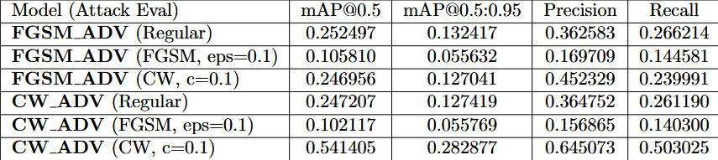
Cross-Attack Robustness Analysis
Performance comparison to original model:
Both models experience a drop in mAP@0.5 of approximately 0.09 on regular images
Cross-attack performance:
CW_ADV achieves mAP@0.5 score of ~0.028 when exposed to FGSM attacks (ε=0.1)
Both models achieve mAP@0.5 score of ~0.10 on C&W attacks (c=0.1)
Key insights:
Models fine-tuned with adversarial examples show robustness to the specific attack methods they were trained on
Limited transferability when exposed to other adversarial methods
CW_ADV's exceptionally high performance when exposed to C&W validation split (0.541 mAP@0.5) suggests potential overfitting
Table comparing the performance of two fine-tuned models, one trained on FGSM examples and the other trained on C&W examples, over three different validation splits.

Slide 17
Limitations & Challenges
Computational costs:
Adversarial training increases training time by 2.3x
C&W example generation is computationally expensive
Dataset limitations:
VisDrone class imbalance affects generalization
Chinese environments may not transfer to other regions
Attack coverage:
Limited to two attack methods (FGSM and C&W)
Modified C&W implementation not as effective as original
Black-box attacks not fully evaluated
Performance tradeoffs:
Small clean image performance degradation (3.5%)
Some adversarial examples still causes misclassifications
Real-world constraints:
Physical-world attacks not tested
Constrained to RGB imagery only

Slide 18
Conclusion
DNNs for aerial imagery object detection are highly vulnerable to adversarial attacks
FGSM can reduce performance with imperceptible changes
C&W attacks are slower but also highly effective at fooling models
Adversarial training significantly improves robustness:
Training on FGSM examples improves resilience to both FGSM and C&W attacks
Minimal performance loss on clean images
YOLOv11n with adversarial training provides a viable solution for security-critical applications
Balance of speed, accuracy, and adversarial robustness
Important for military, intelligence, and public safety applications
Future Work:
Test against additional attack methods
Explore ensemble approaches combining multiple defensive strategies
Evaluate on more diverse datasets

