Slide 1

Lombok

Slide 2
Features
@Getter and @Setter
@FieldNameConstants
@ToString
@EqualsAndHashCode
@AllArgsConstructor, @RequiredArgsConstructor and @NoArgsConstructor
@Log, @Log4j, @Log4j2, @Slf4j, @XSlf4j, @CommonsLog, @JBossLog, @Flogger, @CustomLog
@Data
@Builder
@SuperBuilder
@Singular
@Delegate
@Value
@Accessors
@Wither
@With
@SneakyThrows
@val
@var
experimental @var
@UtilityClass

Slide 3
Gebruik van Lombok

Slide 4
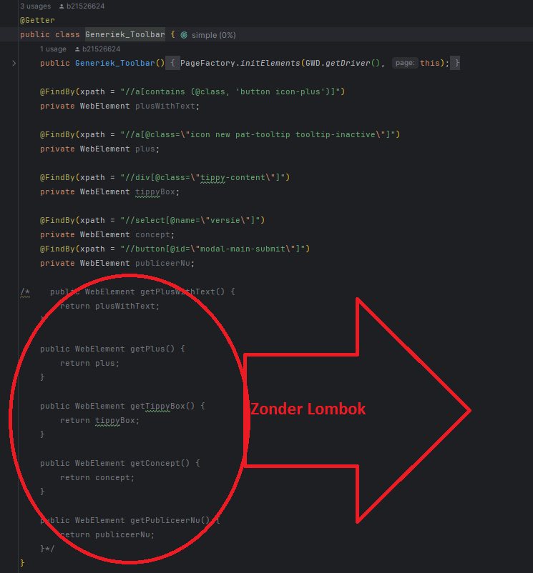

Slide 5
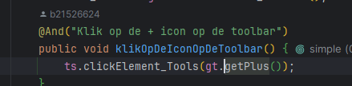
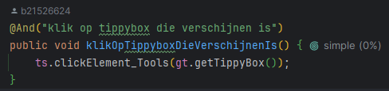
get...

