Slide 1

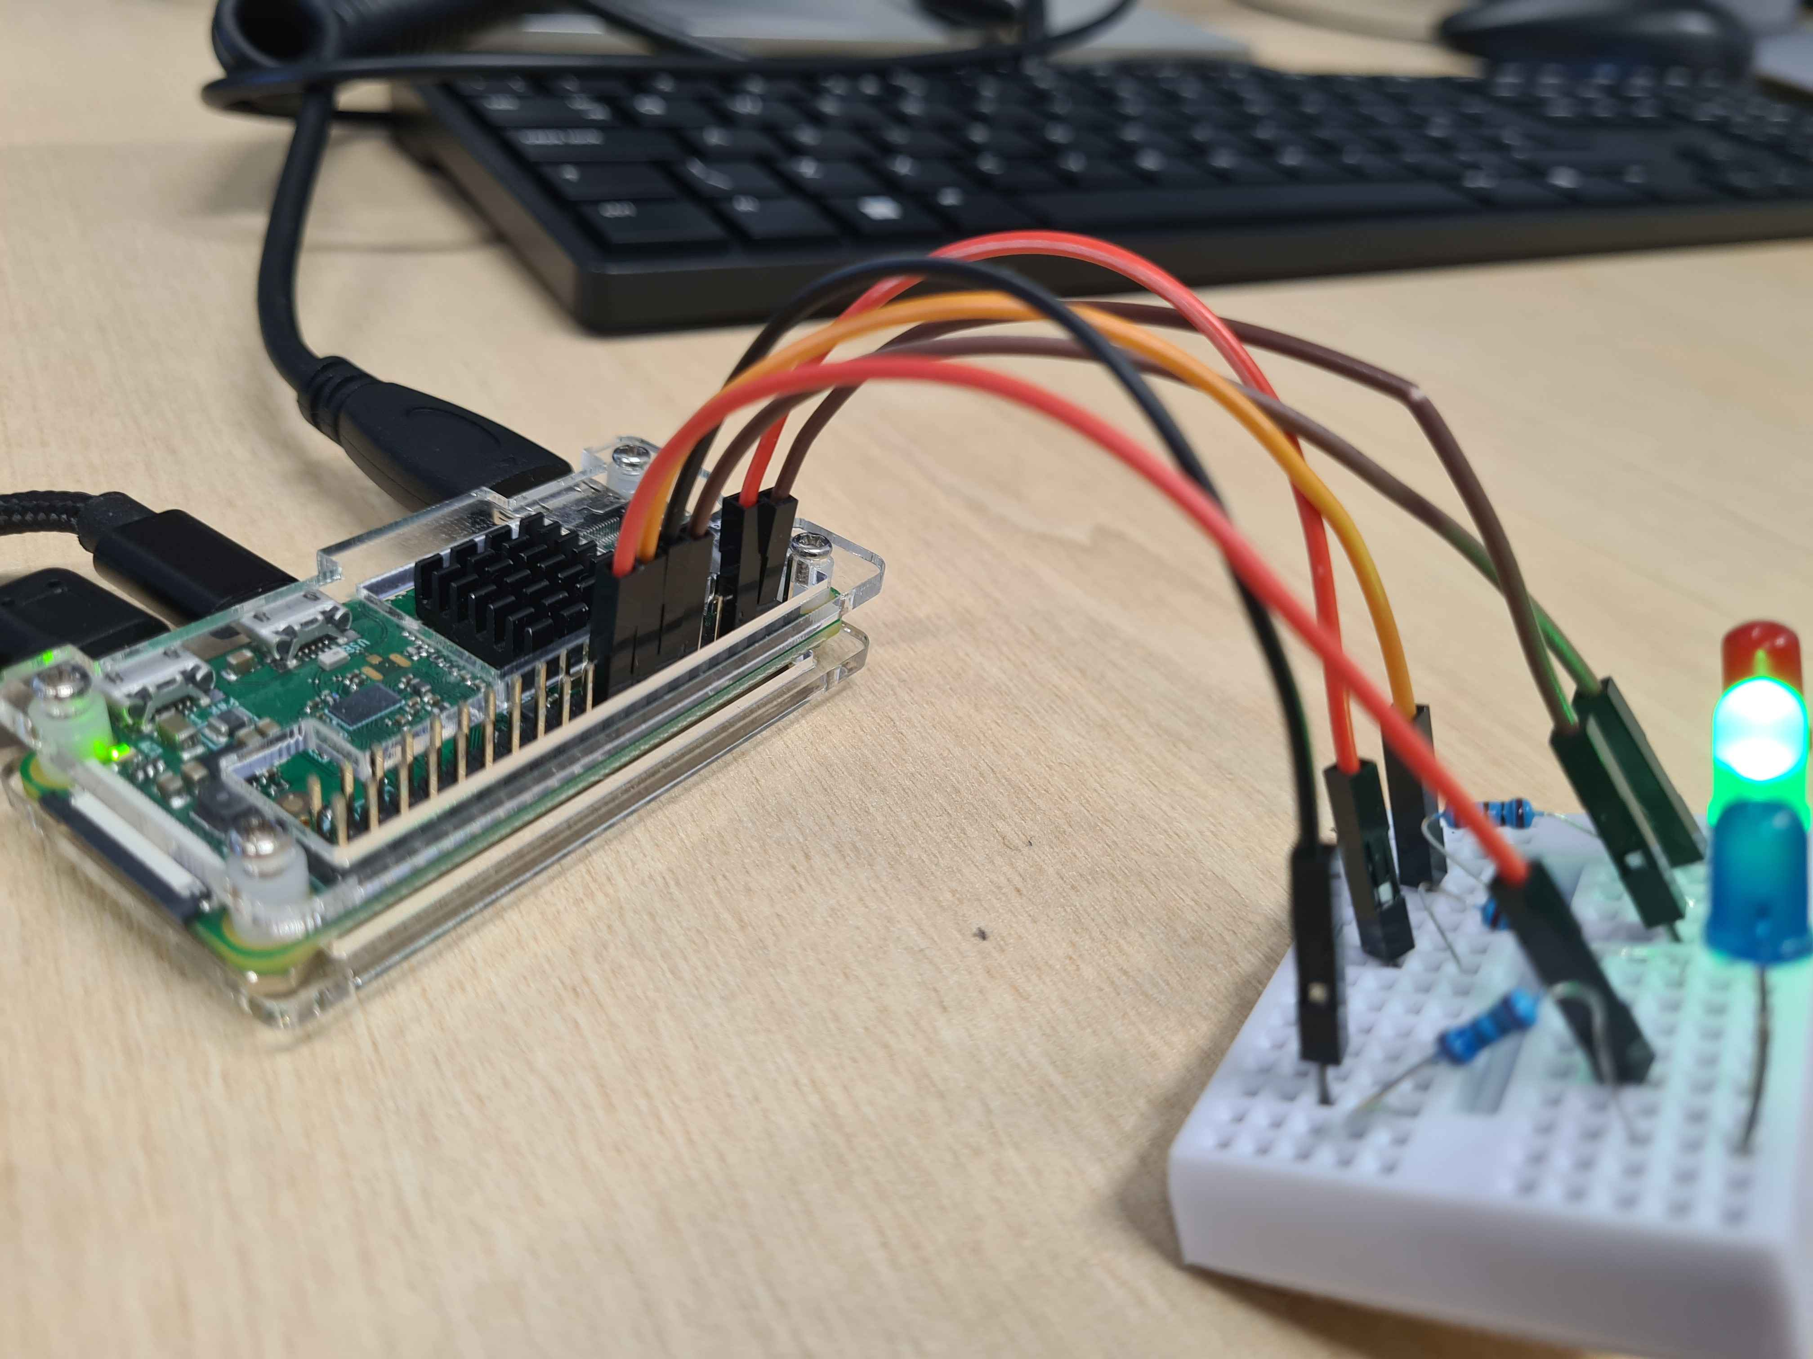

Rand LED flicker IoT to Cloud Project
Annie Place 2301241
CMP408
Introduction
Methodology
Project Highlights
Content
This project is a kernel based python script ran on a raspberry pi zero. This python script connects to a loadable kernel module that randomly flickers three LEDs attached to GPIO pins on the Pi pin board. The timings of these flickers are then saved into a DynamoDB table through lambda expressions that connect to a EC2 server.
Content:
Hardware development:
- The Raspberry Pi Zero provided had three LED devices attached to its GPIO pin board. The pins utilized were 24, 23, and 14 as well as three grounded pins as displayed below.
- The Pi was hard programmed to be permanently routed
to the local WiFi network utilized by the programmer.
Python development:
- Before Kernel construction, a simple python script
utilizing the GPIO python library was created that randomly
flickered the three LEDs on a off.
- This was later connected to the developed kernel
module.
LKM development:
- A kernel module that turns on each LED briefly and attaches three functions that the python script can utilize that turn on and off the LEDs was developed. These three functions, ioctl, open and release, are then utilized by an io controller library in python which allowed for the method to flicker the lights from the kernel module.
- A Makefile based off the work of Dr. Abdul Razaq was utilized to make the low level c program into a kernel module.
Cloud development:
- Within AWS, a DynamoDB table was constructed for the LED lights, which categories for the colour of the LED, the time that the light was flickered.
- A Lambda expression was implemented to connect the DynamoDB table to a developed EC2 server. This EC2 server was tunneled through the hosting laptop public IP address with which the Pi was able to communicate with.
- The python script called the unique AWS key to connect to the EC2 server and input the information into the DynamoDB table.
Through the combination of these IoT hardware components and kernel based infrastructure, the python script was able to communicate with the LEDs attached the Pis pinboard and transfer information about these devices to an AWS cloud server. Below is a screenshot of the testing output, showcasing the times of each light flick.
Future Work
In the future the tester would like to expand the amount of pins utilized and attach mp3-based synchronization between the pins and songs that could be played at the same time. This would allow for the lights to “dance” to different musical numbers.
References
Sinha, S. (2024) State of IoT 2024: Number of connected IoT devices growing 13% to 18.8 billion globally, IoT Analytics.

