Slide 1

Food waste,
made measurable.
PROJECT
Kai Commitment
Food Waste Impact
Calculator
Helping New Zealand food businesses understand and reduce food-waste impact by translating everyday waste data into clear environmental and financial results.
COMPSCI 399 · TEAM 16
502 Bad Gateway
Presenter: [Austin Sha]
Notes:
Hi everyone, we are Team 16. Our project is the Kai Commitment Food Waste Impact Calculator: a New Zealand-focused tool that translates everyday food-waste data into clear environmental and financial results.

Slide 2





KAI COMMITMENT · TEAM 16
02
Meet the team
Calculation engine
Database & API
Calculator UX
Stats & BA
Admin & Panel
Austin Sha
Ruoxuan Huang
Xiangsong Tian
Roub Li
Ziqi Zhong
Presenter: [All Team Member]
Notes:
Introduce the five existing team members shown on the slide. Keep this section brief so the pitch can move quickly into the problem.

Slide 3
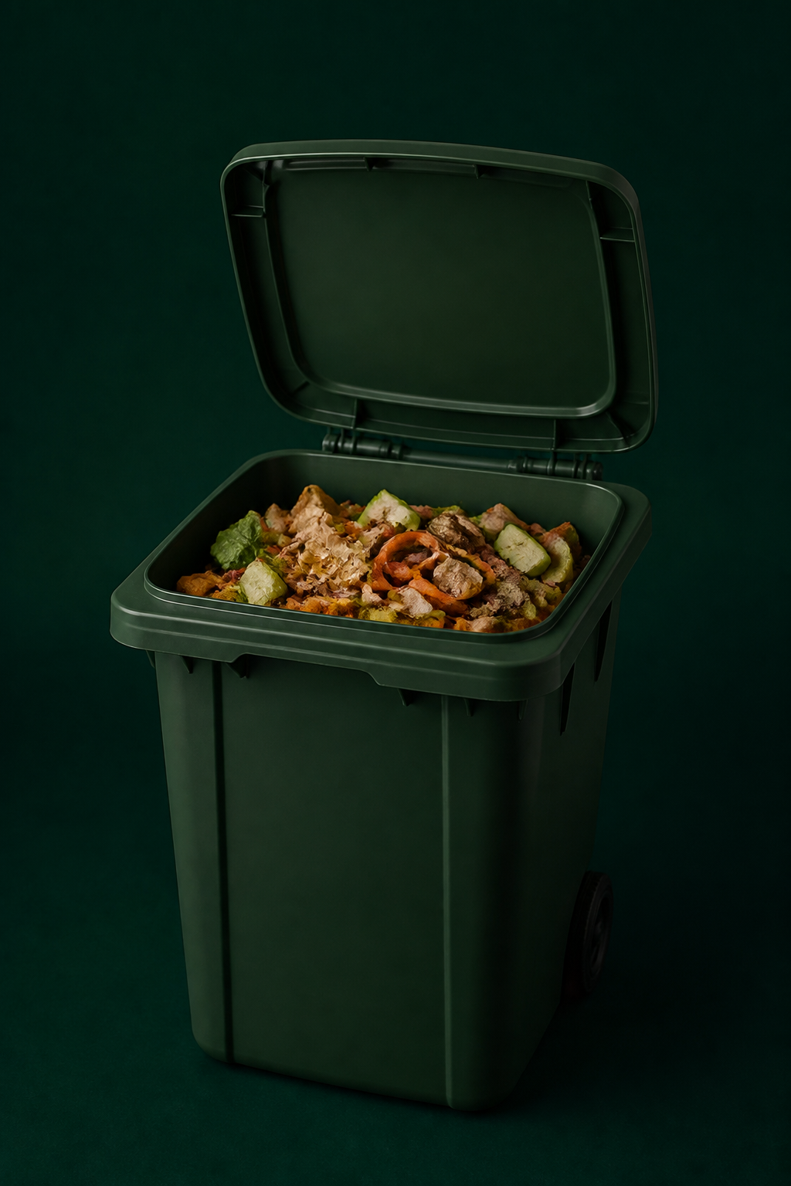
LOOK AGAIN
This is not just a bin.
INSIDE THE BIN
Money spent
It is also a receipt.
Water used
Carbon released
Meals never eaten
Most businesses see only one thing:
kilograms of waste.
TEAM 16 · 502 BAD GATEWAY
Presenter: [Austin Sha]
Notes:
What if this is not just a bin, but also a receipt? Inside it is money spent, water used, carbon released, and meals that will never be eaten. Most businesses still see only kilograms of waste.
[Sources]
- AI-generated supporting visual; no external factual claim.

Slide 4
KAI COMMITMENT · TEAM 16
04
Without the right tool, 100 kilograms is just a number
The weight is visible. The consequences — and the next action — are not.
100
How much money?
How much water?
kg
Impact unknown
Impact unknown
What emissions?
Compost or landfill?
Measured
Impact unknown
Better choice unknown
Around one-third of food produced globally is lost or wasted.
Source: FAO — Global Food Losses and Food Waste
Presenter: [Austin Sha]
Notes:
A restaurant manager can record 100 kilograms of food waste, but the number alone does not answer four practical questions: how much money, how much water, what emissions, and whether composting or landfill is the better choice.
[Sources]
- https://www.fao.org/platforms/green-agriculture/areas-of-work/consumption-food-loss-and-waste/en

Slide 5
KAI COMMITMENT · TEAM 16
05
Existing tools prove the idea — but not the NZ fit
ReFED demonstrates what impact calculators can achieve, but it is not designed for Kai Commitment’s New Zealand context and calculation requirements.
EXISTING APPROACH
THE GAP → OUR OPPORTUNITY
ReFED and other impact calculators demonstrate that everyday waste data can be translated into impact.
New Zealand food system
Relevant waste destinations
Approved or local impact factors
Proof of value
A New Zealand-focused calculator for Kai Commitment — including local costs where applicable.
Presenter: [Ruoxuan Huang]
Notes:
Existing tools such as ReFED show what impact calculators can achieve. The opportunity is to build for Kai Commitment’s New Zealand context: relevant food categories, waste destinations, approved impact factors, and local costs where applicable.
[Sources]
- https://insights-engine.refed.org/impact-calculator

Slide 6
KAI COMMITMENT · TEAM 16
06
From everyday waste data to meaningful impact
EVERYDAY WASTE DATA → KAI COMMITMENT CALCULATOR → MEANINGFUL RESULTS
1
Where
2
What
3
How much
Supply-chain stage
Food type
kg or tonnes
4
Where to
5
Review
6
Results
Waste destination
Add or edit entries
Break down + download
Multiple entries · review and edit · breakdown by stage, food type and destination
Presenter: [Ruoxuan Huang]
Notes:
The current prototype guides a business through six clear steps: where the waste occurred, what food it was, how much, where it went, review, and results. This keeps the journey understandable without exposing technical architecture.

Slide 7
KAI COMMITMENT · TEAM 16
06
Step 1 — Choose the supply-chain stage
WHERE DID THE FOOD WASTE OCCUR?
2
What
3
How much
Where
1
Food type
kg or tonnes
Supply-chain stage
4
5
Review
6
Results
Choose the stage that best describes where the waste was generated.
Add or edit entries
Break down + download
Presenter: [Ruoxuan Huang]
Notes:
The current prototype guides a business through six clear steps: where the waste occurred, what food it was, how much, where it went, review, and results. This keeps the journey understandable without exposing technical architecture.

Slide 8
KAI COMMITMENT · TEAM 16
07
Step 2 — Select the food type
WHAT TYPE OF FOOD WASTE ARE YOU MEASURING?
3
How much
What
2
Supply-chain stage
kg or tonnes
Food type
4
5
Review
6
Results
Add or edit entries
Break down + download
Select a category if it is known, or use the general food-waste option.
Presenter: [Ruoxuan Huang]
Notes:
The current prototype guides a business through six clear steps: where the waste occurred, what food it was, how much, where it went, review, and results. This keeps the journey understandable without exposing technical architecture.

Slide 9
KAI COMMITMENT · TEAM 16
08
Step 3 — Enter the waste amount
HOW MUCH FOOD WASTE ARE YOU MEASURING?
2
What
3
How much
Food type
kg or tonnes
5
Review
6
Results
Enter the measured total and choose kilograms or tonnes.
Add or edit entries
Break down + download
Presenter: [Ruoxuan Huang]
Notes:
The current prototype guides a business through six clear steps: where the waste occurred, what food it was, how much, where it went, review, and results. This keeps the journey understandable without exposing technical architecture.

Slide 10
KAI COMMITMENT · TEAM 16
09
Step 4 — Allocate the destinations
WHERE DID THE FOOD WASTE GO?
2
What
3
How much
4
Where to
Food type
kg or tonnes
Waste destination
5
Review
6
Results
Allocate the total across landfill, composting and other destinations.
Add or edit entries
Break down + download
Presenter: [Ruoxuan Huang]
Notes:
The current prototype guides a business through six clear steps: where the waste occurred, what food it was, how much, where it went, review, and results. This keeps the journey understandable without exposing technical architecture.

Slide 11
KAI COMMITMENT · TEAM 16
10
Step 5 — Review the information
CHECK EVERY ENTRY BEFORE CALCULATING
2
What
3
How much
5
Review
Food type
kg or tonnes
Add or edit entries
4
6
Results
Review the entry, make edits, or add another supply-chain entry.
Break down + download
Presenter: [Ruoxuan Huang]
Notes:
The current prototype guides a business through six clear steps: where the waste occurred, what food it was, how much, where it went, review, and results. This keeps the journey understandable without exposing technical architecture.

Slide 12
KAI COMMITMENT · TEAM 16
11
Step 6 — Understand the results
TURN WASTE DATA INTO CLEAR IMPACT
2
What
3
How much
6
Results
Food type
kg or tonnes
Break down + download
5
Review
See environmental and financial estimates, breakdowns and downloadable results.
Add or edit entries
Presenter: [Ruoxuan Huang]
Notes:
The current prototype guides a business through six clear steps: where the waste occurred, what food it was, how much, where it went, review, and results. This keeps the journey understandable without exposing technical architecture.

Slide 13
KAI COMMITMENT · TEAM 16
13
Meaningful results
VERIFIED FACTORS → UNDERSTANDABLE IMPACT
Carbon
Water
Financial cost
Wasted food
→
km driven
→
showers
→
NZD
→
meal equivalents
Evidence before claims
Current values remain demonstration placeholders until Kai Commitment approves the factors. Factors can be updated as science and costs change.
Presenter: [Xiangsong Tian]
Notes:
The aim is to connect scientific measures to understandable equivalents: carbon to kilometres driven, water to showers, cost to New Zealand dollars, and wasted food to meal equivalents. Evidence comes before claims, and factors remain updateable as science and costs change.

Slide 14
KAI COMMITMENT · TEAM 16
14
Why it matters
The calculator turns food-waste data into information that supports better decisions.
FOR FOOD BUSINESSES
FOR KAI COMMITMENT
• Understand impact
• Compare disposal choices
• Identify waste hotspots
• Track improvement
• Reduce avoidable costs
• Maintain approved impact factors
• Support consistent impact reporting
• Understand broader waste patterns
• Keep the calculator useful as evidence and costs change
Better information can support better food-waste decisions.
Presenter: [Xiangsong Tian]
Notes:
For food businesses, the calculator can help reveal impact, compare choices, identify hotspots, track improvement, and reduce avoidable costs. For Kai Commitment, it can support consistent factors and reporting while revealing broader waste patterns.

Slide 15
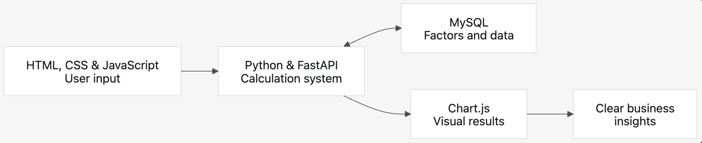
KAI COMMITMENT · TEAM 16
12
How the calculator turns input into insight
USER INPUT → CALCULATION ENGINE → FACTORS & DATA → VISUAL RESULTS
A clear front end is supported by a maintainable calculation pipeline — from user input to business insight.
Presenter: [Roub Li]
Notes:
Explain the implementation at a high level: the browser collects user input, FastAPI runs the calculation, MySQL supplies factors and data, and Chart.js presents clear results.
[Sources]
- User-provided Team 16 technical architecture diagram.

Slide 16
TEAM FIT · WORKING PROTOTYPE · CALCULATION, DATA & UX SKILLS
We are not simply building
another calculator.
We are giving food waste a voice.
When businesses can finally see what is inside the bin, they can make better decisions about what happens before food reaches it.
TEAM 16 · 502 BAD GATEWAY
Presenter: [Roub Li & Ziqi Zhong]
Notes:
Our working prototype and complementary skills connect reliable calculations behind the scenes with an interface that food businesses can understand and use. We are not simply building another calculator. We are giving food waste a voice. When businesses can finally see what is inside the bin, they can make better decisions about what happens before food reaches it.

