Slide 1

QUIC performance
QUIC and Satellite
Open Stakeholder Meeting
Lorena Albiol, Indra Sistemas, lalbiol@indra.es
04/11/2020

Slide 2
Performance Evaluation Test bed – Fixed BW (1)
Downloaded file
100kB
1MB
2MB
10MB
100MB
SATELLITE
GROUND
TCP client (curl)
QUIC client
TCP server (Apache)
QUIC server
Fixed BW
RTT = 650 ms
PEP
(satellite side)
Satellite network
emulator (AINE)
PEP
(ground-side)
2M (RTN)
10M (FWD)

Slide 3
Performance Evaluation Test bed – BoD (1)
Downloaded file
100kB
1MB
2MB
10MB
100MB
SATELLITE
GROUND
TCP client (curl)
QUIC client
RTN link with
Bandwidth On Demand
20k CRA, 2M VBDC
TCP server (Apache)
QUIC server
Terr Delay Emul
(10 ms)
Average RTT = 625 ms
PEP
(satellite side)
Satellite network
emulator (AINE)
PEP
(ground-side)
2M (RTN)
10M (FWD)

Slide 4
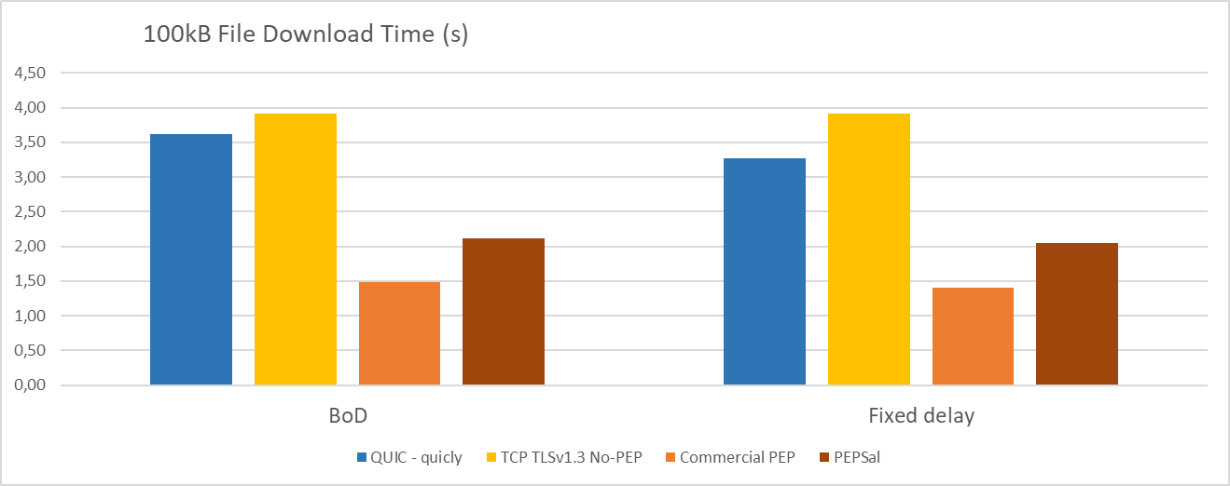
QUIC Performance with a short file transfer
Effects of connection set-up and initial congestion window
QUIC
TCP
TCP & PEPs
quicly, March 2020, IETF draft-27
https://github.com/uoaerg/quicly

Slide 5
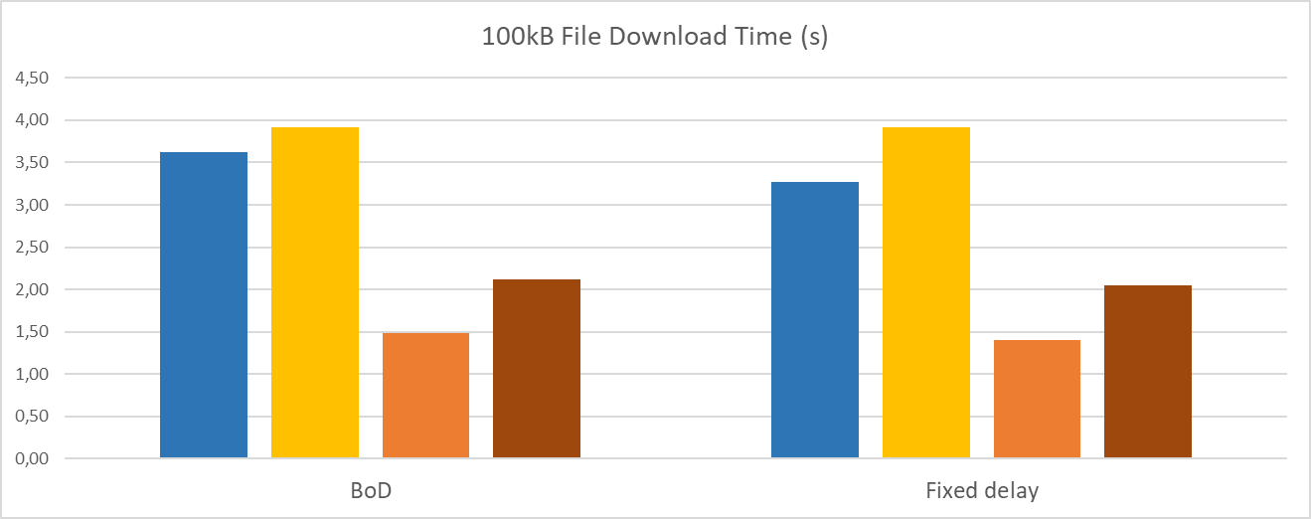
QUIC Performance with a short file transfer
QUIC supports 1-RTT connection set-up
But initial QUIC packet is larger. This is noticeable with BoD.
QUIC
TCP
QUIC
TCP
QUIC/quicly performance similar to TCP NewReno with TLSv1.3
quicly, March 2020, IETF draft-27
https://github.com/uoaerg/quicly

Slide 6
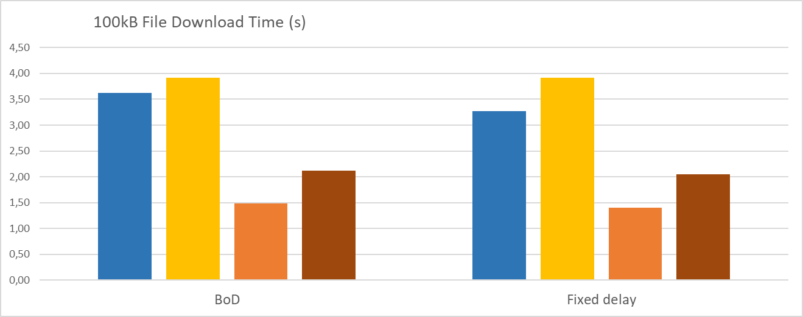
QUIC Performance with a short file transfer
Much better performance with PEPs (Fast Start, high IW).
TCP
QUIC
TCP & PEPs
TCP & PEPs
quicly, March 2020, IETF draft-27
https://github.com/uoaerg/quicly

Slide 7
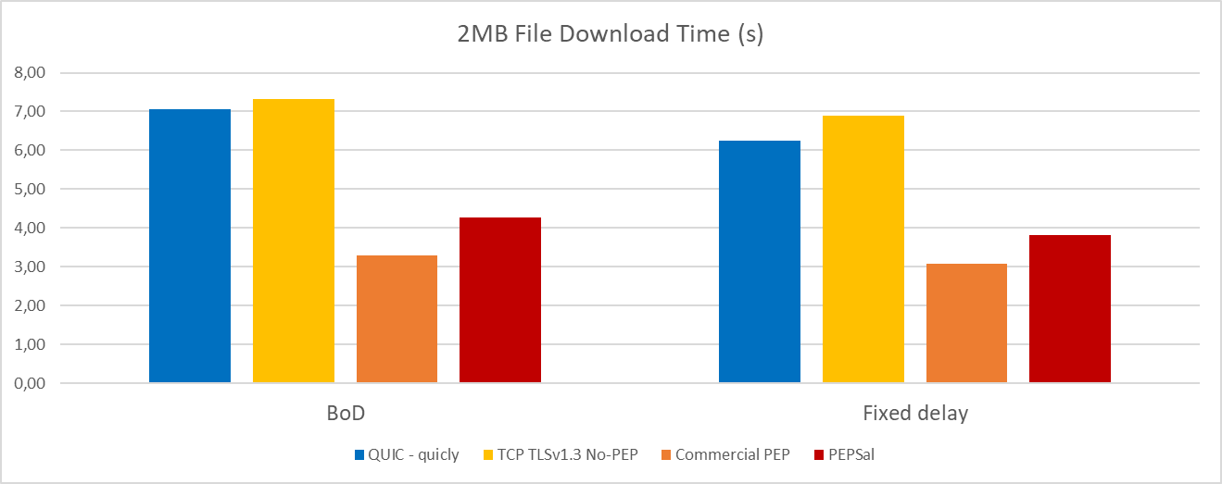
QUIC Performance with a medium file transfer
Performance with PEPs is still much better
QUIC
TCP
TCP & PEPs
quicly, March 2020, IETF draft-27
https://github.com/uoaerg/quicly

Slide 8
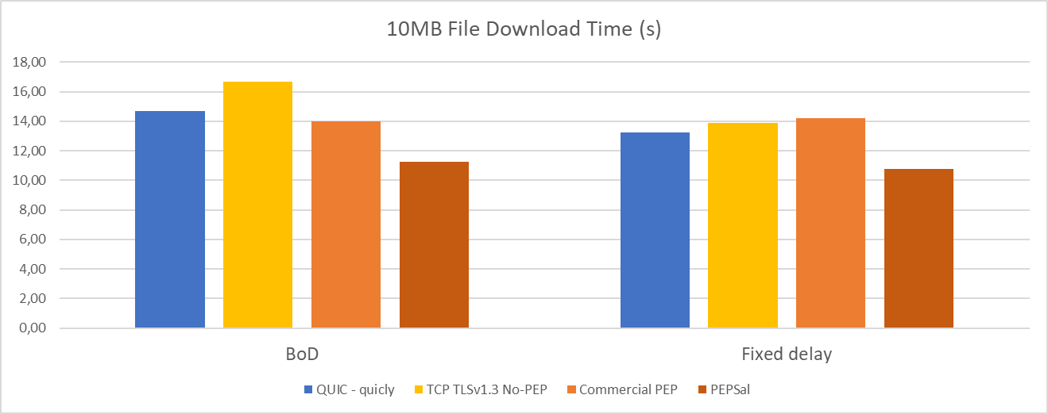
QUIC Performance with a long file transfer
Performance differences with /without PEPs become less relevant.
Data rate becomes main performance driver.
quicly, March 2020, IETF draft-27
https://github.com/uoaerg/quicly

Slide 9
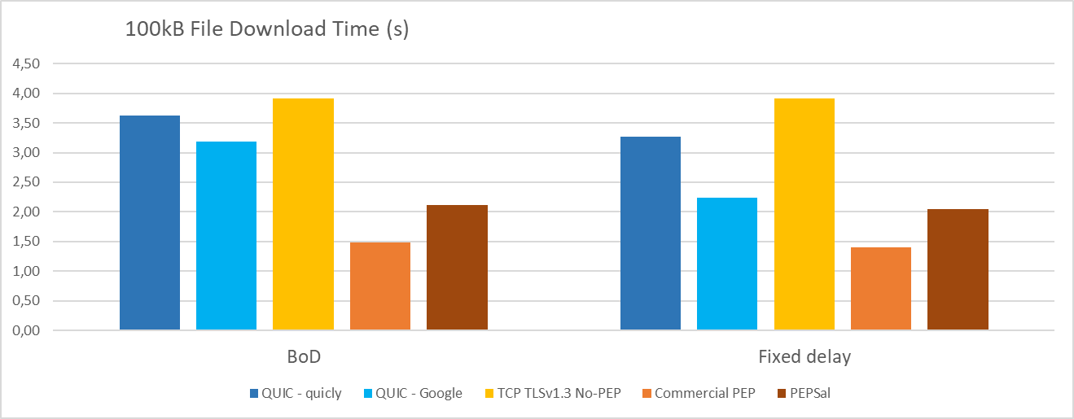
Performance tests with Chromium IETF QUIC
Better performance of Chromium QUIC
IW = 32 instead of IW = 10
QUIC - Chromium
QUIC - quicly
QUIC - quicly
QUIC - Chromium
Chromium QUIC, IETF draft-29, retrieved 3/06/2020 (https://www.chromium.org/quic/playing-with-quic)

Slide 10
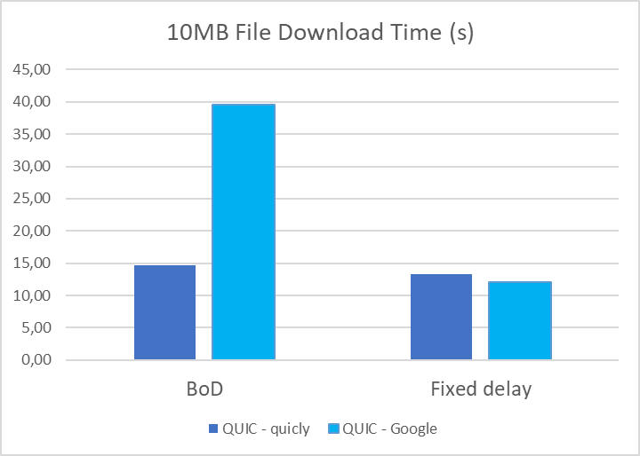
Performance tests with Chromium IETF QUIC
Performance problems of Chromium QUIC implementation with BoD
Hybrid Fast Start feature
Does not work well with more variable RTT of BoD scenario
Premature entry into congestion avoidance
QUIC - Chromium
QUIC - quicly
Chromium QUIC, IETF draft-29, retrieved 3/06/2020 (https://www.chromium.org/quic/playing-with-quic)

Slide 11
Performance Evaluation Test bed – Fixed BW (2)
Downloaded file
100kB
1MB
2MB
10MB
100MB
SATELLITE
GROUND
TCP client (curl)
QUIC client
TCP server (Apache)
QUIC server
Fixed BW
RTT = 650 ms
PEP
(satellite side)
Satellite network
emulator (AINE)
PEP
(ground-side)
10M (RTN)
50M (FWD)

Slide 12
Performance Evaluation Test bed – BoD (2)
Downloaded file
100kB
1MB
2MB
10MB
100MB
SATELLITE
GROUND
TCP client (curl)
QUIC client
RTN link with
Bandwidth On Demand
20k CRA, 10M VBDC
TCP server (Apache)
QUIC server
Terr Delay Emul
(10 ms)
Average RTT = 625 ms
PEP
(satellite side)
Satellite network
emulator (AINE)
PEP
(ground-side)
10M (RTN)
50M (FWD)

Slide 13
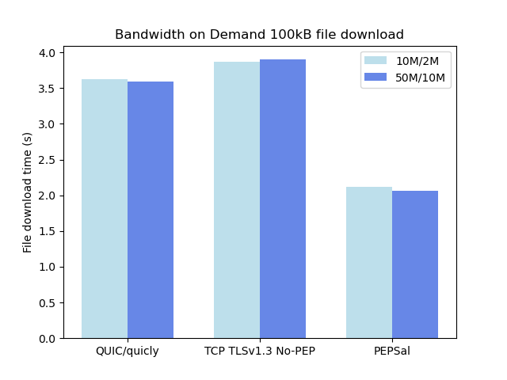
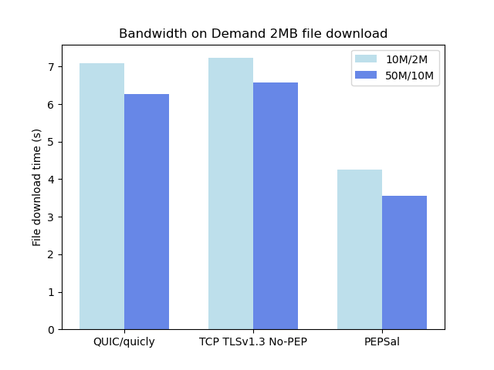
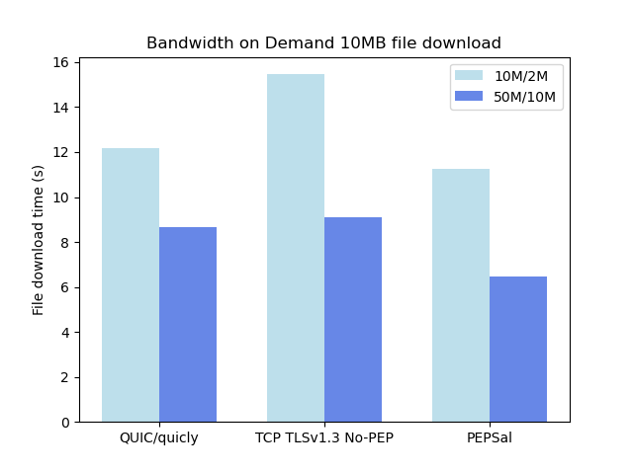
QUIC Performance – 50M/10M scenario
Similar considerations as for the Small scenario
Flow control disabled (QUIC) or tuned parameters (TCP)
Effects of higher bandwidth become more relevant for ≥ 10MB

Slide 14
QUIC performance conclusions
QUIC performance similar to TCP / NewReno (with connection start-up improvements)
Scenarios with PEPs provide much better performance for short to medium file sizes
Typical of web browsing
Non-standard QUIC congestion control features may need to be tuned for satellite (Hybrid Fast Start)
QUIC provides increased flexibility to optimize congestion control
May be dangerous for scenarios that are not the main target
Impact of QUIC flow control on performance >> for further study

