Slide 1

QUIC and Satellite Open Stakeholder Meeting
Accelerating Start-up
Nicolas KUHN
nicolas.kuhn@cnes.fr

Slide 2
Typical GEO satellite-based Internet access
QUIC and Satellite Open Stakeholder Meeting - Accelerating Start-up
Solution #1 : adapt the end-to-end protocols
Solution #2 : inform end point of the path characteristics
« Internet »
Satellite ISP Network
Satellite Access Network
Local Access Network
Data rate | High | High | Variable | Average
Latency | Low | Low | High | Low
Loss | No loss | Congestion losses | No loss | Loss if Wi-Fi

Slide 3
Solution #1 : adapt the end-to-end protocols
QUIC and Satellite Open Stakeholder Meeting - Accelerating Start-up
Utilised platform for tests
End-to-end path without split
QUIC SERVER
Delay / capacity limitation
Losses
QUIC CLIENT
picoquic/picoquic (h3-25/24/23)
or
h2o/quicly(h3-25)
picoquic/picoquic (h3-25/24/23)
or
curl/ngtcp2 (h3-25)
Multiple paths with split
IPERF3 SERVER
PEPSal
Delay / capacity limitation
PEPSal
Losses
IPERF3 CLIENT
Default
Kernel 4.15
Ubuntu 16.04
iperf3 v3.6
Default ; Kernel 4.4
Same configuration on both PEP client and PEP server
Default
Kernel 4.15
Ubuntu 16.04
iperf3 v3.6
 | TCP_WMEM_MAX (MB) | TCP_RMEM_MAX (MB) | CORE_WMEM_MAX CORE_RMEM_MAX (MB) | ICWND IRWND (packets)
NO PEP | 4 | 6 | 0,2 | 10
PEP A | 4 | 6 | 0,2 | 10
PEP B | 4 | 6 | 0,2 | 100
PEP C | 33 | 33 | 33 | 10
PEP D | 33 | 33 | 33 | 100

Slide 4
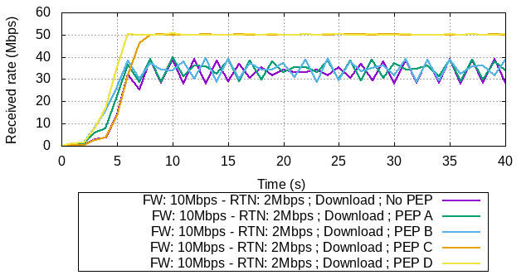
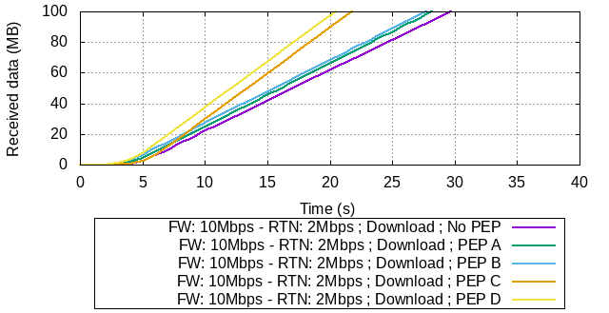
Solution #1 : adapt the end-to-end protocols
QUIC and Satellite Open Stakeholder Meeting - Accelerating Start-up
Focus on the 50 Mbps / 10 Mbps use-case
Multiple paths with split
With TCP-Proxy:
Capacity to reach channel capacity
Reduced transmission time
Proposed objectives :
2MB: 3 sec
10 MB: 5 sec
100MB: 20 sec

Slide 5
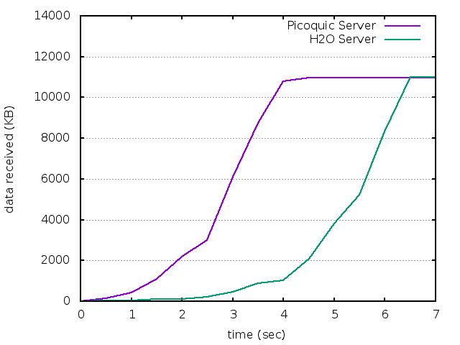
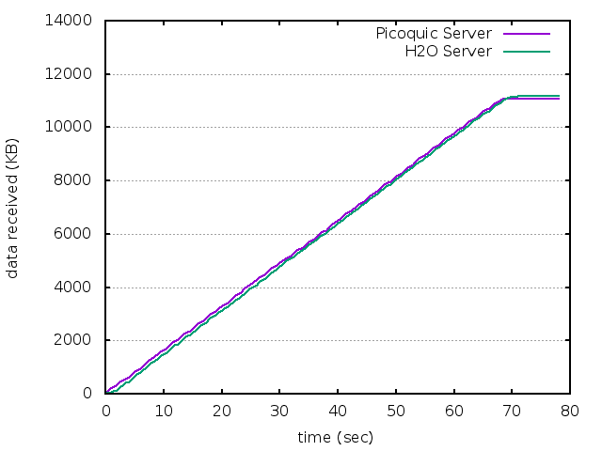
Solution #1 : adapt the end-to-end protocols
QUIC and Satellite Open Stakeholder Meeting - Accelerating Start-up
Focus on the 50 Mbps / 10 Mbps use-case
End-to-end path without split
PICO-QUIC CLIENT
CURL CLIENT
PICO-QUIC (Version v0.24d) client
PICO-QUIC server (Version v0.24d) : the objectives are met
H20 server (2.3.0-DEV@9f65c27) : the objectives are not met
CURL client (Version 7.69.0-DEV (x86_64-pc-linux-gnu) libcurl/7.69.0-DEV OpenSSL/1.1.1d zlib/1.2.8 brotli/1.0.4 ngtcp2/0.1.0-DEV nghttp3/0.1.0-DEV)(any server)
The objectives are not met

Slide 6
Solution #1 : adapt the end-to-end protocols
QUIC and Satellite Open Stakeholder Meeting - Accelerating Start-up
Designing a CC that is relevant for all deployment cases may not be relevant
Knowing about the path characteristics can help in adapting the CC in specific deployment scenarios
Tuning RTT_INIT
Tuning flow control parameters (MAX_STREAM_DATA)
Issue in CC convergence in SATCOM use cases

Slide 7
Solution #2 : inform end point of the path characteristics
QUIC and Satellite Open Stakeholder Meeting - Accelerating Start-up
The objective: inform end point of the path characteristics
Based on previous connections
During a connection:
Both peers measure BDP (rtt * bytes_in_flight)
The server sends to the client the information that has been measured
When reconnecting:
Client sends a 0-RTT token for faster connection establishment
The idea: add the information from previous BDP to the server
See draft-kuhn-quic-0rtt-bdp-07 for how it could be done in QUIC
There is also a strawman algorithm in the draft on how to safely jump to the available capacity
The results showed here :
No safe jump
The server uses directly previously measured BDP

Slide 8
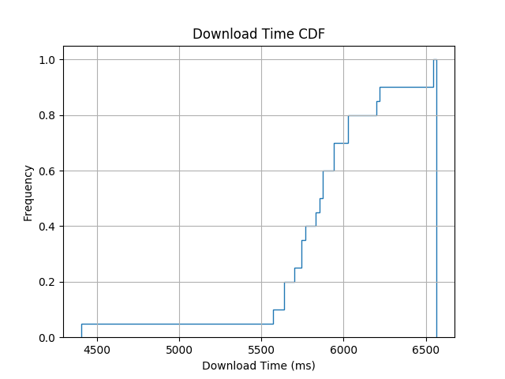
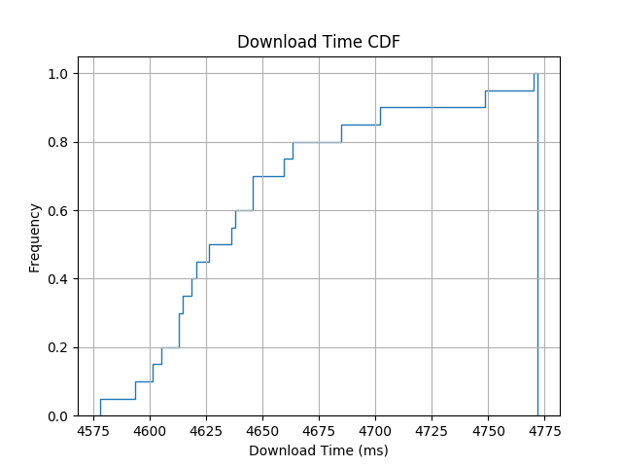
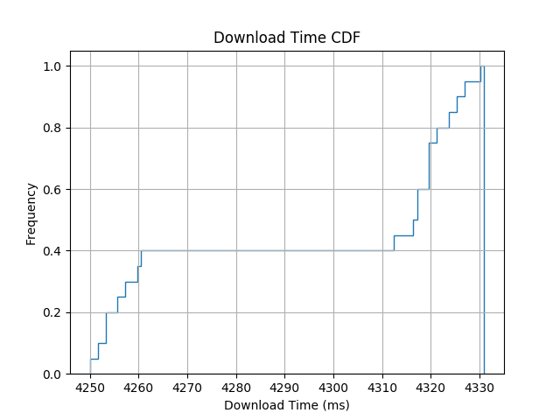
Solution #2 : inform end point of the path characteristics
QUIC and Satellite Open Stakeholder Meeting - Accelerating Start-up
Focus on the 50 Mbps / 10 Mbps use-case
Time needed to download 10 MB
End-to-end path without split
Cumulative Density Function
Cumulative Density Function
Cumulative Density Function
No 0-RTT
0-RTT
0-RTT-BDP

Slide 9
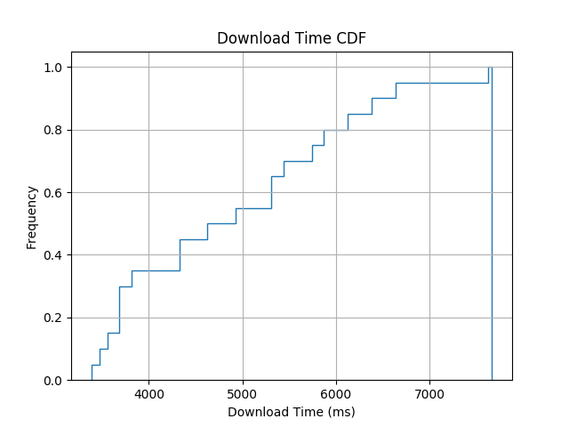
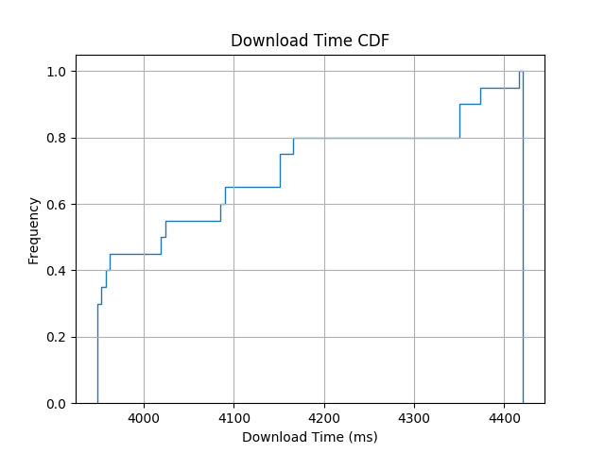
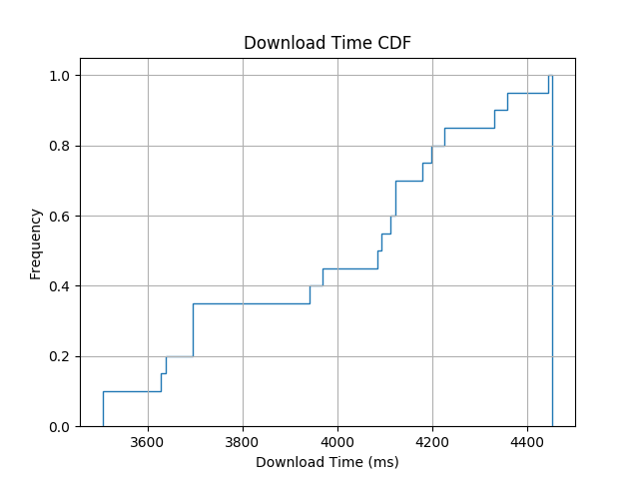
Solution #2 : inform end point of the path characteristics
QUIC and Satellite Open Stakeholder Meeting - Accelerating Start-up
Focus on the 250 Mbps / 3 Mbps use-case
Time needed to download 10 MB
End-to-end path without split
Cumulative Density Function
Cumulative Density Function
Cumulative Density Function
No 0-RTT
0-RTT
0-RTT-BDP

Slide 10
Summary
QUIC and Satellite Open Stakeholder Meeting - Accelerating Start-up
We are working at IETF on this
If you are interested, please join the ETOSAT list: https://www.ietf.org/mailman/listinfo/Etosat
Or discuss our drafts
draft-kuhn-quic-0rtt-bdp-07
draft-kuhn-quic-4-sat-06
On the median case
0-RTT-BDP improves by approx. 25% cases with no 0-RTT
0-RTT-BDP improves by approx. 10% cases with *just* 0-RTT
The CC has been simply modified
More specific optimization could be imagined
What is going on ?
What are the impacts of RRM mechanisms or various satellite-based (variable delay in mega constellation, etc.) or losses, etc on the end-to-end performance of QUIC ?
What are the performance of application level designs ? Do they need specific tuning or implementations ?

Slide 11
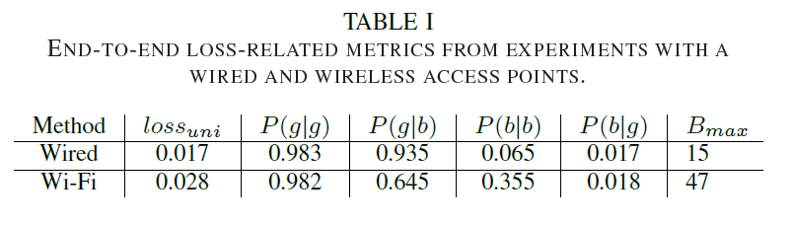
Appendix – impact of losses
QUIC and Satellite Open Stakeholder Meeting - Accelerating Start-up
ISAE server (picoquic)

Slide 12
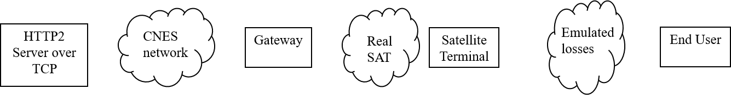
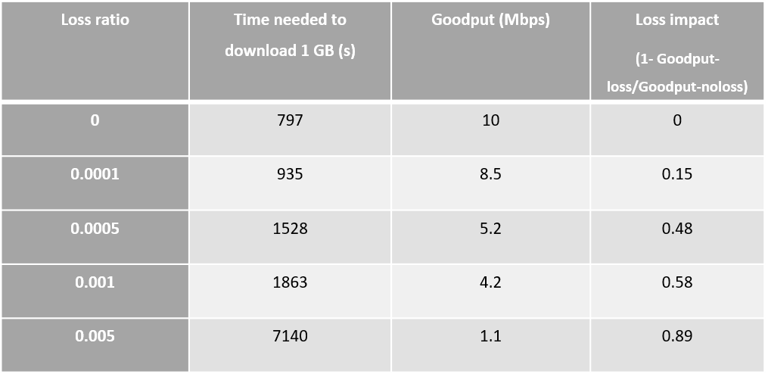
Appendix – impact of losses
QUIC and Satellite Open Stakeholder Meeting - Accelerating Start-up

Slide 13
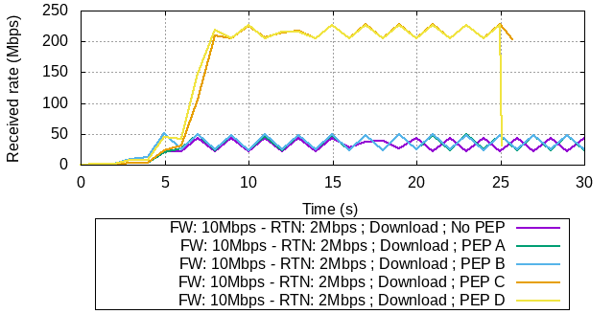
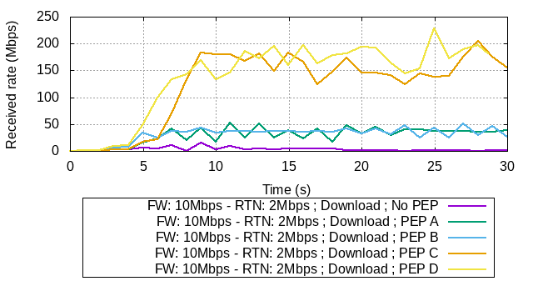
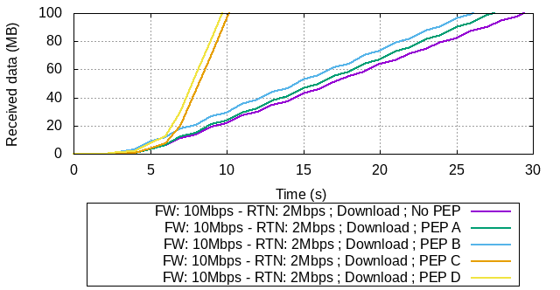
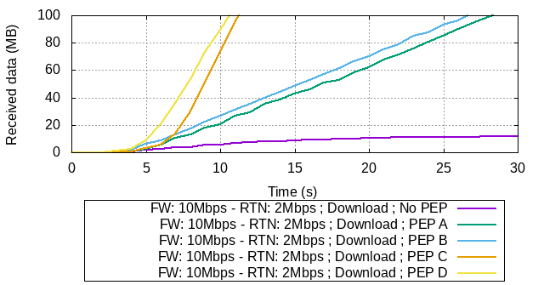
Appendix – impact of losses
QUIC and Satellite Open Stakeholder Meeting - Accelerating Start-up

