Slide 1


COMS31700 Design Verification:
Coverage
Kerstin Eder
(Acknowledgement: Avi Ziv from the IBM Research Labs in Haifa has kindly permitted the re-use of some of his slides.)
Department of
COMPUTER SCIENCE

Slide 2
Last Time
Verification Cycle
Verification Methodology &
Verification Plan
Previously: Verification Tools
Coverage is part of the Verification Tools.

Slide 3
Outline
Introduction to coverage
Code coverage models
Structural coverage models
Functional coverage
Case study and lessons to learn
Coverage closure

Slide 4
Simulation-based Verification Environment
Test Plan
Checking, Assertions
Design Under Test
Biased-Random Stimuli Generator
Test
Pass
Directives
Test
Simulator
Fail
Coverage Information
Coverage Reports
Coverage
Analysis Tool

Slide 5
Why Coverage?
Simulation is based on limited execution samples
  Cannot run all possible scenarios, but
  Need to know that all (important) areas of the DUV are verified
Solution: Coverage measurement and analysis
The main ideas behind coverage
  Features (of the specification and implementation) are identified
  Coverage models capture these features
Notes:
The last element, which will be described in much more details, is coverage. As stated earlier, one of the problems of simulation is that we cannot simulate all possible scenarios (or apply all possible stimuli). On the other hand, we need to ensure that all areas of the design are verified and all items in the VP are fulfilled. The solution to this problem is coverage measurement and analysis. The main idea is identification of features in the specification and implementation and creation (in an organized fashion) coverage models that quantify their behavioral space. We will see many examples for this during the day. The two main coverage techniques are code and functional coverage that focus on the code and functionality of the design. We will talk more on commonly used coverage in few minutes.

Slide 6
Coverage Goals
Measure the "quality" of a set of tests
  NOTE: Coverage gives ability to see what has not been verified!
  Coverage completeness does not imply functional correctness of the design! Why?
Help create regression suites
  Ensure that all parts of the DUV are covered by regression suite
Provide a stopping criteria for unit testing
Improve understanding of the design

Slide 7
Coverage Types
Code coverage
Structural coverage
Functional coverage
Other classifications
  Implicit vs. explicit
  Specification vs. implementation

Slide 8
Code Coverage - Basics
Coverage models are based on the HDL code
  Implicit, implementation coverage
Coverage models are syntactic
  Model definition is based on syntax and structure of the HDL
Generic models – fit (almost) any programming language
  Used in both software and hardware design

Slide 9
Code Coverage - Scope
Code coverage can answer the question:
“Is there a piece of code that has not been exercised?”
  Method used in software engineering for some time.
  Have you used gcov?
Main problem:
False positive answers can look identical to true positive answers.
False positive: A bad design is thought to be good.
Useful for profiling:
  Run coverage on testbench to indicate what areas are executed most often.
  Gives insight on what to optimize!
Many types of code coverage report metrics/models.

Slide 10
Types of Code Coverage Models
Control flow
  Check that the control flow of the program has been fully exercised
Data flow
  Models that look at the flow of data in, and between, programs/modules
Mutation
  Models that check directly for common bugs by mutating the code and comparing results

Slide 11
Control Flow Models
Routine (function entry)
  Each function / procedure is called
Function call
  Each function is called from every possible location
Function return
  Each return statement is executed
Statement (block)
  Each statement in the code is executed
Branch/Path
  Each branch in branching statement is taken
    if, switch, case, when, …
Expression/Condition
  Each (sub-)expression in Boolean expression takes true and false values
Loop
  All possible number of iterations in (Bounded) loops are executed

Slide 12
Statement/Block Coverage
Measures which lines (statements) have been executed by the verification suite.
    if (parity==ODD || parity==EVEN) begin
    parity_bit = compute_parity(data,parity);
    end
    else begin
    parity_bit = 1’b0;
    end
    #(delay_time);
    if (stop_bits==2) begin
    end_bits = 2’b11;
    #(delay_time);
    end
What do we need to do to get statement coverage to 100%?
Why has this never occurred?
Is it a condition that can never occur? Was is simply forgotten?
(Dead code can be “ok”!) WHY?

Slide 13
Path/Branch Coverage
Measures all possible ways to execute a sequence of statements.
  Are all if/case branches taken?
  How many execution paths?
    if (parity==ODD || parity==EVEN) begin
    parity_bit = compute_parity(data,parity);
    end
    else begin
    parity_bit = 1’b0;
    end
    #(delay_time);
    if (stop_bits==2) begin
    end_bits = 2’b11;
    #(delay_time);
    end
    □ □ □ □
Dead code: default branch on exhaustive case
Don’t measure coverage for code that was not meant to run! (tags)
Note: 100% statement coverage but only 75% path coverage!

Slide 14
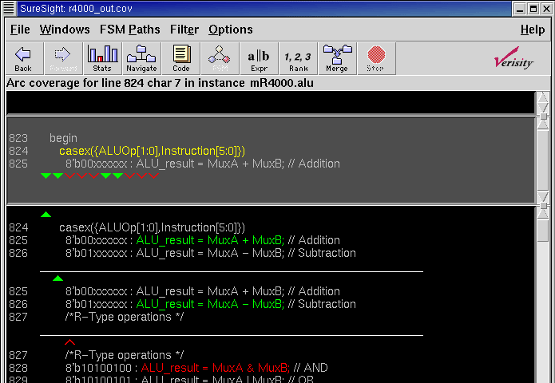
Branch Coverage Report

Slide 15
Expression/Condition Coverage
Measures the various ways paths through the code are executed.
  Where a branch condition is made up of a Boolean expression, want to know which of the subexpressions have been covered.
    if (parity==ODD || parity==EVEN) begin
    parity_bit = compute_parity(data,parity);
    end
    else begin
    parity_bit = 1’b0;
    end
    #(delay_time);
    if (stop_bits==2) begin
    end_bits = 2’b11;
    #(delay_time);
    end
    □ □
Analysis: Understand WHY part of an expression was not executed
Reaching 100% expression coverage is extremely difficult.
Note: Only 50% expression coverage!

Slide 16
Data Flow Models
Coverage models that are based on flow of data during execution
Each coverage task has two attributes
  Define – where a value is assigned to a variable (signal, register, …)
  Use – where the value is being used
Types of dataflow models
  C-Use – Computational use
  P-Use – Predicate use
  All Uses – Both P and C-Uses
process (a, b)
begin
s <= a + b;
end process
process (clk)
begin
if (reset)
a <= 0; b <= 0;
else
a <= in1; b <= in2;
end if
end process

Slide 17
Mutation Coverage
Mutation coverage is designed to detect simple (typing) mistakes in the code
  Wrong operator
    + instead of –
    >= instead of >
  Wrong variable
  Offset in loop boundaries
A mutation is considered covered if we found a test that can distinguish between the mutation and the original
  Strong mutation – the difference is visible in the primary outputs
  Weak mutation – the difference is visible inside the DUV
For more on Mutation Coverage see: J Offutt and R.H. Untch. “Mutation 2000: Uniting the Orthogonal”
Commercial tools: Certitude by SpringSoft
  http://www.springsoft.com/products/functional-qualification/certitude

Slide 18
Code Coverage Models for Hardware
Toggle coverage
  Each (bit) signal changed its value from 0 to 1 and from 1 to 0
All-values coverage
  Each (multi-bit) signal got all possible values
  Used only for signals with small number of values
    For example, state variables of FSMs

Slide 19
Code Coverage Strategy
Set minimum % of code coverage depending on available verification resources and importance of preventing post tape-out bugs.
  A failure in low-level code may affect multiple high-level callers.
  Hence, set a higher level of code coverage for unit testing than for system testing.
Generally, 90% or 95% goal for statement, branch or expression coverage.
  Some feel that less than 100% does not ensure quality.
  Beware: Reaching full code coverage closure can cost a lot of effort!
  This effort could be more wisely invested into other verification techniques.
Avoid setting a goal lower than 80%.
Literature: [J Barkley. Why Statement Coverage Is Not Enough. A practical strategy for coverage closure., TransEDA.]

Slide 20

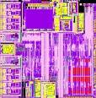


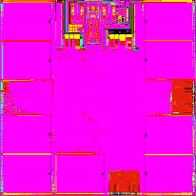
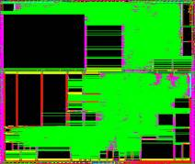

Increasing Design Complexity
5-10K Lines of Control Code
250-500K Lines of F/W
50-100K Lines of Protocol F/W
Video
Display
MPEG
Processing
Core
TV Decode
μC
>100K Lines of Appl S/W
Over 2M Lines of Application S/W
20-50K Lines of Protocol F/W
250-300K Lines of DSP F/W
OFDM
Modem
Processor
Wireless
xDSL
Baseband Signal
Processor
5-10K Lines of Microcode
Up to 2M Lines of Network S/W
Multiple Power Domains, Security, Virtualisation
Nearly five million lines of code to enable Media gateway
Notes:
Lot of cores Lots of Domains
Software – more state space needed
What breaks these –
Architectural screw ups (often integration errors) – segue to IP reuse discussion
Logical errors – deadlock state space
Electrical issue lockup in power network leaving domain unisolated undriven etc etc
Dynamic rail crap
Need to do simulations generate SAIF to drive power analyiss
IP integration issues with abstractions of power networks and behavioural models (where are these in beta in Arm)

Slide 21
Increasing Design Complexity
LOC count: 10K
100K
50K
10K
500K
100K
2M
300K
2M
TOTAL: ~5M LOC
5-10K Lines of Control Code
250-500K Lines of F/W
50-100K Lines of Protocol F/W
>100K Lines of Appl S/W
Over 2M Lines of Application S/W
20-50K Lines of Protocol F/W
250-300K Lines of DSP F/W
5-10K Lines of Microcode
Up to 2M Lines of Network S/W
At 95% coverage, this leaves 250K LOC
not exercised during verification
Notes:
Lot of cores Lots of Domains
Software – more state space needed
What breaks these –
Architectural screw ups (often integration errors) – segue to IP reuse discussion
Logical errors – deadlock state space
Electrical issue lockup in power network leaving domain unisolated undriven etc etc
Dynamic rail crap
Need to do simulations generate SAIF to drive power analyiss
IP integration issues with abstractions of power networks and behavioural models (where are these in beta in Arm)

Slide 22
Structural Coverage
Implicit coverage models that are based on common structures in the code
  FSMs, Queues, Pipelines, …
The structures are extracted automatically from the design and pre-defined coverage models are applied to them
Users may refine the models
  Define illegal events

Slide 23
State-Machine Coverage
State-machines are the essence of RTL design
FSM coverage models are the most commonly used structural coverage models
Types of coverage models
  State
  Transition (or arc)
  Path

Slide 24
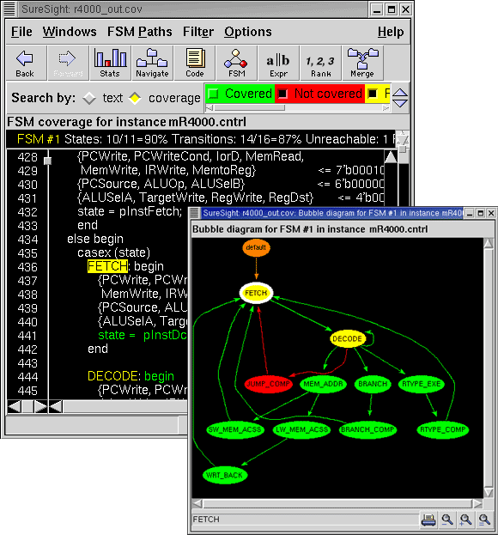
FSM Coverage Report

Slide 25
Code Coverage - Limitations
Coverage questions not answered by code coverage tools
  Did every instruction take every exception?
  Did two instructions access the register at the same time?
  How many times did cache miss take more than 10 cycles?
  Does the implementation cover the functionality specified?
  …(and many more)
Code coverage indicates how thoroughly the test suite exercises the source code!
  Can be used to identify outstanding corner cases
Code coverage lets you know if you are not done!
  It does not indicate anything about the functional correctness of the code!
100% code coverage does not mean very much. ☹
Need another form of coverage!

Slide 26
Functional Coverage
It is important to cover the functionality of the DUV.
  Most functional requirements can’t easily be mapped into lines of code!
Functional coverage models are designed to assure that various aspects of the functionality of the design are verified properly, they link the requirements/specification with the implementation
Functional coverage models are specific to a given design or family of designs
Models cover
  The inputs and the outputs
  Internal states or microarchitectural features
  Scenarios
  Parallel properties
  Bug Models

Slide 27
Functional Coverage Model Types
Discrete set of coverage tasks
  Set of unrelated or loosely related coverage tasks often derived from the requirements/specification
  Often used for corner cases
    Driving data when a FIFO is full
    Reading from an empty FIFO
  In many cases, there is a close link between functional coverage tasks and assertions
Structured coverage models
  The coverage tasks are defined in a structure that defines relations between the coverage tasks
    Allow definition of similarity and distance between tasks
    Most commonly used model types
      Cross-product
      Trees
      Hybrid structures

Slide 28
Cross-Product Coverage Model
[O Lachish, E Marcus, S Ur and A Ziv. Hole Analysis for Functional Coverage Data. In proceedings of the 2002 Design Automation Conference (DAC), June 10-14, 2002, New Orleans, Louisiana, USA.]
A cross-product coverage model is composed of the following parts:
A semantic description of the model (story)
A list of the attributes mentioned in the story
A set of all the possible values for each attribute (the attribute value domains)
A list of restrictions on the legal combinations in the cross-product of attribute values

Slide 29
Example: Cross-Product Coverage Model 1
Design: switch/cache unit
[G Nativ, S Mittermaier, S Ur and A Ziv. Cost Evaluation of Coverage Directed Test Generation for the IBM Mainframe. In Proceedings of the 2001 International Test Conference, pages 793-802, October 2001.]
Motivation: Interactions of core processor unit command-response sequences can create complex and potentially unexpected conditions causing contention within the pipes in the switch/cache unit when many core processors (CPs) are active.
All conditions must be tested to gain confidence in design correctness.
Attributes relevant to command-response events:
Commands - CPs to switch/cache [31]
Responses - switch/cache to CPs [16]
Pipes in each switch/cache [2]
CPs in the system [8]
(Command generators per CP chip [2])
How big is the coverage space, i.e. how many coverage tasks?

Slide 30
Example: Cross-Product Coverage Model 2
Size of coverage space:
Coverage space is formed by cross-product over all attribute value domains.
Size of cross-product is product of domain sizes:
  31x16x2x8x2 = 15872
Hence, there are 15872 coverage tasks.
Example coverage task:
(Command=20, Response=01, Pipe=1, CP=5, CG=0)
Are all of these tasks reachable/legal?
Restrictions on the coverage model are:
  possible responses for each command
  unimplemented command/response combinations
  some commands are only executed in pipe 1
After applying restrictions, there are 1968 legal coverage tasks left.
Make sure you identify & apply restrictions before you start!

Slide 31
Defining the Legal and Interesting Spaces
In Practice:
Boundaries between legal and illegal coverage spaces are often not well understood
The design and verification team create initial spaces based on their understanding of the design
Coverage feedback modifies the space definition
Sub-models are used to economically check and refine the spaces
  Easy to define as these are sub-crosses!
Interesting spaces tend to change often due to shift in focus in the verification process

Slide 32
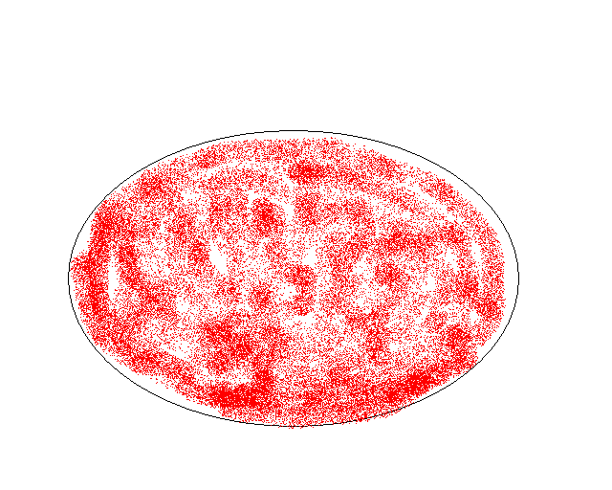

Legal Spaces Are Self-correcting
Coverage space
Illegal space
Legal space
Covered space

Slide 33
Cross-Product Coverage more formally
Functional cross-product coverage models can be defined using multi-dimensional coverage spaces.
A functional coverage space C_{m} is defined as the Cartesian product over m signal domains D₀; …;D_{m-1}.
  C_{m} = D₀ X … X D_{m-1}
Let ||D_{k}|| = d_{k} denote the size of domain D_{k}.
The functional coverage space C_{m} contains
||C_{m}|| = ||D₀|| * … * ||D_{m-1}|| = d distinct coverage points p₀; …; p_{d-1}.
A coverage point p_{i} with i є {0; …;d -1} is characterized by an m-tuple of values
p_{i} = (v₀; …;v_{m-1}), where p_{i} [k] = v_{k} and each v_{k} ε D_{k},
for k ε {0; …;m-1}.
Formalization facilitates automation of coverage analysis e.g. identification of coverage gaps.

Slide 34
Coverage Terminology
cov·er·age model n. 1. A set of legal and interesting coverage points in the coverage space.
cov·er·age point n. 1. A point within a multi-dimensional coverage space. 2. An event of interest that can be observed during simulation.
Coverage Space
Coverage Point
Read
Memory
Len = 8
Type (RD, WR)
Destination
Transaction Coverage Model
Metrics
Length
Notes:
Often when we define a coverage space it contains many points that are either unreachable or are not interesting. Therefore, a coverage model, which is the collection of the points we are interested in covering, is the set of legal and interesting points in the coverage space. In other words, a coverage point is an interesting and legal point in a multi-dimensional coverage space, or an alternative definition for a coverage point is an event of interest that can be observed during simulation.
To illustrate this, let’s look at the following example for the I/O bridge. We are interested in covering transactions sent by the CPU to the bridge. Possible metrics for the coverage model are the type of the transaction (read, write, etc.), the destination of it (memory. i/o device 0, etc.) and its length. Based on these metrics, a three dimensional coverage space is defined and the space includes a coverage point of a read transaction to memory with length 8.

Slide 35
Cross-Product Models In e
Verification Languages such as e support cross-product coverage models:
The story is hidden in the event
The attributes and their values are defined in the coverage items
Legal and interesting space are defined using the illegal and ignore constructs
  Restrictions can be defined on the coverage items and the cross itself
struct instruction {
opcode: [NOP, ADD, SUB,
AND, XOR];
operand1 : byte;
event stimulus;
cover stimulus is {
item opcode;
item operand1;
cross opcode, operand1
using ignore = (opcode == NOP);
};
};

Slide 36
Summary: Functional Coverage
Determines whether the functionality of the DUV was verified.
Functional coverage models are user-defined.
  (specification driven)
  This is a skill. It needs (lots of) experience!
  Focus on control signals. WHY?
Strengths:
  High expressiveness: cross-correlation and multi-cycle scenarios.
  Objective measure of progress against verification plan.
  Can identify coverage holes by crossing existing items.
  Results are easy to interpret.
Weaknesses:
  Only as good as the coverage metrics.
  To implement the metrics, engineering effort is required and a lot of expertise.

Slide 37
Summary: Code Coverage
Determines if all the implementation was verified.
Models are implicitly defined by the source code.
  (implementation driven)
  statement, path, expression, toggle, etc.
Strengths:
  Reveals unexercised parts of design.
  May reveal gaps in functional verification plan.
  No manual effort is required to implement the metrics. (Comes for free!)
Weaknesses:
  No cross correlations.
  Can’t see multi-cycle/concurrent scenarios.
  Manual effort required to interpret results.

Slide 38
Summary: Coverage Models
Do we need both code and functional coverage? YES!
Functional Coverage | Code Coverage | Interpretation
Low | Low | There is verification work to do.
Low | High | Multi-cycle scenarios, corner cases, cross-correlations still to be covered.
High | Low | Verification plan and/or functional coverage metrics inadequate. Check for “dead” code.
High | High | High confidence in quality.
Coverage models complement each other!
No single coverage model is complete on its own.

Slide 39
Case Studies

Slide 40
The Coverage Process in Practice
Examples:
Verifying interdependency in a PowerPC processor
Pipeline of Branch unit in S/390 system
(Thanks to Avi Ziv from IBM Research Labs in Haifa for sharing these.)

Slide 41
Example 1: Interdependency in a PowerPC Processor
Interdependencies between instructions in the pipeline of a processor create interesting testing scenarios
  They activate many microarchitectural mechanisms, such as forwarding and stalling
  Studies have shown that they are the source of many bugs in processor designs
  Functionality at this level is often related to increasing processor performance

Slide 42
Lesson No. 1
Define coverage models in interesting areas in the design
  Bug prone, New logic, Complex algorithm
In our case:
  Register interdependency activates many pipeline mechanisms, such as forwarding and stalling
  Coverage model aims to ensure that all forward and stall mechanisms are activated

Slide 43
First Approach – Black Box Model
The motivation (story):
Verify all dependency types of a resource (register) relating to all instructions
The semantics of the coverage tasks:
A coverage task is a quadruplet (I_{i}, I_{k}, R, DT), where Instruction I_{i} is followed by Instruction I_{k}, and both share Resource R with Dependency Type DT
The attributes:
  I_{i}, I_{k} - Instruction: add, sub, ...
  R - Register (resource): G1, G2, ...
  DT - Dependency Type: WW, WR, RW, RR and None

Slide 44
More Semantics
The semantics provided so far is too coarse
  What if I_{i} is the first instruction in the test and I_{k} is the 1000 instruction?
Need to refine the semantics to improve probability of hitting interesting events
Additional semantics
  The distance between the instructions is no more than 5
  The first instruction is at least the 6th

Slide 45
The Legal Space
Not all combinations are valid
  Not all instructions read from registers
  Not all instructions write to registers
  Fixed point instructions cannot share FP (floating point) registers
  … and more

Slide 46
Space and Model Size
PowerPC has
  ~400 instructions
    (actually this is an old number, current PowerPC has close to 1000 instructions)
  ~100 registers
Coverage space size is 400 x 400 x 100 x 5 = 80,000,000 tasks
Even after all restrictions are applied, the model size is still 200,000 tasks

Slide 47
Lesson No. 2
Define a model of realistic size
  Ensure good coverage can be achieved with simulation resources
  Group similar cases together to reduce model size
In our case:
  Original space size is
    (400 x 400 x 100 x 5) = 80,000,000 tasks
  Many instructions behave similarly in the pipe
    For example add and sub
  Many registers are activated in the same way
    All general purpose registers, all floating-point registers
  Grouping similar instructions together helps to reduce the model size to a manageable size

Slide 48
Coverage Results
A random test generator was used to generate tests that achieved 100% coverage
Testing the generated tests against the forwarding and stalling mechanisms of a specific processor showed that many such mechanisms were not activated by the tests

Slide 49
Lesson No. 3
Define coverage models at the proper level of abstraction for the coverage tasks
In our case:
  Forwarding and stalling are microarchitectural mechanisms, so the coverage model should be defined at the microarchitectural level
In general:
  Microarchitecture is the place to look for coverage models
    This is where the complexity of the design hides
      Architecture is not detailed enough
      Implementation is too messy

Slide 50
Grey Box Model
Microarchitectural model for a specific Processor
  Multithreaded
  In-order execution
  Up to four instructions dispatched per cycle
Dispatch
Data Fetch
B1
R1
M1
S1
Execute
B2
R2
M2
S2
Write Back
B3
R3
M3
S3
S4f
S4b
Branch
(B)
Simple
Arith (R)
Complex
Arith (M)
Load/Store
(S)
Notes:
The first design I am going to talk about is the core (execution units) of a multithreaded PPC design with in-order execution. The processor contain four execution units, one for branch instructions one for load and store instructions and two for arithmetic operations. Each unit has a three stage pipe in it with stages for data fetch, execution and write back. The load store unit has in addition two stages that keep instructions that are waiting for the cache in the forward and backward threads.

Slide 51
Model Details
Model contains 7 attributes
  Type, pipe and stage of first instruction (I1 ,P1 ,S1)
  Same attributes for second instruction (I2, P2, S2)
  Type of dependency between the instructions
    RR, RW, WR, WW, None
Grouping is done in a similar way to the architectural model
Many restrictions exist
  I1 is simple fixed point → P1 is R or M
  P1 is not S → S1 is 1, 2, or 3
After restrictions, 4418 tasks are legal

Slide 52
Coverage Measurement
Make sure that you measure what you really want and what really happens
Use simpler environment and models to test and debug the measurement system
  Hierarchy of models
    All instructions
    All pipe stages
  Controlled simulation

Slide 53
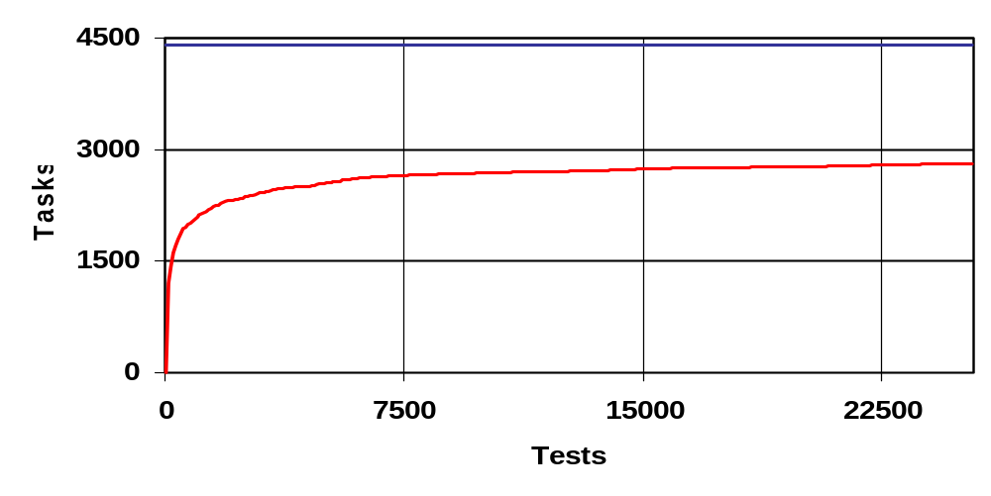
Analysis of Interdependency Model
After 25,000 tests 2810 / 4418 tasks were covered (64%)

Slide 54
Lesson No. 4
Coverage analysis is more than a single number
In our case:
  64% is not bad but
  Progress report shows that coverage is progressing slowly
  Hole analysis finds big areas that are covered very lightly
  Analysis found some problems in test generators

Slide 55
Analysis of Interdependency Model
Hole analysis detected two major areas that are lightly covered
  Stages S4f and S4b that are specific to thread switching are almost always empty
    Reason: not enough thread switches during tests
  The address-base register in the store-and-update instruction is not shared with other registers in the test
    Reason: bug in the test generator that didn’t consider the register as a modified register

Slide 56
Lesson No. 5
Look for large uncovered areas
  Can indicate problems in the testing
  Or missing restrictions
Constantly update the coverage models
  Makes coverage picture clearer
In our case:
  Two large holes caused by problems in the test generator and test specification

Slide 57
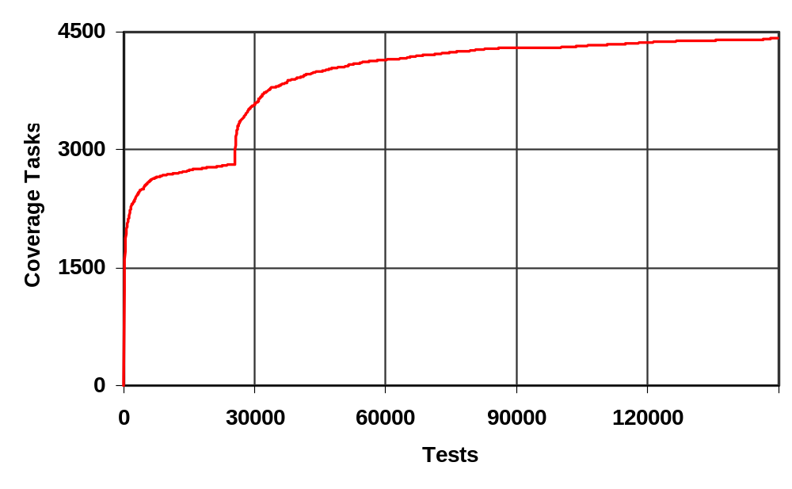
Coverage Progress
Causes of holes are fixed

Slide 58
Architecture vs. Microarchitecture
Architecture
  No implementation details
  Easy to share between designs
  Temporal model
Microarchitecture
  Pipe implementation knowledge is needed
  Access to microarchitectural mechanisms is needed
    White box or at least grey box
    More for observability than for controllability (Why?)
  Snapshot model
Notes:
(In practice, we seldom control the internals of the DUV)
(May lead to inconsistent state)
(In practice, we seldom control the internals of the DUV)
(May lead to inconsistent state)
In practice we seldom control the internals of the DUV. This may lead to inconsistent state, i.e. a state not reachable from the defined starting state of the DUV.

Slide 59
Example 2: S/390 Branch Unit
Unit handles branch prediction and execution of branch instructions
Contains
  Nine stage complex pipe
    More than one instruction at the same time in some stages
    Instructions can enter the pipe at two places
  Branch history tables
  and more
2 PY spent on verification
Done by experts with experience with similar designs
About 100,000 tests per day
Notes:
The second design is the branch unit of a S/390 processor. This unit contains a complex pipe with 9 stages (where instructions can enter the pipe at more than one place and in some stages more than one instruction can reside. In addition in contains the branch history table, and other tables and logic that handle prediction and execution of branch instructions …

Slide 60
Coverage Models for Branch Unit
Several models defined
  Access to branch tables
  Flow of a branch in the pipe
  State of the pipe
State of the pipe model
  Attributes contain
    Location and type of each branch in the pipe in a given cycle
    Reset signal
  Model size:
    Without restrictions ~ 15,000,000
    With restrictions ~ 1400

Slide 61
Lesson No. 6
Define families of coverage models that represent different views of the design
  Help capture all the functionality with a small number of coverage tasks
  Analysis of one model can help understanding behavior of another
In our case:
  Two views of pipe functionality
  Model for the flow of a single instruction in the pipe
  Model for all instructions in the pipe at a given time

Slide 62
Lesson No. 7
Look for models that have a view different from the view of the designer
  Model definition can lead to better understanding of the design
  Coverage can lead to unexpected scenarios
In our case:
  Designer’s view is the flow of instructions in the pipe
  Model for global pipe state led to accurate analysis of number of instructions in the pipe

Slide 63
Coverage Closure

Slide 64
Using Coverage – What can go wrong?
Low coverage goals
Some coverage models are ill-suited to deal with common problems
  Missing code
    Use Requirements-based Methodology to overcome this!
Generating simple tests just to cover specific uncovered tasks
  There is merit in generating tests outside the coverage! WHY?
Collecting coverage without analyzing and interpreting the results

Slide 65
Coverage Closure
Coverage closure is the process of:
Finding areas of coverage not exercised by a set of tests.
  Coverage Holes!
Creating additional tests to increase coverage by targeting these holes.
  Beware: Aim to “balance” coverage!

Slide 66
Controllability Problems
If the cases to be hit contain internal states/signals of the DUV, directed tests that exercise all combinations are hard to find.
    Processor pipeline verification: Control logic, Internal FSMs
Generate biased random tests automatically. [RTPG]
    ISG
  Typically tests are filtered to retain only those that add to coverage.
  Coverage analysis indicates hard-to-reach cases.
  Don’t waste engineers time on what automation can achieve.
Combine automatically generated stimulus with coverage.
Gives rise to Coverage DRIVEN Verification Methodology
BUT:
Hard-to-reach cases (may) need manual attention.
  Bias tests towards certain conditions or corner cases.
  Supplying bias requires significant engineering skill.
    Often only trial-and-error approach.

Slide 67
Biasable Random Test Generation
[A Adir, E Almog, L Fournier, E Marcus, M Rimon, M Vinov and A Ziv. Genesys-Pro: Innovations in Test Program Generation for Functional Processor Verification. In IEEE Design & Test of Computers, 2004.]
Test template description language
  expressiveness of programming language
  virtually unlimited control over events to be generated
Architectural modelling framework
  building blocks at high enough level to describe processors
    VLIW architectures
Generation engine based on constraint satisfaction
  generic constraint solver customized for pseudo-random test generation

Slide 68
Coverage DRIVEN Verification Methodology
From Verification Plan:
Create initial coverage model
Generate tests
Run tests
Collect coverage
Identify coverage holes
Add tests to target holes
Review / enhance coverage models if needed
Current research: How can we automate this further?

Slide 69
80/20 Split
In practice: 80/20 (20/80) split wrt coverage progress.
Good news:)
80% of coverage is achieved (relatively quickly/easily) driving randomly generated tests.
This takes about 20% of total time/effort/sim runs spent on verification.
Bad news:(
Gaining the remaining 20% coverage,
  i.e. filling the remaining coverage holes (which often needs to be done manually and requires a lot of skill plus design understanding),
can take as much as 80% of the total time/effort/sim runs spent on verification.

Slide 70
Benefits of Coverage DRIVEN Verification Methodology
Benefits:
  Shortens implementation time
    (Initial setup time)
    Random generation covers many “easy” cases
  Improves quality
    Focus on goals in verification plan
    Encourages exploration/refinement of coverage models
  Accelerates verification closure
    Refine/tighten constraints to target coverage holes

Slide 71
Coverage DRIVEN Verification Methodology
From Verification Plan:
Create initial coverage model
Generate tests
Run tests
Collect coverage
Identify coverage holes
Add tests to target holes
Review / enhance coverage models if needed
Current research: How can we automate this further?

Slide 72
Coverage DIRECTED Test Generation
From Verification Plan:
Create initial coverage model
Generate tests
Run tests
Collect coverage
Machine Learning
Identify coverage holes
Add tests to target holes
Review / enhance coverage models if needed
Current research: How can we automate this further?

Slide 73
CDG: Coverage DIRECTED Test Generation
How can we make better use of coverage data to automate stimulus generation?
Latest Research:
Coverage DIRECTED (stimulus/test) generation [IBM]
BY CONSTRUCTION
  Require description of design as FSM.
  Use formal methods to derive transition coverage.
  Automatically translate paths through FSM to test vectors.
  Fall over in practice: FSMs are prohibitively large!
BY FEEDBACK
  (Exploit Machine Learning techniques)
  GAs/GP - Need to find suitable encoding (e.g. of instructions).
  Bayesian Networks - Need to design and train BN.
  Data Mining in coverage spaces
No significant breakthrough in CDG yet!

Slide 74
Summary: Coverage
Coverage is an important verification tool.
  Code coverage: statement, path, expression
  Structural coverage: FSM
  Functional coverage models: story, attributes, values, restrictions
  (Assertion coverage will be introduced during the lecture on Assertion-based Verification.)
Combination of coverage models required in practice.
  Code coverage alone does not mean anything!
Verification Methodology should be coverage driven.
Automation: Research into coverage directed test generation
Delays in coverage closure are the main reason why verification projects fall behind schedule!

