Slide 1
Intelligent Mistakes in Test Automation
(or: it seemed a good idea at the time)
Prepared and presented by
Dorothy Graham
email: info@dorothygraham.co.uk
Twitter: @DorothyGraham
www.DorothyGraham.co.uk
© Dorothy Graham 2013
Notes:
Not agile TDD, dev testing – system level, aut of test execution

Slide 2
Intelligent mistakes?
mistake:
  an action resulting from defective judgment, deficient knowledge or carelessness, a misconception or misunderstanding
intelligent
  exercising good judgment, showing mental resourcefulness, being well-informed
intelligent mistake
  action based on a faulty premise, with the best of intentions, but with adverse consequences

Slide 3
Contents
Automation should find lots of bugs
Automation comes out of a box (or download)
Let’s automate all of our manual tests
ROI is essential for automation
Testing tools are testers’ tools
  Twitter: @DorothyGraham

Slide 4
Good idea?
Automation should find lots of bugs
Seems very sensible
  we are automating tests
  tests find bugs
  automation is more thorough and faster
  therefore, automation should find more bugs - and quicker
Problems
  what tests are we automating?
  what does automation actually give us?

Slide 5
What finds most bugs?
What is usually automated?
most often
automated
likelihood of
finding bugs
regression tests
exploratory testing
Notes:
1st time run/run before, testing new stuff/old stuff
from “not likely” to “even less likely”
At Star West lunch, sat next to mgr, asked about aut – “I think I’m going to have to stop funding it – it’s not finding many bugs.”

Slide 6
Automation success = find lots of bugs?
tests find bugs, not automation
automation is a mechanism for running tests
the bug-finding ability of a test is not affected by the manner in which it is executed
this can be a dangerous objective
  especially for regression automation!
Automated tests Manual Scripted Exploratory Fix Verification
9.3%
24.0%
58.2%
8.4%
Experiences of Test Automation, Ch 27, p 503, Ed Allen & Brian Newman
Notes:
(At Star West lunch, sat next to mgr, asked about aut – “I think I’m going to have to stop funding it – it’s not finding many bugs.”)
Brian Newman & Ed Allen’s case study – no. bugs found over 3 releases of 5000 KLOC product – using 20 testers and good automation
Aut (regression): 197, manual scripted: 507, Exploratory testing: 1229, Bug fix failures: 178. CRM system, 25 QA people, incl web, mobile.

Slide 7
Efficiency and effectiveness
greatest
benefit
better
good
good
slow
testing
High
fast
testing
Manual testing
Efficiency
Automated
poor
slow
testing
poor
fast
testing
not good but common
worst
Effectiveness
Low
Notes:
Aut about efficiency
aut chaos

Slide 8
When do automated tests find bugs?
when the first run of a given test is automated
  Test-Driven Design in Agile (& BTDD)
  Model-Based Testing (MBT), automated test design, monkey testing, exploratory test automation
  keyword-driven (e.g. users populate spreadsheet)
find bugs in parts we wouldn’t have tested?
  indirect result of automation
  direct result of running more tests
Notes:
not because automated, because 1st time, testing new stuff
tends to mean: “get automation to make the tests better!”
Goal of automation: run tests (more, faster)

Slide 9
Contents
Automation should find lots of bugs
Automation comes out of a box (or download)
Let’s automate all of our manual tests
ROI is essential for automation
Testing tools are testers’ tools
  Twitter: @DorothyGraham

Slide 10
Good idea? Automation comes out of the box (or download)
Seems very sensible
  automation gives great benefit, success stories
  spending a lot on the tool must guarantee great benefits
  all we need to do is “get the right tool”
Problems
  technical issue: what testware architecture is right for your organisation? (hint: not the tool’s)
  management issues: staffing, support, resources
Notes:
Susan Windsor: co’s aut failed – must be wrong tool, get another. Failed again, get a 3rd tool, failed yet again (blame the testers?)

Slide 11
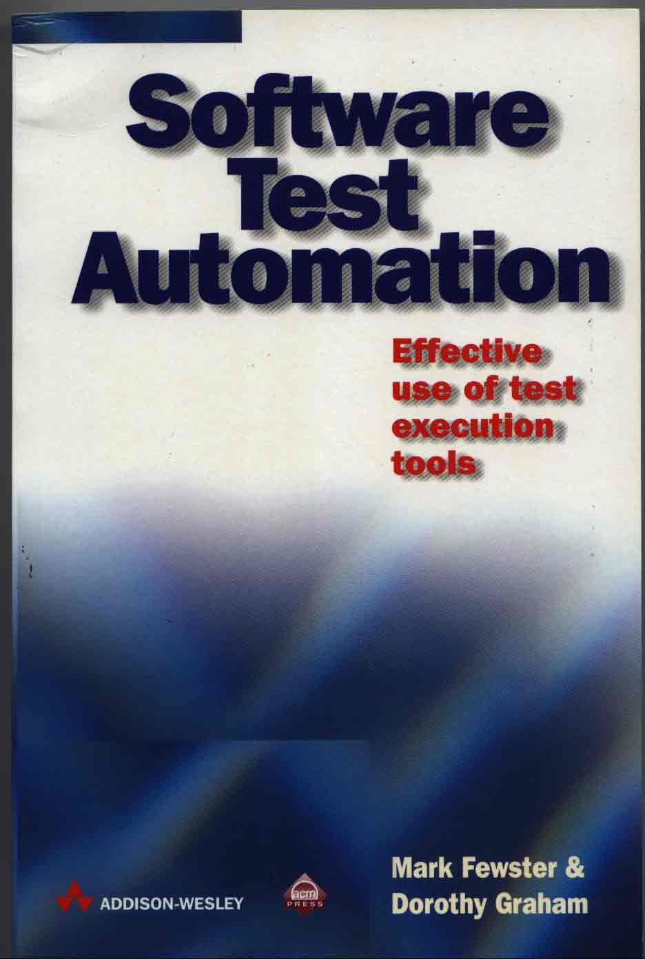
Automation should fit your organisation
your own testware architecture is critical
  a poor architecture gives high maintenance cost
    most frequent cause of abandoned automation/shelfware
  two layers of abstraction
    technical: for long life
    human: for wide use
  using the tool’s architecture ties you to that tool [version]
Testers
write tests (in DSTL)
HL Keywords
Ch 6
testware
architecture
Structured Scripts
Test Execution Tool
runs scripts
Notes:
good program design, modularity, single-purpose, separate tool-specific stuff from the tests. Aut tests outlive releases of s/w and tool
you need distance from your tool
HL – don’t make testers conform to tool, make tool conform to testers
Move your tests away from the tool, closer to the testers

Slide 12



It’s not about the tool
no such thing as “the right tool” or “best tool”
  what’s “the best car”?
Notes:
If money were no object, you can have any car you want, what are you thinking of?

Slide 13
It’s not about the tool
no such thing as “the right tool” or “best tool”
  what’s “the best car”?
commercial tools?
investment in good automation
good benefits
low cost
good benefits
moderate cost
good benefits
high cost
benefits
poor benefits
low cost
poor benefits
high cost
tool cost
budget
open source tools?
Notes:
what comes out of the box? just the tool
good automation doesn’t come out of the box

Slide 14
It takes time and effort to succeed
management support is critical
  high level managers need to understand automation capability & limitations, and have realistic expectations
  building good automation is a learning process
  “people issues” – people use the automation, people develop the automation
Notes:
good automation doesn’t come out of the box

Slide 15
Automated tests/automated testing
Automated tests
Automated testing
Select / identify test cases to run
Set-up test environment:
  create test environment
  load test data
Repeat for each test case:
  set-up test pre-requisites
  execute
  compare results
  log results
  analyse test failures
  report defect(s)
  clear-up after test case
Clear-up test environment:
  delete unwanted data
  save important data
Summarise results
Select / identify test cases to run
Set-up test environment:
  create test environment
  load test data
Repeat for each test case:
  set-up test pre-requisites
  execute
  compare results
  log results
  clear-up after test case
Clear-up test environment:
  delete unwanted data
  save important data
Summarise results
Analyse test failures
Report defects
Manual process
Automated process
Notes:
LHS – what comes out of the box/download (maybe)
RHS – can use the surrounding aut and put manual test back in the middle

Slide 16
Contents
Automation should find lots of bugs
Automation comes out of a box (or download)
Let’s automate all of our manual tests
ROI is essential for automation
Testing tools are testers’ tools
  Twitter: @DorothyGraham

Slide 17
Good idea?
Let’s automate all of our tests
Seems very sensible
  we already have lots of tests being done manually
  automation would be much quicker
  we can be completely automated, no need for manual tests [testers?!]
Problems
  what tests are you automating?
  what are you missing by automating [only] existing tests?

Slide 18
Automate manual tests?
manual
tests
automated
tests
tests not
automated yet
tests (& verification) not possible to do manually
tests not
worth automating
manual tests automated
(% manual)
new ways of automating, e.g. exploratory test automation
Notes:
Popular example objective
Use computers to do what they do best, people what they do best. Colours nice? Users like it? Takes too long to aut?
Shouldn’t be automated: Captcha (human readable characters to type in to prevent robots) – if it can be tested automatically, it’s a bug!
Verify the state of screen objects – attributes that aren’t visible
Harry Robinson says that automating what you do manually is “horseless carriage” testing – no horse, but still has a holder for the whip. Should be a different thing altogether – do what automation does best.

Slide 19
Tools will replace testers?
“we can reduce the number of testers once we have the tool”
  what are your testers like?
    mindless morons, or
    intelligent investigators?
  need more skills, not fewer
  automation can free testers to do more test design, exploratory testing
    and find more bugs
  tools don’t replace testers, they support them
Notes:
only true if your testers are mindless automatons
Tools can turbo-charge your testers
Not get rid of testers, get more out of them – if 20, 2 for aut, 18 new testers for free
Do your testers always finish the testing they want to do? What could/would they do if they had more time? Managers – ask this before getting rid of testers.

Slide 20
Contents
Automation should find lots of bugs
Automation comes out of a box (or download)
Let’s automate all of our manual tests
ROI is essential for automation
Testing tools are testers’ tools
  Twitter: @DorothyGraham

Slide 21
Good idea?
ROI is essential for automation
Seems very sensible
  we will be spending time and possibly lots of money on tools – need to be sure it will be worth it
  a “water-tight” business case will convince our managers to invest in automation
Problems
  ROI is not the whole story
  people are not convinced by numbers
  calculating ROI is difficult and can be dangerous

Slide 22
Is this Return on Investment (ROI)?
tests are run more often
tests take less time to run
it takes less human effort to run tests
we can test (cover) more of the system
we can run the equivalent of days / weeks of manual testing in a few minutes / hours
faster time to market
(benefit – cost) cost
these are (good) benefits
but are not ROI
ROI =
Notes:
3rd – easy to quantify, so that’s all there is to it

Slide 23
How important is ROI?
ROI can be dangerous
  may give impression that people are replaced by tools (see http://dorothygraham.blogspot.co.uk/)
“automation is an enabler for success, not a cost reduction tool” – Yoram Mizrachi
many achieve lasting success without measuring ROI (depends on your context)
  need to be aware of benefits (and publicize them)
Notes:
Snyman: Aut process for large-scale success (South Africa – US$) Test impr cost: $4m (p566)

Slide 24
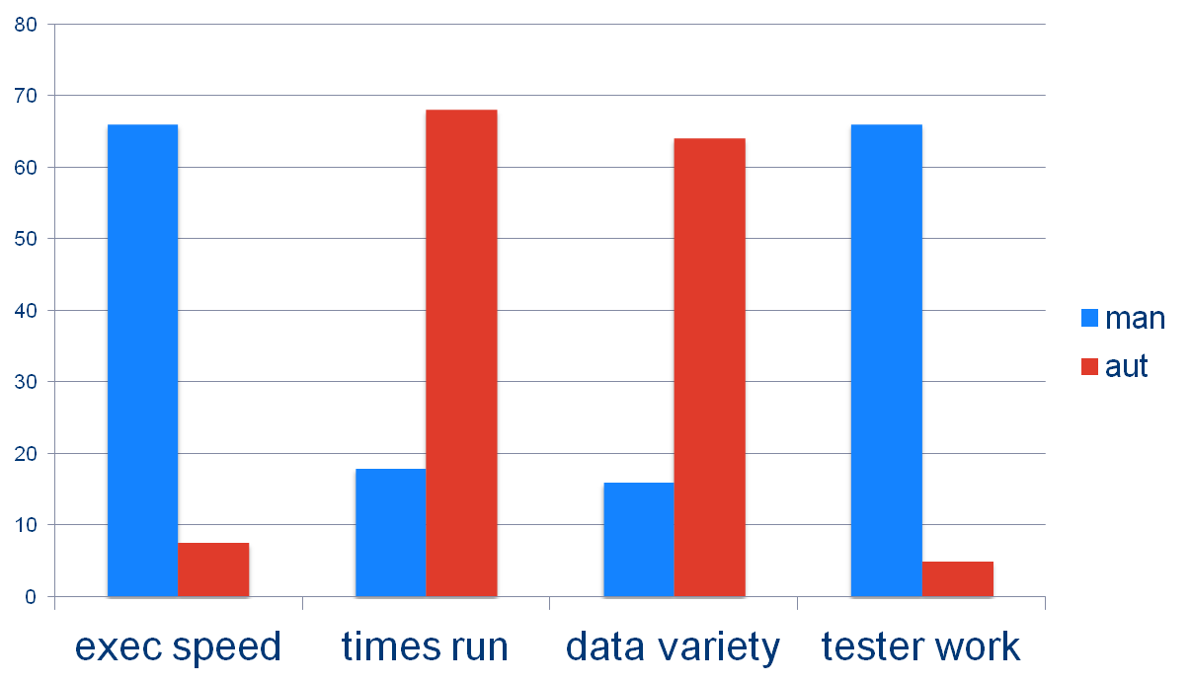
An example comparative benefits chart
14 x faster
5 x more often
4 x more data
12 x less effort
ROI spreadsheet – email me for a copy
Notes:
exec speed – how long the test takes to run (not the whole story, but still a benefit)
tester work – time needed by tester for a set of tests – easiest to measure but testers do more than this!
Plus: time to market (not shown here)

Slide 25
Contents
Automation should find lots of bugs
Automation comes out of a box (or download)
Let’s automate all of our manual tests
ROI is essential for automation
Testing tools are testers’ tools
  Twitter: @DorothyGraham

Slide 26
Good idea?
Testing tools are testers’ tools
Seems very sensible
  testers do testing – testing tools help with testing
  tools will make them better testers, because they will be able to run more tests, faster
Problems
  tools are software packages using programming languages; tester skills are different to development skills
  spending time on / with tools means less testing, not more testing (initially at least)
Notes:
Hans Buwalda: lose a good tester and gain a poor programmer

Slide 27
Is it the tester’s job to automate tests?
  test execution automation is software development
    needs programming skills
  not all testers want to become developers
    or would be good at it
  do automators need testing skills?
    helpful but not essential
  if testers are automators ➔ a conflict of interest
    do you run tests or do you automate tests?
    automation is better long-term, BUT
    deadline pressure pushes you back into manual testing
Notes:
Paul Parsons: one tester is great at XT – finds twice as many bugs as rest of team tog. Doesn’t want to do aut.
Hans Buwalda: Lose a good tester and gain a poor programmer
Aut trained in testing? V helpful – Jasbir & Brian. If not may code around bugs

Slide 28
Current thinking?
“Testers, if you want to have a job, you need to learn to write code”
  so testers who don’t write code are now worthless?
  the only good tester is a developer-tester?
I see serious consequences (and I don’t agree!)
  for every context? (user/business testers)
    fine for those who want to, in agile team, dev level
  pure testing skills are no longer valued?
  not right to force good testers out of our industry!
Notes:
Simon Stewart, at EuroStar 2012
Two testers: Leslie: degree in CS, on agile team as tester, happy to use scripting languages for aut tests.
Fran: came into testing from the business side, gave good feedback for new releases, become user acceptance tester, not chief BA/user rep. Hates the idea of writing code.

Slide 29
Why are these intelligent mistakes?
Automation should find bugs?
  tests find bugs; automated tests are still tests
Automation comes “out of the box”
  you think you buy a solution that will just work
Automate all manual tests?
  a starting point for tests to be automated
Automation has to achieve ROI?
  can’t expect investment without showing some return
Testing tools are tools for testers?
  testers write and run tests; tools run tests
Notes:
decisions are perceived to be rational – but emotional, instinct the real driver

Slide 30
Why are these intelligent mistakes?
Automation should find bugs?
  tests find bugs, automation runs tests
Automation comes “out of the box”
  effort and time, e.g. tailor your testware architecture
Automate all manual tests?
  not all should be, automate more than manual
Automation has to achieve ROI?
  may be dangerous, need to show benefits
Testing tools are tools for testers?
  different skills, not all testers should code
Notes:
decisions are perceived to be rational – but emotional, instinct the real driver

Slide 31
Summary
Many ideas seem sensible at first / on the surface, but have serious problems
  automation should find lots of bugs
  automation comes out of a box (or download)
  let’s automate all of our manual tests
  ROI is essential for automation
  testing tools are testers’ tools
Recognise these “intelligent mistakes” and avoid them
Notes:
What other ones do you see?
TDD is all the testing/aut you need

Slide 32
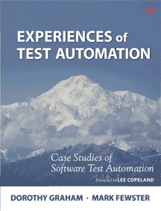
More information
downloads www.DorothyGraham.co.uk
  articles and papers
email info@DorothyGraham.co.uk for
  list of test execution & framework tools
  automation ROI calculator spreadsheet
  an invitation to join the new Test Automation Patterns wiki
  my random newsletter
blog http://dorothygraham.blogspot.com
  including automation, DDP, certification
twitter
  @DorothyGraham
with Seretta Gamba – we are looking for feedback!

