Slide 1

Undergraduate pilot course with ROS and MiniMax: enthusiasm gained & lessons learned
Dr. Sharon Gower Small
Director Siena College Institute for Artificial Intelligence
www.siena.edu/SCIAI
SIGCSE February 29, 2012

Slide 2
Agenda
MiniMax
ROS challenges
Course Design
ROBOSHOW 2011
Fall 2012
Course will be offered again
Changes to be made

Slide 3
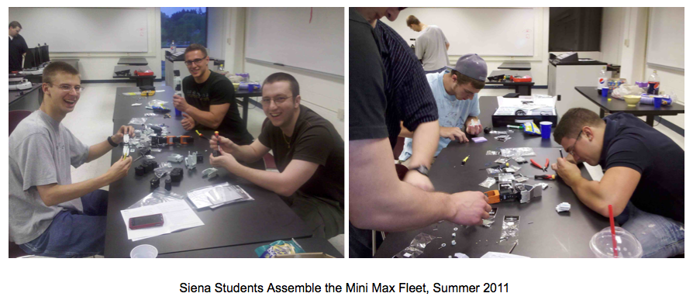
MiniMax comes to life

Slide 4
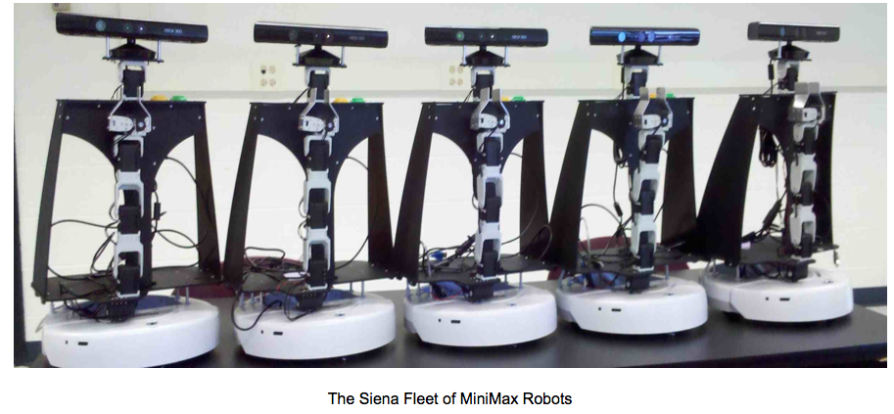
MiniMax

Slide 5
Main Challenges
Operating System
Linux was new to a majority of the students
ROS File System & Communication
Packages, Nodes, Topics, Messages, etc.
Publishing messages to a topic
Subscribing to topics
Class Size

Slide 6
Course Design
Very Fast Paced
Nothing -> fully functional demos in 13 weeks
Linux
ROS
Used the Online ROS tutorials
Tested their knowledge
post tutorial worksheets
applied work

Slide 7
Course Design
Team Projects
Teams of 4 students
Professor Selected Teams
Balanced GPA
Self Selected Projects
Team proposals
3 Project Checkpoints
Round Table Research
Individual presentations to the class
Second half of the semester

Slide 8
ROBOSHOW 2011
https://www.siena.edu/pages/179.asp?item=321056
http://www.youtube.com/user/SCIAIRobotics
Excellent community turnout
Student body, local media, College President and other administrators, etc.
Formal Event
Post Videos Required

Slide 9
Fall 2012
Limiting Enrollment
Repeat for Credit
More experienced teams take their demo further
Solve teaming issues
Ramp up faster
More upper level students
Biweekly homework assignments

Slide 10
Fall 2012
Repeat Round Table Research
Repeat RoboShow
Require Video
Require project documentation
Require nodes uploaded to ROS website

Slide 11
Fall 2012
Expand on vision capabilities
Expand on dialogue capabilities
Better arms/grippers?

Slide 12
QUESTIONS?

