Slide 1
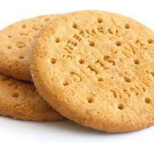
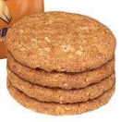
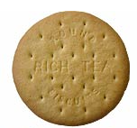
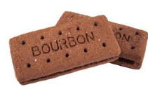
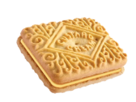
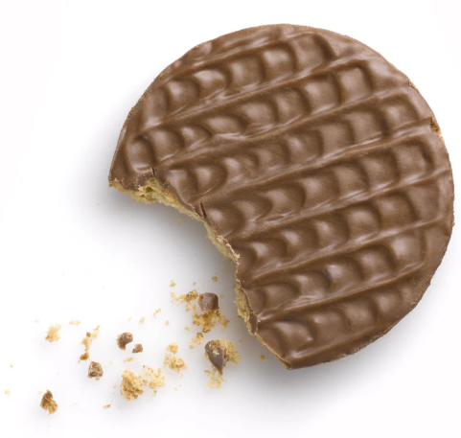
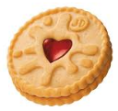
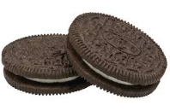
The DAPR3 Crumb Coefficient Scale
Love of biscuits

Slide 2
The DAPR3 Crumb Coefficient Scale
Love of biscuits

Slide 3
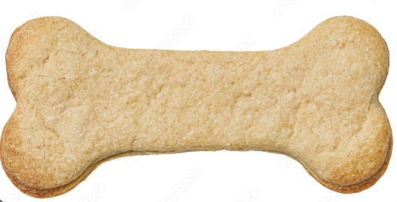
The DAPR3 Crumb Coefficient Scale
Love of biscuits

Slide 4
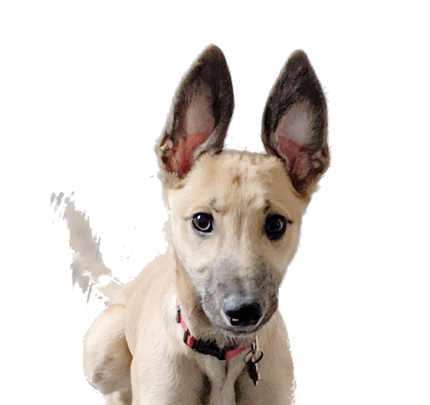
The DAPR3 Crumb Coefficient Scale
Love of biscuits

Slide 5
The DAPR3 Crumb Coefficient Scale
Love of biscuits?

Slide 6


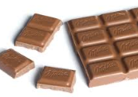
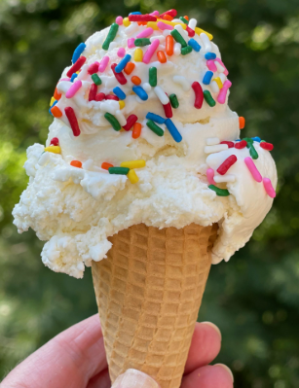
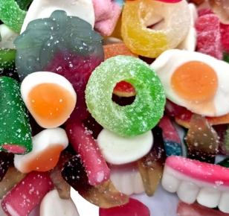
hobnobs
digestives
jaffa
Rich tea
victoria
The McVities Biscuit Measure
Hopefully high
The DAPR3 Crumb Coefficient Scale
Sweet Tooth Scale
Hopefully not too high

Slide 7

Love of biscuits
The Standard
Measure of love of biscuits

Slide 8
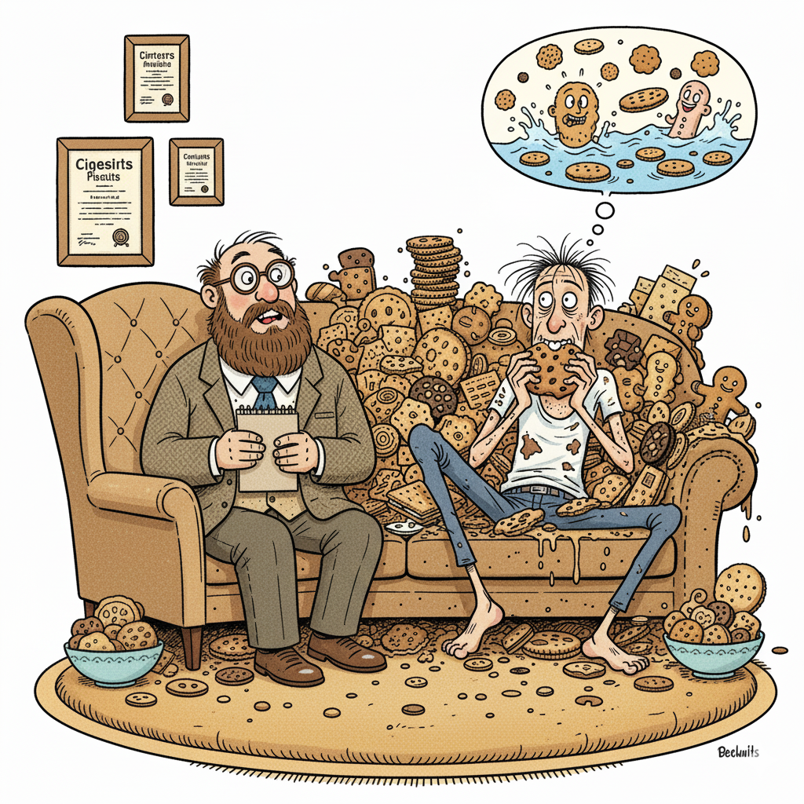
Love of biscuits

Slide 9
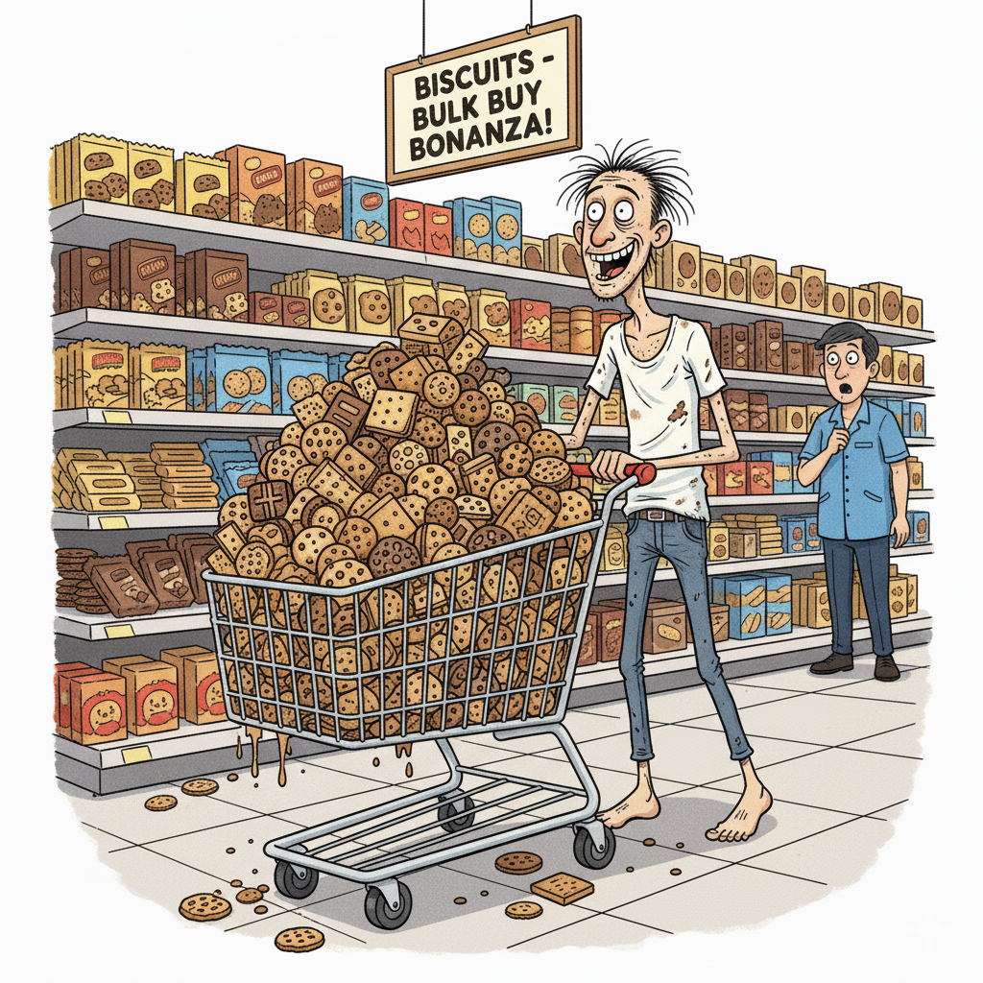
Love of biscuits

Slide 10

OTHER BISCUIT BRANDS ARE AVAILABLE!

Slide 11
hobnobs
digestives
jaffa
Rich tea
victoria
The McVities Biscuit Measure

