Slide 1
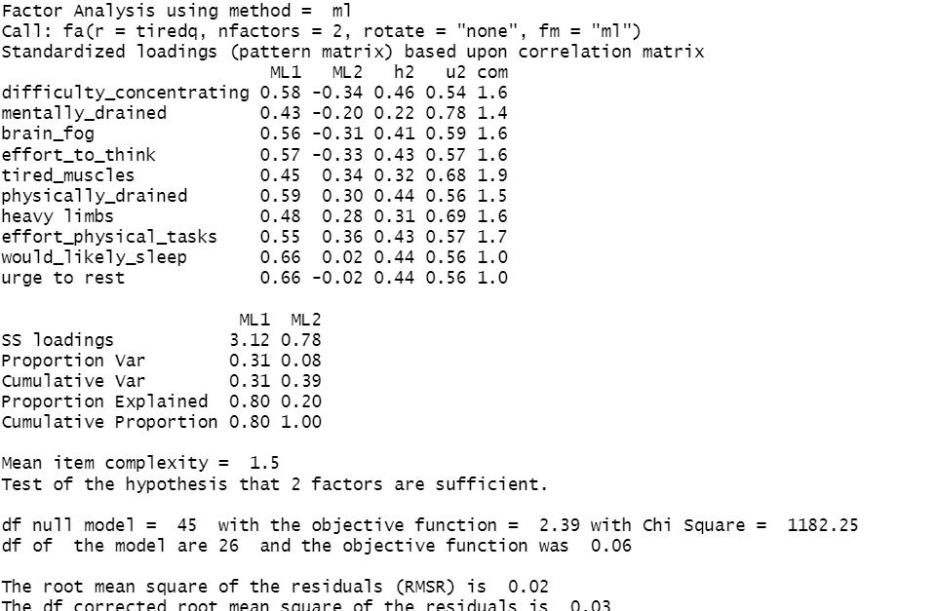
Loadings
Associations between observed variables and underlying dimensions. Allows us to give meaning to the dimensions by examining which items link with which dimensions.
Variance accounted for by each dimension
Allows us to evaluate and compare models
OTHER STUFF …
…

