Slide 1
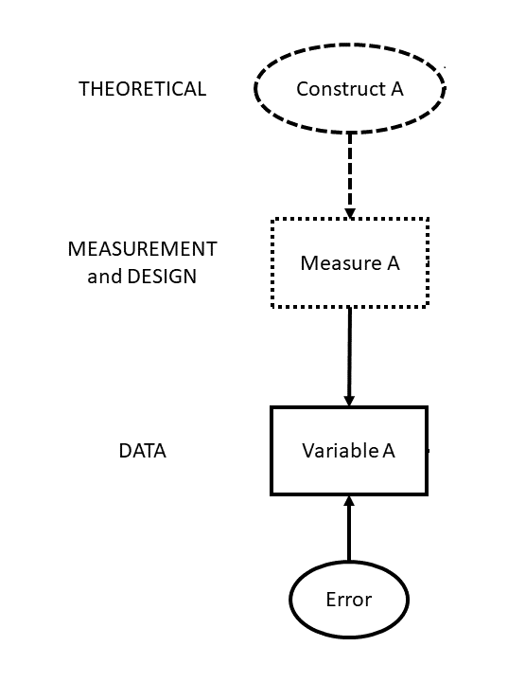
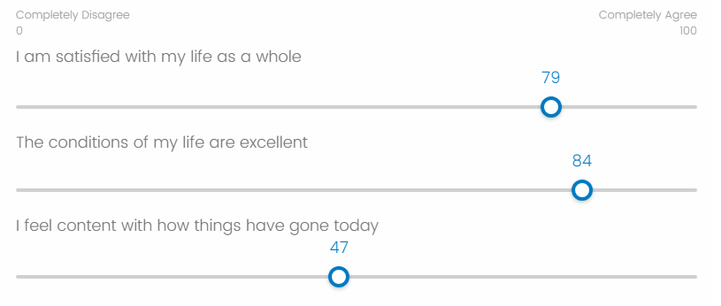
higher because I feel social pressure to not be too negative
higher because I just read the news and it made me acutely aware of my privilege
lower because I missed the train today
ID | Q_1 | Q_2 | Q_3 | Avg
josiah | 79 | 84 | 47 | 70
Error

