Slide 1


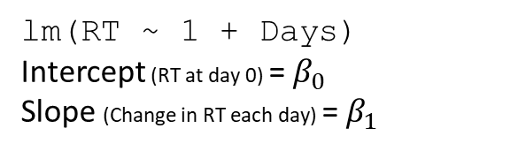
lm(RT ~ 1 + Days)
Intercept (RT at day 0) = $β_{0}$
Slope (Change in RT each day) = $β_{1}$
RT
$$β_{1}$$
$$β_{0}$$
1
days of sleep deprivation

Slide 2
lm(RT ~ 1 + Days)
Intercept (RT at day 0) = $β_{0}$
Slope (Change in RT each day) = $β_{1}$
Josiah
RT
$$β_{1}$$
Tom
$$β_{0}$$
1
days of sleep deprivation

Slide 3




lm(RT ~ 1 + Days + ID)
Intercept (RT at day 0) = $β_{0}$
Slope of Days (Change in RT each day) = $β_{1}$
Group Difference (Change in RT moving from T to J) = $β_{2}$
Josiah
RT
$$β_{2}$$
Tom
$$β_{1}$$
$$β_{0}$$
1
days of sleep deprivation

Slide 4
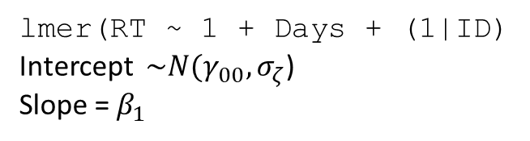




lmer(RT ~ 1 + Days + (1|ID)
Intercept $\sim N(γ_{00},σ_{ζ}$)
Slope = $β_{1}$
Josiah
$$ζ_{josiah}$$
RT
$$σ_{ζ}$$
$$β_{1}$$
Tom
$$γ_{00}$$
1
$$ζ_{tom}$$
days of sleep deprivation

Slide 5
FIXED
RANDOM
lmer(RT ~ 1 + Days + (1|ID)
Intercept $\sim N(γ_{00},σ_{ζ}$)
Slope = $β_{1}$
Josiah
$$ζ_{josiah}$$
RT
$$σ_{ζ}$$
$$β_{1}$$
Tom
$$γ_{00}$$
1
$$ζ_{tom}$$
days of sleep deprivation

Slide 6




lmer(RT ~ 1 + Days + (1|ID)
Intercept $\sim N(γ_{00},σ_{ζ}$)
Slope = $β_{1}$
Josiah
$$β_{1}$$
1
$$ζ_{josiah}$$
$$β_{1}$$
1
RT
$$σ_{ζ}$$
$$β_{1}$$
Tom
$$γ_{00}$$
1
$$β_{1}$$
$$ζ_{tom}$$
1
$$β_{1}$$
1
days of sleep deprivation

Slide 7
FIXED
lmer(RT ~ 1 + Days + (1|ID)
Intercept $\sim N(γ_{00},σ_{ζ}$)
Slope = $β_{1}$
Josiah
$$β_{1}$$
1
$$ζ_{josiah}$$
$$β_{1}$$
1
RT
$$σ_{ζ}$$
$$β_{1}$$
Tom
$$γ_{00}$$
1
$$β_{1}$$
$$ζ_{tom}$$
1
$$β_{1}$$
1
days of sleep deprivation

Slide 8
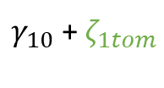


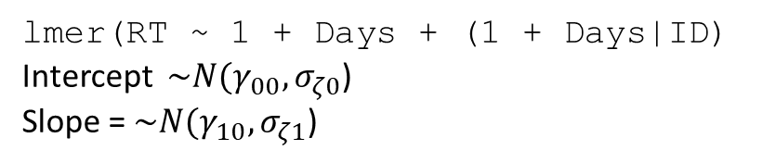



lmer(RT ~ 1 + Days + (1 + Days|ID)
Intercept $\sim N(γ_{00},σ_{ζ0}$)
Slope = $\sim N(γ_{10},σ_{ζ1}$)
Josiah
1
$γ_{10}$ +${ ζ}_{1josiah}$
$$ζ_{0josiah}$$
RT
$$σ_{ζ0}$$
$$γ_{10}$$
Tom
$$γ_{00}$$
1
$$ζ_{0tom}$$
$γ_{10}$ + $ζ_{1tom}$
1
days of sleep deprivation

Slide 9



lmer(RT ~ 1 + Days + (1 + Days|ID)
Intercept $\sim N(γ_{00},σ_{ζ0}$)
Slope = $\sim N(γ_{10},σ_{ζ1}$)
Josiah
1
$γ_{10}$ +${ ζ}_{1josiah}$
$$ζ_{0josiah}$$
RT
$$σ_{ζ0}$$
$$γ_{10}$$
Tom
$$γ_{00}$$
1
$$σ_{ζ1}$$
$$ζ_{0tom}$$
J
$$γ_{10}$$
$$T$$
$γ_{10}$ + $ζ_{1tom}$
1
days of sleep deprivation

Slide 10
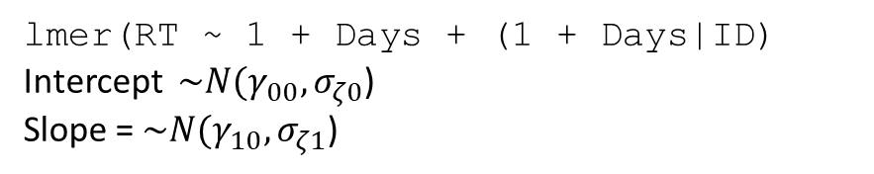
lmer(RT ~ 1 + Days + (1 + Days|ID)
Intercept $\sim N(γ_{00},σ_{ζ0}$)
Slope = $\sim N(γ_{10},σ_{ζ1}$)
Josiah
1
$γ_{10}$ +${ ζ}_{1josiah}$
$$ζ_{0josiah}$$
RT
$$σ_{ζ0}$$
$$γ_{10}$$
Tom
$$γ_{00}$$
1
$$σ_{ζ1}$$
$$ζ_{0tom}$$
$$γ_{10}$$
$γ_{10}$ + $ζ_{1tom}$
1
days of sleep deprivation

Slide 11
lmer(RT ~ Days + (1 + Days|Department/ID)
Josiah
Psychology
Tom
Linguistics
Engineering
days of sleep deprivation

Slide 12
lmer(RT ~ Days + (1|ID) + (1|Task)
Josiah
Tom
Josiah
RT
Tom
$$γ_{00}$$
TaskX
TaskY
TaskZ
days of sleep deprivation

Slide 13
lm(RT ~ 1 + Days)
Intercept (RT at day 0) = $β_{0}$
Slope (Change in RT each day) = $β_{1}$
Josiah
Umberto
Monica
Emma
RT
$$β_{1}$$
Alex
$$β_{0}$$
1
Tom
days of sleep deprivation

