Slide 1
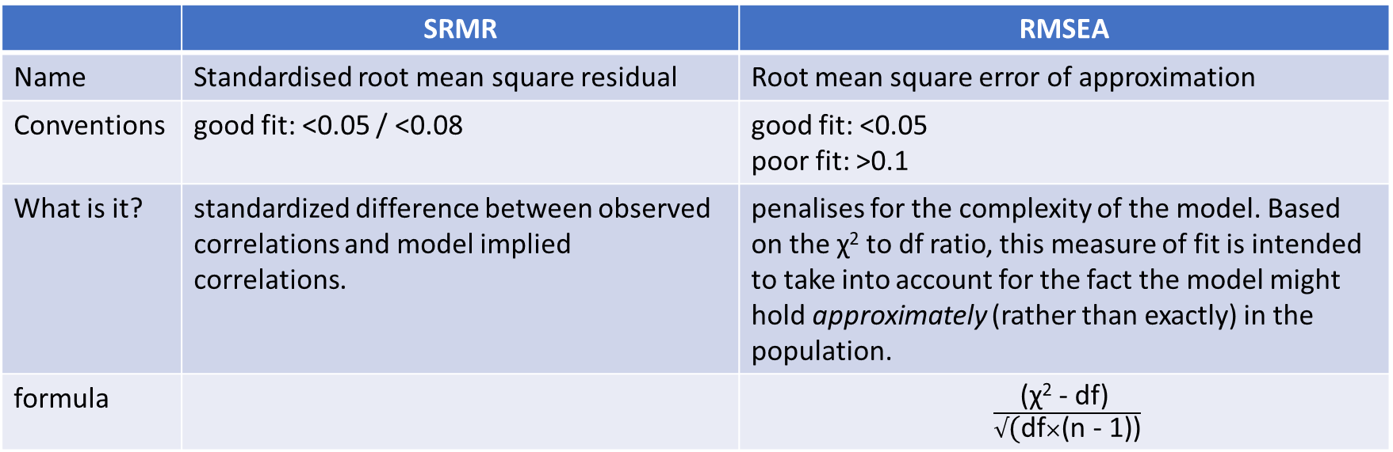
Absolute fit indices measures of fit are based on comparing our model to a (hypothetical) perfectly fitted model. So we get an indication of "how far from perfect fit" our model is. Smaller values indicate closer fit, larger values indicate worse fit.
 | SRMR | RMSEA
Name | Standardised root mean square residual | Root mean square error of approximation
Conventions | good fit: <0.05 / <0.08 | good fit: <0.05 poor fit: >0.1
What is it? | standardized difference between observed correlations and model implied correlations. | penalises for the complexity of the model. Based on the χ² to df ratio, this measure of fit is intended to take into account for the fact the model might hold approximately (rather than exactly) in the population.
formula |  | $\frac{\text{(}\text{χ}\text{2}\text{ - }\text{df}\text{) }}{√\text{(}\text{df}×\text{(}\text{n}\text{ - 1)}\text{)}}$

Slide 2
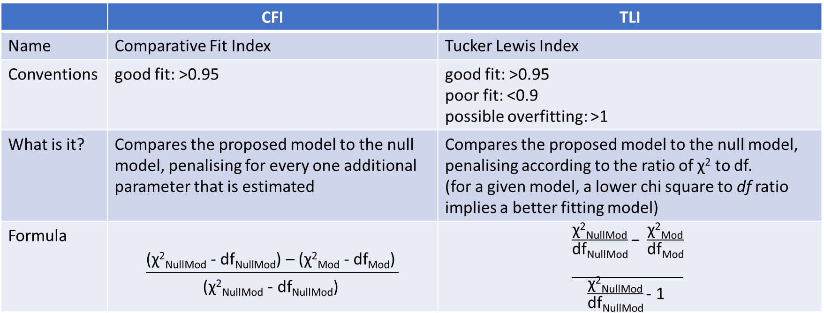
Incremental fit indices compare our model to a baseline model. Typically, this is the ‘null model’, in which variances are estimated, but covariances are fixed to zero.
Both of these (TLI & CFI) are somewhat sensitive to the average size of correlations in the data. If the average correlation between variables is low, then these indices will not be very high.
 | CFI | TLI
Name | Comparative Fit Index | Tucker Lewis Index
Conventions | good fit: >0.95 | good fit: >0.95 poor fit: <0.9 possible overfitting: >1
What is it? | Compares the proposed model to the null model, penalising for every one additional parameter that is estimated | Compares the proposed model to the null model, penalising according to the ratio of $\text{χ}\text{2}$ to df. (for a given model, a lower chi square to df ratio implies a better fitting model)
Formula | $$\frac{\text{(}\text{χ}\text{2}\text{NullMod}\text{ - }\text{dfNullMo}\text{d}\text{) – (}\text{χ}\text{2}\text{Mod}\text{ - }\text{dfMod}\text{) }}{\text{(}\text{χ}\text{2}\text{NullMod}\text{ - }\text{dfNullMo}\text{d}\text{)} }$$ | $$\frac{\frac{\text{χ}\text{2}\text{NullMod}}{\text{d}\text{f}\text{NullMod}}\text{− }\frac{\text{χ}\text{2}\text{Mod}}{\begin{aligned}\text{d}\text{f}\text{Mod} \\ \end{aligned}}}{\frac{\text{χ}\text{2}\text{NullMod}}{\text{d}\text{f}\text{NullMod}}\text{- 1 }}$$

