Slide 1
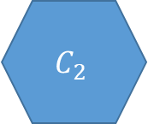

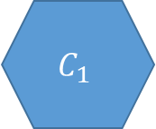

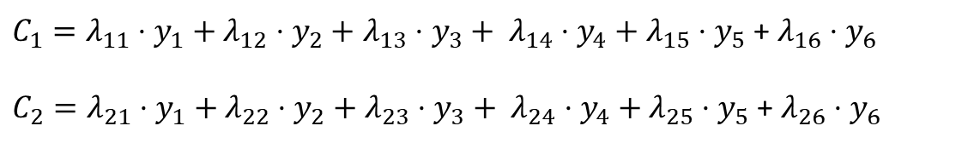




Principal Components Analysis (PCA)
$$y_{1}$$
$C_{1}=λ_{11}⋅y_{1}+λ_{12}⋅y_{2}+$ $λ_{13}⋅y_{3}+ λ_{14}⋅y_{4}+λ_{15}⋅y_{5}$ + $λ_{16}⋅y_{6}$
$C_{2}=λ_{21}⋅y_{1}+λ_{22}⋅y_{2}+$ $λ_{23}⋅y_{3}+ λ_{24}⋅y_{4}+λ_{25}⋅y_{5}$ + $λ_{26}⋅y_{6}$
$$y_{2}$$
$$C_{1}$$
$$y_{3}$$
$$y_{4}$$
$$C_{2}$$
$$y_{5}$$
Arrows go from variables to components, indicating that a Principal Component is a composite of observed variables - each component is a weighted sum of the measured variables.
$$y_{6}$$

Slide 2
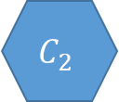
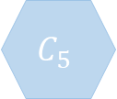
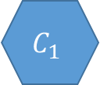
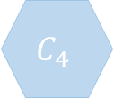
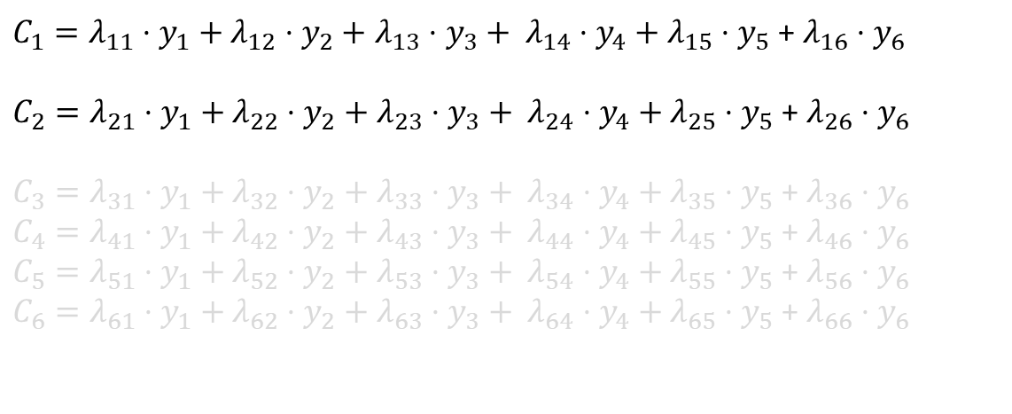
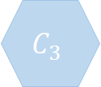

Principal Components Analysis (PCA)
$$y_{1}$$
$$C_{1}$$
$C_{1}=λ_{11}⋅y_{1}+λ_{12}⋅y_{2}+$ $λ_{13}⋅y_{3}+ λ_{14}⋅y_{4}+λ_{15}⋅y_{5}$ + $λ_{16}⋅y_{6}$
$C_{2}=λ_{21}⋅y_{1}+λ_{22}⋅y_{2}+$ $λ_{23}⋅y_{3}+ λ_{24}⋅y_{4}+λ_{25}⋅y_{5}$ + $λ_{26}⋅y_{6}$
$C_{3}=λ_{31}⋅y_{1}+λ_{32}⋅y_{2}+$ $λ_{33}⋅y_{3}+ λ_{34}⋅y_{4}+λ_{35}⋅y_{5}$ + $λ_{36}⋅y_{6}$
$C_{4}=λ_{41}⋅y_{1}+λ_{42}⋅y_{2}+$ $λ_{43}⋅y_{3}+ λ_{44}⋅y_{4}+λ_{45}⋅y_{5}$ + $λ_{46}⋅y_{6}$
$C_{5}=λ_{51}⋅y_{1}+λ_{52}⋅y_{2}+$ $λ_{53}⋅y_{3}+ λ_{54}⋅y_{4}+λ_{55}⋅y_{5}$ + $λ_{56}⋅y_{6}$
$C_{6}=λ_{61}⋅y_{1}+λ_{62}⋅y_{2}+$ $λ_{63}⋅y_{3}+ λ_{64}⋅y_{4}+λ_{65}⋅y_{5}$ + $λ_{66}⋅y_{6}$
$$y_{2}$$
$$C_{2}$$
$$y_{3}$$
$$C_{3}$$
$$y_{4}$$
$$C_{4}$$
PCA is a re-expression of n variables into n orthogonal composites, which sequentially capture smaller and smaller portions of the variance. The data reduction comes from our choice to keep a subset of the components, each of which represents a different ‘dimension’ of the data.
$$y_{5}$$
$$C_{5}$$
$$y_{6}$$
$$C_{6}$$

Slide 3
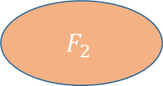
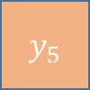
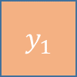


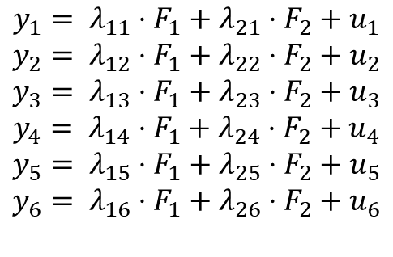

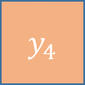




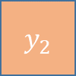

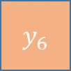
Exploratory Factor Analysis (EFA)
$$y_{1}$$
$$u_{1}$$
$$y_{1}= λ_{11}⋅F_{1}+λ_{21}⋅F_{2}+u_{1}$$
$$y_{2}= λ_{12}⋅F_{1}+λ_{22}⋅F_{2}+u_{2}$$
$$y_{3}= λ_{13}⋅F_{1}+λ_{23}⋅F_{2}+u_{3}$$
$$y_{4}= λ_{14}⋅F_{1}+λ_{24}⋅F_{2}+u_{4}$$
$$y_{5}= λ_{15}⋅F_{1}+λ_{25}⋅F_{2}+u_{5}$$
$$y_{6}= λ_{16}⋅F_{1}+λ_{26}⋅F_{2}+u_{6}$$
$$F_{1}$$
$$y_{2}$$
$$u_{2}$$
$$y_{3}$$
$$u_{3}$$
$$y_{4}$$
$$u_{4}$$
$$F_{2}$$
$$y_{5}$$
$$u_{5}$$
Arrows go from factors to variables, indicating that we are modelling values on observed variables as being generated by some underlying common factor plus an additional factor that is unique to that variable.
$$y_{6}$$
$$u_{6}$$

Slide 4
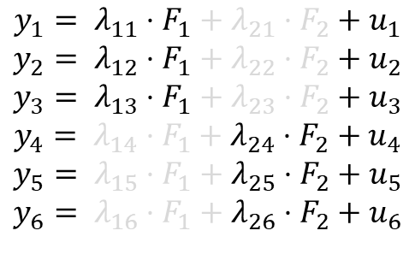
Exploratory Factor Analysis (EFA), rotated
$$y_{1}$$
$$u_{1}$$
$$y_{1}= λ_{11}⋅F_{1}+λ_{21}⋅F_{2}+u_{1}$$
$$y_{2}= λ_{12}⋅F_{1}+λ_{22}⋅F_{2}+u_{2}$$
$$y_{3}= λ_{13}⋅F_{1}+λ_{23}⋅F_{2}+u_{3}$$
$$y_{4}= λ_{14}⋅F_{1}+λ_{24}⋅F_{2}+u_{4}$$
$$y_{5}= λ_{15}⋅F_{1}+λ_{25}⋅F_{2}+u_{5}$$
$$y_{6}= λ_{16}⋅F_{1}+λ_{26}⋅F_{2}+u_{6}$$
$$F_{1}$$
$$y_{2}$$
$$u_{2}$$
$$y_{3}$$
$$u_{3}$$
$$y_{4}$$
$$u_{4}$$
$$F_{2}$$
$$y_{5}$$
$$u_{5}$$
Rotations transform the factors to allow for a clearer structure (variables loading primarily on to one factor rather than several).
Oblique rotations allow factors to be correlated
$$y_{6}$$
$$u_{6}$$

Slide 5

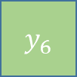
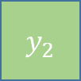
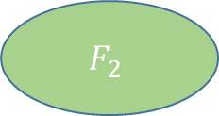
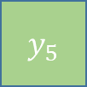
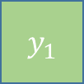
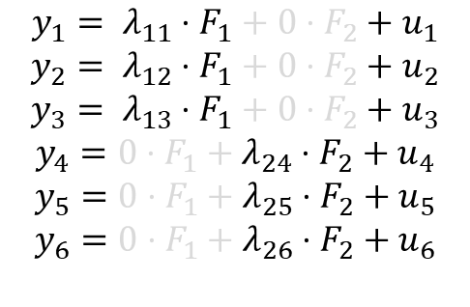
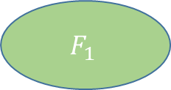

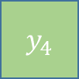


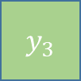


Confirmatory Factor Analysis (CFA)
$$y_{1}$$
$$u_{1}$$
$$y_{1}= λ_{11}⋅F_{1}+0⋅F_{2}+u_{1}$$
$$y_{2}= λ_{12}⋅F_{1}+0⋅F_{2}+u_{2}$$
$$y_{3}= λ_{13}⋅F_{1}+0⋅F_{2}+u_{3}$$
$$y_{4}=0⋅F_{1}+λ_{24}⋅F_{2}+u_{4}$$
$$y_{5}=0⋅F_{1}+λ_{25}⋅F_{2}+u_{5}$$
$$y_{6}=0⋅F_{1}+λ_{26}⋅F_{2}+u_{6}$$
$$F_{1}$$
$$y_{2}$$
$$u_{2}$$
$$y_{3}$$
$$u_{3}$$
$$y_{4}$$
$$u_{4}$$
$$F_{2}$$
$$y_{5}$$
$$u_{5}$$
A Confirmatory Factor model is one in which values on observed variables are generated specifically by one/some factors but not others. The lack of an arrow from F₁ to y₄ indicates that being lower/higher on from F₁ is not directly linked to scoring lower/higher on y₄
$$y_{6}$$
$$u_{6}$$

Slide 6




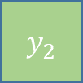





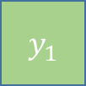
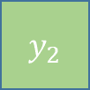





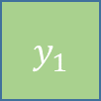









“Congeneric” Factor Model
$$y_{1}$$
Typically, the factor analytic models that we fit will estimate:
item-specific loadings, denoted by λ (“lambda”)
item-specific variances, denoted by θ (“theta”).
The scaling of the latent variable is defined by setting its variance to 1 (or sometimes we fix a single loading to 1 instead).
$$u_{1}$$
$$θ_{1}$$
$$λ_{1}$$
$$F_{1}$$
$$λ_{2}$$
$$y_{2}$$
$$u_{2}$$
1
$$θ_{2}$$
$$λ_{3}$$
$$y_{3}$$
$$u_{3}$$
$$θ_{3}$$
Sum Scores and Mean Scores
$$y_{1}$$
$$u_{1}$$
$$θ$$
When we compute a sum score, we are implicitly referring to a model in which:
All items have the same loading (in this case 1)
All items have the same variance.
$$1$$
$$F_{1}$$
$$1$$
$$y_{2}$$
$$u_{2}$$
$$Ψ$$
$$θ$$
$$1$$
$$y_{3}$$
$$u_{3}$$
$$θ$$

