Slide 1
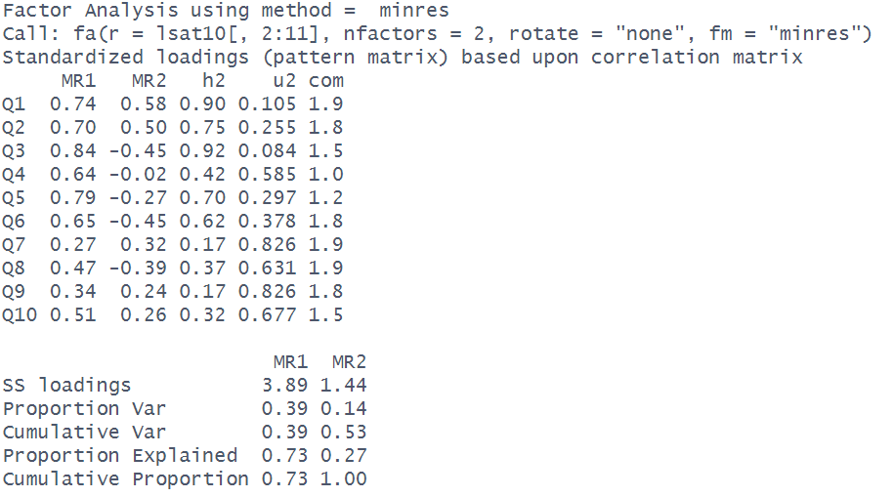
LOADINGS
Each column is a factor (these are named according to the extraction method)
Each row is an item (one of our measured variables)

Slide 2
LOADINGS
Each column is a factor (these are named according to the extraction method)
Loadings show the association between each item and each factor.
Each row is an item (one of our measured variables)
A squared loading reflects the proportion of variance in an item that is explained by a factor.
Loadings > 1 are a problem! (a factor can’t explain more than 100% of the variance in an item!)

Slide 3
LOADINGS (Orthogonal or No Rotation)
Each column is a factor (these are named according to the extraction method)
Loadings show the association between each item and each factor.
With no rotation or an orthogonal rotation these are correlation coefficients.
Each row is an item (one of our measured variables)
A squared loading reflects the proportion of variance in an item that is explained by a factor.
e.g., 0.51² = 0.26
26% of the variance in Q10 is explained by Factor 1
Variance in Q10 explained by MR2
Q10
Variance in Q10 explained by MR1
MR2
MR1
rotate = “none”
means that MR1 and MR2 are uncorrelated (no overlap)

Slide 4
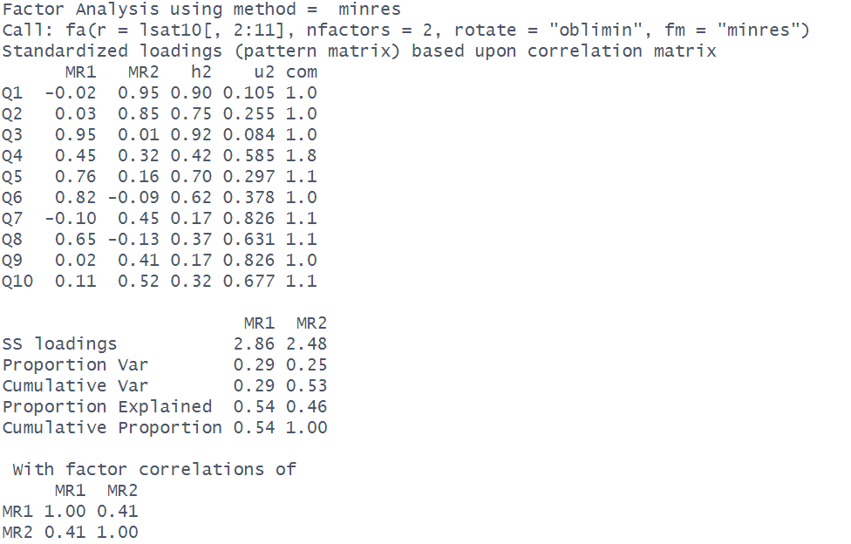
LOADINGS (Oblique Rotation)
Each column is a factor (these are named according to the extraction method)
Loadings show the association between each item and each factor.
With an oblique rotation, the pattern matrix shows something similar to standardised regression coefficients:
item_{i} = loading_{F1,i}*Factor1 + loading_{F2,i}*Factor2 + … + uniqueness_{i}
Each row is an item (one of our variables)
A squared loading reflects the proportion of variance in an item that is uniquely explained by a factor.
e.g., 0.52² = 0.27
27% of the variance in Q10 is explained by Factor 2
Variance in Q10 explained by MR2
Q10
MR2
MR1
Variance in Q10 explained by MR1
oblique rotation
means that MR1 and MR2 are correlated (overlap)

Slide 5
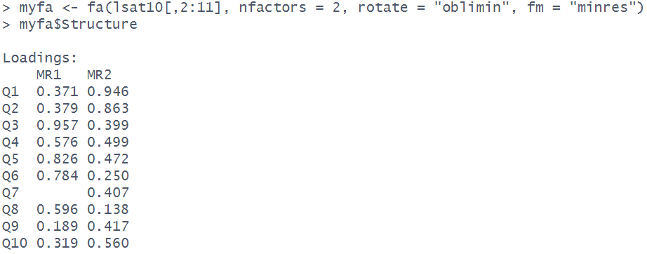
RABBIT HOLE: STRUCTURE MATRIX vs PATTERN MATRIX
When an oblique rotation is used, factors can be correlated. Therefore to get the unique association between item and factors, we use the “pattern matrix”. This is what fa() prints by default. The loadings in the pattern matrix are similar to regression weights from a model of item ~ factor1 + factor2.
Behind the scenes, there is also the “Structure matrix” which contains the correlations cor(item, factor1) and cor(item, factor2).
If the factors are not correlated (by definition they are uncorrelated when no rotation or an orthogonal rotation is used), then pattern matrix and structure matrix are identical.
Q10
Q10
MR2
MR2
MR1
MR1

Slide 6
COMMUNALITIES
communalities give us the proportion of variance in an item that is explained by all the factors. e.g., 32% of the variance in Q10 is explained by the two factors
If no rotation or an orthogonal rotation is used, then we can get these numbers by taking the all the loadings for a given item, squaring them, and adding them up.

Slide 7
UNIQUENESS
The proportion of variance in each item that is left unexplained by the factors is 1 minus the communality.
e.g., 68% of the variance in Q10 is left unexplained

Slide 8
COMPLEXITY
The extent to which a given item loads on to a single factor vs onto multiple factors is termed ‘complexity’.
It equals 1 if an item loads only on one factor, 2 if it loads evenly on 2 factors, and so on.

Slide 9
SS Loadings & “Variance Accounted For”
Square all the loadings for each factor and add them up. This gives you the “SS loadings”.
These are the same as the eigenvalues unless an oblique rotation is used. As the variance in each item is scaled to be 1, the total variance in the data is equal to the number of items.

Slide 10
SS Loadings & “Variance Accounted For”
SS loadings divided by number of items gives the proportion of variance in the data explained by each factor
e.g., 2.86/10 = 0.29
29% of the total variance is explained by Factor 1

Slide 11
SS Loadings & “Variance Accounted For”
Taking each factor sequentially, we can calculate the cumulative variance explained.
e.g., 0.29+0.25 = 0.53

Slide 12
SS Loadings & “Variance Accounted For”
Out of the total variance explained by all factors, we can calculate the proportion of this that is explained by each factor.
e.g., 0.29/0.53 = 0.54
We can see this cumulatively too

Slide 13
FACTOR CORRELATIONS
Correlation matrix for the factors. Only present with oblique rotations. Shows how related the factors are to one another.

Slide 14
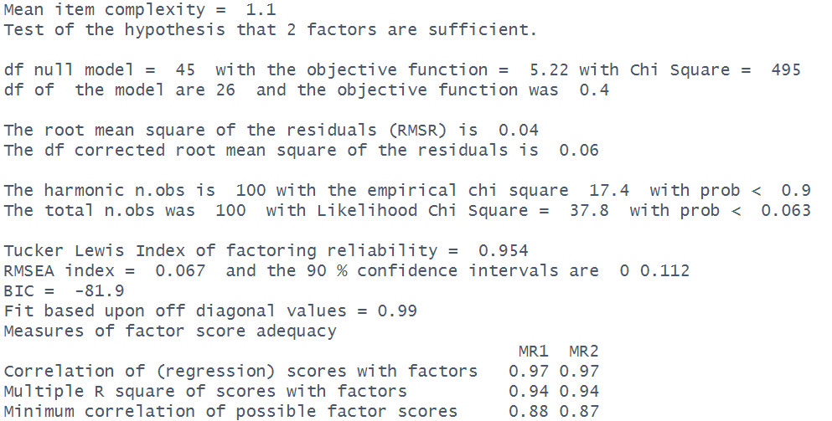
OPTIONAL EXTRA: GOODNESS OF FIT TEST
Mean of the item complexities column
the “null model” is a model that assumes no correlation structure. df = p * (p-1)/2
p = number of items
our model df = p * (p-1)/2 - p * nF + nF*(nF-1)/2
p = number of items
nF = number of factors
Chi-square ‘goodness of fit’ for our model (calculated two ways, see ?factor.stats ). The set of parameters from our model implies a correlation matrix, and we have our observed matrix. The discrepancy between these is the residual correlation matrix, and it is on this that the Chi-Square statistic is based (think “observed minus expected”).
Lower Chi-Square values are better. A significant Chi-square value indicates possible under-extraction of factors.
average number of non-missing observations for each pair of items
Total number of observations in the data

Slide 15
OPTIONAL EXTRA: FIT INDICES
All of these are essentially measure of how well (or how badly) the model fits to the observed data. They are more conventionally used in confirmatory factor analysis (CFA) and structural equation modelling (SEM), but are printed here too.
We want RMSR to be low (it indicates the average size of the residual correlation)
Tucker Lewis Index (TLI) compares the chi-square of our model to that of the null model (adjusted for the df). It ranges 0 to 1, and we want it to be high. Typical cut-offs used to indicate good fit are >0.9 or >0.95.
RMSEA is a measure of how far our model is from a ‘perfect model’. Lower is better, and typical cut-offs used to indicate good fit are <0.05, <0.08 or <0.1.
BIC is only relevant for comparing models

Slide 16
OPTIONAL EXTRA: INDETERMINACY INDICES
“Factor score indeterminacy”: there are an infinite number of pairs of factor loadings and factor score matrices which will fit the data equally well, and are thus indistinguishable by any numeric criteria, so there are infinite number of sets of factor scores that are consistent with a given set of loadings.
Multiple R square of scores with factors “The multiple R² between the factors and factor score estimates, if they were to be found." (Grice, 2001). This is a little bit like the R² for a regression model of the items predicting the estimated factor score. If we could perfectly predict factor scores from items, then it would be 1.
Correlation of (regression) scores with factors This just the square root of the multiple R².
Minimum correlation of possible factor scores This is 2 x R² – 1, so essentially the R² but transformed to be between -1 and 1.

Slide 17
set.seed(533)
makeitems <- function(){
S = runif(5,.4,2)
f = runif(5,.4,.99)
R = f %*% t(f)
diag(R) = 1
items = round(MASS::mvrnorm(400, mu = rnorm(5,3,.6), Sigma=diag(S)%*%R%*%diag(S)))
apply(items, 2, function(x) pmin(7,pmax(1,x)))
}
eg_data = do.call(cbind,lapply(1:2, function(x) makeitems()))
eg_data[,5] <- round(rowMeans(eg_data[,c(5,10)]))
eg_data <- eg_data[,-10]
eg_data[,1] <- max(eg_data[,1]) - eg_data[,1] + 1
eg_data[,6] <- max(eg_data[,6]) - eg_data[,6] + 1
eg_data <- as.data.frame(eg_data)
names(eg_data) <- paste0("item_",1:9)
mm = fa(eg_data, nfactors=2, rotate = "oblimin", fm="ml")
mm
# tli
((1138.13/36) - (20.71/19)) /
((1138.13/36) - 1)
# rmsea
sqrt(20.71 - 19) /
sqrt(19*(400-1))

Slide 18
Variance in Q10 explained by ML2
Q10
Variance in Q10 explained by ML1
ML2
ML1
rotate = “none”
means that ML1 and ML2 are uncorrelated (no overlap)
Variance in Q10 explained by ML2
Q10
ML2
ML1
Variance in Q10 explained by ML1
oblique rotation
means that ML1 and ML2 are correlated (overlap)

