Slide 1
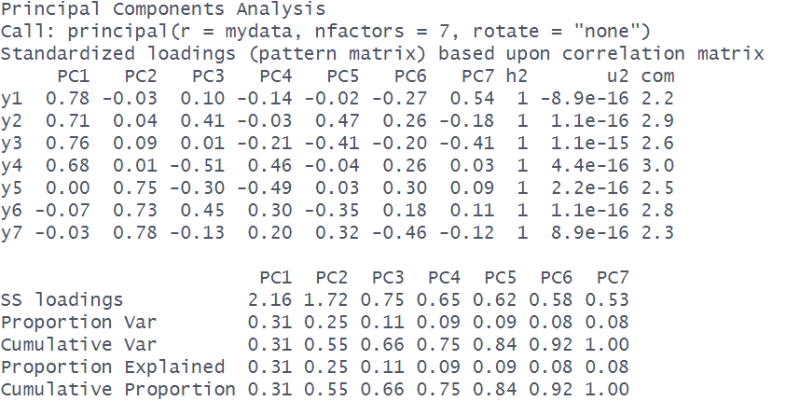
LOADINGS
(how each observed variables relates to each component)
VARIANCE ACCOUNTED FOR
(how much total variance is accounted for by each component)

Slide 2
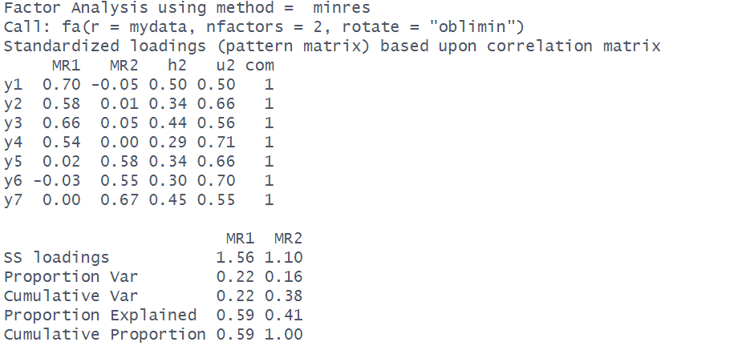
LOADINGS
(how each observed variable is predicted by each component)
factor
VARIANCE ACCOUNTED FOR
(how much total variance is accounted for by each component)
explained
factor

