Slide 1
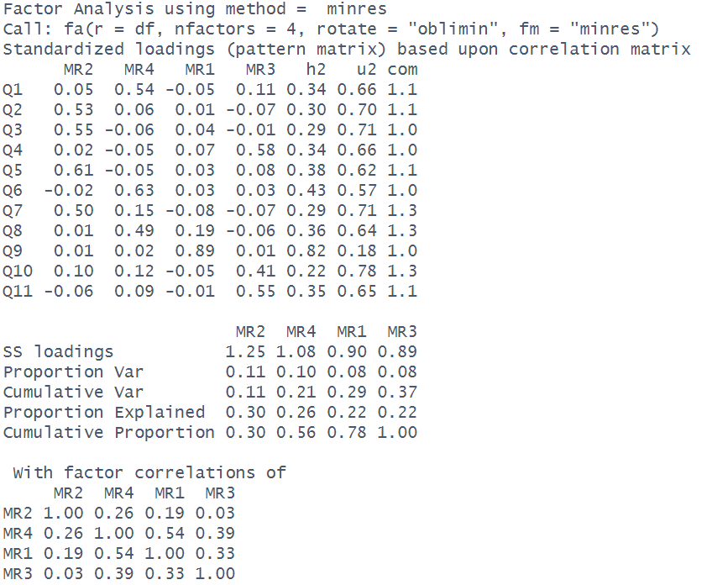
My manager actively helps me overcome workplace obstacles.
I feel emotionally drained at the end of my workday.
I feel wiped out before my workday even begins.
I have total control over how I structure my daily tasks.
Working all day is a real strain for me.
I receive constructive and timely feedback from leadership.
I feel burned out from my current job responsibilities.
I feel supported by my organization when facing heavy demands.
Overall, I am completely satisfied with my job.
I am free to decide when to take breaks or complete tasks.
I can choose the methods I use to accomplish my goals.

Slide 2
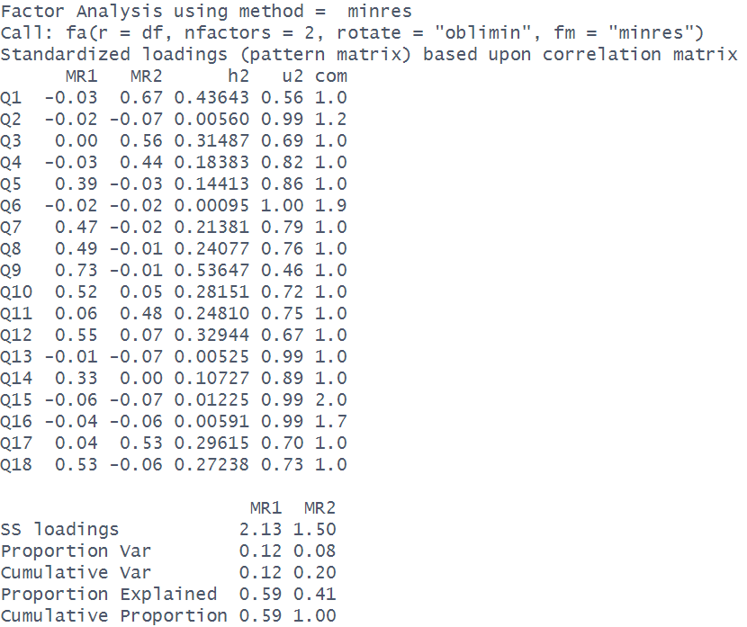

I buy things spontaneously
I stick to favourite brands
I make unplanned purchases
I shop on impulse
I stress over purchase choices
I always buy the same label
I worry about overspending
I feel buyer's remorse
I get anxious about bad deals
I dread hidden fees
I treat myself frequently
I second-guess my purchases
I trust preferred brands
I fear wrong choices
I am loyal to specific shops
I never switch retailers
I can't resist sales
I obsess over checkout totals

Slide 3
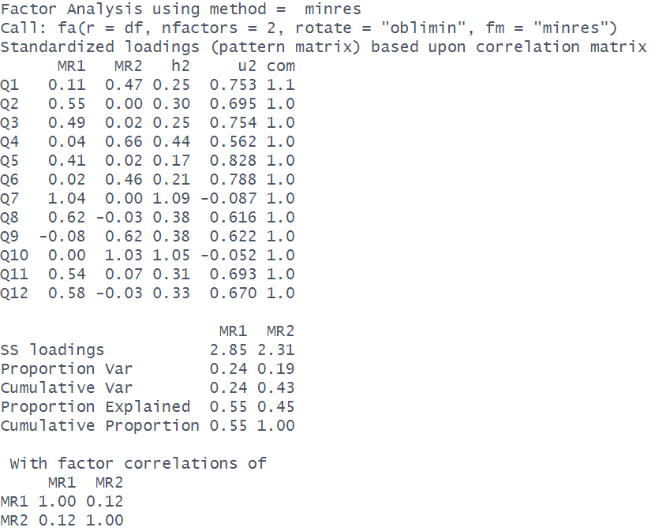
I change topic to avoid arguments
I feel deep compassion for suffering of others
I am affected by other people's misfortunes
I keep quiet rather than start conflict
I want to protect vulnerable individuals
I smooth over tense personal disagreements
I feel deep compassion for anyone who suffers
I share in the emotional pain of friends
I yield easily to keep the peace
I avoid interpersonal confrontations
I am touched by the hardships of others
I suffer along with people in trouble

Slide 4
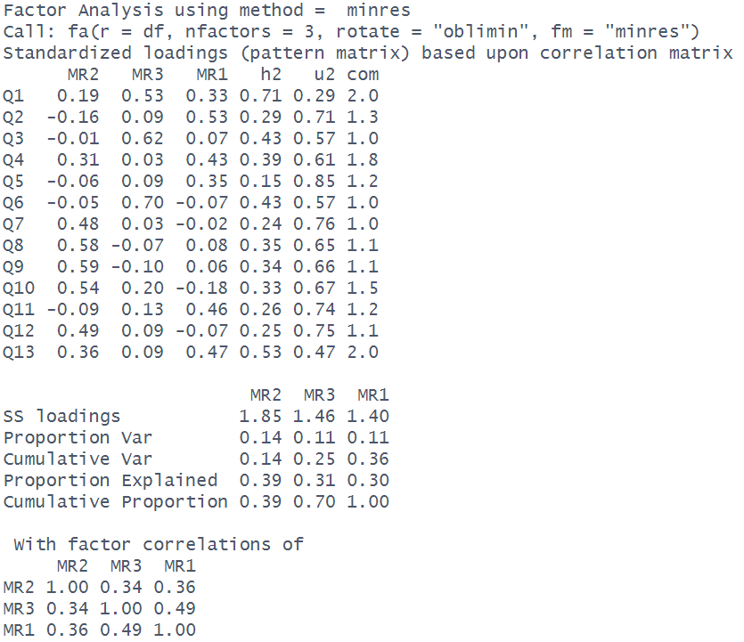
Process my feelings with friends
Reach out to support groups
Journal about my emotional struggles
Ask family to help track my daily medication
Talk with others who share my diagnosis
Express my frustrations about being sick
Adjust my daily activity level to conserve energy
Track and manage physical pain symptoms
Follow prescribed medical routines
Modify physical exercises to avoid feeling discouraged
Rely on loved ones during health crises
Take resting breaks when symptoms flare up
Attend doctor appointments with family members

Slide 5
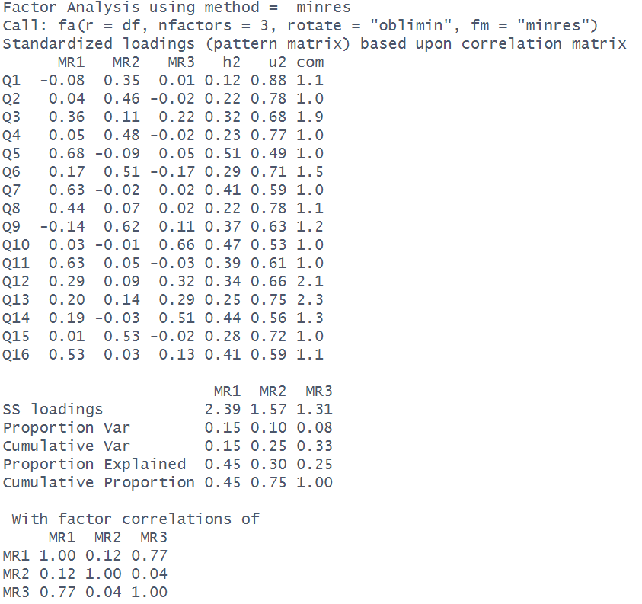
Believe human activity causes severe climate disruption
Concerned about the loss of global biodiversity
Carefully sort household plastics into recycling bins
Value protecting natural ecosystems for future generations
Consciously limit my daily household energy usage
Worry about environmental pollution in my local area
Strive to reduce my overall ecological footprint
Avoid purchasing single-use consumer products
Believe urgent societal action is needed to save the planet
Regularly separate paper and cardboard for weekly pickup
Make eco-friendly choices a top priority in my daily life
Rinse out aluminium cans before placing them in recycling bins
Check local municipal rules about sorting recyclable waste
Consistently place plastic bottles in the proper waste containers
Believe environmental protection is a moral duty
Limit personal water consumption during daily routines

