Slide 1
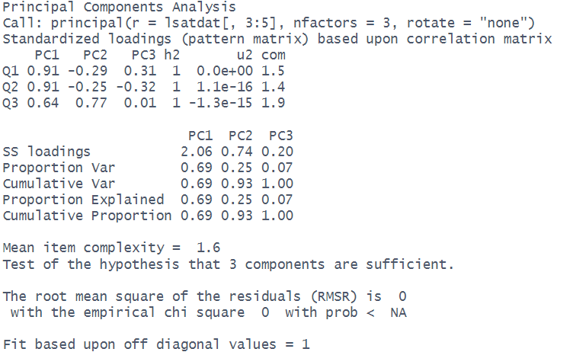

“loadings”
directions of each dimension (relative to original variables)
Correlations between items and components: r_{Q1,PC1} = .91
Squaring them gives us proportion of variance in item captured by each component: R²_{Q1,PC1} = .83
“variance accounted for”
magnitude of each dimension
SS loadings = “sums of squared loadings” = proportion of total variance (across all items) captured by each component i.e., R²_{Q1,PC1} + R²_{Q2,PC1} + R²_{Q3,PC1} = 2.06
SS loadings = $eigenvalues$
Loadings = $eigenvector×\sqrt{eigenvalue}$

