Slide 1
Truth
score
Error
1
1
When we measure something, there are two things that contribute to the number we get out:
the true value of the thing we want to measure
Error
When I measure how much Dougal weighs, and I see “23.42” on the scales. This might be a little above,
or a little below Dougal’s “true weight”. This bit above/below is the error!
Dougal’s true weight:
23.51475…kg
“23.42kg”
error
1
1

Slide 2
Forget about Dougal specifically, and just think about the dog-weighing scales that I’m using, and all the dogs
that there could ever possible be and all the measurements that we could ever possibly take.
In this abstract world, this diagram still works:
But now we can put some variances on them.
Suppose that the variance of all dogs weights is 36.4066336…..
And the error variance is 4..
True weights
Recorded weights
error
1
1
36.4066336…..
4

Slide 3
This would mean the variance of recorded weights
(the numbers we would actually record) is 36.406636…. + 4 = 40.406636….
True weights
Recorded weights
error
1
1
36.4066336…..
4

Slide 4
This would be if we had some very very accurate scales
The error variance gets smaller
True weights
Recorded weights
error
1
1
36.4066336…..
0.1

Slide 5
This would be if we had some very very accurate scales
The error variance gets smaller
So one way to think about “reliability” is the proportion of score variance that is attributed to true variance.
Variance in true scores
Variance in true scores
Reliability =
Reliability =
Variance in observed scores
Variance in true scores + variance of errors

Slide 6
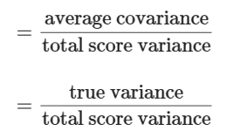

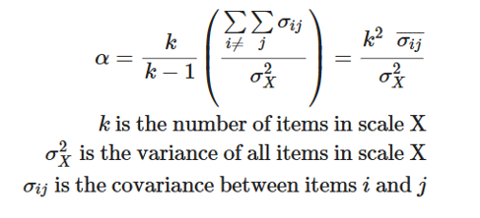
So one way to think about “reliability” is the proportion of score variance that is attributed to true variance.
Variance in true scores
Reliability =
Variance in true scores + variance of errors
So the exercise in estimating reliability comes in how we split up “truth” and “error”
CRONBACH’S ALPHA
By using “average covariance” we are assuming all items are equally important.

Slide 7
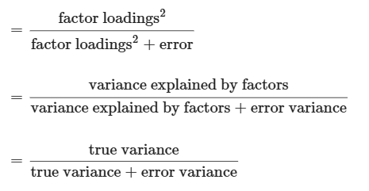
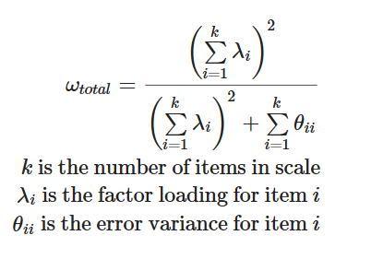
So one way to think about “reliability” is the proportion of score variance that is attributed to true variance.
Variance in true scores
Reliability =
Variance in true scores + variance of errors
So the exercise in estimating reliability comes in how we split up “truth” and “error”
MCDONALD’s OMEGA
By using factor loadings for “truth” we allow items to be differentially important

Slide 8
So one way to think about “reliability” is the proportion of score variance that is attributed to true variance.
Variance in true scores
Reliability =
Variance in true scores + variance of errors
HOLD UP…!??!?
I thought reliability was about correlation of repeated tests? Or something like that?

Slide 9
HOLD UP…!??!?
I thought reliability was about correlation of repeated tests? Or something like that?
Let’s suppose I weigh Dougal twice. I get two numbers..
“23.42kg”
error
1
Dougal’s true weight:
23.51475…kg
1
1
“23.65kg”
error
1
Remember that diagrammatic models “imply” covariances.
In this case, the only way in which weight_1 and weight_2 are related is via the true weight.
cov(weight_1, weight_2) = 1*

Slide 10
HOLD UP…!??!?
I thought reliability was about correlation of repeated tests? Or something like that?
Let’s suppose I weigh Dougal twice. I get two numbers..
Var(E)
Score at time 1
Error 1
1
True scores
1
Var(E)
1
Score at time 2
Error 2
1
Var(T)
Remember that diagrammatic models “imply” covariances.
In this case, the only way in which scores at time1 and scores at time 2 are related is via the true weight.
cov(time_1, time_2) = 1*var(T)*1
To get from cov to cor, we divide by sd(x)*sd(y). But because sd(error1) and sd(error2) are the same, the correlation between time1 and time2 becomes Var(T) / ( sd(T)+sd(E) + sd(T)+sd(E) ) =>> Var(T) / (Var(T)+Var(E))…
Back to variance in true scores / total variance!

