Slide 1
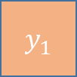
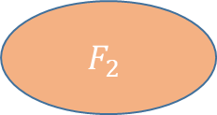
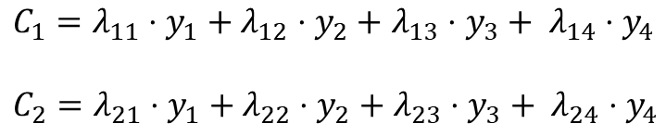
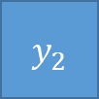
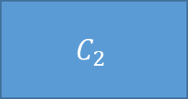
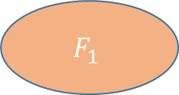




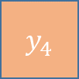
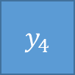

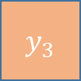
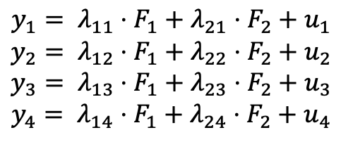
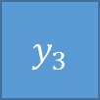


Principal Components Analysis (PCA)
Exploratory Factor Analysis (EFA)
$$y_{1}$$
$$y_{1}$$
$$u_{1}$$
$$y_{2}$$
$$C_{1}$$
$$F_{1}$$
$$y_{2}$$
$$u_{2}$$
$$y_{3}$$
$$C_{2}$$
$$F_{2}$$
$$y_{3}$$
$$u_{3}$$
$$y_{4}$$
$$y_{4}$$
$$u_{4}$$
$C_{1}=λ_{11}⋅y_{1}+λ_{12}⋅y_{2}+$ $λ_{13}⋅y_{3}+ λ_{14}⋅y_{4}$
$C_{2}=λ_{21}⋅y_{1}+λ_{22}⋅y_{2}+$ $λ_{23}⋅y_{3}+ λ_{24}⋅y_{4}$
$$y_{1}= λ_{11}⋅F_{1}+λ_{21}⋅F_{2}+u_{1}$$
$$y_{2}= λ_{12}⋅F_{1}+λ_{22}⋅F_{2}+u_{2}$$
$$y_{3}= λ_{13}⋅F_{1}+λ_{23}⋅F_{2}+u_{3}$$
$$y_{4}= λ_{14}⋅F_{1}+λ_{24}⋅F_{2}+u_{4}$$

Slide 2

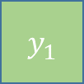
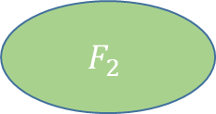
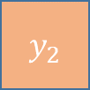

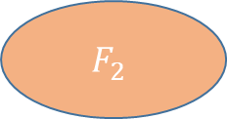
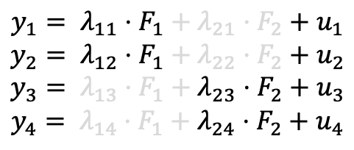
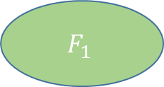
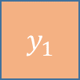
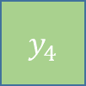

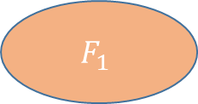

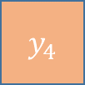
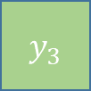
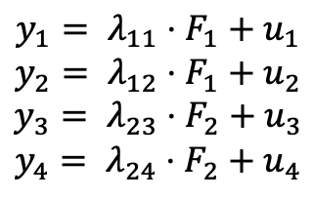


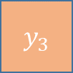

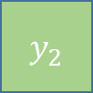

Exploratory Factor Analysis (rotated)
Confirmatory Factor Analysis (CFA)
$$y_{1}$$
$$u_{1}$$
$$y_{1}$$
$$u_{1}$$
$$F_{1}$$
$$F_{1}$$
$$y_{2}$$
$$y_{2}$$
$$u_{2}$$
$$u_{2}$$
$$F_{2}$$
$$y_{3}$$
$$u_{3}$$
$$y_{3}$$
$$u_{3}$$
$$F_{2}$$
$$y_{4}$$
$$u_{4}$$
$$y_{4}$$
$$u_{4}$$
$$y_{1}= λ_{11}⋅F_{1}+λ_{21}⋅F_{2}+u_{1}$$
$$y_{2}= λ_{12}⋅F_{1}+λ_{22}⋅F_{2}+u_{2}$$
$$y_{3}= λ_{13}⋅F_{1}+λ_{23}⋅F_{2}+u_{3}$$
$$y_{4}= λ_{14}⋅F_{1}+λ_{24}⋅F_{2}+u_{4}$$
$$y_{1}= λ_{11}⋅F_{1}+u_{1}$$
$$y_{2}= λ_{12}⋅F_{1}+u_{2}$$
$$y_{3}= λ_{23}⋅F_{2}+u_{3}$$
$$y_{4}= λ_{24}⋅F_{2}+u_{4}$$

