Slide 1
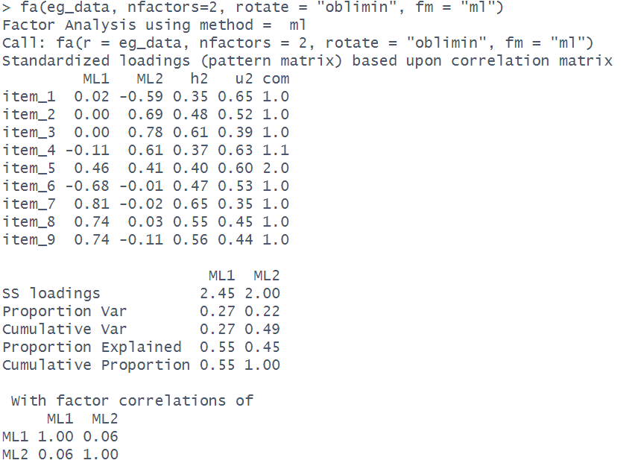
Each column is a factor (these are named according to the extraction method)
Loadings show the correlation between each item and each factor.
Each row is an item (one of our variables)
A squared loading reflects the proportion of variance in an item that is explained by a factor.
e.g., -0.59² = 0.35
35% of the variance in item 1 is explained by Factor 2

Slide 2
Square the loadings for each item and add them up, and you get the proportion of variance in an item that is explained by all the factors. This is the “communality”.
e.g., -0.11² + -0.61² = 0.37
37% of the variance in item 4 is explained by this 2 Factor solution

Slide 3
The proportion of variance in each item that is left unexplained by the factors is 1 minus the communality.
e.g., 1 - 0.37 = 0.63
63% of the variance in item 4 is left unexplained

Slide 4
The extent to which a given item loads on to a single factor vs onto multiple factors is termed ‘complexity’.
It equals 1 if an item loads only on one factor, 2 if it loads evenly on 2 factors, and so on.

Slide 5
Square all the loadings for each factor and add them up. This gives you the “SS loadings”.
These are the same as the eigenvalues unless an oblique rotation is used. As the variance in each item is scaled to be 1, the total variance in the data is equal to the number of items.

Slide 6
SS loadings divided by number of items gives the proportion of variance in the data explained by each factor
e.g., 2.45/9 = 0.27
27% of the variance is explained by Factor 1

Slide 7
Taking each factor sequentially, we can calculate the cumulative variance explained.
e.g., 0.27+0.22 = 0.49

Slide 8
Out of the total variance explained by all factors, we can calculate the proportion of this that is explained by each factor.
e.g., 0.27/0.49 = 0.55
We can see this cumulatively too

Slide 9
Correlation matrix for the factors. This will depend on whether or not a correlation is estimated (i.e. whether an oblique rotation is used). Shows how related the factors are to one another.

