Slide 1


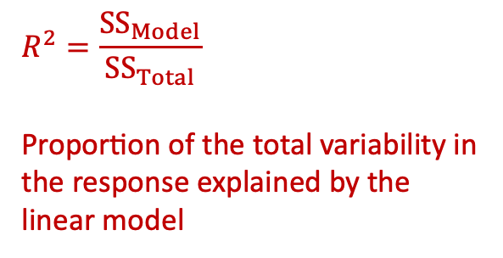


Call:
lm(formula = y ~ 1 + x, data = df)
Residuals:
Min 1Q Median 3Q Max
-0.23327 -0.06267 0.02448 0.06006 0.12851
Coefficients:
Estimate Std. Error t value Pr(>|t|)
(Intercept) 2.98639 0.07648 39.05 2.03e-10 ***
x 2.04039 0.12186 16.74 1.64e-07 ***
---
Signif. codes: 0 ‘***’ 0.001 ‘**’ 0.01 ‘*’ 0.05 ‘.’ 0.1 ‘ ’ 1
Residual standard error: 0.1154 on 8 degrees of freedom
Multiple R-squared: 0.9723, Adjusted R-squared: 0.9688
F-statistic: 280.4 on 1 and 8 DF, p-value: 1.638e-07
$$\hat{y}={\hat{β}}_{0}+{\hat{β}}_{1} x$$
Tests if the population slope $β_{1}$
is equal to 0 or it is different from 0
$${\hat{β}}_{0}$$
$${\hat{β}}_{1}$$
$$R^{2}=\frac{{SS}_{Model}}{{SS}_{Total}}$$
Proportion of the total variability in the response explained by the linear model
Test of model utility

