Slide 1
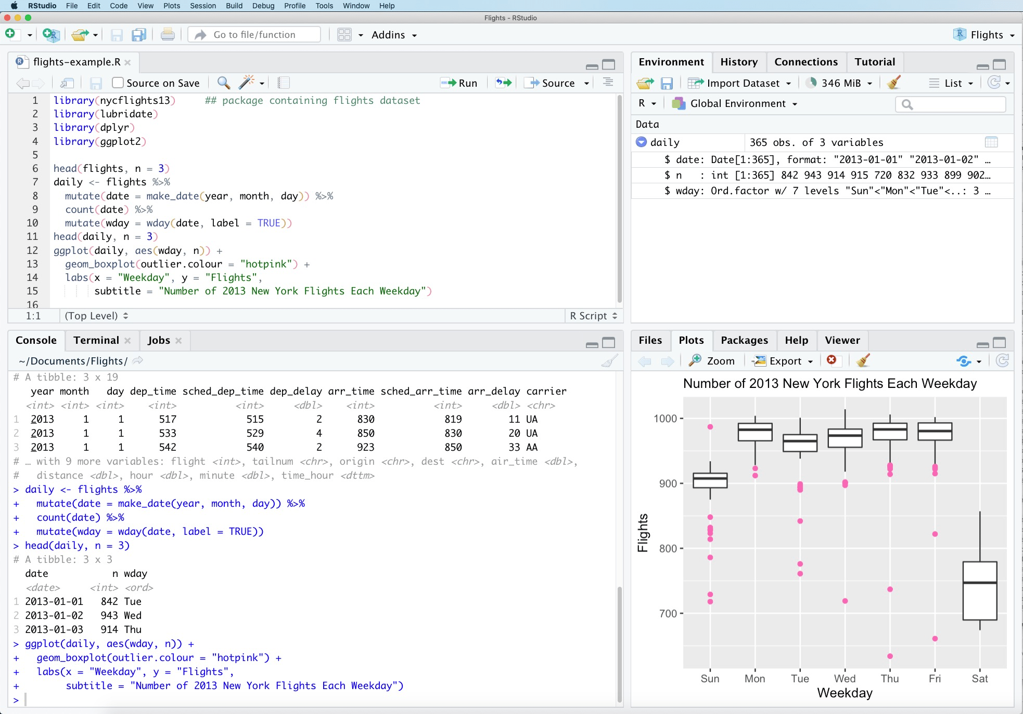
EDITOR
ENVIRONMENT
CONSOLE
PLOTS AND FILES

Slide 2
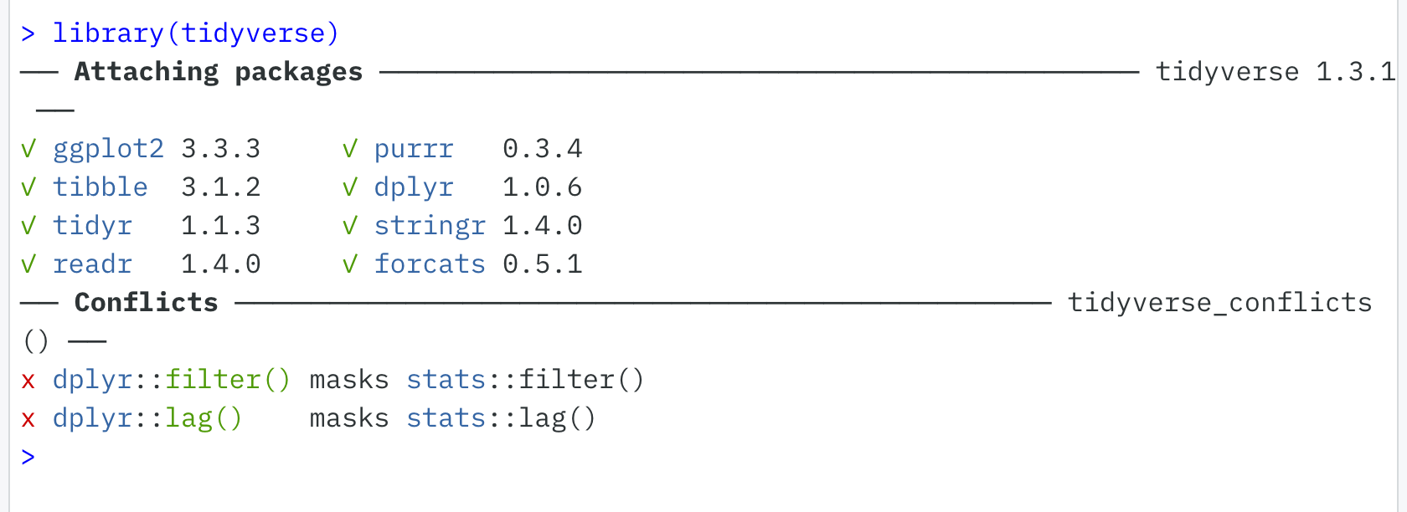

Slide 3
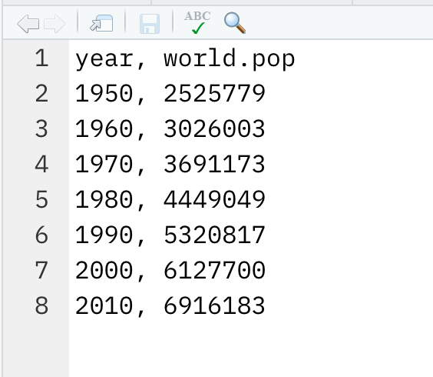
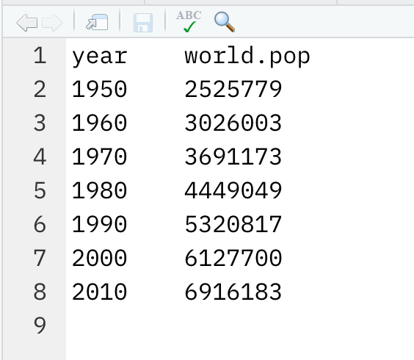
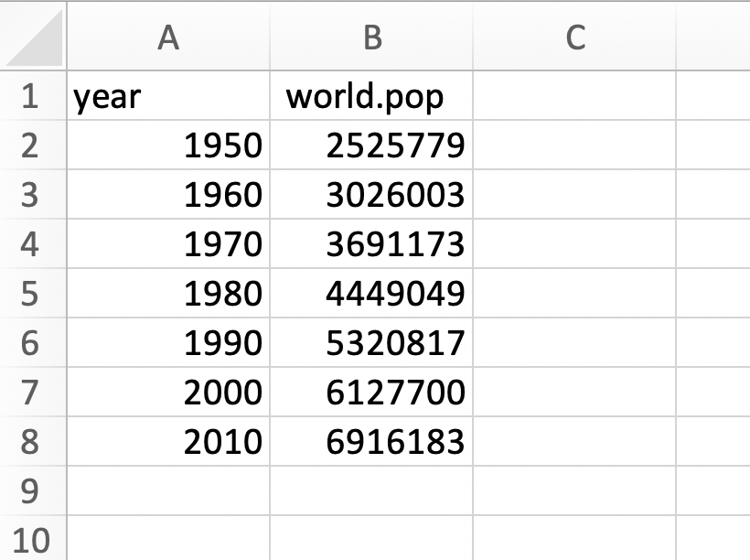

Slide 4
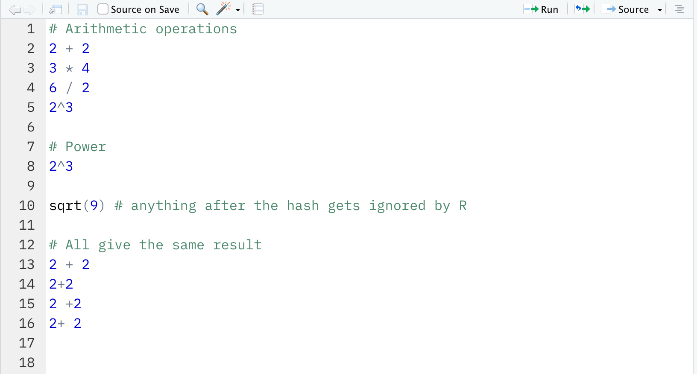

Slide 5
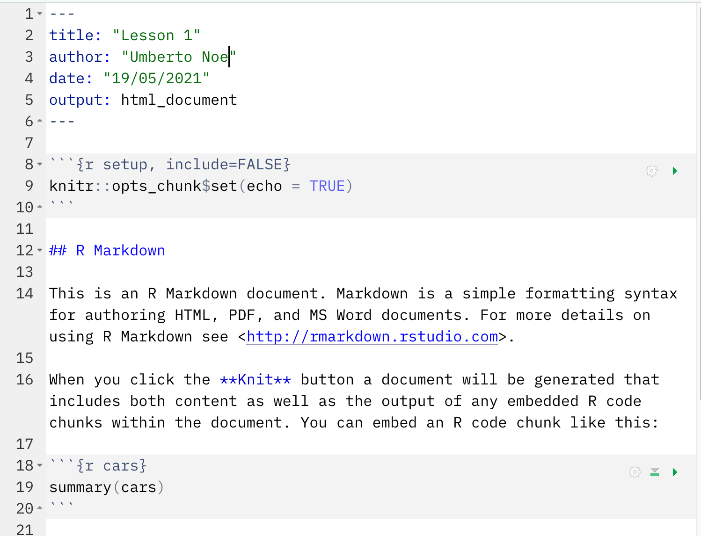
DOCUMENT SETTINGS
TELLS R TO SHOW ALL
CODE GRAY BOXES
SECTION HEADING

Slide 6
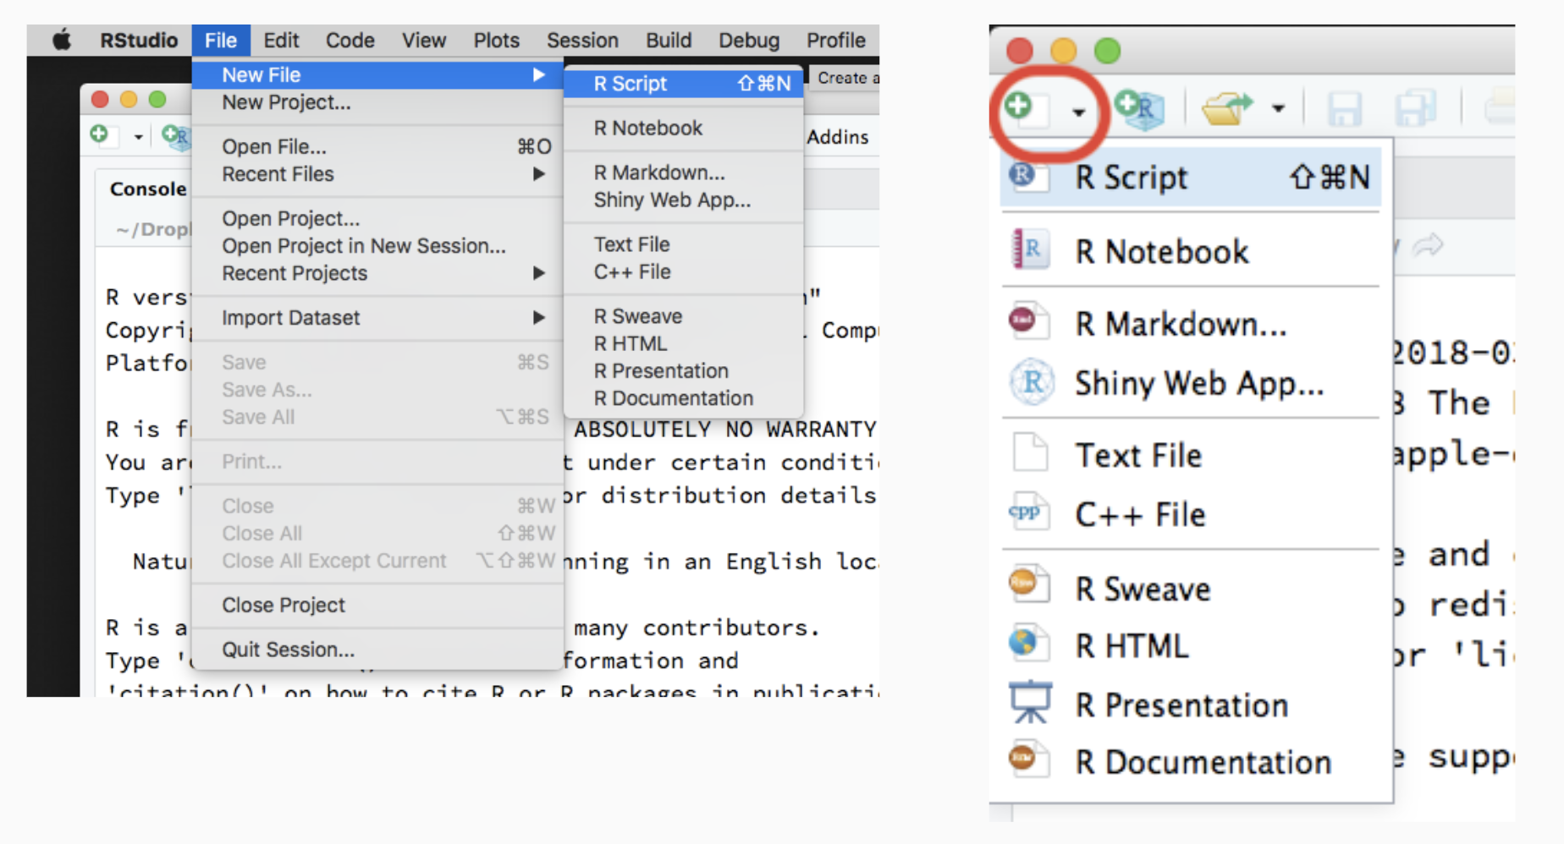

Slide 7

base
stats
graphics
c()
data.frame()
sum()
mean()
...
cov()
cor()
dnorm()
pnorm()
rnorm()
...
boxplot()
legend()
...

Slide 8

base
graphics
stats
grid
lattice
MASS
Matrix
mgcv
nlme
parallel
tools
utils

Slide 9


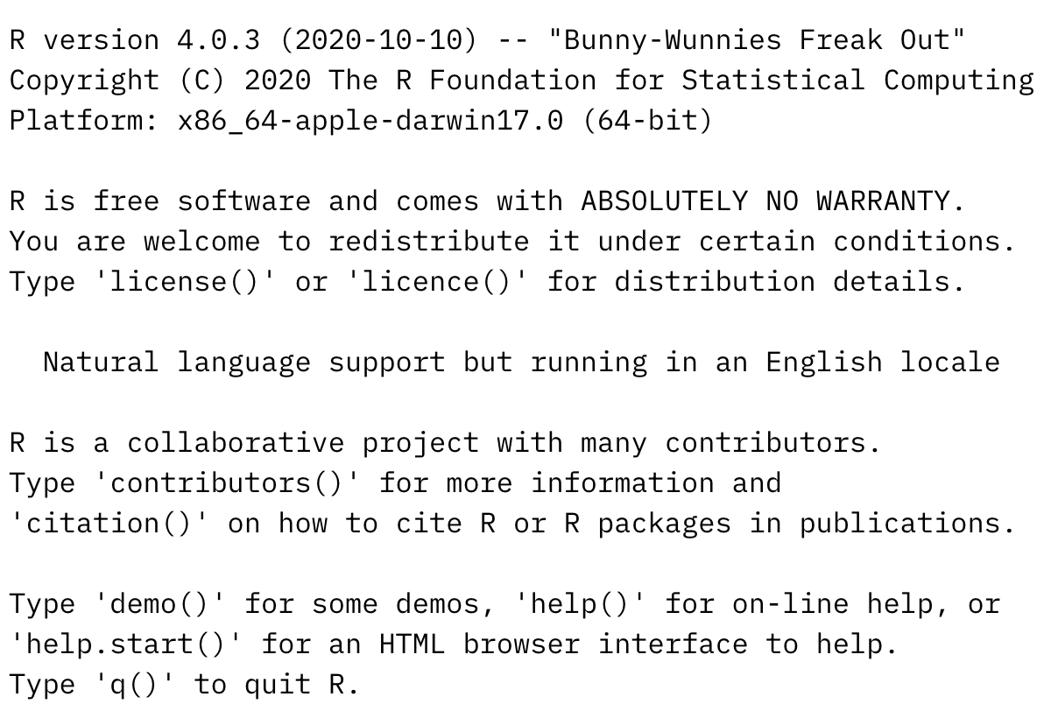
Installing the package = taking it from the internet and putting it on your local computer. This only needs to be done once.
Loading the package makes it useable in your R session. You must do it in every R session.

Slide 10
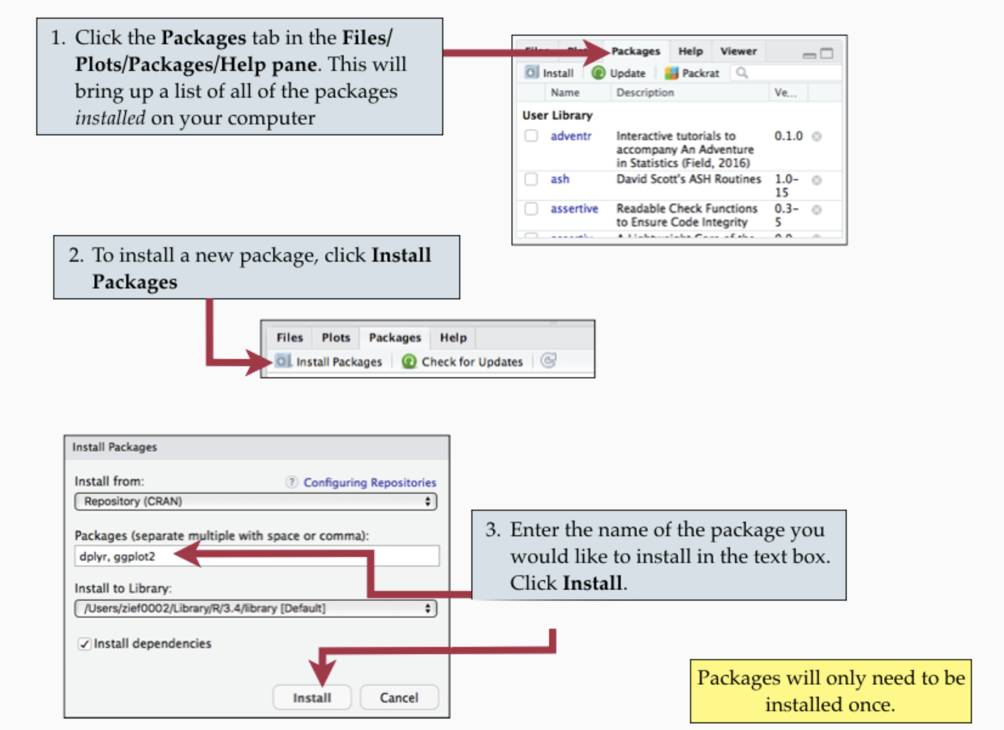

Slide 11


Documents
r-bootcamp
data
lesson1.R

Slide 12
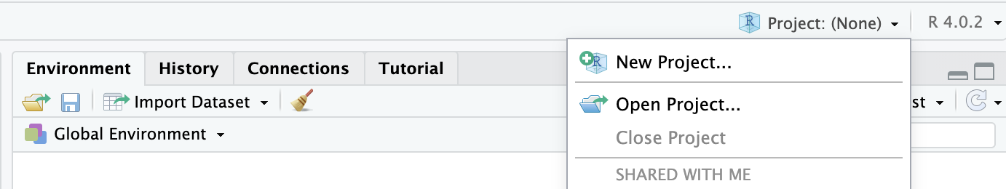

Slide 13
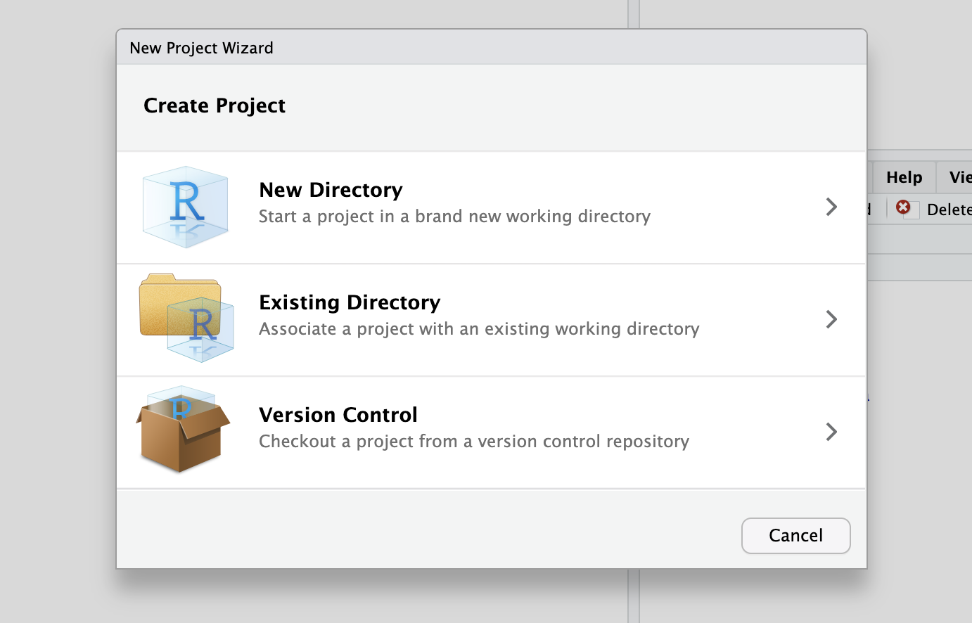

Slide 14
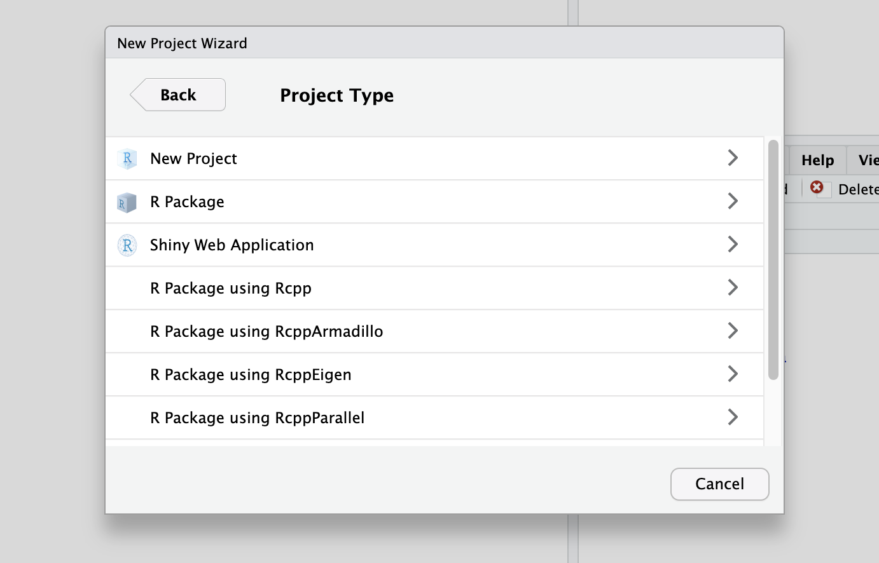

Slide 15
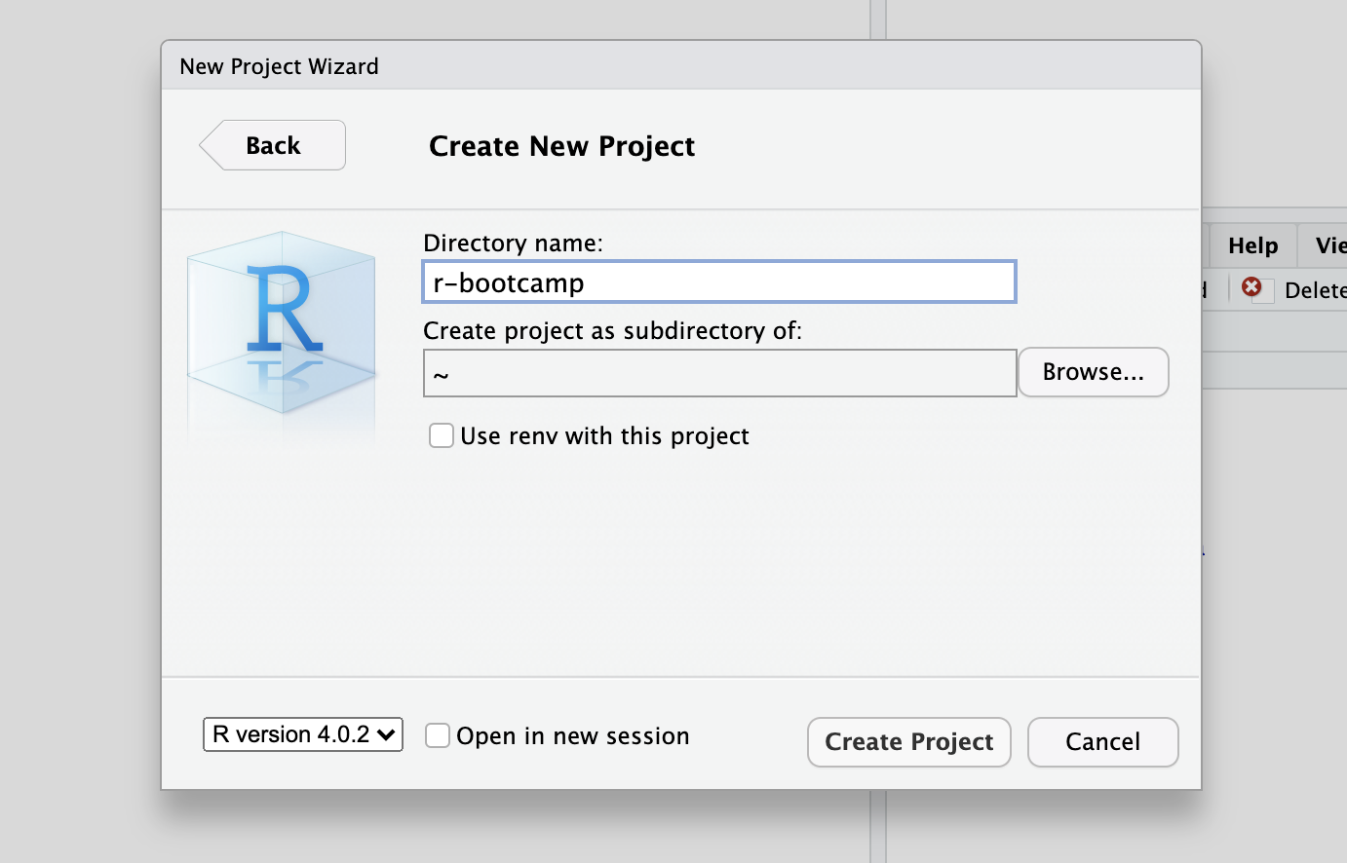
1
2

