Slide 1

X
Y

Slide 2
Z
X
Y

Slide 3
Z
X
Y

Slide 4
Z
X
Y

Slide 5
drug
blood pressure

Slide 6
age
drug
blood pressure

Slide 7
age
drug
blood pressure
random

Slide 8
cholesterol
drug
blood pressure

Slide 9
is a movie star
talent
attractiveness

Slide 10
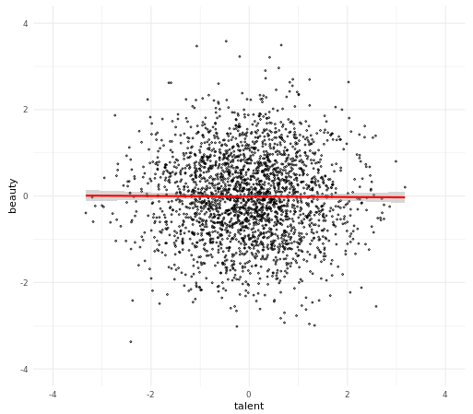

Slide 11
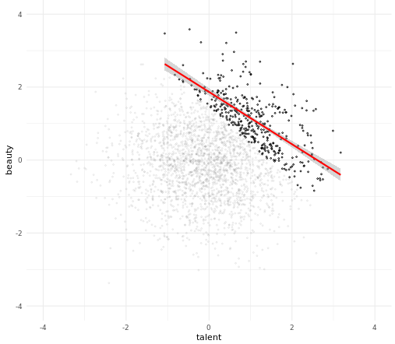

Slide 12
x2
Top. Estimating the effect of x on y when controlling for x2 is not what we would get if we were to ‘intervene’ on x.
If we intervene on x, then x2 changes, and so does y.
So we don’t want to control for x2, because that removes some of the effect of x.
Bottom.
Controlling for x2 is a good thing.
What we want is to estimate what would happen when ‘intervening’ on x.
An intervention is just keeping everything the same but changing x.
Here, if we
x
y
x2
y
x

Slide 13
Z
X
Y

