Slide 1
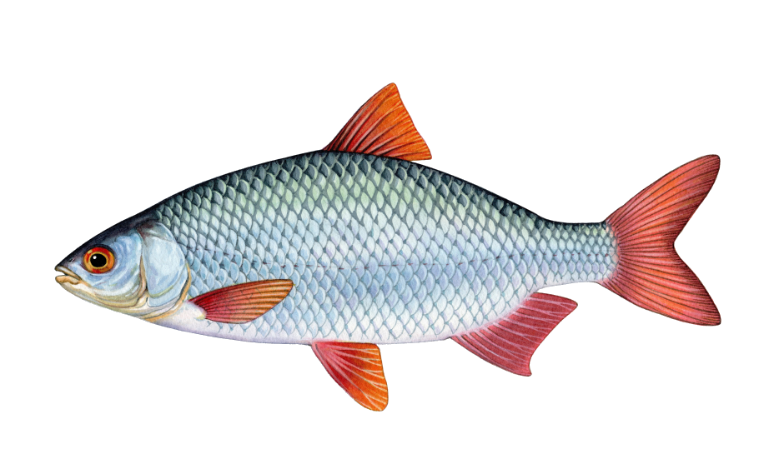
Odds of catching a fish = 1/5
Odds of catching a fish = 2/5

