Slide 1
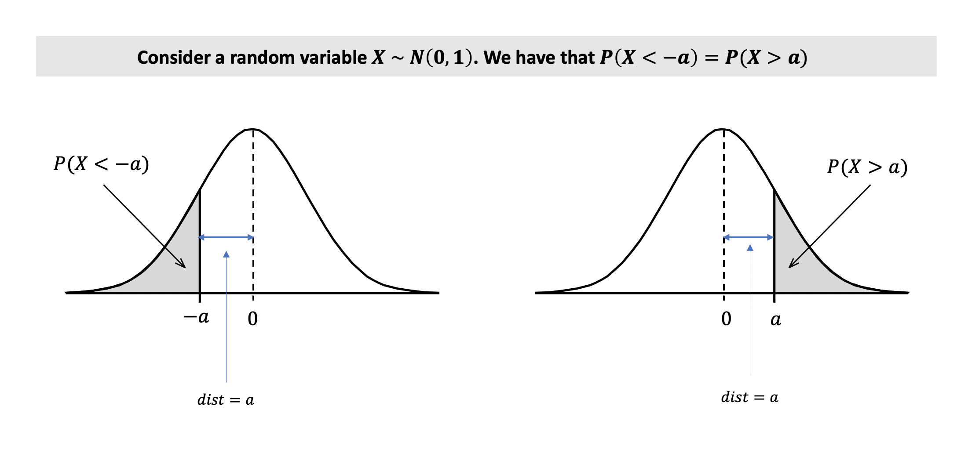







Consider a random variable $X \sim N\left(0,1\right)$. We have that $P\left(X<−a\right)=P(X>a)$
$$P(X<−a)$$
$$P(X>a)$$
$$−a$$
$$0$$
$$0$$
$$a$$
$$dist=a$$
$$dist=a$$

