Slide 1





Ideal world
nondiabetic
diabetic
$$C$$
Fasting glucose level (mmol/L)
Specificity
Sensitivity

Slide 2





Reality
nondiabetic
diabetic
Fasting glucose level (mmol/L)
Specificity
$$C$$
Sensitivity
False negative rate
False positive rate

Slide 3
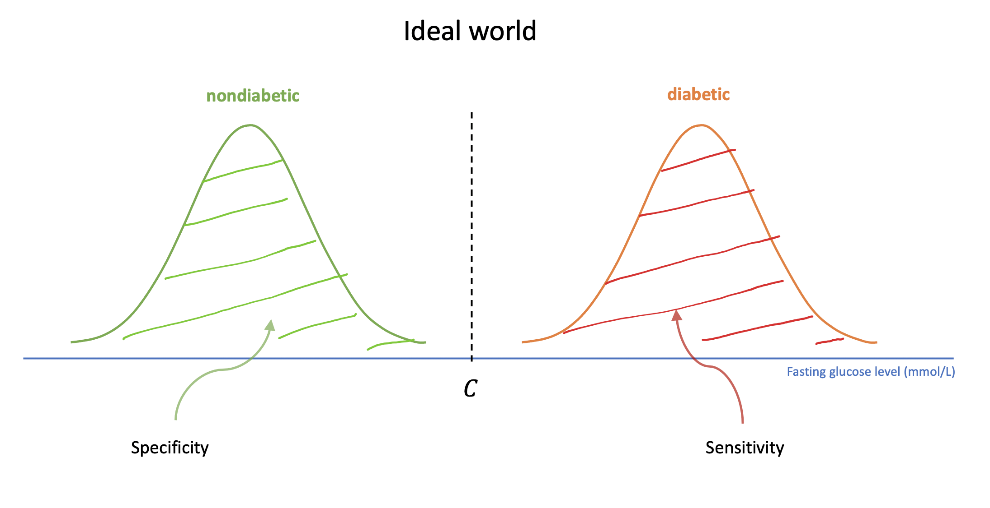

Slide 4
