Slide 1
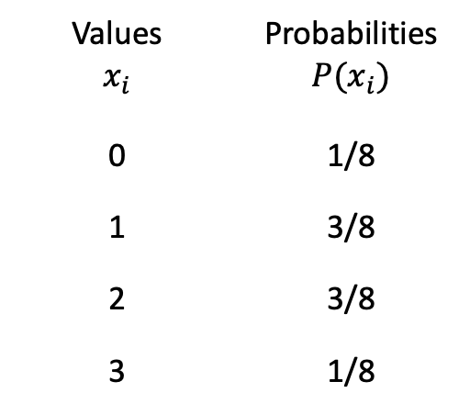
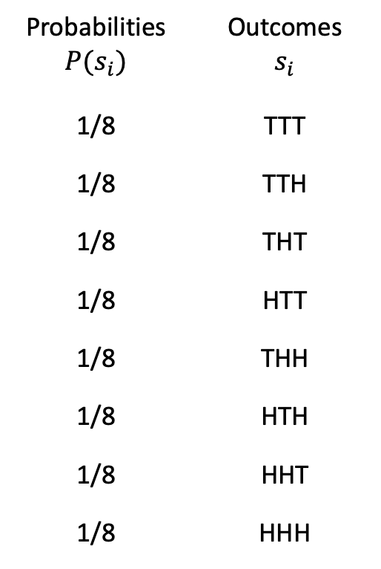
Experiment
Random variable
Probabilities $$P(s_{i})$$ | Outcomes $$s_{i}$$
1/8 | TTT
1/8 | TTH
1/8 | THT
1/8 | HTT
1/8 | THH
1/8 | HTH
1/8 | HHT
1/8 | HHH
Values $$x_{i}$$ | Probabilities $$P(x_{i})$$
0 | 1/8
1 | 3/8
2 | 3/8
3 | 1/8

