Slide 1


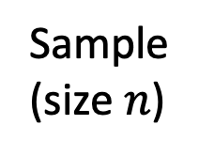

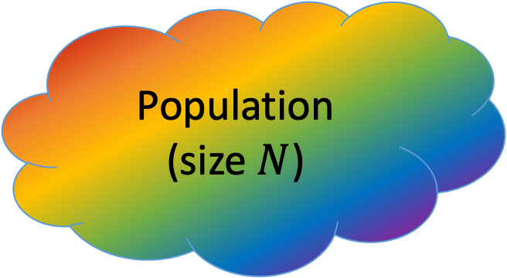
(a) Unbiased sampling
(b) Biased sampling
Population (size $N$)
Population (size $N$)
Sample
(size $n$)
Sample
(size $n$)

