Slide 1

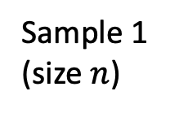




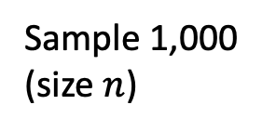

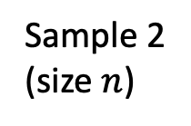

Population (size $N$)
Sample 1
(size $n$)
Sample 2
(size $n$)
Sample 1,000
(size $n$)
…
$$s_{1}$$
$$s_{2}$$
$$s_{1000}$$
= outcome 1
= outcome 2
= outcome 1000
Compute
sample mean
Compute
sample mean
…
Compute
sample mean
$${\overline{x}}_{1}$$
$${\overline{x}}_{2}$$
$${\overline{x}}_{1000}$$

