Slide 1
S
A
B
1
5
2
3
4
6

Slide 2
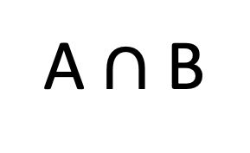
A
B
A $∩$ B

