Slide 1
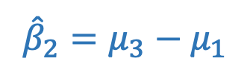

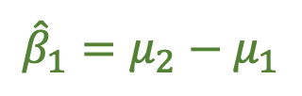
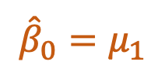


By group
Pooled data
$$μ_{2}$$
$${{\hat{β}}_{1}=μ}_{2}−μ_{1}$$
WELLBEING
$${{\hat{β}}_{2}=μ}_{3}−μ_{1}$$
$$μ_{1}$$
$$μ_{3}$$
$${{\hat{β}}_{0}=μ}_{1}$$
City
Rural
Suburb
LOCATION

Slide 2
