Slide 1
HTTP Performance
Abram Hindle
abram.hindle@ualberta.ca
Department of Computing Science
University of Alberta
http://softwareprocess.es/
CC-BY-SA 4.0

Slide 2
Performance on the Web
Performance is a non functional requirement referring to how well a web site or service responds.
Performance can be measured in terms
  Requests
  Volume
  Latency
  Bandwidth
  Utilization

Slide 3
BEFORE YOU OPTIMIZE
Measure something:
  Requests, volume, latency, bandwidth, utilization, time
Record that number!
  You need to compare it against future values
Record and track the original settings.
  You need to compare to performance with your changes
Run your tests more than once.
  For real stats, you want more than 10 runs before and after
  For t-tests and Wilcoxon tests you want 40+

Slide 4
Google says...
Web Performance Best Practices https://developers.google.com/speed/docs/best-practices/rules_intro
  Optimizing caching — keeping your application's data and logic off the network altogether
  Minimizing round-trip times — reducing the number of serial request-response cycles
  Minimizing request overhead — reducing upload size
  Minimizing payload size — reducing the size of responses, downloads, and cached pages
  Optimizing browser rendering — improving the browser's layout of a page
  Optimizing for mobileNew! — tuning a site for the characteristics of mobile networks and mobile devices
    Portions of this page are modifications based on work created and shared by Google and used according to terms described in the Creative Commons 3.0 Attribution License.

Slide 5
Caching!
Caching increase locality
Locality increases bandwidth
Locality decreases latency
Levels of cache:
  CPU
  Memory
  Disk
  Network

Slide 6
Caching!
> GET /static/SoftwareProcess.es.html HTTP/1.1
> User-Agent: curl/7.32.0
> Host: softwareprocess.es
> Accept: */*
>
< HTTP/1.1 200 OK
< Date: Mon, 07 Apr 2014 03:09:26 GMT
* Server Apache is not blacklisted
< Server: Apache
< Last-Modified: Mon, 07 Apr 2014 03:00:05 GMT
< ETag: "215f-4f66b107fc739"
< Accept-Ranges: bytes
< Content-Length: 8543
< Vary: Accept-Encoding
< Content-Type: text/html; charset=utf-8
<

Slide 7
Caching! Do it Again!
> GET /static/SoftwareProcess.es.html HTTP/1.1
> User-Agent: curl/7.32.0
> Host: softwareprocess.es
> Accept: */*
>
< HTTP/1.1 200 OK
< Date: Mon, 07 Apr 2014 03:10:50 GMT
* Server Apache is not blacklisted
< Server: Apache
< Last-Modified: Mon, 07 Apr 2014 03:00:05 GMT
< ETag: "215f-4f66b107fc739"
< Accept-Ranges: bytes
< Content-Length: 8543
< Vary: Accept-Encoding
< Content-Type: text/html; charset=utf-8
<

Slide 8
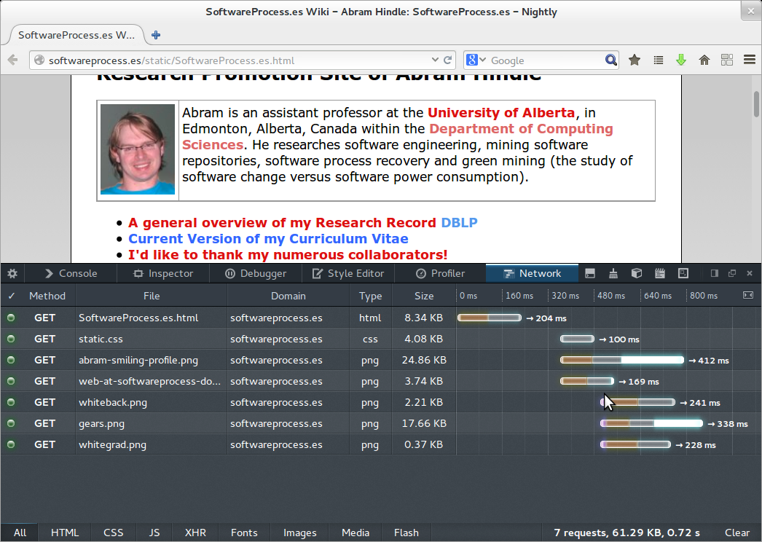
Cold GET

Slide 9
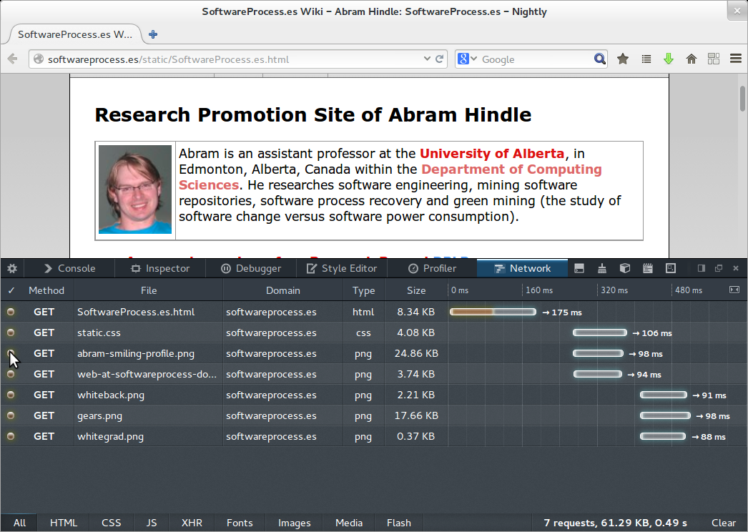
Refresh

Slide 10
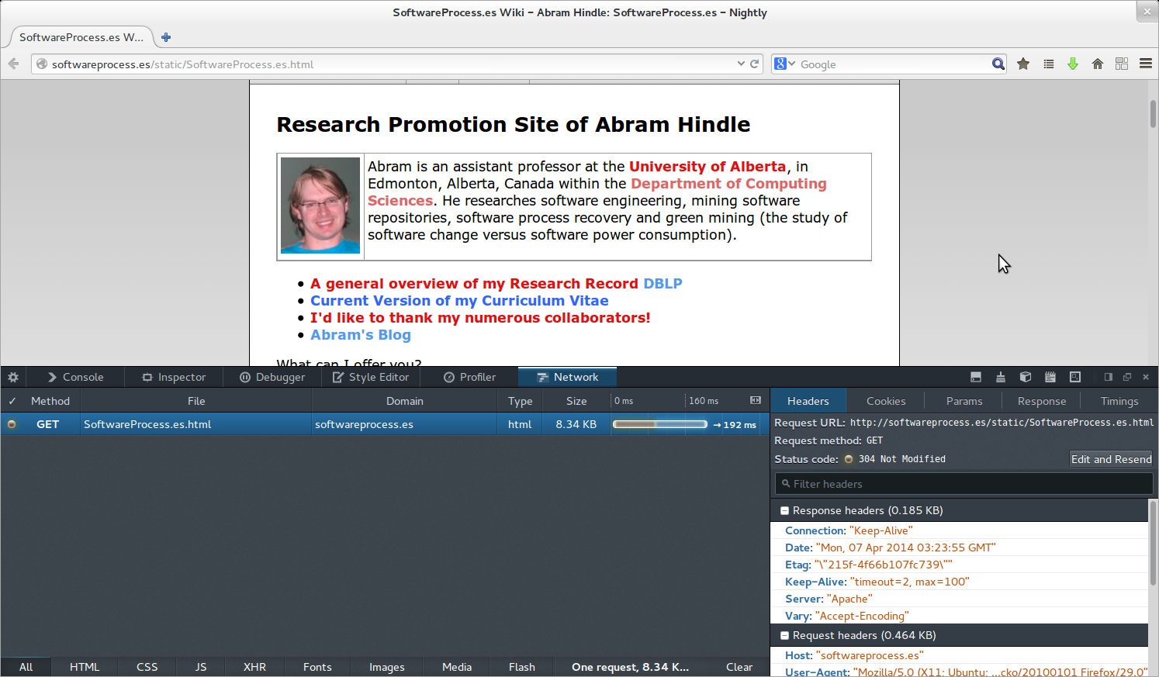
If I just type in the URL again

Slide 11
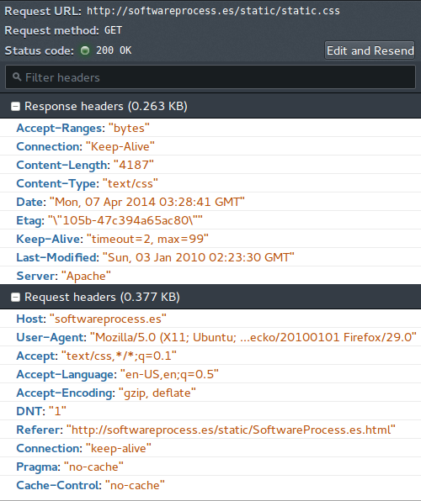
New
Cache Headers

Slide 12
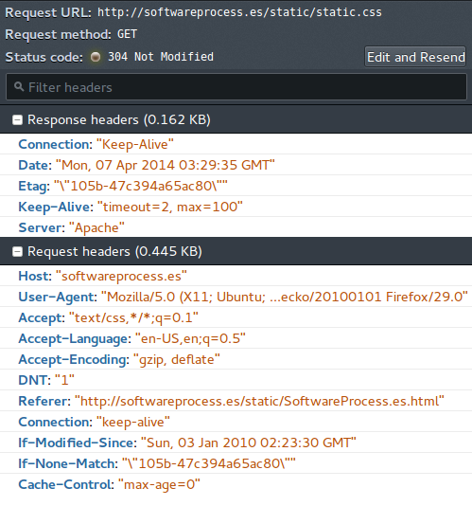
Refresh
Cache Headers

Slide 13
User Agent (Browser) Cache
Also, if the response does have a Last-Modified time, the heuristic expiration value SHOULD be no more than some fraction of the interval since that time. A typical setting of this fraction might be 10%. – RFC2616 section 13
This means if it was modified 10 minutes ago, you should probably hit it up again in a minute.
  Where as if it was modified 100 days ago, you should get a new version 10 days from now.

Slide 14
User Agents (Browser) Cache
Thus it is up to the browser to emit a request
They do so upon expiry or last modified time heuristic
Or the user forces a refresh
  CTRL-SHIFT-R or ctrl-shit click on the refresh button
In browser cache is the most local and high performance cache!

Slide 15
Cache-control
Generally sent by User Agent
Indicates how they want to handle this request
It signals proxies and caches how to handle the request

Slide 16
Cache-Control: no-cache
You must revalidate
  We didn't give it a time
A 304 response is fine
Forces a request out to the server
max-age=0 means the same thing

Slide 17
Cache-Control: no-store
Don't store anything
Suggests that the results are not-cacheable and emphemeral.
Will not act as DRM

Slide 18
Cache-Control: max-age=
Cache-Control: max-age=seconds in a HTTP response tells the Use-Agent the maximum age they should let this resource last
Easy to deploy
Cache-Control: max-age=259200
  3 Days
Benefit: no date math for you!
Benefit: No date formatting!
Disadvantage: Have to predict max-age!

Slide 19
Response Header: Expires
Expires tells the Use-Agent after which date they should ask for a new instance of the resource.
Easiest to deploy
Very simple
Causes lots of problems if set wrong!
Expires: Mon, 07 Apr 2014 03:00:05 GMT

Slide 20
Request Header: If-Modified-Since
Conditional HTTP Request
Return a 304 if not modified since
If-Modified-Since: Mon, 07 Apr 2014 03:00:05 GMT
  Don't send me anything new unless the resource has been modified after that time.
If the response is anything but a 200 OK, return a normal response instead of the 304

Slide 21
Response Header: Last-Modified
The Last-Modified entity-header field value is often used as a cache validator. In simple terms, a cache entry is considered to be valid if the entity has not been modified since the Last-Modified value. – HTTP RFC 2616 Fielding et al. http://www.w3.org/Protocols/rfc2616/rfc2616-sec13.html#sec13.3.1

Slide 22
Response Header: Last-Modified
Last-Modified is a date that the resource was last modified
Used for simple caching
Requires the HTTP server to respond

Slide 23
HTTP ETag
What if you cannot guess or estimate the time that content will be safe?
What if content updates all the time, unpredictably?
What if content updates but all changes aren't that important:
  E.g. your age does increase every second but maybe it isn't important to caching to have your age updated per each second?

Slide 24
HTTP ETag
How do you make it?
If strong (exact content) just use a hash like SHA1
If weak then hash some content you think is relevant and prefix with W/”etagvalue” to indicate it is a weak hash
If hashing is pointless make an etag of actual values in plaintext
Keep it short

Slide 25
ETags: Entity Tags!
HTTP Response Header
Contains a name or tag indicating the content or revision of a resource.
  Is not date related
  Tends to be content related
  Can be any value
  Can use any hash

Slide 26
ETags: If-None-Match
HTTP Request Header that makes the request conditional.
If any of the provided e-tags match send us back a 304 status code, otherwise send us the resource!
If-None-Match: “someetag”
If-None-Match: “*” // rely on the date stuff, not etags
If-None-Match: “etag1”, “etag2”

Slide 27
ETags: If-Match
HTTP Request Header that makes the request conditional.
Used in updates to ensure the wrong version is not being updates (like a revision id)
Provide “*” or an ETag
  “*” means anything (e.g. you probably have it or it might not exist, but you're just checking)
If-Match: “someetag”
If-Match: “*”
If-Match: “etag1”, “etag2”

Slide 28
Dangers of the Etag
Cookies part II
  Etags allow for vendors (advertisers) to finger print your client because your client will send the etags back.
  If you deny cookies, you tend to send etags.
  AOL, Spotify, GigaOm, Etsy, KISSmetrics sued over undeletable tracking cookies http://www.extremetech.com/internet/91966-aol-spotify-gigaom-etsy-kissmetrics-sued-over-undeletable-tracking-cookies
  Ayenson, Mika, et al. "Flash cookies and privacy II: Now with HTML5 and ETag respawning." World Wide Web Internet And Web Information Systems (2011). ftp://peramides.com.ar/SSRN-id1898390.pdf

Slide 29
Dangers of the Etag
Too much information
  Some Etags contain irrelevant information!
  What if the browser reboots and the Etags are lost?
    If the browser/user-agent had a timing guarantee this wouldn't be a problem

Slide 30
Performance, the Cross Cutting Concern
Performance is a cross cutting concern because it interacts with other functionality:
  Security
    Lack of encryption means global proxying
    Authentication can limit caching
    Authentication can imply state
  State
    State can limit caching
    State can limit layering

Slide 31
Round Trips
DNS Lookups, Connections, HTTP transactions
Async is fast: Just send it! Who cares when it arrives
Rountrips are synchronous and slow: We must wait for a response!
  Avoid HTTP Redirects that aren't cacheable
    Rewrite Server Side
  Avoid too many HTTP hosts
  Can you piggyback?
  CSS Sprites are often recommended to reduce number of image requests
    Avoid CSS imports

Slide 32
Round Trip Tricks
Use multiple static content hostnames:
  Take a hit in DNS lookup
  But improve parallel download performance
  Static hosts should not be dynamic and have stable IPs

Slide 33
Reduce Request Size
Giant Cookies – NOOOOO
Giant URIs -- NOOOO
Too many headers? NOOOO
Remember all that networking we went over?
  Try to fit within the MTU!

Slide 34
Avoid Dynamism and Cookies for Static Content
For static content, do GETs to get it
  For static content avoid dynamism and cookies
  Cookies imply state and can mess up caching
Use seperate domains for static content to avoid statefulness

Slide 35
Minimize Resource Size
Images – too big
Javascript – minify (I dislike this one)
GZIP Encoding!
Sound – too big
Video – too big
  You can fake Sound and Video in JS!

Slide 36
Minimize Number of Resources
1 or 0 CSS Files
1 or 0 Javascript Files
1 or 0 Images (CSS Sprites)
1 or 0 HTML Files
  You could generate a page in JS and take no hit.
1 giant page has the problem if it is dynamic, but if it is 1 giant page that does dynamic things you can cache that page and never have to get HTML/JS/CSS again.

Slide 37
Optimize Rendering
Recommendations:
  CSS at the top
  Javascript at the bottom
  Content in the middle
Give appropriate sizes and hints
  The layouter is quite expensive, give some hints and it will go to town.

Slide 38
Defer Javascript
Nasty trick:
  Encode javascript as a string and eval it later when you need it.
  Avoids heavy page loading and JS parsing with the browser is working hard.
  CPU driven

Slide 39
Content Delivery Networks
These are global networks of content providers that can mirror your content.
Excellent latency and locality
Great for static stuff
$$$

Slide 40
GZIP It!
Turn on GZIP encoding to make things smallers
  Watch out! This affects latency
  Improves bandwidth
  Balancing act
  Generally recommended

Slide 41
Fix DNS
Use A and AAAA records instead of CNAMEs
Have your authoritative name server give the results
Allow for caching of DNS requests to avoid excessive lookups
Provide many A records in 1 response
Reduce number of hosts on 1 page
Some recommend using CNAME to allow multiple connections (so it depends!)

Slide 42
Avoid Indirection
Redirections
Imports
Dynamic choosing of content
Javascript downloading of content

Slide 43
Avoid POST
POST is not idempotent
POST is not cacheable
POST is dynamic
POST smashes all the performance infrastructure in a fine powder and blows it into your face.

Slide 44
Check for Errors
403s, 404s, 410s, etc. Are all slow
  Often the server works harder to serve an error than it does to serve real content.
  Errors cause exceptions, exceptions cause latency and pain and reporting.
  Errors cause logging – more IO
  Errors are worthless requests hogging up resources

Slide 45
Encoding!
Sending a JSON encoding is not always appropriate in terms of size.
Sending an audio stream as ASCII text? Bad idea. Use an appropriate format.
Do you need lossy or losseless?
Do you need XML? JSON? CSV? Binary?

Slide 46
Repeat yourself or don't repeat yourself
Cache matters if the cache can avoid you repeating yourself then go for it.
But sometimes denormalizing data and providing duplicate information avoids more requests.

Slide 47
Async over Sync
Asynchronous means that you can do other things while something is occurring.
Synchronous is blocking which implies latency.
Synchronous means round trips
Async means parallelizable
Synchronous means serialized

Slide 48
Javascript Includes...
Some people like to include common libraries from the library homepage.
  Benefit: Someone else has done this so the user has cached it.
  Disadvantage: What if they get hacked
  Disadvantage: What if they are slower than you?
  Disadvantage: What if you lose locality?

Slide 49
Resources
RFC 2616 Section 13 http://www.w3.org/Protocols/rfc2616/rfc2616-sec13.html
RFC 2616 Section 14 http://www.w3.org/Protocols/rfc2616/rfc2616-sec14.html
Web Performance Best Practices https://developers.google.com/speed/docs/best-practices/rules_intro

Slide 50
Resources
HTTP Caching https://developers.google.com/speed/articles/caching
Best Practices for Speeding Up Your Web Site http://developer.yahoo.com/performance/rules.html
Browser Cache Matters http://yuiblog.com/blog/2007/01/04/performance-research-part-2/

Slide 51
Resources
Chapter 10 — Improving Web Services Performance http://msdn.microsoft.com/en-us/library/ff647786.aspx
19 Tuning Web Services http://docs.oracle.com/cd/E24329_01/web.1211/e24390/webservicestune.htm

