Slide 1

Market Churn
Team Member:
Rozhan Makhdoomi
Wei Guo
Shubhada Gopale
Sumithra Hariguruprasad

Slide 2
1
Define the Issue
2
Data Preparation
3
Modeling
Model 1: Naïve Bayes
Model 2: Decision Tree
Model 3: KNN
Model Evaluation and Comparison
4
Conclusion

Slide 3

Background
Roz
the telecom company would like to know in advance which customers would churn in near future
help this company in characterizing customer churn

Slide 4
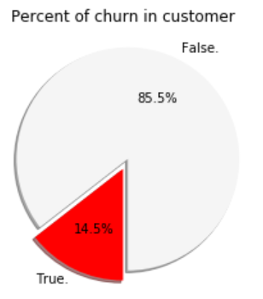
Facts
Roz
14.5% of customers have churned
The company has its most clients in West Virginia State.
Most of the customers did not escape.
We can drop the phone number and area code columns as they contain each customer's unique phone number and it's not going to be useful in the analysis.
Half of the clients remain in the company for more than 101 months
The average total revenue generated per customer is 67.49
Each customer had an average 305 calls in the course of using the service of this company
Half of the clients has called the customer service at least one time

Slide 5
Assumptions
Correlating.
We want to know how well does each feature correlate with Churn.
Completing.
We do not have any null value in this data set so we do not need to complete any of the variables.
Correcting.
phone number and area code had been dropped from our analysis as there may not be a correlation between phone number and churn.
State feature may be dropped as it does not contribute to churn.
Creating.
We may want to create a new feature called total charges based on partial charges to get total revenue of the company from each customer.
We may want to create a new feature called total calls based on partial calls to get total calls of each customer.
We may want to create a new feature called total minutes based on partial minutes each customer talked to get total usage of the each customer.
We may want to change the Intplan,VMailPlan,Churn from yes/no to 0 and 1 categorical variables.
Classifying.
Then we will classify the model

Slide 6
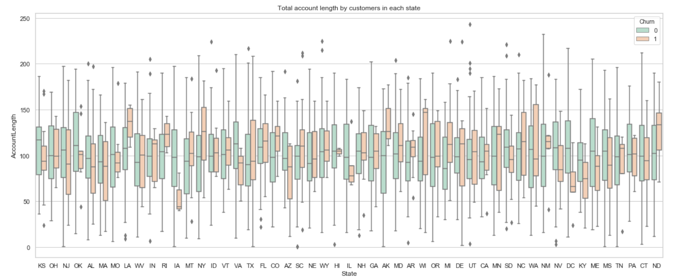
Total account length by customers in each state
West Virgina State is the most populated state by the customers.
There is no evident relationship between different states and the customer's leave.
We can drop this column too

Slide 7
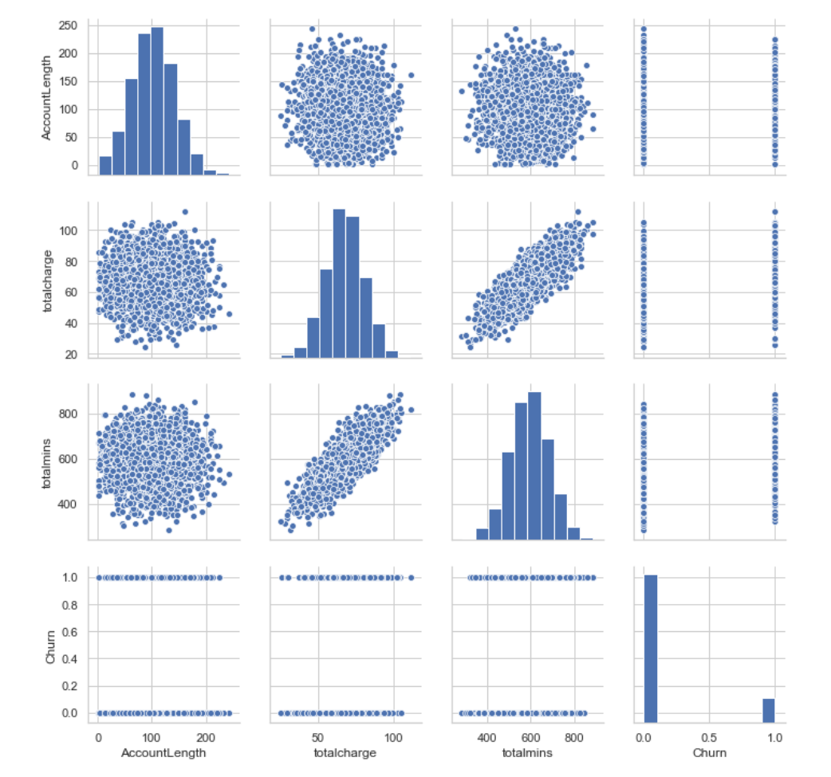
Numerical variables

Slide 8
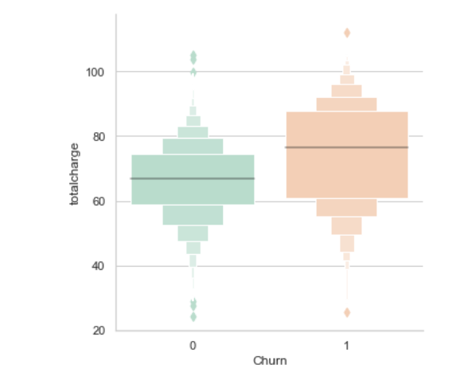
Total Charges & Churn
From the plot, most of the customers that left have more than 60 in total charge. In range of 60 to 85, population of loyal customer is around half of the population of customers who left.
According to the plot, High totalcharges may affect to churn probability. And seems like customer will not churn if they have lower amounts in totalcharges

Slide 9
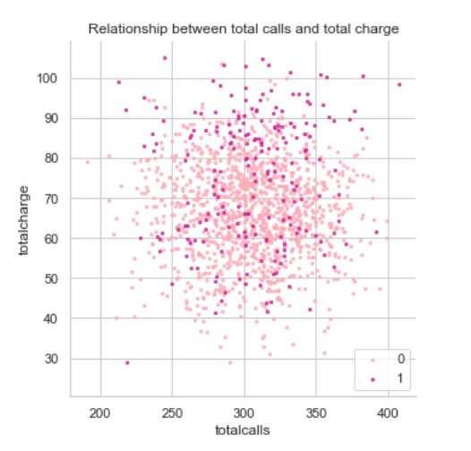
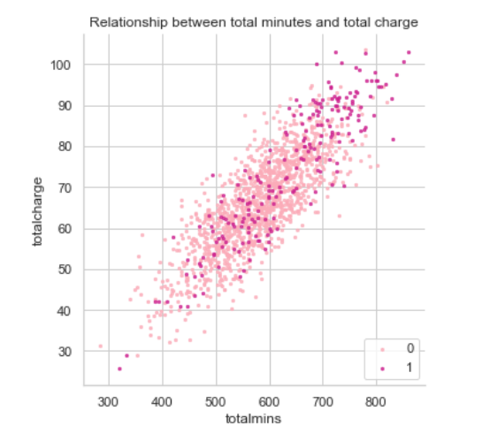
Total calls/mins vs total charge

Slide 10
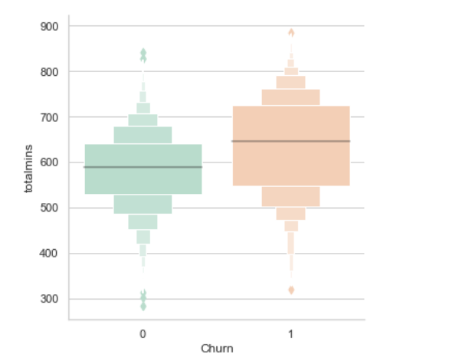
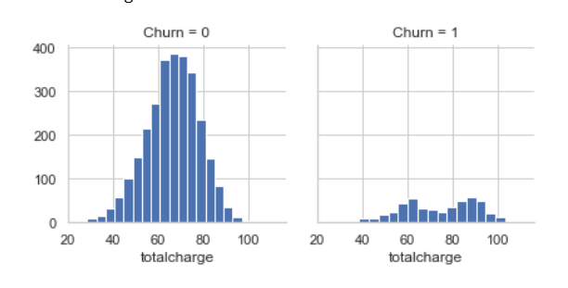
From the two scatters plot above we found out that number of calls that each customer made does not have a direct relationship with the company's revenue from that customer. However Total minutes that each customer talks on the phone have a linear relationship with the total charges.
We already found out that customers who left the company, used the services more. and most of them have used the service for more than 550 minutes. And the population of the customers who left the company and have used the service between 550-700 minutes are nearly twice the population that stayed.
So we can have this assumption that the reason why the customers are leaving are the quality or the high cost of the services.

Slide 11
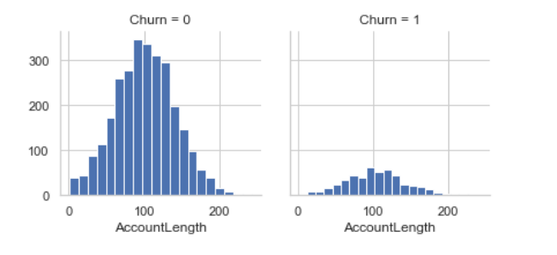
We can see that the distribution of the Account Length of customers that left or were loyal are somehow similar.
The frequency of the customers who left are less than loyal customers and that's the reason why the bins are shorter in right histogram above. Most of the customers stayed with the company between 60 to 120 months.

Slide 12
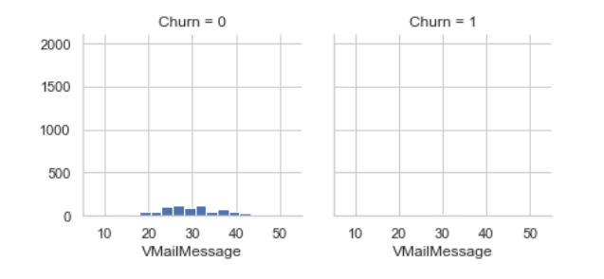
As we can see in the distribution of the Voicemail messages, most of the customers have no voicemail messages. and there is no relationship between voicemail messages and churn

Slide 13
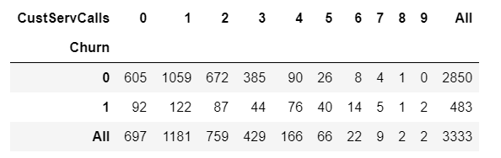
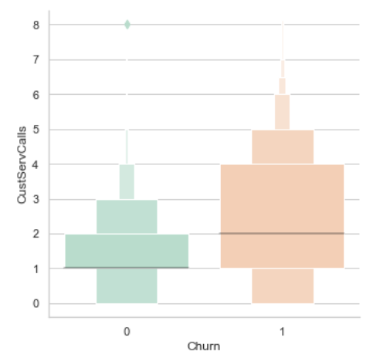
Customer Service Calls
most of the customers had at least one call to customer service
most of the customers who escaped had at least one to four call to customer service.
So we can see that there is clearly an influence here. So we have to analyze this factor more

Slide 14
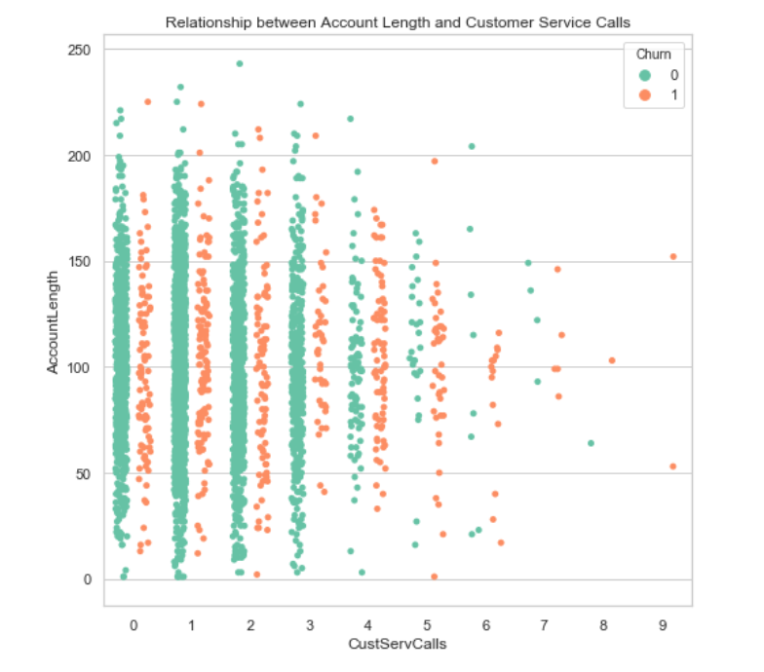

Slide 15
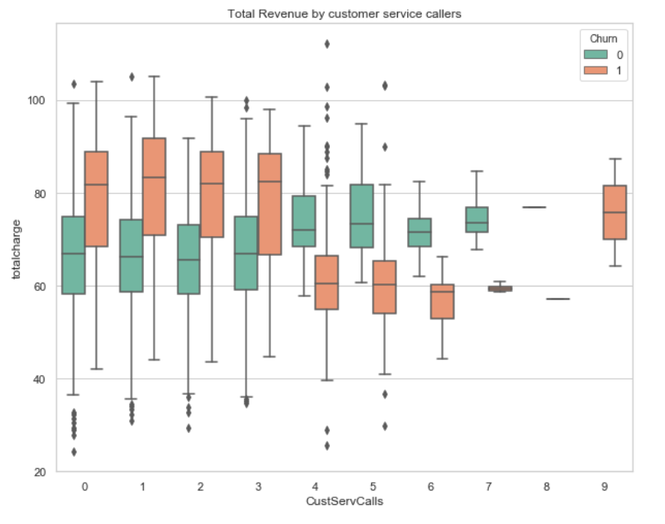

Slide 16
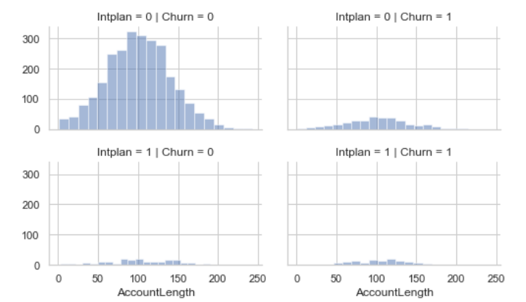
International Plan vs. Churn

Slide 17
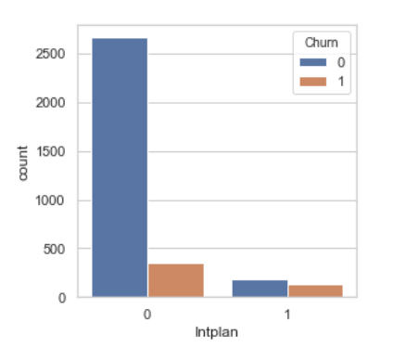
Most of the customers do not have the international plan(nearly 90%).
Most of the customers who left did not have the international plan either.
It does not seem that having international plan has any influence on the escape of the customers.

Slide 18
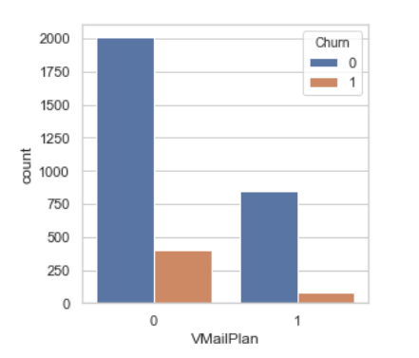
Voicemail Plan vs. Churn
Most of the customers do not have the Voicemail plan.
Most of the customers who left did not have the voicemail plan either.
It does not seem that having voicemail plan has any influence on the escape of the customers.

Slide 19
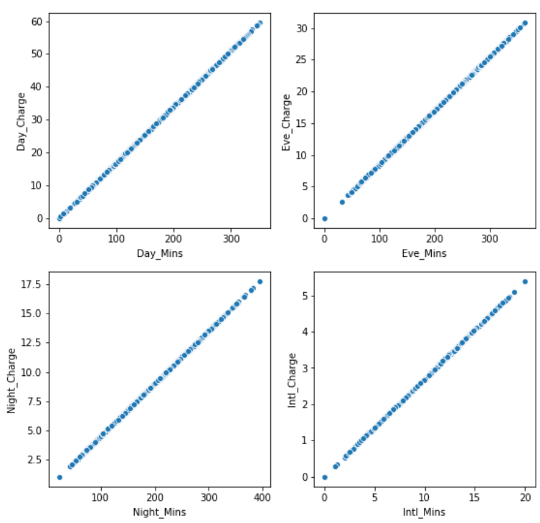
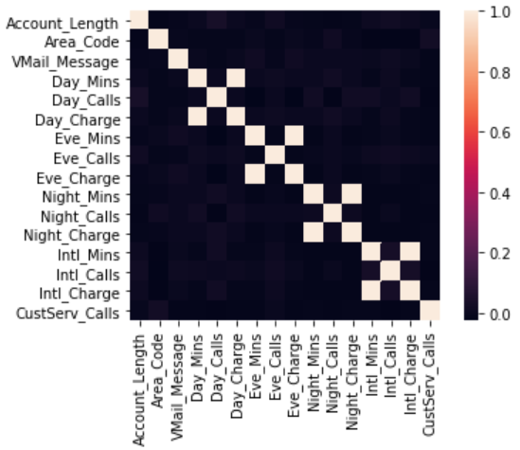
Correlation
Grace
Correlation between metrics
High correlation between:
Day_charge & Day_Mins
Eve_charge & Eve_Mins
Night_charge & Night_Mins
Intl_charge & Intl_Mins
Drop 'Day_Charge’, 'Eve_Charge’, 'Night_Charge', 'Intl_Charge'

Slide 20
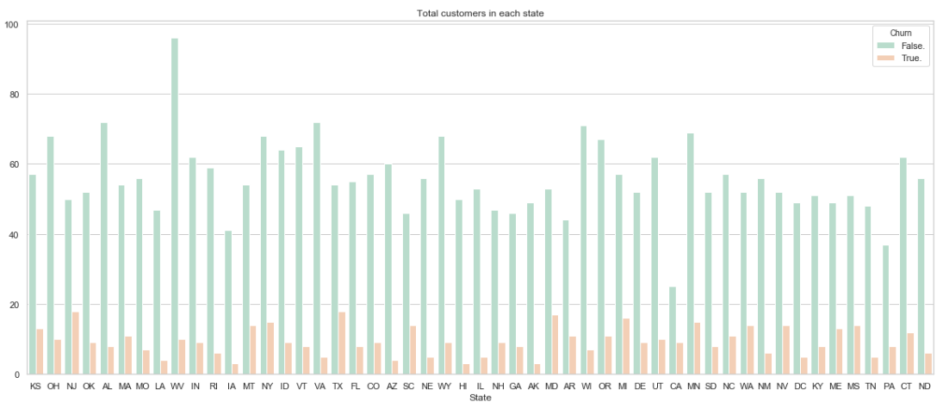
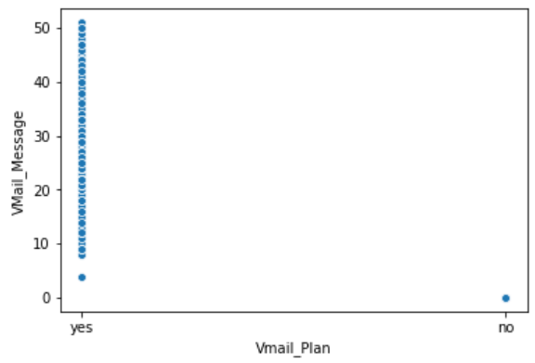
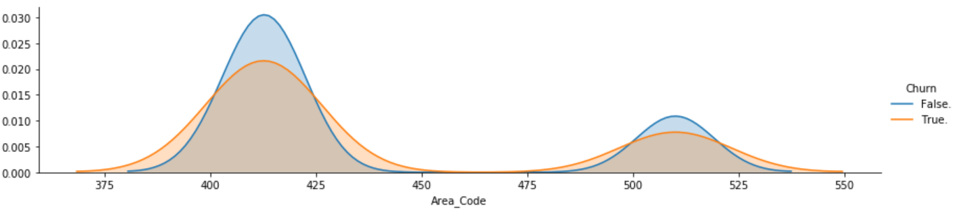
Variable Dropped
Grace
Variable | Distribution | Note
State |  | Drop “State”
Vmail_Plan & Vmail_Message |  | High correlation between Vmail_Plan & Vmail_Message Drop “Vmail_Plan”
Area Code |  | Drop “Area Code”

Slide 21
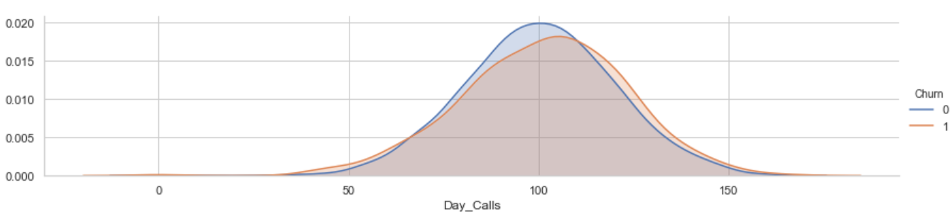
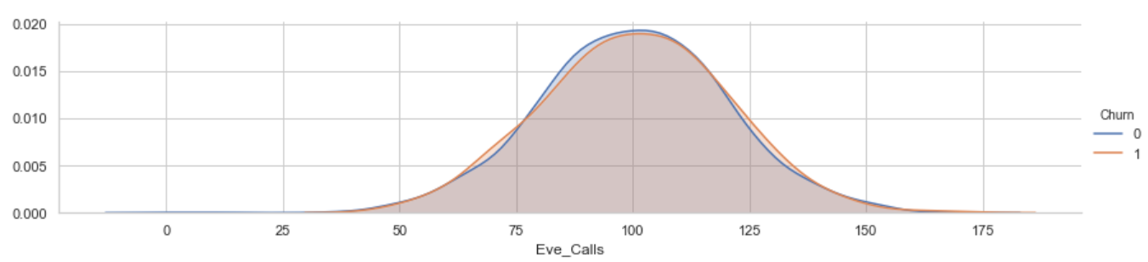
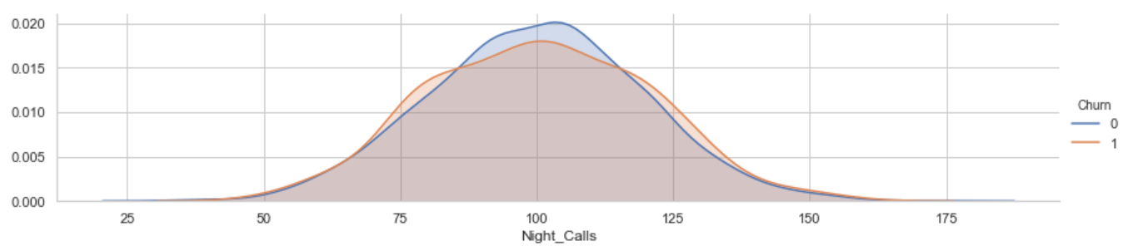
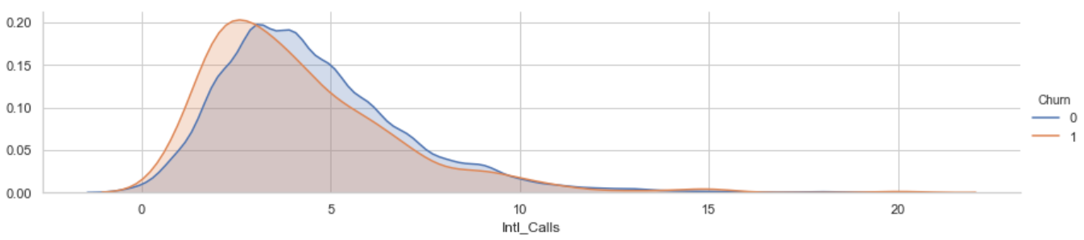
Variable Dropped (Cont.)
Grace
Variable | Distribution | Note
Day_Calls, Eve_Calls, Night_Calls, Intl_Calls |  | No big differences between Churn and not Churn Drop “Day_Calls”, “Eve_Calls”, “Night_Calls”, “Intl_Calls”
Other areas dropped: Phone

Slide 22
Final Columns used in the Modeling
Shub
Account Length
Intl Plan
Vmail Message
Day Mins
Eve Mins
Night Mins
Intl Mins
CustServ Calls
Churn

Slide 23
Measuring Metric Chosen
Sumithra
performance measures | Description | Pros / Cons
Accuracy

Slide 24
Model 1: Naïve Bayes
Sumithra
Method :xxx
Pros and cons
Results: xxx
Model Comparison
(if you run multiple models, the comparison)

Slide 25
Model 2: Decision Tree
Shub
Simple to understand, interpret and visualize
Can handle both numerical and categorical data
Parameter | Validation Accuracy | Test Accuracy
Depth=4 | 0.917 | 0.906
Depth=7 | 0.922 | 0.928
Unpruned | 0.885 | 0.895
Churn Recall
0.50
0.68
0.70

Slide 26
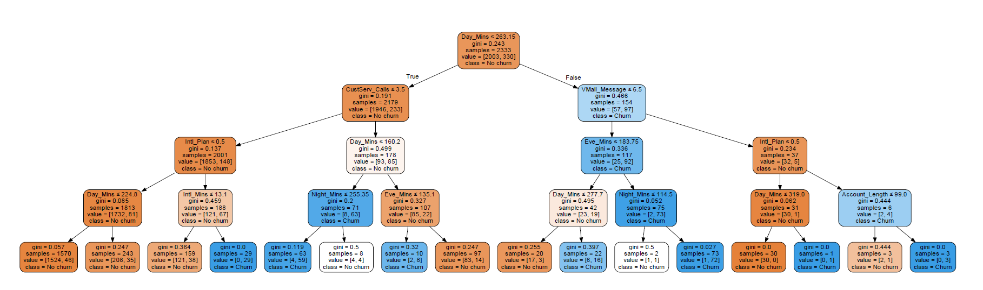
Decision Tree Visualisation
Shub

Slide 27
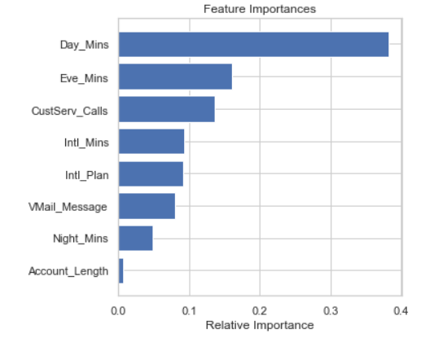
Feature Importance
Sumithra

Slide 28
Model 3: KNN
Grace
K-NN is non-parametric lazy learning algorithm
Pro: Does not assume any probability distributions on the input data
Con: If one type of category occurs much more than another, classifying an input will be more biased towards that one category
Parameter | Validation Accuracy | Test Accuracy
N = 3 | 0.867 | 0.859
N = 5 | 0.885 | 0.874
N = 7 | 0.887 | 0.874

Slide 29
Model Comparison
Grace
Model | Validation Accuracy | Test Accuracy | Diff (Validation vs. Test)
Model 1: Naive Bayes (Gaussian ) | 0.850 | 0.845 | 0.005
Model 2: Decision Tree | 0.922 | 0.928 | -0.006
Model 3: KNN (N = 5) | 0.885 | 0.874 | 0.011

Slide 30
Conclusion
Roz
Customers having high talk time in peak hours or making more international calls and calling Customer Service more than 3 times are likely to Churn
Customers having day talk time(>263 mins), evening talk time(>266 mins), International mins(>7 mins) on regular basis and have made more than 3 customers calls should be made eligible for promotions to retain them.

Slide 31
Thank you!

Slide 32
Appendix

Slide 33
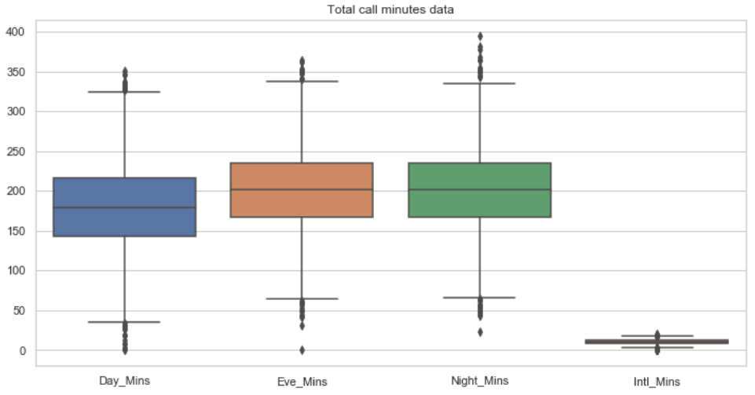
Question 1: Is there any outlier?
Shub

Slide 34
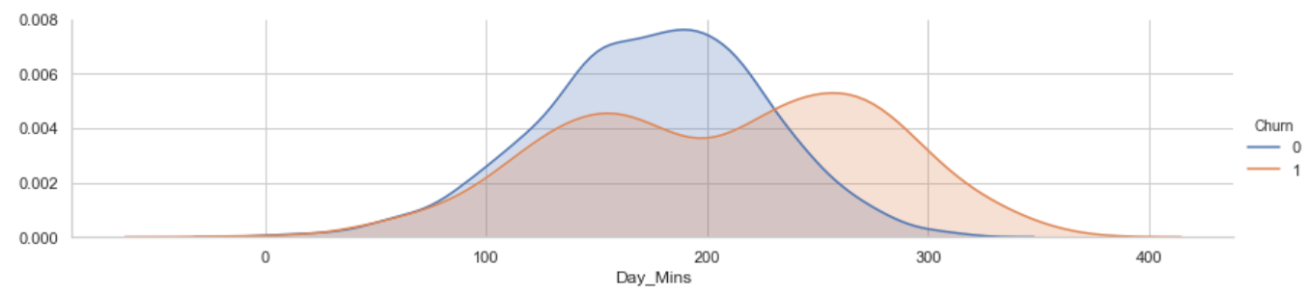
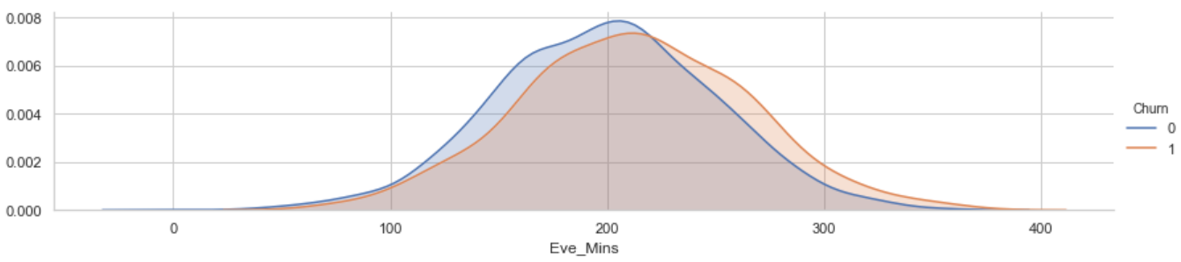
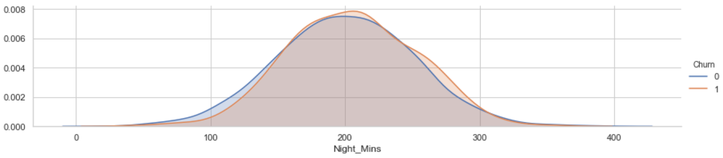
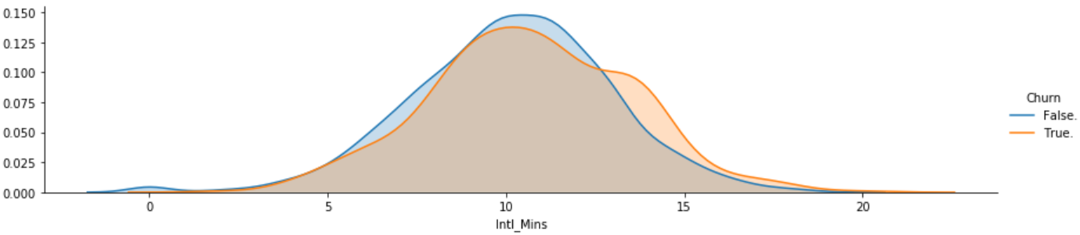
Question 2: Why not creating the Total_Mins?
Variable | Distribution | Note
Day_Mins, Eve_Mins, Night_Mins, Intl_Mins |  | The Churn split results are different for three metrics Keep the four instead creating a “Total_Mins” metric

Slide 35
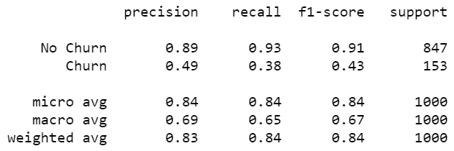
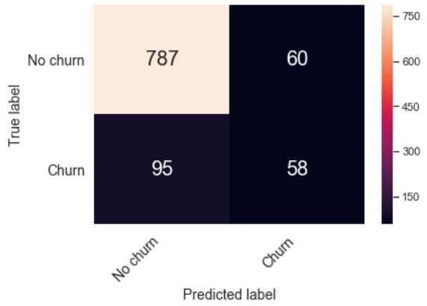
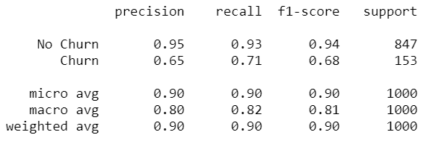
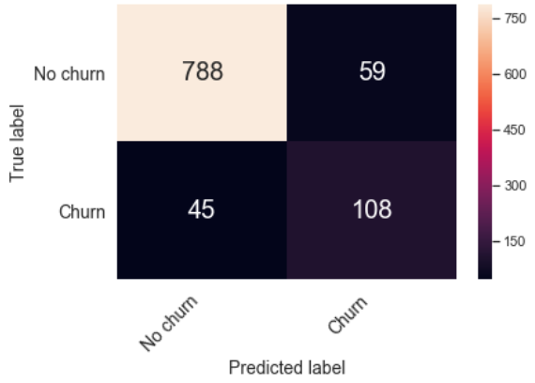
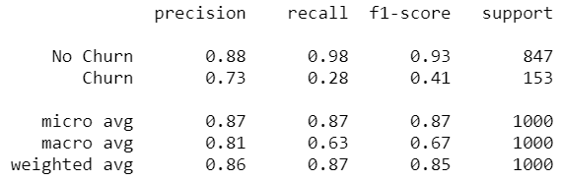
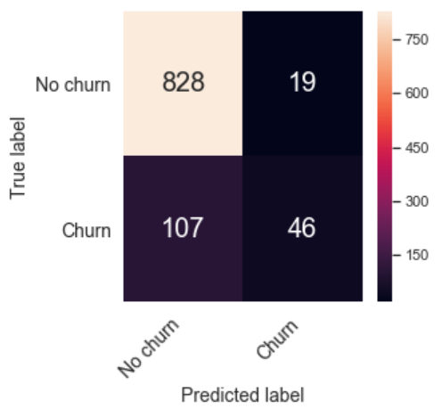
Question 3: What’s the result of other performance measures?
 | Other Performance Measures | Confusion Matrix Results
Model 1: Gaussian Naive Bayes
Model 2: Decision Tree
Model 3: KNN

