Slide 1

Market Churn
Team Member:
Rozhan Makhdoomi
Wei Guo
Shubhada Gopale
Sumithra Hariguruprasad

Slide 2
1
Define the Issue
2
Data Preparation
3
Modeling
Model 1: Naïve Bayes
Model 2: Decision Tree
Model 3: KNN
Model Evaluation and Comparison
4
Conclusion

Slide 3

Background
Roz
the telecom company would like to know in advance which customers would churn in near future
help this company in characterizing customer churn

Slide 4
1
Define the Issue
2
Data Preparation
3
Modeling
Model 1: Naïve Bayes
Model 2: Decision Tree
Model 3: KNN
Model Evaluation and Comparison
4
Conclusion

Slide 5
Available Metrics
Roz
Xx metrics,
Churn is the predicted value
No null values
Category | Metric | Data Type
 | State
 | Account Length
 | Area Code
 | Phone Number
 | Inter Plan
 | VoiceMail Plan
 | No of Vmail Mesgs
 | No of Calls Customer Service
 | Churn
 | Total Day Min
 | Total Day Calls
 | Total Day Charge
 | Total Evening Min
 | Total Evening Calls
 | Total Evening Charge
 | Total Night Min
 | Total Night Calls
 | Total Night Charge
 | Total Int Min
 | Total Int Calls
 | Total Int Charge

Slide 6
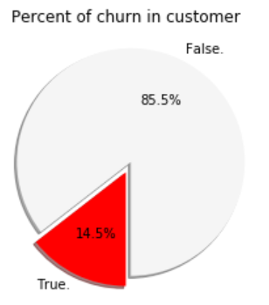
Finding more about Churn
Roz

Slide 7
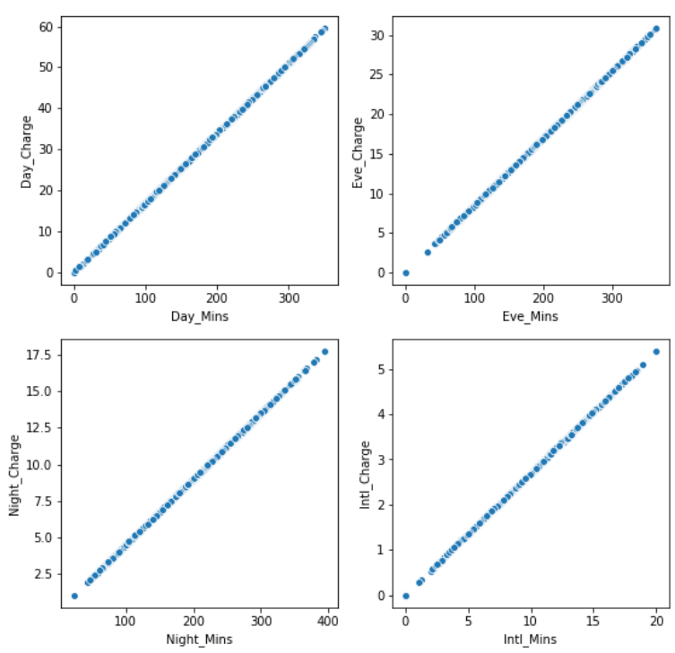
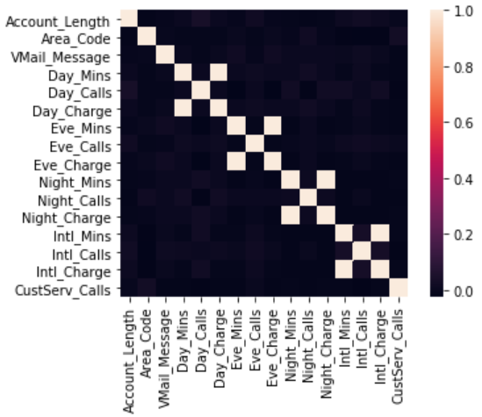
Correlation
Grace
Correlation between metrics
High correlation between:
Day_charge & Day_Mins
Eve_charge & Eve_Mins
Night_charge & Night_Mins
Intl_charge & Intl_Mins
Drop 'Day_Charge’, 'Eve_Charge’, 'Night_Charge', 'Intl_Charge'

Slide 8
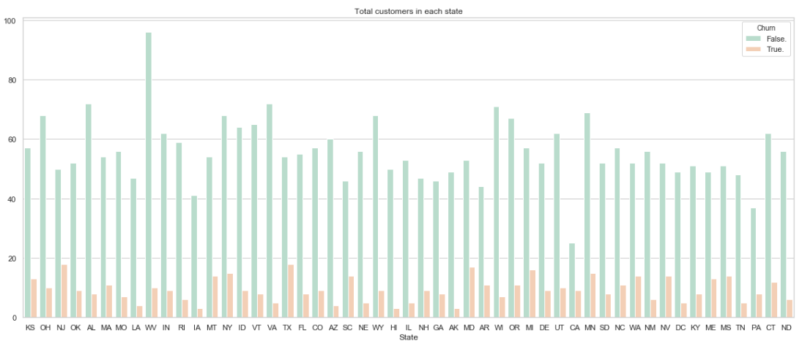
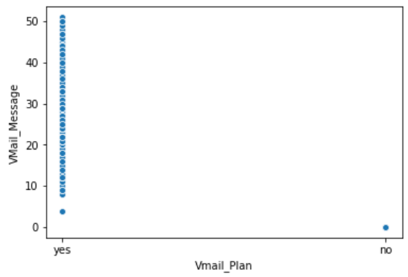
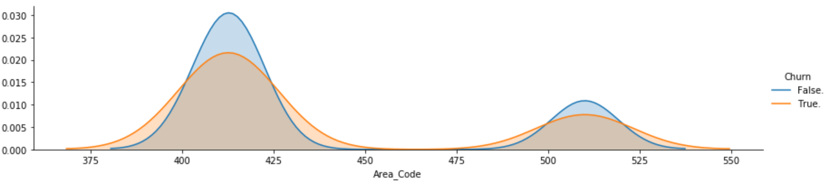
Variable Dropped
Grace
Variable | Distribution | Note
State |  | Drop “State”
Vmail_Plan & Vmail_Message |  | High correlation between Vmail_Plan & Vmail_Message Drop “Vmail_Plan”
Area Code |  | Drop “Area Code”

Slide 9
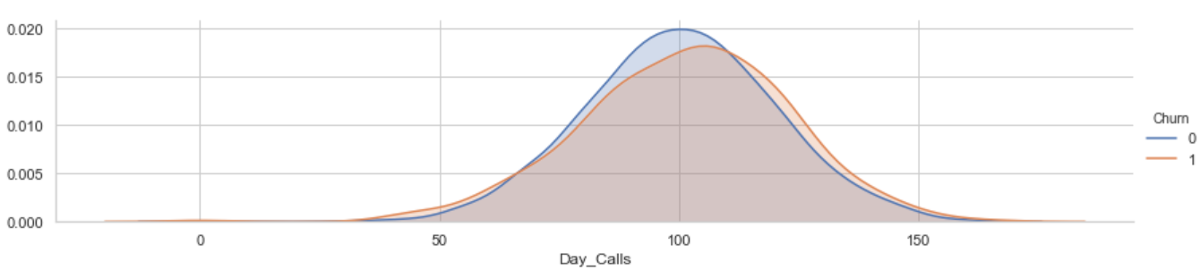
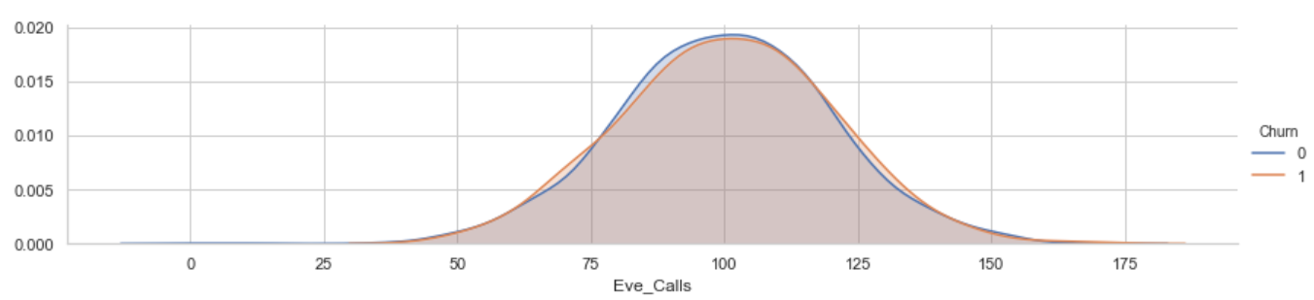
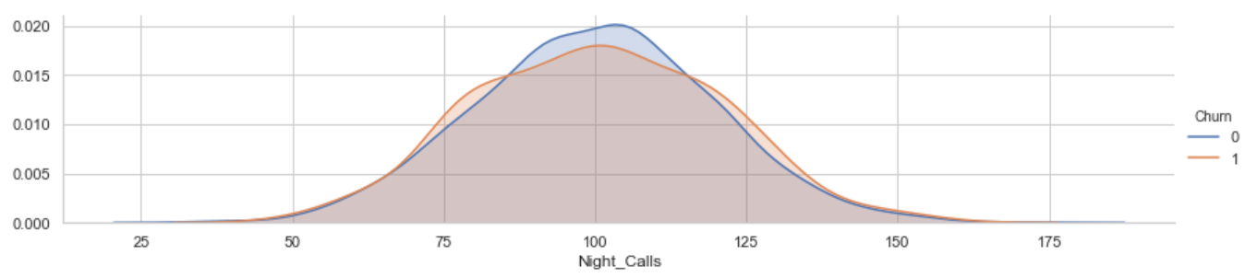
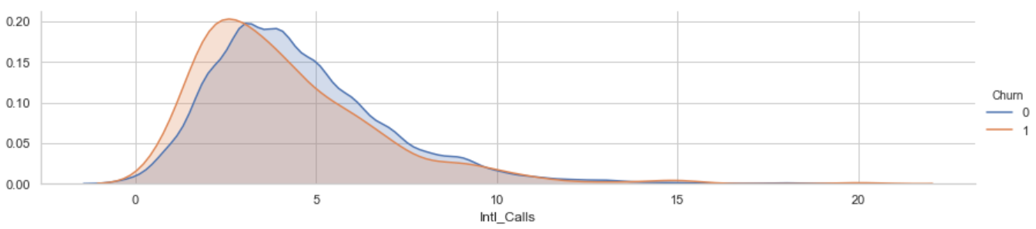
Variable Dropped (Cont.)
Grace
Variable | Distribution | Note
Day_Calls, Eve_Calls, Night_Calls, Intl_Calls |  | No big differences between Churn and not Churn Drop “Day_Calls”, “Eve_Calls”, “Night_Calls”, “Intl_Calls”
Other areas dropped: Phone

Slide 10
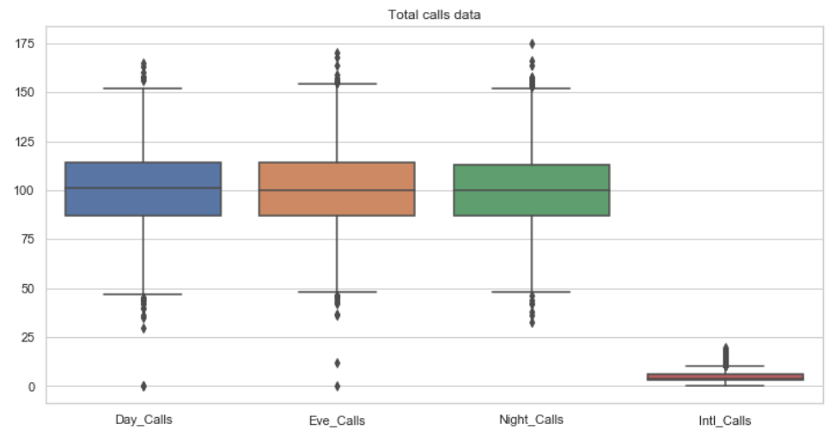
Outlier
Shub

Slide 11
Final Metrics in the Model
Shub

Slide 12
1
Define the Issue
2
Data Preparation
3
Modeling
Model 1: Naïve Bayes
Model 2: Decision Tree
Model 3: KNN
Model Evaluation and Comparison
4
Conclusion

Slide 13
Measuring Metric Chosen
Sumithra
performance measures | Description | Pros / Cons
Accuracy

Slide 14
1
Define the Issue
2
Data Preparation
3
Modeling
Model 1: Naïve Bayes
Model 2: Decision Tree
Model 3: KNN
Model Evaluation and Comparison
4
Conclusion

Slide 15
Model 1: Naïve Bayes
Sumithra
Method :xxx
Pros and cons
Results: xxx
Model Comparison
(if you run multiple models, the comparison)

Slide 16
Model 2: Random Forrest
Shub
Method :xxx
Results: xxx
Model Comparison

Slide 17
Model 3: KNN
Grace
K-NN is non-parametric lazy learning algorithm
Pro: Does not assume any probability distributions on the input data
Con: If one type of category occurs much more than another, classifying an input will be more biased towards that one category
Parameter | Validation Accuracy | Test Accuracy
N = 3 | 0.867 | 0.859
N = 5 | 0.885 | 0.874
N = 7 | 0.887 | 0.874

Slide 18
1
Define the Issue
2
Data Preparation
3
Modeling
Model 1: Naïve Bayes
Model 2: Decision Tree
Model 3: KNN
Model Evaluation and Comparison
4
Conclusion

Slide 19
Model Comparison
Grace
Model | Validation Accuracy | Test Accuracy | Diff (Validation vs. Test)
Model 1: Naive Bayes (Gaussian ) | 0.850 | 0.845 | 0.005
Model 2: Decision Tree | 0.889 | 0.896 | -0.007
Model 3: KNN (N = 5) | 0.885 | 0.874 | 0.011

Slide 20
1
Define the Issue
2
Data Preparation
3
Modeling
Model 1: Naïve Bayes
Model 2: Decision Tree
Model 3: KNN
Model Evaluation and Comparison
4
Conclusion

Slide 21
Decision Tree Result
Shub

Slide 22
Feature Importance
Sumithra

Slide 23
Conclusion
Roz

Slide 24
Thank you!

Slide 25
Appendix

Slide 26
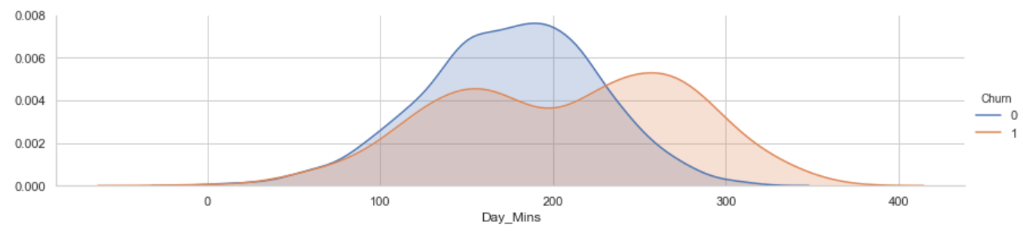
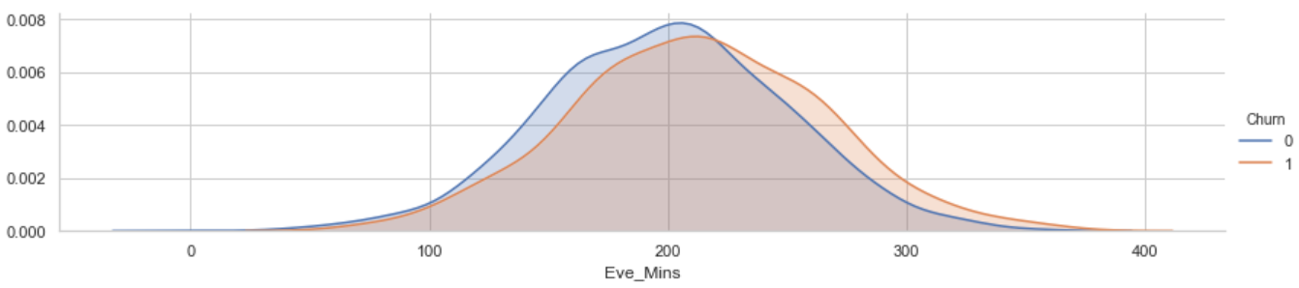
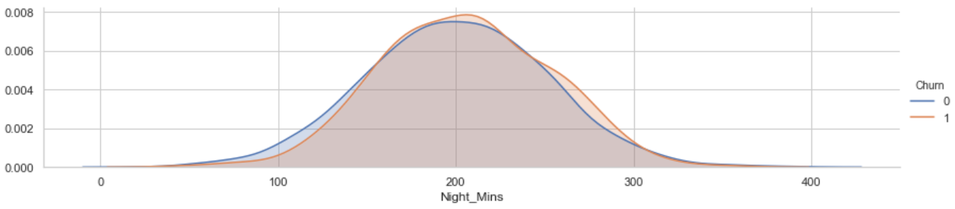
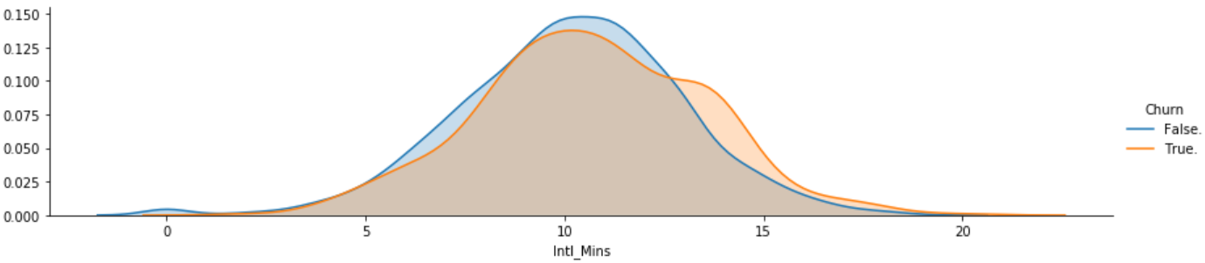
Question 1: Why not creating the Total_Mins?
Variable | Distribution | Note
Day_Mins, Eve_Mins, Night_Mins, Intl_Mins |  | The Churn split results are different for three metrics Keep the four instead creating a “Total_Mins” metric

Slide 27
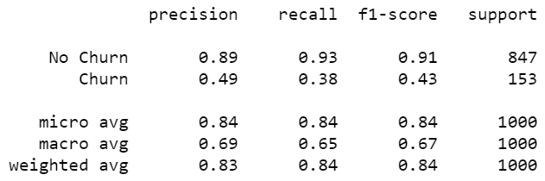
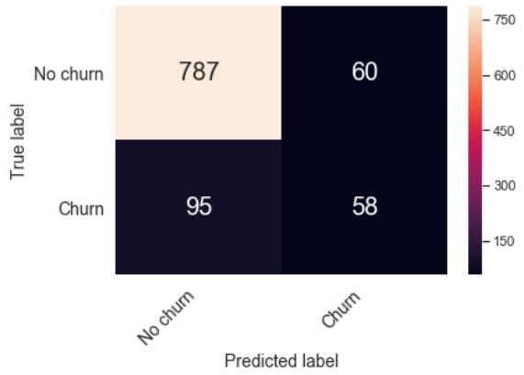
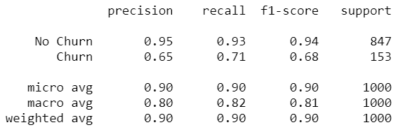
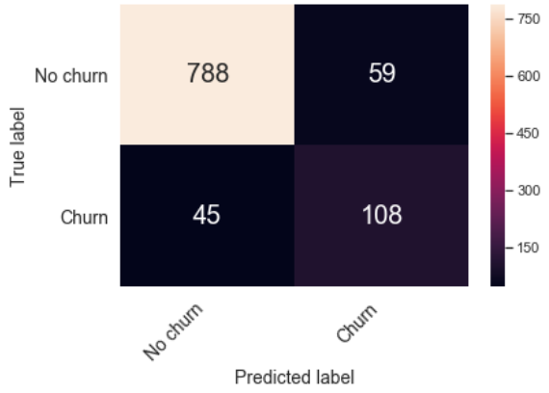
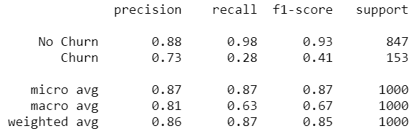
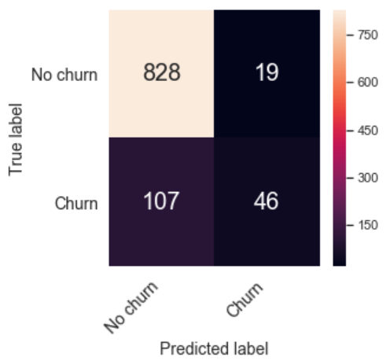
Question 2: What’s the result of other performance measures?
 | Other Performance Measures | Confusion Matrix Results
Model 1: Gaussian Naive Bayes
Model 2: Decision Tree
Model 3: KNN

Slide 28
SlidesCarnival icons are editable shapes.
This means that you can:
Resize them without losing quality.
Change fill color and opacity.
Change line color, width and style.
Isn’t that nice? :)
Examples:

Slide 29
😉
Now you can use any emoji as an icon!
And of course it resizes without losing quality and you can change the color.
How? Follow Google instructions https://twitter.com/googledocs/status/730087240156643328
✋👆👉👍👤👦👧👨👩👪💃🏃💑❤😂😉😋😒😭👶😸🐟🍒🍔💣📌📖🔨🎃🎈🎨🏈🏰🌏🔌🔑 and many more...

