Slide 1


General Overview of High-Performance Computing (HPC) Systems
Passant Hafez
HPC Systems Administrator
RCaaS – Information Services

Slide 2


What is HPC and how can I benefit from it as a researcher?
PC
Scalability
Supercomputer
Image sources: lifewire.com, forbes.com

Slide 3
General Overview of a Typical HPC System
Configuration
Access
User Spaces
Available Software
Job Scheduling

Slide 4
1. Configuration
A typical HPC system consists of: Compute Resources (CPU, GPU, High memory,..) Shared Storage High Speed Interconnect (Infiniband, Ethernet,..) Login/Head Node (user interface to the system) Data Transfer Node

Slide 5
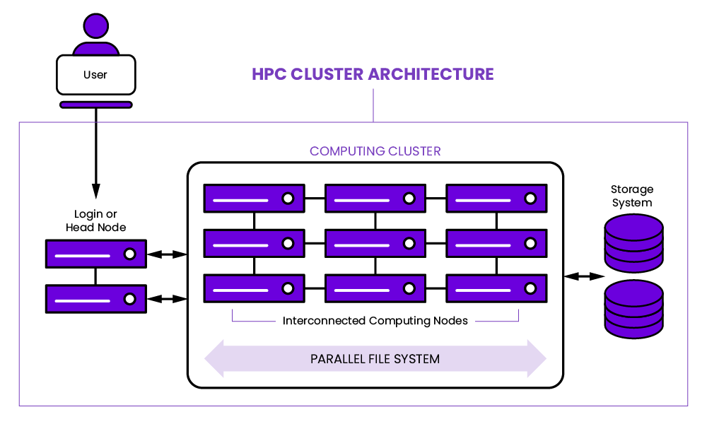
image source: https://www.weka.io/

Slide 6
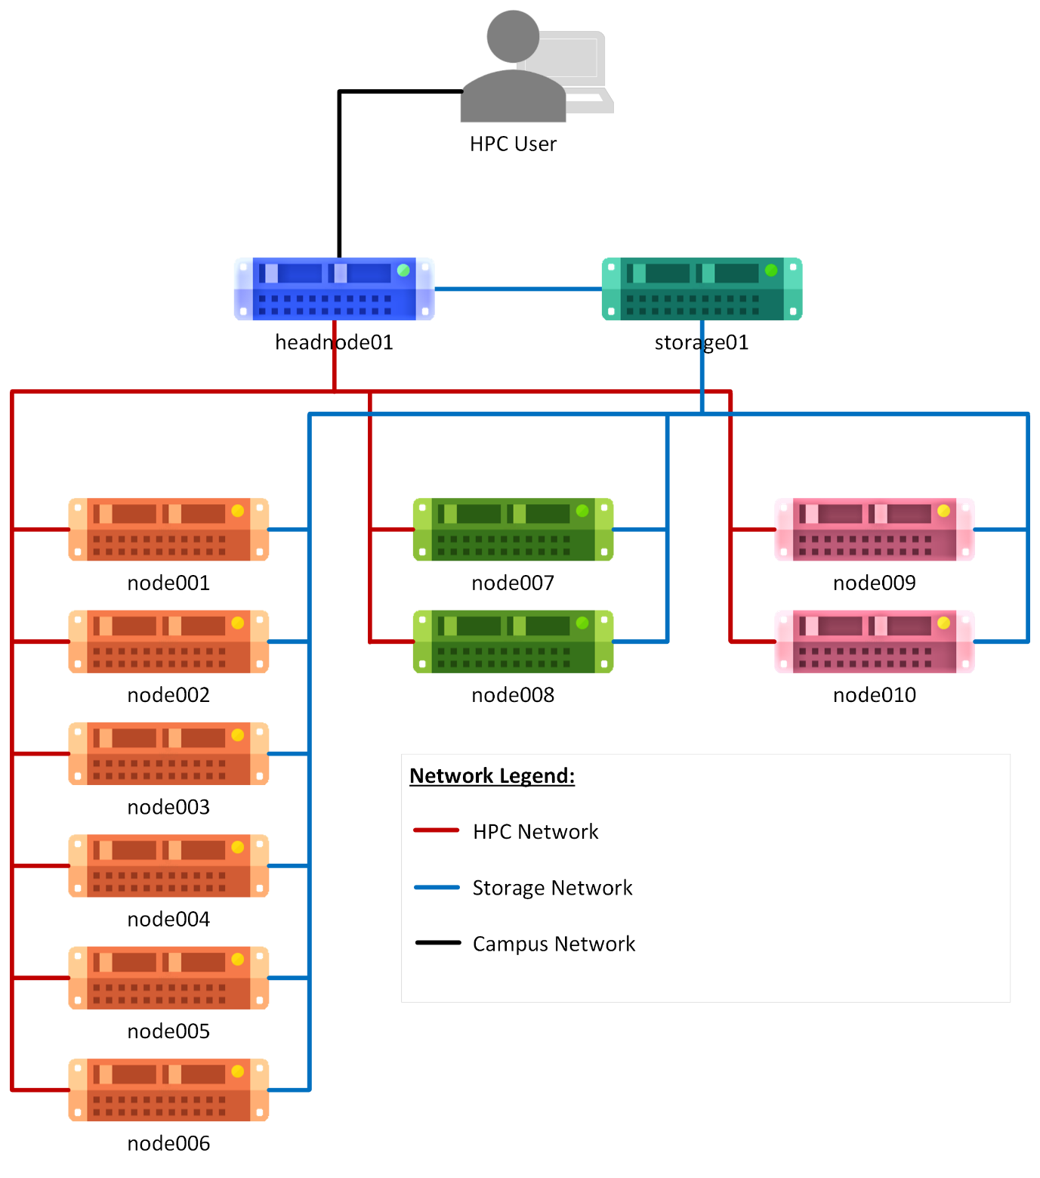

Slide 7
2. Access
Start with contacting the system owners/admins to check eligibility, check T&Cs.
Request an account and check the system’s user manuals.
May need VPN.
Terminal/Commandline (native terminal programs on Linux and MacOS, PuTTY, MobaXTerm).
GUI (Web Tool).
SSH Key Autentication.

Slide 8
3. User Spaces
Home: ~ or $HOME
Shared Scratch: shared across compute nodes, for parallel runs
Local Scratch: local to the node, for high I/O runs
Project Space: shared space among multiple users, using same data or software, and working on the same project
Other Spaces: Shared Installations, Datasets,.. (where users can benefit from but have no control over)

Slide 9
Re: Moving Data
SFTP (command or GUI tools e.g. FileZilla)
SCP (or WinSCP)
RSYNC
Web Tools

Slide 10
4. Available Software
OS Packages
System-wide Installations → Modules (Environment Modules, Lmod,..)
Local* Installations (per user or per group/project) * still on the HPC system, not on your PC

Slide 11
5. Job Scheduling & Resource Management
The HPC system is not the login node.
Computing resources on an HPC system are usually managed via a scheduler/resource manager, which ensures accurate resource allocations and isolating the work of different users even if they land on the same server.
Jobs are either Interactive or Batch

Slide 12
Examples: SLURM (Simple Linux Utility for Resource Management), SchedMD PBS (Portable Batch System), Altair Torque/Maui (Terascale Open-source Resource and Queue Manager) UVE (Univa Grid Engine), forked from SGE (Sun Grid Engine)

Slide 13
Example of Resources Requested:
Request | SLURM (in batch job start with #SBATCH) | PBS (in batch job start with #PBS)
time/walltime/wall-clock time | --time=0-01:00:00 or -t 60 | walltime=01:00:00
No. of nodes | --nodes=1 or -N 1 | nodes=1
memory | --mem=200M | mem=200mb
Email notifications | --mail-type=all --mail-user=me@glasgow.ac.uk | -m abe -M me@glasgow.ac.uk

Slide 14
What are the available HPC resources within UoG?

Slide 15
Do and Don’t Do.. Best Practices for Almost Any System
Don’t run resource-intensive processes on login node.
Don’t run interactively what you can run as a batch job.
Check the resource efficiency of your past jobs and adjust new ones accordingly.
If the system uses a data transfer node for copying files over, use that instead of using the login node.
Some systems are configured to terminate interactive jobs after a certain period of inactivity.

Slide 16
Don’t do workarounds for the previous point, if the job isn’t suitable as an interactive job, work with the staff to convert it to a batch job.
Pay attention to any messages sent to you via the mailing list, Teams, Slack,.. Also read through the motd you get when you login to the system, or when you load software modules,..
By default, there are no software modules loaded when you login to the system, if you choose to edit your login files (e.g. ~/.bashrc or ~/.bash_profile for Bash shell) to automatically activate/load any SW, just keep that in mind as you may run into conflicts when you later use related sw (python, conda,..)

Slide 17
HPC in Practice

Slide 18
Who am I?
Name: Jasmin Schar
Pronouns: She / Her
Department: Research Computing as a Service (RCaaS)
Occupation: HPC System Administrator
Background: System Engineer

Slide 19


Please connect to the UofG network:
eduroam or VPN
Open this link:
https://shorturl.at/T9uiD

Slide 20

GES Petrarch
Thank you to the School of Geographical & Earth Sciences for letting us use this cluster for the practical part of this workshop!

