Slide 1
Group c: hand gesture recognition
Niklas Holtz, Joshua Falk und Julien Räker

Slide 2
What is gesture recognition?
Interpreting human gestures
Control or interact with devices without physically touching them
Focus on deep learning

Slide 3
Use cases
Switch slides during the presentation
Skip songs while listening to music
Playback control on videos
Zoom
Change volume

Slide 4
Possible problems
Lighting
Hand decor
Hand Color

Slide 5
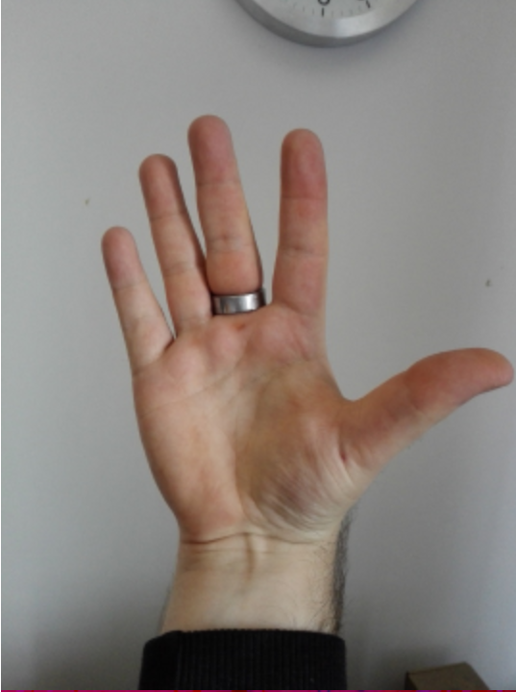
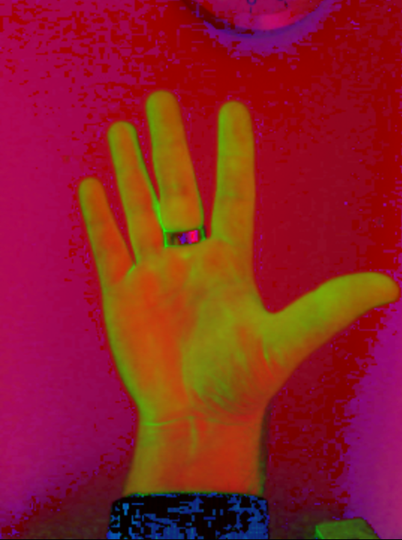

First attempt: Skin Detection

Slide 6
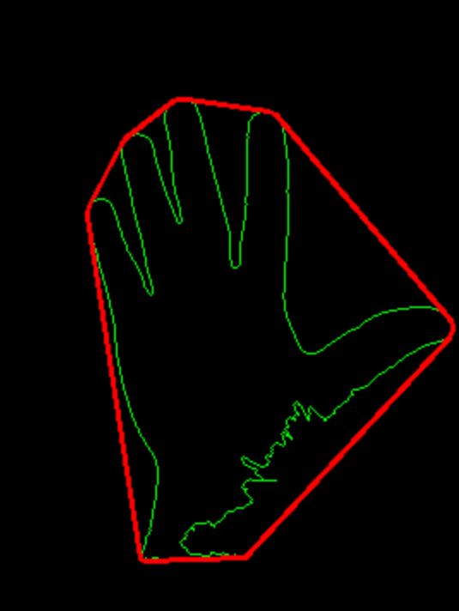
Good results at first

Slide 7
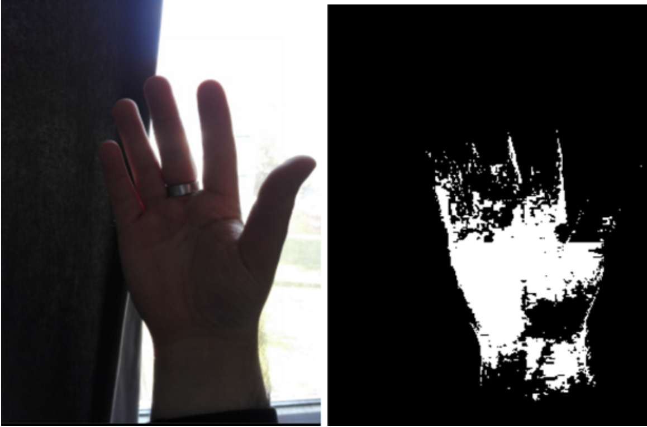
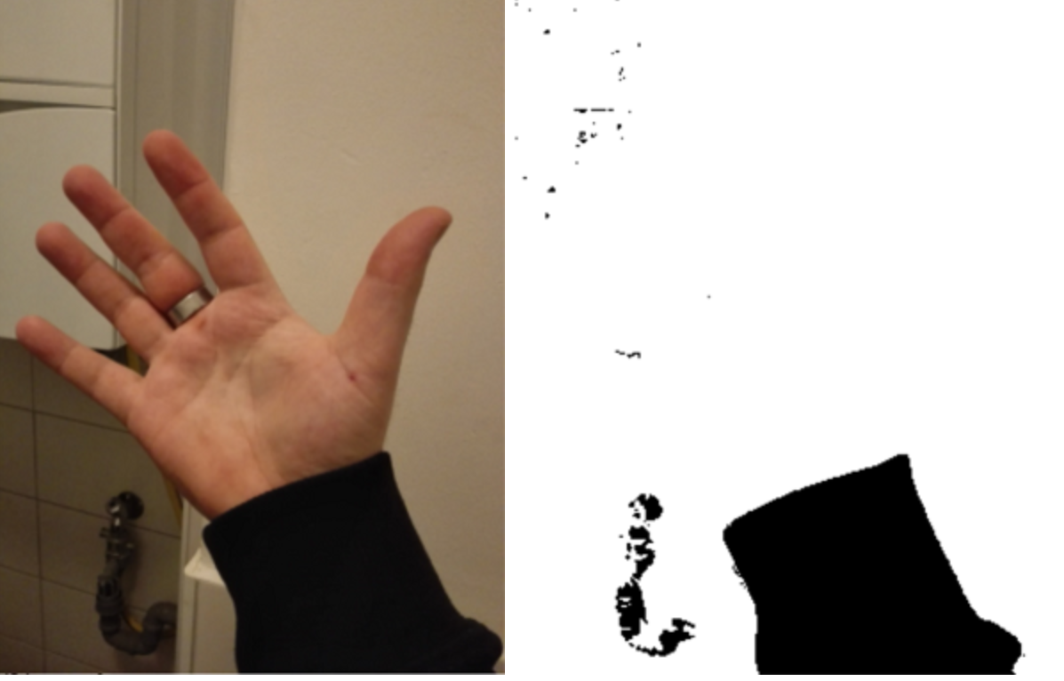
Poor results after several tests

Slide 8
Problems with Skin Detection
Does not work with poor lighting conditions
Can only detect hands with white skin color

Slide 9
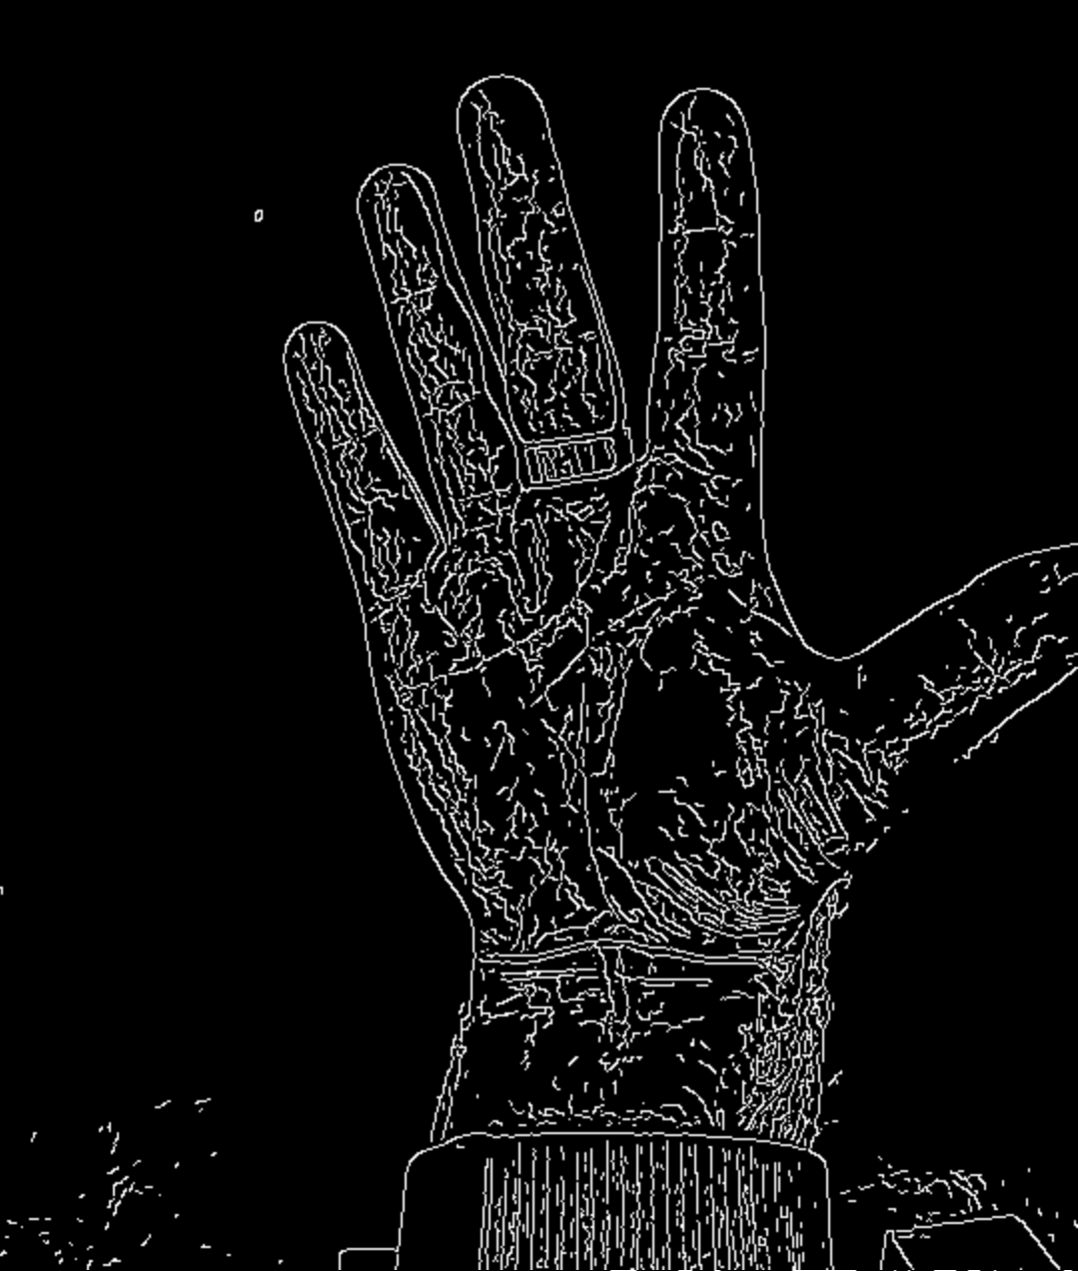
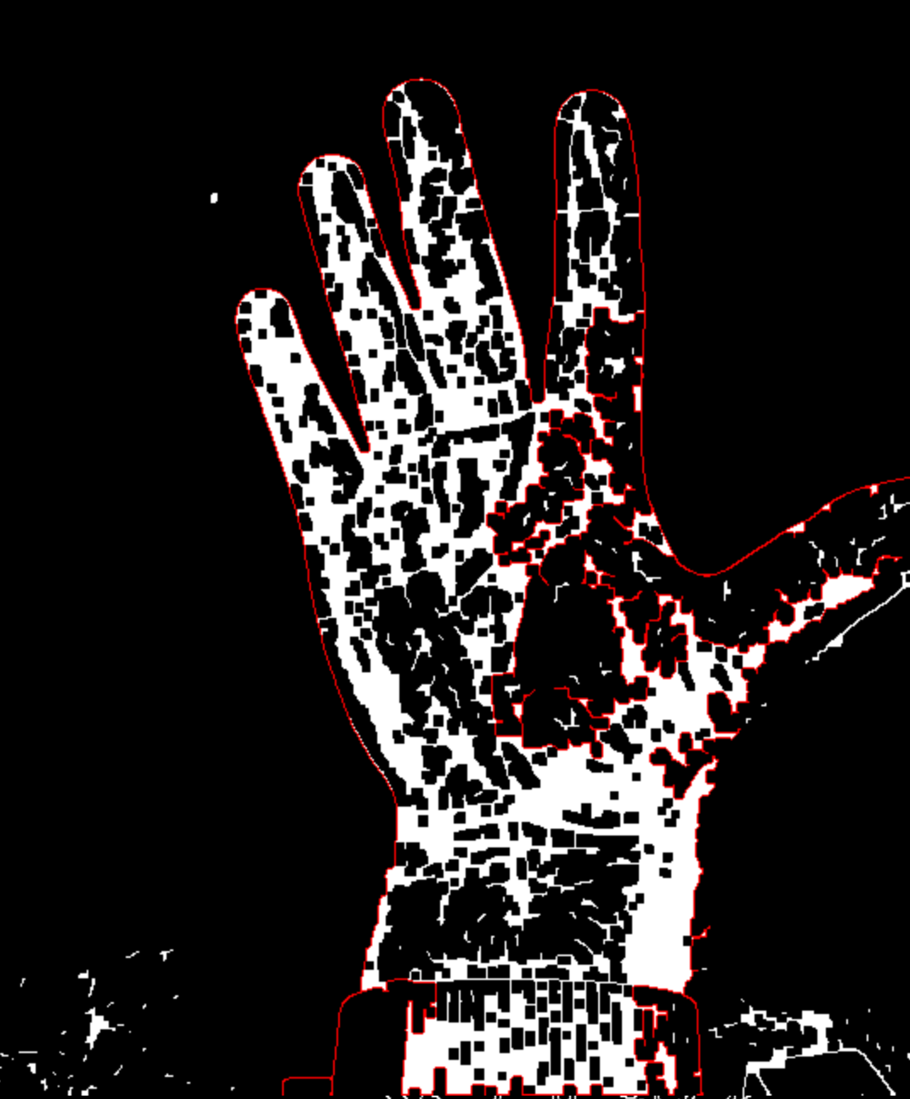
Second attempt: Edge Detection

Slide 10
Problems with Edge Detection
Busy background
The hand contours often have holes
Closing filter does not help

Slide 11
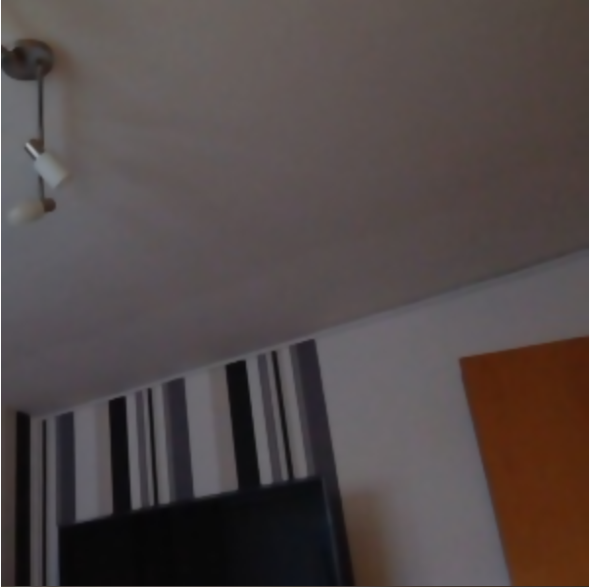

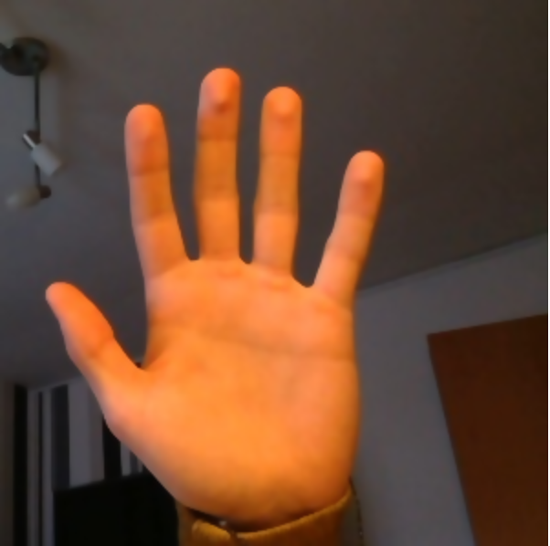
Third attempt: Background Subtraction

Slide 12

Background Subtraction

Slide 13
Background Subtraction
Good results
Regardless of skin color
Independent of lighting conditions

Slide 14
Camera Capturing

Slide 15
Machine Learning
We have not fout a suitable data set on the internet
We have tried to create one of our own
Which data are the best?
RGB?
Grayscale?
Binary?

Slide 16
Machine Learning
We have trained several models
Most models worked good on the trainingsset but failed on the realtime demo
Best results we had with the pictures from the Background Subtraction

Slide 17






Creating the Dataset and train a model
3000 images
6 gestures:
0. palm
Peace
Thumb
Fist
Ok
L

Slide 18
Demo…

