Slide 1
Collection and Shipment Training
Blood Based Biomarker Shared Resource (BBBSR)

Slide 2
Training Overview: BBBSR
Study Overview
Kit Review
Sample Collection and Processing
Sample Shipping
Sample Form
NCRAD Website
Common Nonconformance Issues
Questions?

Slide 3
Globally Unique Identifier (GUID)
The GUID is a subject ID that allows researchers to share data specific to a study participant, without exposing personally identifiable information
A GUID is made up of random alpha-numeric characters and does not include any PHI in the identifier

Slide 4
Globally Unique Identifier (GUID)
Create an account: https://bricsguid.nia.nih.gov/portal/jsp/login.jsp
Once you have an account, go to the GUID Tool – Create GUID
To open the ‘Launch GUID Tool’ you will need to have Java installed on your device
When the GUID Tool is open, you will need all of the following information
Complete legal given (first)name of participant at birth
The participant’s middle name, if applicable
Complete legal family (last) name of subject at birth
Day of birth
Month of birth
Year of birth
Name of city/municipality in which subject was born
Country of birth

Slide 5
BBBSR Study Specimens
Biospecimen | All Visits
Plasma | X
Buffy Coat (DNA) | X

Slide 6
Kit Request Module
http://kits.iu.edu/bbbsr/

Slide 7
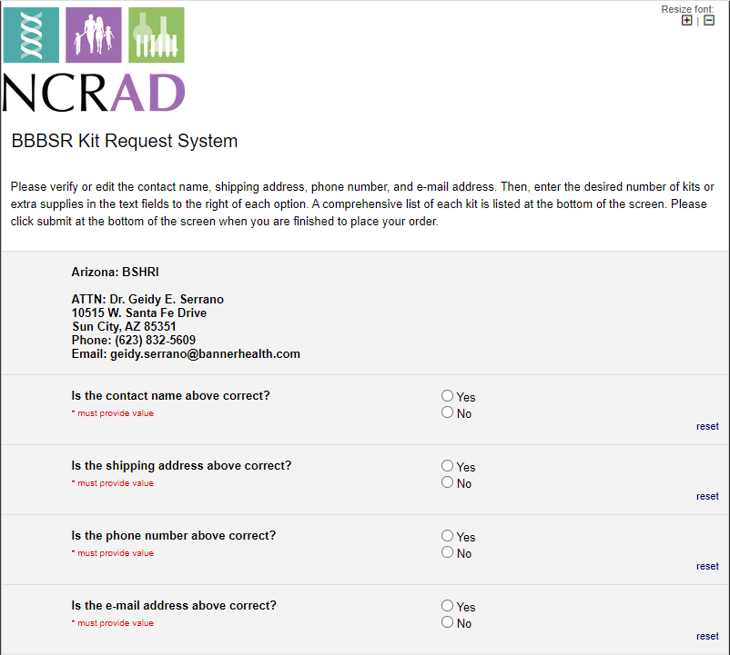
BBBSR Kit Request Module
Verify that this information is accurate, or correct it if necessary.

Slide 8
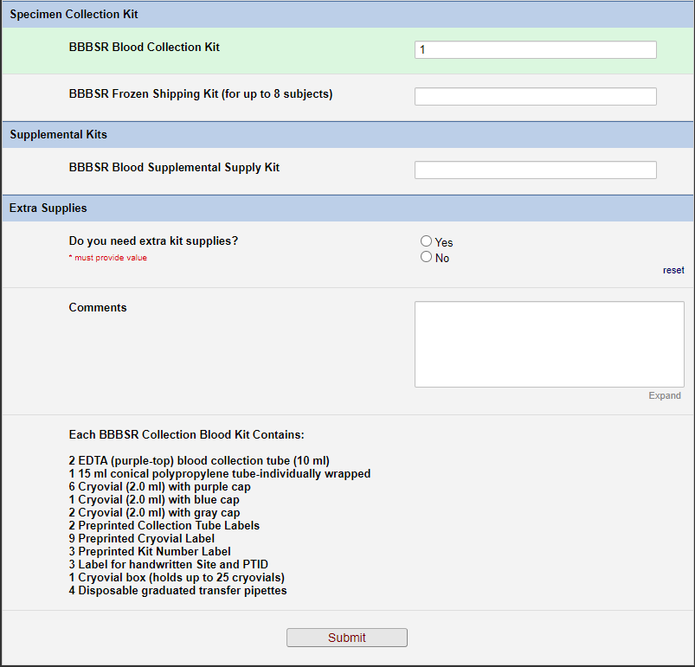
Indicate the quantity needed of each kit
Once selected, kit components of the chosen kit will appear at the bottom of the screen
Click “Submit” to turn in your request.
**Note: You can order more than one type of kit in a single kit request**

Slide 9
Specimen Labels

Slide 10
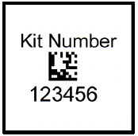
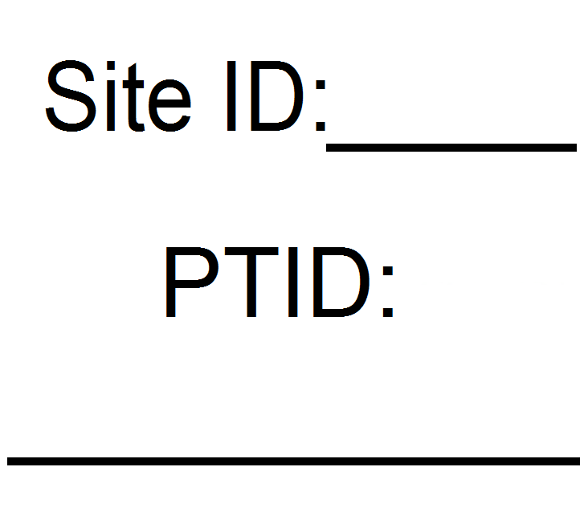
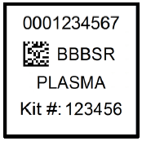
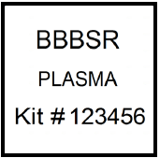
Four Label Types
Kit Number
Site and PTID
Collection Tube
Cryovial

Slide 11
Kit Number Labels
Used to track patient samples and provide quality assurance – Will be placed on the following locations :
Blood Sample and Shipment Notification Forms
Cryoboxes that house aliquots during shipping
One extra label provided
Provided by NCRAD in the kits

Slide 12
Site and PTID Labels
Subjects will be identified by their Site and PTID
Sites will be responsible for handwriting this onto the provided labels
Must use Fine Point Permanent Marker
Each site will receive 3 markers in initial kit supply

Slide 13
Collection Tube Labels
Collection Tube labels have 4 components:
10 digit specimen barcode
Study name
Specimen type
Kit number

Slide 14
Cryovial Labels
Only one label to be placed on each cryovial
Plasma
From EDTA tube
Buffy Coat
From EDTA tube
BUFFY COAT

Slide 15
Blood Collection Tubes
Label 1: Site and PTID label
Label 2: Collection Tube label
All collection tubes will have two labels:
The handwritten Site and PTID label
The collection tube label

Slide 16
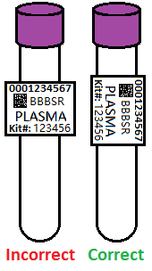
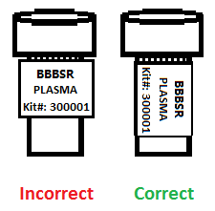
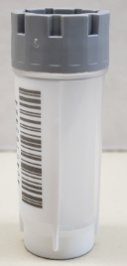
Labeling Biologic Samples
Label all collection and aliquot tubes before cooling, collecting, processing or freezing samples
Label only 1 subject’s tubes at a time to avoid mix-ups
Wrap the label around the tube horizontally. Label position is important for all tube types
Make sure the label is completely adhered by rolling between your fingers
Do NOT cover barcode on cryovial with label

Slide 17
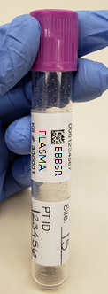
Collection Tube Labeling
Collection Tube Label
Site and PTID Label
EDTA Tube

Slide 18
Handling/Processing Study Specimens

Slide 19


Blood Draw Order
Tube Type | Number of Tubes Drawn | Tube Image
EDTA (Purple-Top) Tube (10 ml) | x2

Slide 20
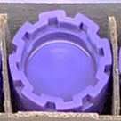

Cryovial Cap Colors
Cap Color | Sample Type | Cap Image
Purple | Plasma
Gray | Buffy Coat

Slide 21
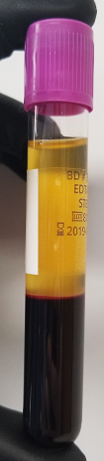
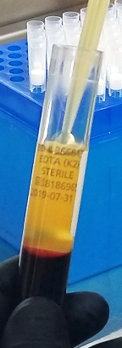
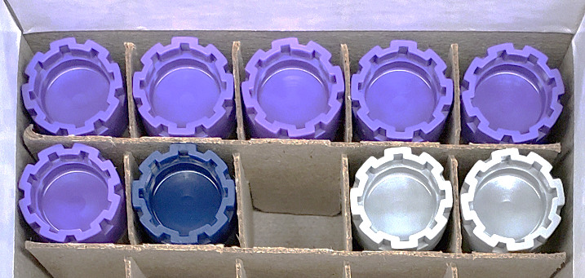
Plasma Collection
Create up to 7 aliquots
(Six 1.5ml aliquots in purple caps + 1 residual aliquot in blue cap)

Slide 22
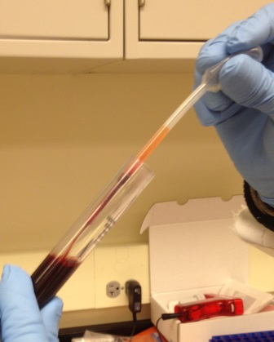
Buffy Coat Collection

Slide 23
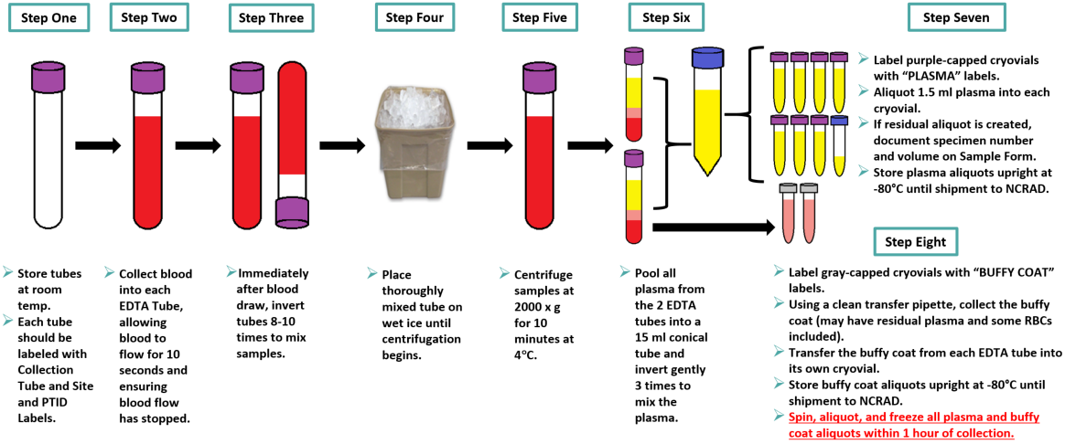
Plasma/Buffy Coat Collection and Processing

Slide 24
Sample Shipments

Slide 25
Sample Shipment Summary
Collection Tube | Drawn At | Specimen Type | Aliquot Volume | Total Number of Aliquots | Shipping Temperature
2 EDTA (Purple-Top) Blood Collection Tubes (10 ml) | All visits | Plasma | 1.5 ml plasma aliquots | Up to 7 | Frozen
 | All visits | Buffy Coat | ~1.0 ml buffy coat aliquots | 2 | Frozen

Slide 26
Frozen Shipment Packaging
All other samples shipped frozen to NCRAD
Plasma and Buffy Coat
Ship Monday-Wednesday Only
Hold packaged samples in a -80°C freezer until pickup
Include copy of Blood Sample Shipment and Notification Form
Batch samples together
8 cryoboxes
Batch shipping should be performed quarterly or as a full shipment of specimens accumulates, whichever is sooner.

Slide 27
Shipping Frozen Samples
Plasma and Buffy Coat Samples

Slide 28
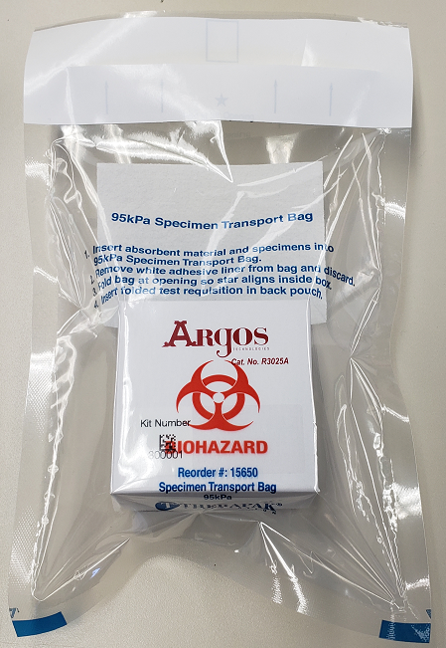
Frozen Shipment Packaging
Use the biohazard bag to package the 25-Slot cryobox
Cryovial box placed in clear biohazard bag

Slide 29
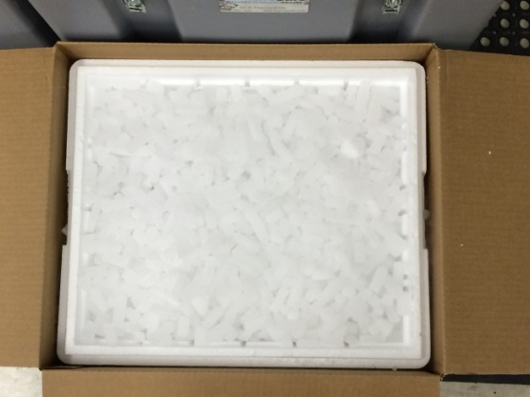
Frozen Shipment Packaging
Place 2-3 inches of dry ice in the bottom of the Styrofoam shipping container, then insert the cryoboxes laying upright.
Fully cover the cryoboxes with about 2 inches of dry ice in the provided shipper.
Each Styrofoam shipper must contain about 45 lbs (20 kg) of dry ice.

Slide 30
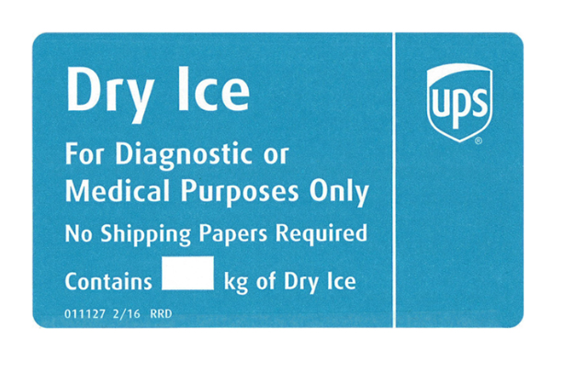
Frozen Shipping – Dry Ice Requirements
Dry Ice label should not be covered with other stickers and must be completed or the shipping carrier will reject/return your package!
Net weight of dry ice in kg
20

Slide 31
Blood Sample and Shipment Notification Form
A copy of the sample form must be emailed or faxed to NCRAD prior to the date of sample arrival.
Please include sample forms in all shipments of frozen and ambient samples.
Email: alzstudy@iu.edu
Fax: 317-321-2003

Slide 32
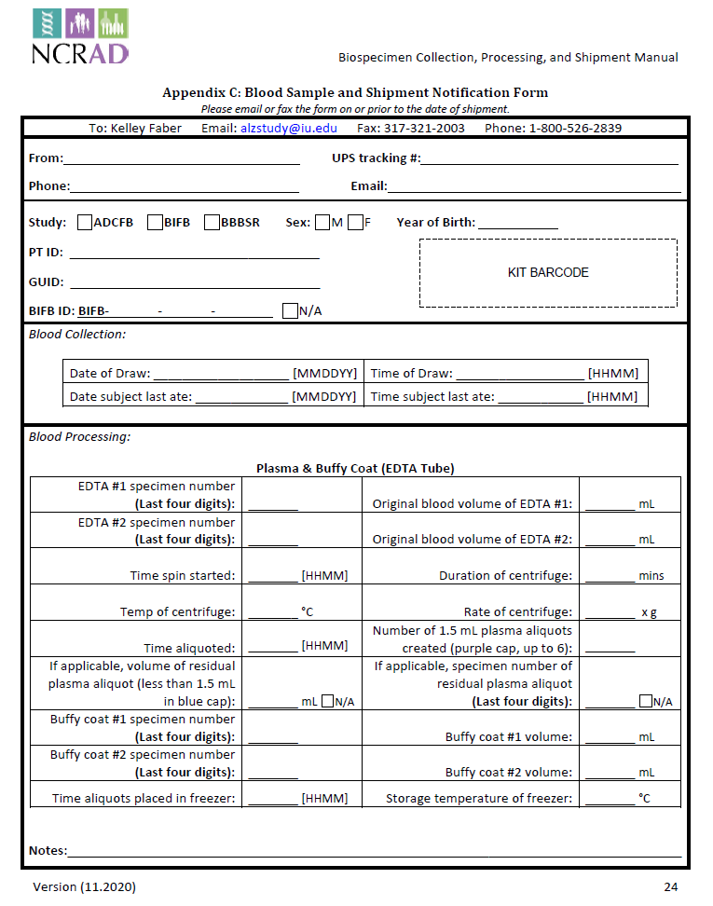

Slide 33
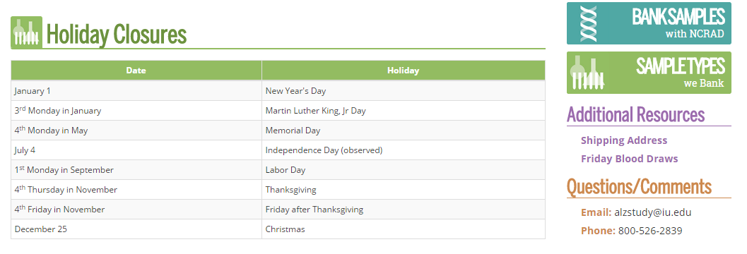
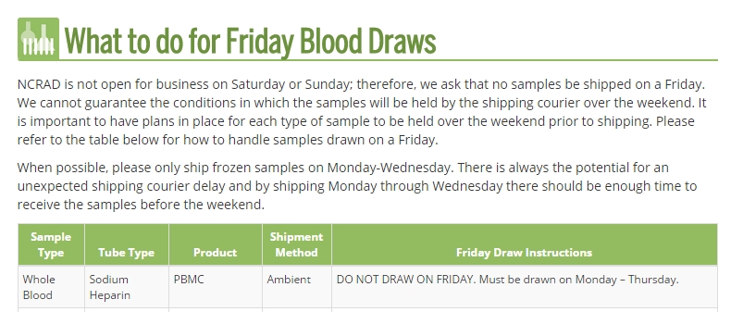
NCRAD Website: Helpful Pages
https://ncrad.org/holiday_closures.html
https://ncrad.org/friday_blood_draws.html

Slide 34
Nonconformance Issues
Sample aliquots and collection tubes frozen at an angle/inverted
Recommendation:
Place aliquots in Argos boxes/tube rack in freezer upright until shipment
Fields left blank on Blood Sample and Shipment Notification Form
Last time subject ate often left blank/unknown
Incorrect data reported on Sample and Shipment Notification Forms
Recommendation: Complete Sample Notification forms during the participant study visit as samples are processed.

Slide 35
Nonconformance Issues
Multiple low volume aliquots
Recommendation:
Lay out cryovials in a row and aliquot in order until sample is depleted
All frozen samples for a participant not sent within one shipment box (plasma and buffy coat aliquots should be kept together)
Aliquots arriving to NCRAD without labels
Sample forms not faxed or scanned to NCRAD the day before shipment
Recommendation:
Ship Samples to NCRAD utilizing the Notification Form, by PTID. Do not throw away labels until samples are packed and shipped.

Slide 36
Contact Information
Kaci Lacy
Phone: (317) 278-1170
E-mail: lacy@iu.edu
General NCRAD Contact
Phone: (800) 526-2839
E-mail: alzstudy@iu.edu
Website: www.ncrad.org

