Slide 1
HALS Coordinator Training
Brown University

Slide 2
Training Overview
GUID
Collection Overview
Kit Requests
Specimen Labels
Sample Form
Sample Collection and Processing
Sample Shipping
NCRAD Website
Common Non-conformance
Questions?

Slide 3
Globally Unique Identifier (GUID)
The GUID is a subject ID that allows researchers to share data specific to a study participant, without exposing personally identifiable information
A GUID is made up of random alpha-numeric characters and does not include any PHI in the identifier

Slide 4
Globally Unique Identifier (GUID)
Create an account: https://bricsguid.nia.nih.gov/portal/jsp/login.jsp
Once you have an account, go to the GUID Tool – Create GUID
To open the ‘Launch GUID Tool’ you will need to have Java installed on your device
When the GUID Tool is open, you will need all of the following information
Complete legal given (first)name of participant at birth
The participant’s middle name, if applicable
Complete legal family (last) name of subject at birth
Day of birth
Month of birth
Year of birth
Name of city/municipality in which subject was born
Country of birth

Slide 5
HALS Study Specimens
Specimen Type | Visit 1
DNA (BUFFY COAT) | X
PLASMA | X
Serum samples also collected but since they are not shipping to NCRAD they are not covered in this training.

Slide 6
HALS Kit Request Module
https://redcap.uits.iu.edu/surveys/?s=NW9J3NCPWF

Slide 7
When to Order Kits
Your site will be responsible for ordering kits (labels included) and maintaining a supply on site for scheduled participants
Allow up to 2-4 weeks for your order to be processed and delivered.

Slide 8
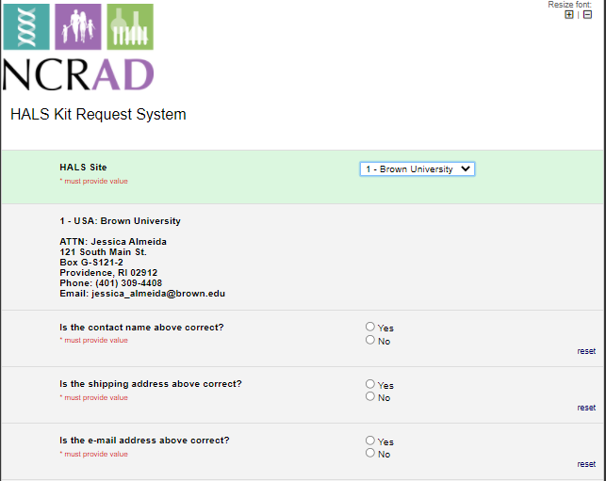
HALS Kit Request Module
Choose your site from the drop-down list.
The coordinator name and contact information will appear.
Verify that this information is accurate, or correct it if necessary.

Slide 9
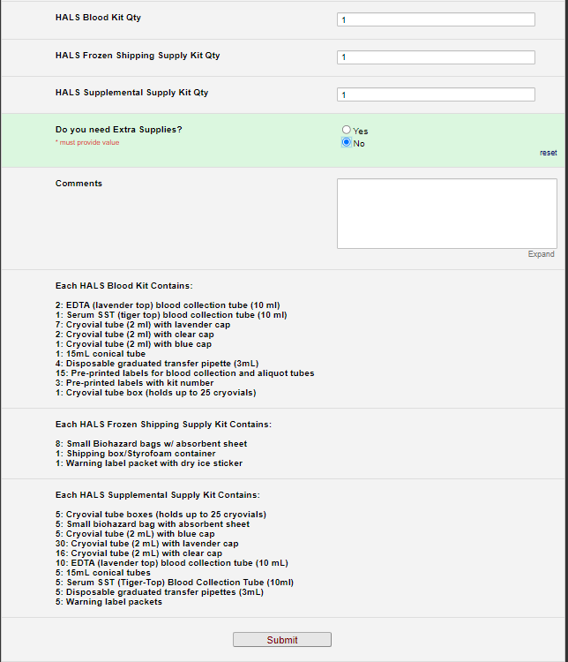
Indicate the quantity needed of each kit
Once selected, kit components of the chosen kit will appear at the bottom of the screen (Pictured)
Click “Submit” to turn in your request.
The IU staff will notify you that your request has been received and address any issues.
**Note: You can order more than one type of kit in a single kit request**

Slide 10
Specimen Labels
Types of labels
How to label tubes

Slide 11
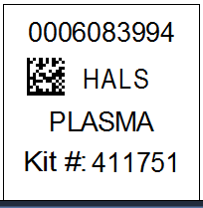
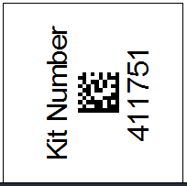
Two Label Types
Collection & Aliquot Tube Labels
Kit Number Labels

Slide 12
Kit Number Labels
Used to track patient samples and provide quality assurance – Will be placed on the following locations :
Biological Sample and Shipment Notification Form
Cryobox that houses aliquots during shipping
Biohazard bag that houses cryobox

Slide 13
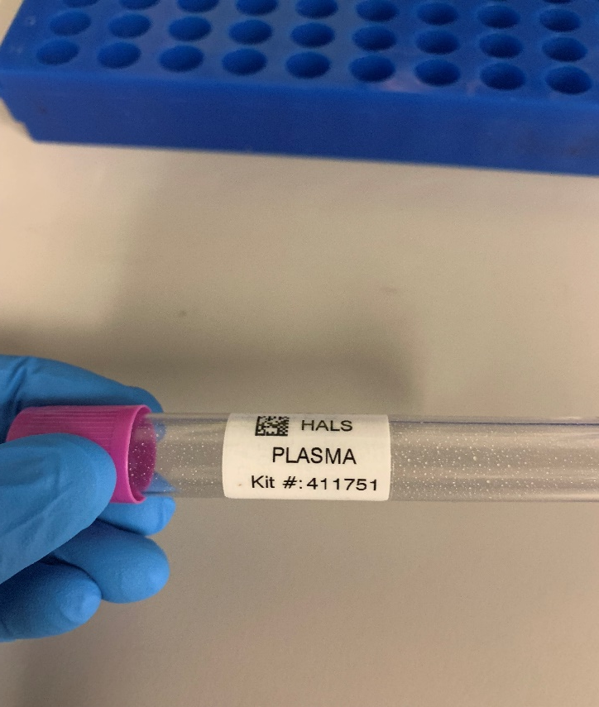
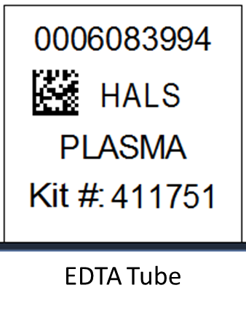
Collection Tubes - Blood
Collection Tube Label

Slide 14
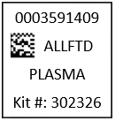
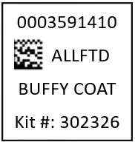
Aliquot Tube Labels
One label to be placed on ALL aliquot tubes
Plasma
From EDTA tube
Lavender cap cryovial
Buffy Coat
From EDTA tube
Clear cap cryovial
HALS
HALS

Slide 15
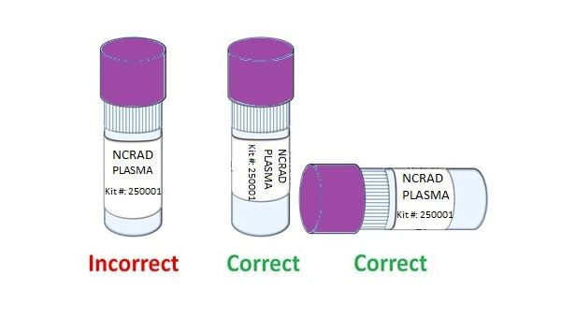
Labeling Biologic Samples
Label all collection and aliquot tubes before cooling, collecting, processing or freezing samples
Label only 1 subject’s tubes at a time to avoid mix-ups
Wrap the label around the tube horizontally. Label position is important for all tube types
Make sure the label is completely adhered by rolling between your fingers

Slide 16
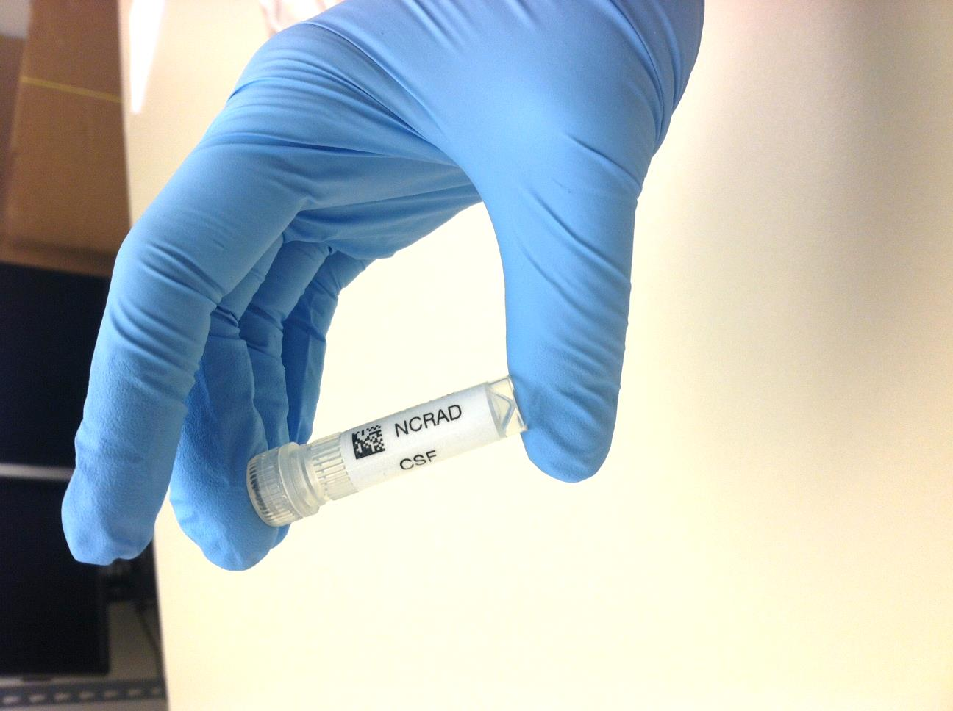
Aliquot Tube Labels
Aliquot tube label only
Please place barcode near cap
One label per tube
HALS
Plasma

Slide 17
Biological Sample and Shipment Notification Forms
“Sample Forms”

Slide 18
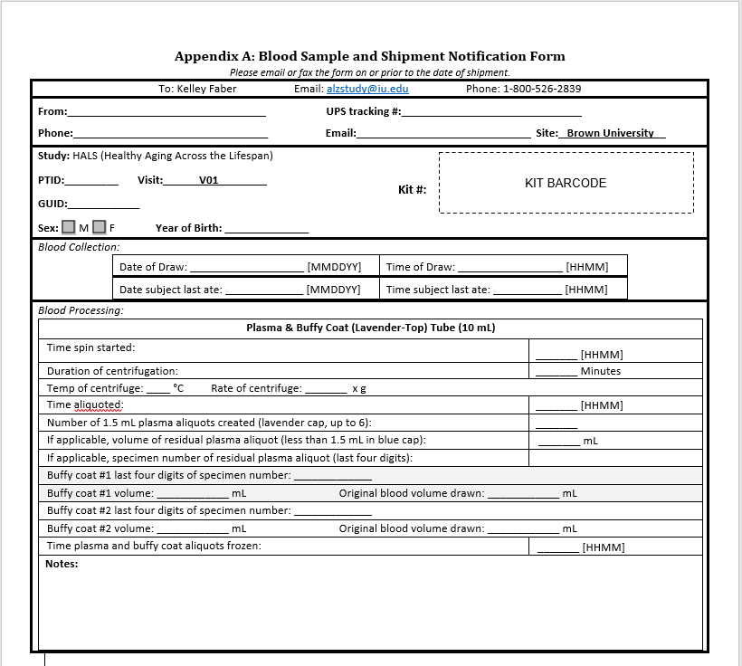
Biological Sample and Shipment Notification Form
(Blood)
Includes expanded blood processing section for plasma and buffy coat
All aspects of this form must be completed prior to the samples and sample form being shipped to NCRAD

Slide 19
Biological Sample and Shipment Notification Forms
A copy of the sample form must be emailed to NCRAD prior to the date of sample arrival.
Please include sample forms in all shipments of frozen and ambient samples.
Email: alzstudy@iu.edu

Slide 20
Handling/Processing Study Specimens
Draw Order
Collection and aliquoting

Slide 21
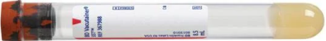

Blood Draw Order
Tube Type | Number of Tubes Drawn | Tube Image
SST (Tiger Top) Tube (8.5 ml)* | 1 (8.5 ml)
2. EDTA (Purple-Top) Tube (10 ml) | 2 (20 ml)
*SST Tube stays at Brown University and is NOT shipped to NCRAD-follow local processing guidelines.

Slide 22


Cryovial Cap Colors
Cap Color | Sample Type | Cap Image
Lavender | Plasma
Clear | Buffy Coat

Slide 23
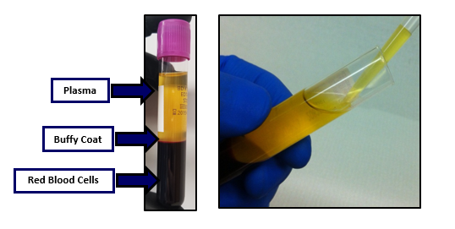
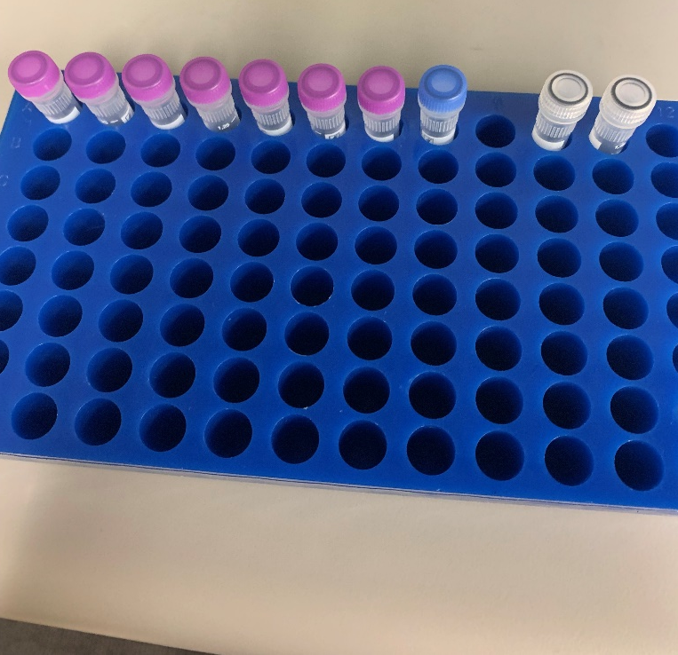
Plasma Collection
2 EDTA tubes will yield approximately 7 plasma aliquots (with 1 residual in blue cap) and 2 buffy coats
Please see the NCRAD tutorial: https://www.ncrad.org/resource/allftd.html

Slide 24
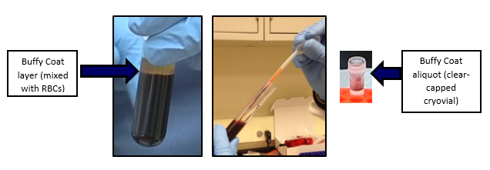
Buffy Coat Collection
Please see the NCRAD tutorial: https://www.ncrad.org/resource/allftd.html

Slide 25
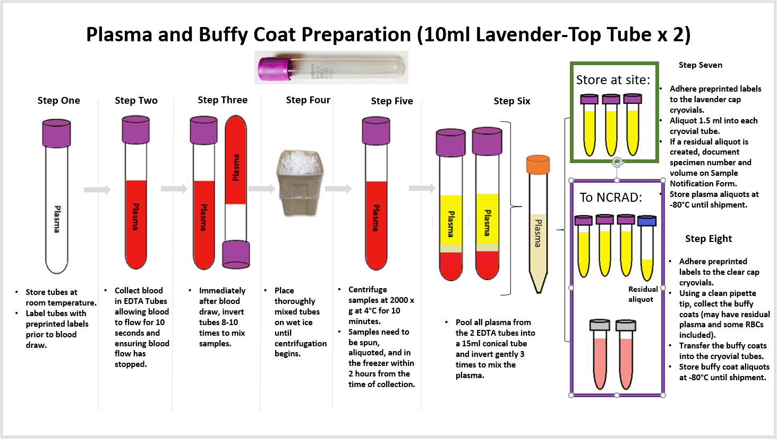

Slide 26
Sample Shipments
How to ship samples back to ncrad

Slide 27
Frozen Shipment Packaging
All samples shipped frozen to NCRAD Monday-Wednesday ONLY
Hold packaged samples in a -80°C freezer until pickup
Include copy of Blood Sample Shipment and Notification Form
Batch samples together (8 cryoboxes)

Slide 28
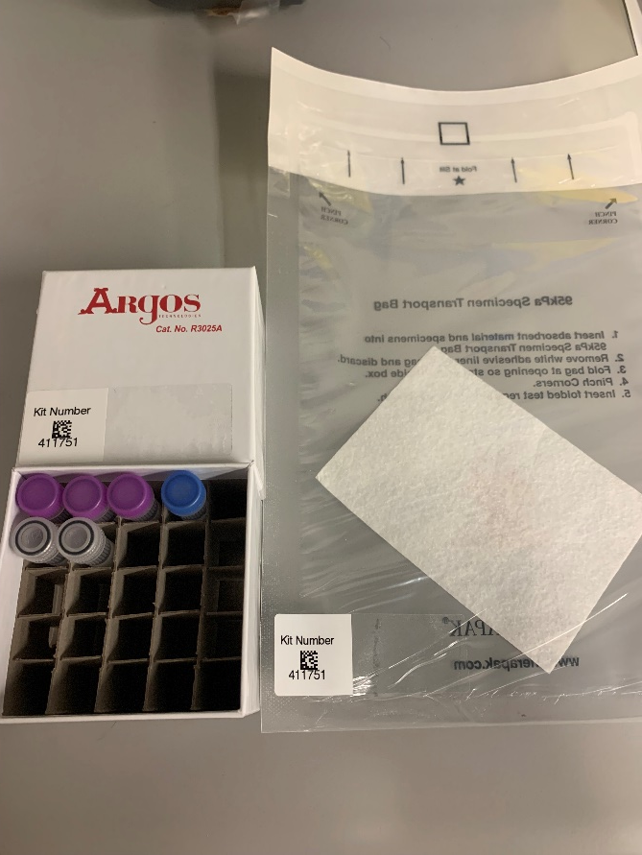
Frozen Batch Sample Shipment
Blood kit number
Blood samples

Slide 29
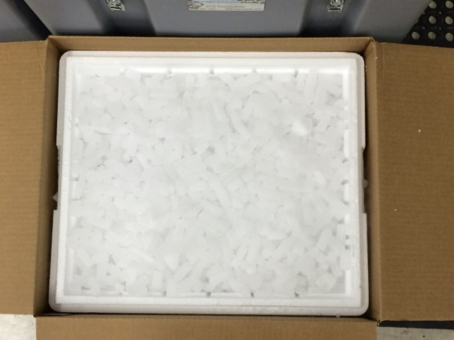
Frozen Batch Sample Shipment
Place 2-3 inches of dry ice in the bottom of the Styrofoam shipping container, then insert the cryoboxes laying upright.
Fully cover the cryoboxes with about 2 inches of dry ice in the provided shipper.
Each Styrofoam shipper must contain about 45 lbs (20 kg) of dry ice.

Slide 30
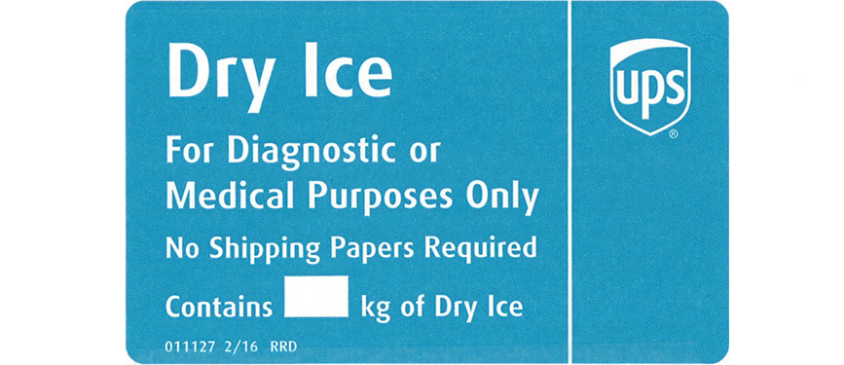
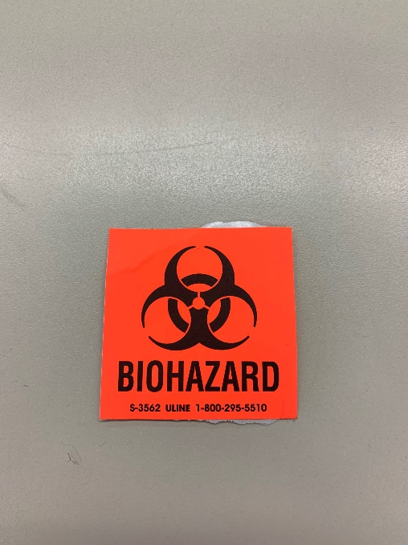
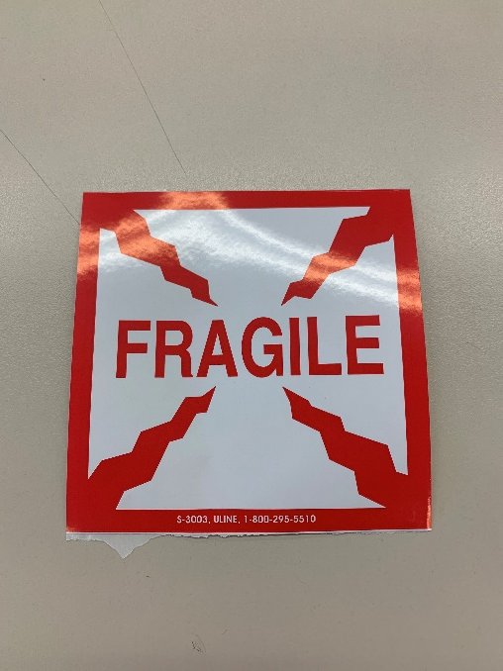
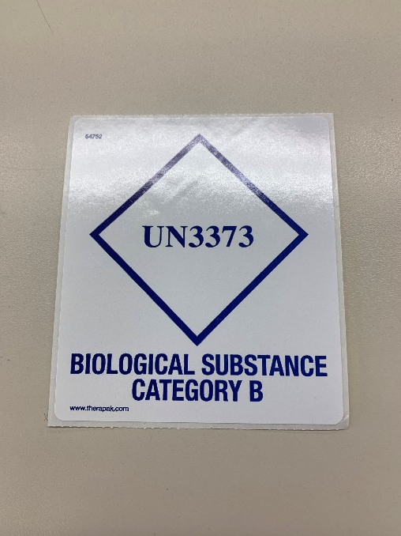
Frozen Batch Sample Shipment

Slide 31

UPS ShipExecTM Thin Client Website
Log into the ShipExec Thin Client: https://kits.iu.edu/UPS
Click on the “Shipping” dropdown and click on “Shipping and Rating”

Slide 32
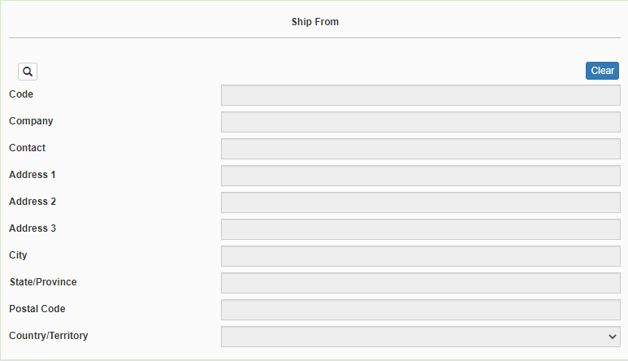
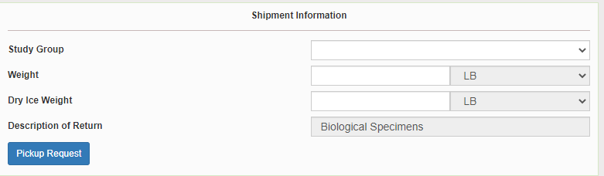
Finding Your Contact Information
On the right side of the screen, choose the name of your study from the “Study Group” drop down menu
This step must be done 1st
On the left side of the screen, Click on the magnifying glass icon

Slide 33
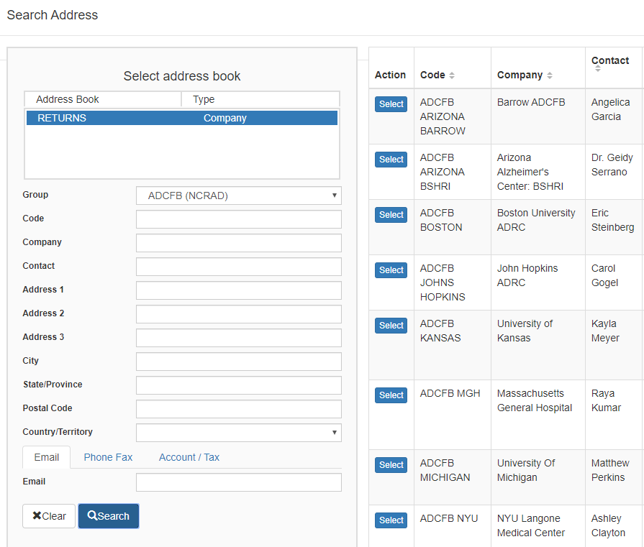
Finding Your Contact Information
On the right side of the screen, a list of all the site addresses within the study you selected should populate
User can filter the search for their address further by filling in the “Company”, “Contact”, or “Address 1” fields
Hit “Search” when ready.
Once you have found your site address, click on the “Select” button to the left of the address
If any information needs to be updated, please reach out to the NCRAD Coordinator of your study

Slide 34
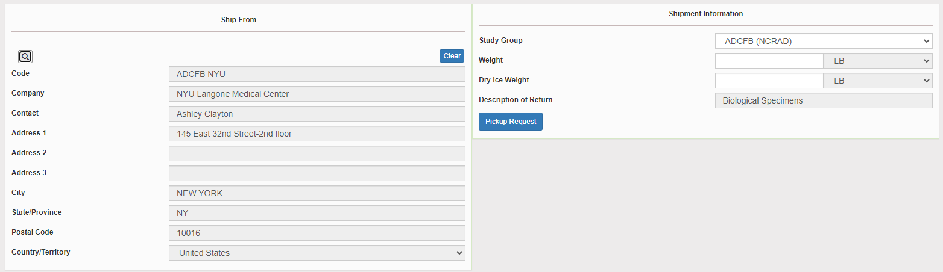
Verify Information
Please verify that both the shipping information AND study reference are correct for this shipment

Slide 35
Entering Shipment Information
Frozen shipments
Enter the total weight of your package in the “Weight” field
Enter the dry ice weight in the “Dry Ice Weight” field
The “Dry Ice Weight” field cannot be higher than the “Weight” field (will receive an error message)

Slide 36
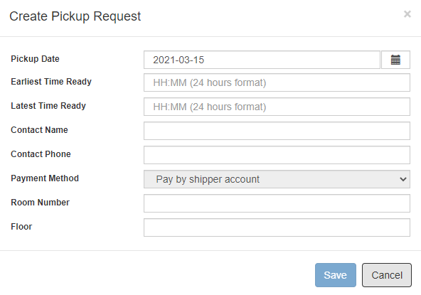
Need to request UPS Pickup?
Click on the “Pickup Request” button
Fill out all fields for the pickup request
Enter in the “Earliest Time Ready” and “Latest Time Ready” in 24-hour format
Users must schedule pickup minimum 1 hour before “Earliest Time Ready”
Choose a name and number that is the best to contact if the UPS driver has questions related to picking up your package
Entering the Room Number and Floor will help the UPS driver locate your package
Room number field is free text
Floor field is numerical only
Hit “Save” when done

Slide 37
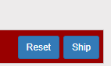
Shipping Packages
If all fields in “Ship From” and “Shipment Information” fields are completed, and pickup request is completed (if necessary), click Ship in the bottom right corner of the page

Slide 38
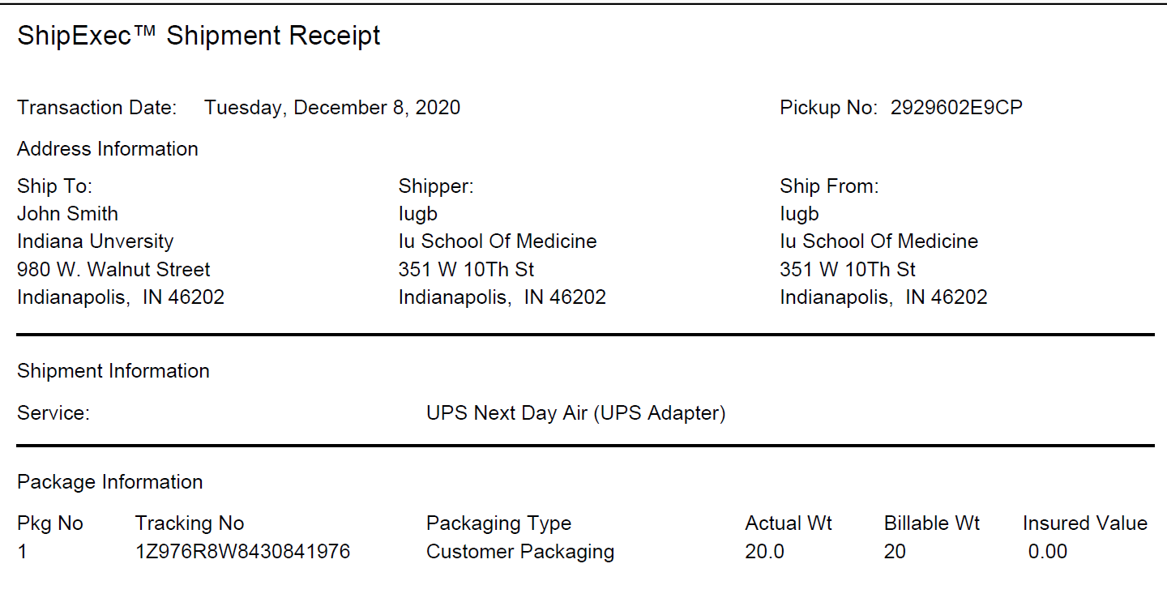
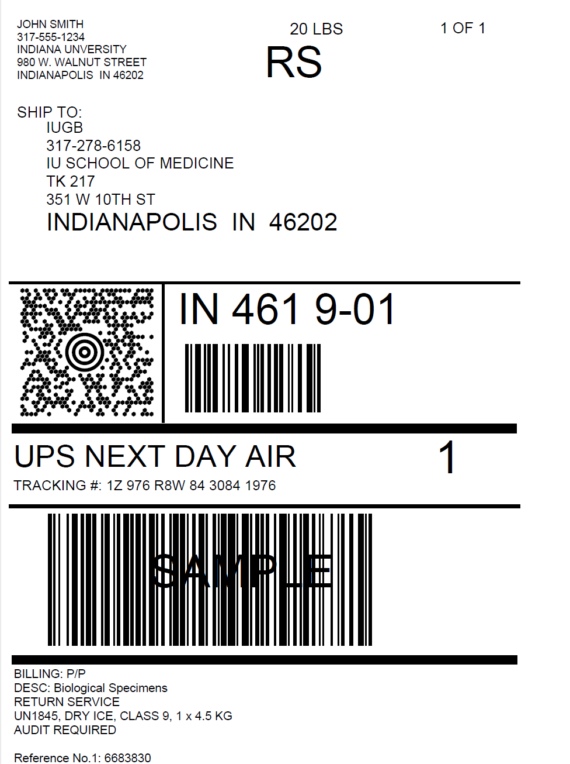
Accessing Airbill
Shipment Receipt
Airbill
Check Pickup Status by going to UPS.com, click on the Shipping, select Schedule a Pickup, and look on the right side of screen to click on “Pickup Request Status”. Enter in the Pickup No. listed on receipt into PRN field and submit

Slide 39
Accessing Airbill
Print out the UPS air waybill
Fold the UPS air waybill and slide it inside the plastic UPS sleeve (NCRAD will provide these in kit requests)
Peel the back off the plastic UPS sleeve and stick the sleeve to your package, making sure it is laying as flat as possible along the surface of the package.

Slide 40

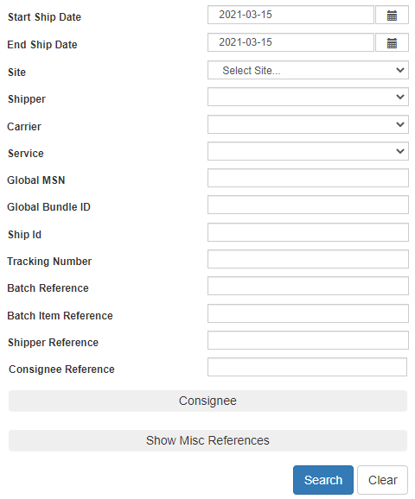
Reprint Airbills/Voiding Shipments
To reprint airbill or void a shipment, click “History” at the top of the ShipExec Thin Client portal
If your shipment doesn’t automatically pop up, enter in the date of shipment and then click “Search”

Slide 41
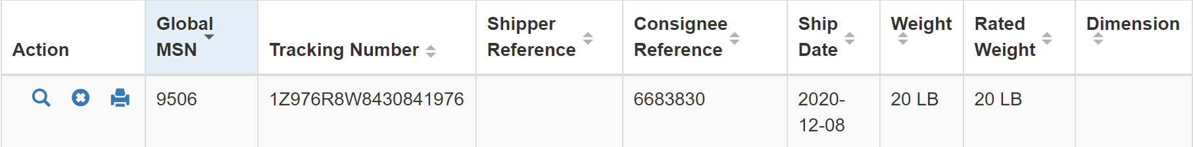
Reprint Airbill
Click the print icon to reprint airbill

Slide 42
Void Shipment
To void a shipment, click on the “X” symbol

Slide 43
NCRAD Website – HALS Page
HALS Website Link (In Progress)
Specimen collection overview
Link to kit request module
Sample forms
MOP
Training Slides

Slide 44
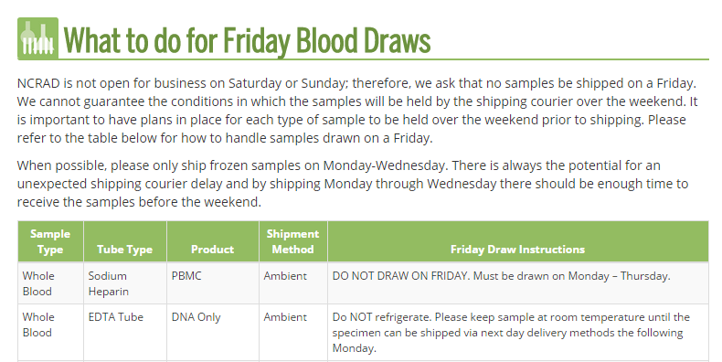
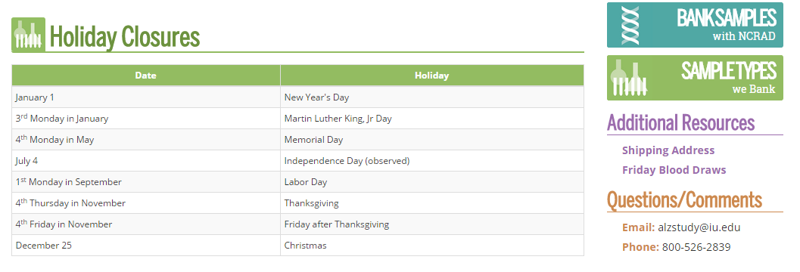
NCRAD Website – Helpful Pages
https://ncrad.org/holiday_closures.html
https://ncrad.org/friday_blood_draws.html

Slide 45
Nonconformance Issues
Sample aliquots and collection tubes frozen at an angle/inverted
Recommendation:
Place aliquots in Argos boxes/tube rack in freezer upright until shipment
Fields left blank on Blood Sample and Shipment Notification Form
Last time subject ate often left blank/unknown
Incorrect data reported on Sample and Shipment Notification Forms
Recommendation: Complete Sample Notification forms during the participant study visit as samples are processed.

Slide 46
Nonconformance Issues
Multiple low volume aliquots
Recommendation:
Lay out cryovials in a row and aliquot in order until sample is depleted
All frozen samples for a participant not sent within one shipment box (plasma and buffy coat aliquots should be kept together)
Aliquots arriving to NCRAD without labels
Sample forms not scanned to NCRAD the day before shipment
Recommendation:
Ship Samples to NCRAD utilizing the Notification Form, by PTID. Do not throw away labels until samples are packed and shipped.

Slide 47

HALS Contact Information
General Information
Phone: 1-800-526-2839
E-mail: alzstudy@iu.edu
Justin Delay– Study Coordinator
E-mail: jndelay@iu.edu
Mitzi Miramontes – Study Specialist
E-mail: memiramo@iu.edu
Erica Lindsey– Study Specialist
E-mail: lindsey2@iu.edu

