Slide 1

University of Manchester AI ML Society - Introduction to ML
Workshop 4
20th of November 2019
By Botond Maros
Notes:
ok I think we should get started
Hi everyone, My name is Botond Maros and welcome to our 4th workshop of the series, intro to ML
So as usual I am going to start with a presentation and then you will do some coding with Antoine

Slide 2
Intro to ML timetable
Workshop 1 - Introduction to Machine Learning
Workshop 2 - Data preprocessing
Workshop 3 - Fundamental Algorithms I
Workshop 4-5 - Neural Networks Part I
Workshop 6 - Neural Networks Part II
Notes:
so I said at the previous workshop that we won’t have time for 3 more because we are running out of time, its already weelk 9.
So today we are going to cover neural networks and the next workshop will be about convolutional neural networks.

Slide 3
Today’s session
Revise logistic regression, gradient descent
Neural network architecture
Backpropagation
Activation functions + batches

Slide 4
What is modeling?
Come up with a model that describes data
Measure how it describes the data
Calculate error = difference of real data vs model
Find model with lowest error
⇒ This is exactly what we are doing with neural networks
Notes:
so what are we doing when we are fitting a simple machine learning model to the data?

Slide 5
Logistic regression and gradient descent

Slide 6
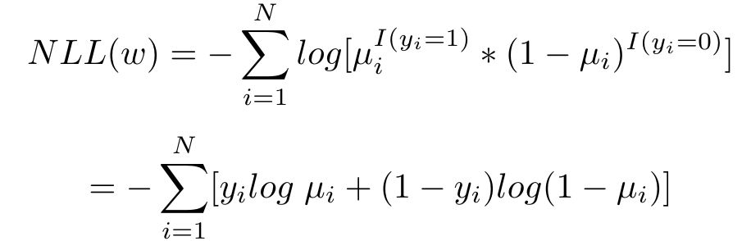

Recall logistic regression and gradient descent
Binary classification - linear model + sigmoid function
Formalizing the problem using negative log likelihood
2nd line is the error we are trying to minimize
where
Notes:
okay so linear regression is for inary classification and it is basically fitting a linear model to the data and then using a sigmoid funciton
a sigmoid funtction maps everyting between 0 and 1 so we can take it as probability and if its less than 0.5 than class 1, otherwise its class 2
the next thing we have to do is fomring to problem as a negative log likelyhood. then we expand that and get the second line which is the errors.
NOTE, this eqation has some wqaights and some input x
so we want to find the best model, which means it has the lowest erros. How we can do that is by the gradient descent.

Slide 7
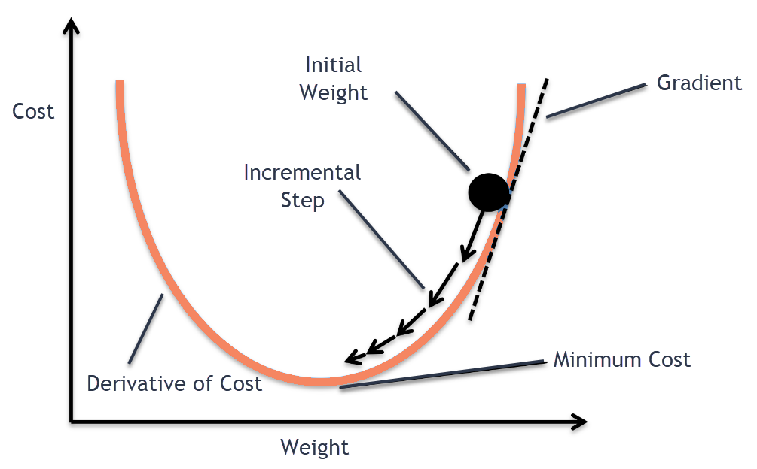
Gradient descent
Notes:
so we do gradient descent. Imagine the wieght and cost space then we have some kind of function which is a ampping between weight to cost. we we are doing is we want to find the minimal cost so we can find the min of this funciton.
how we do that is we start randomly, take the derivative which gives the orientation wehre do we have to go and then move a bit into that direction and then iterate over.

Slide 8
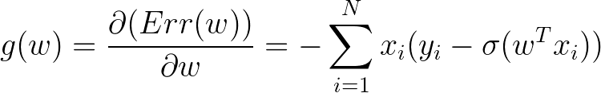
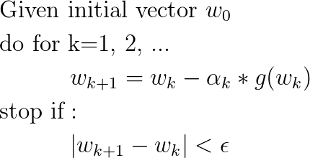
Gradient descent for logistic regression
Gradient:
Gradient descent:
Notes:
this is what I just described.

Slide 9
Artificial neural networks

Slide 10
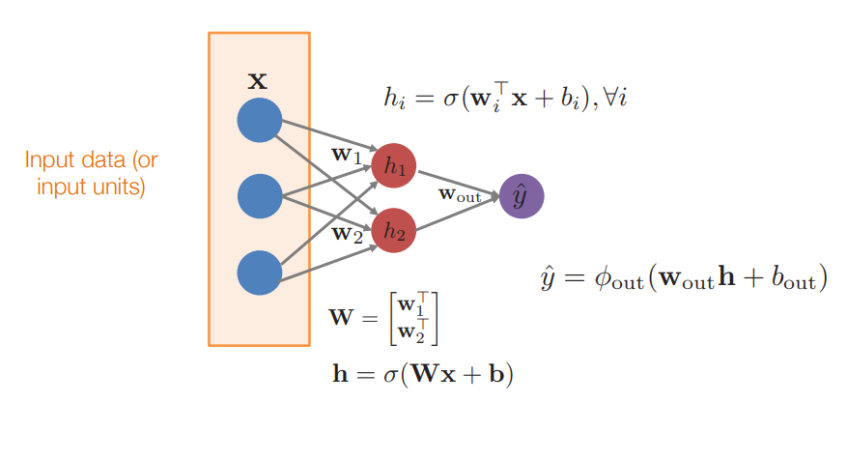
Artificial neural networks
= stacking multiple logistic regressions and training simultaneously
Notes:
ANNs are basiccly loads of multiple regression models
we have data coming in from the left hand side, we perform some calculations and then we get some numerical output
so in the yellow box, we have our input data

Slide 11
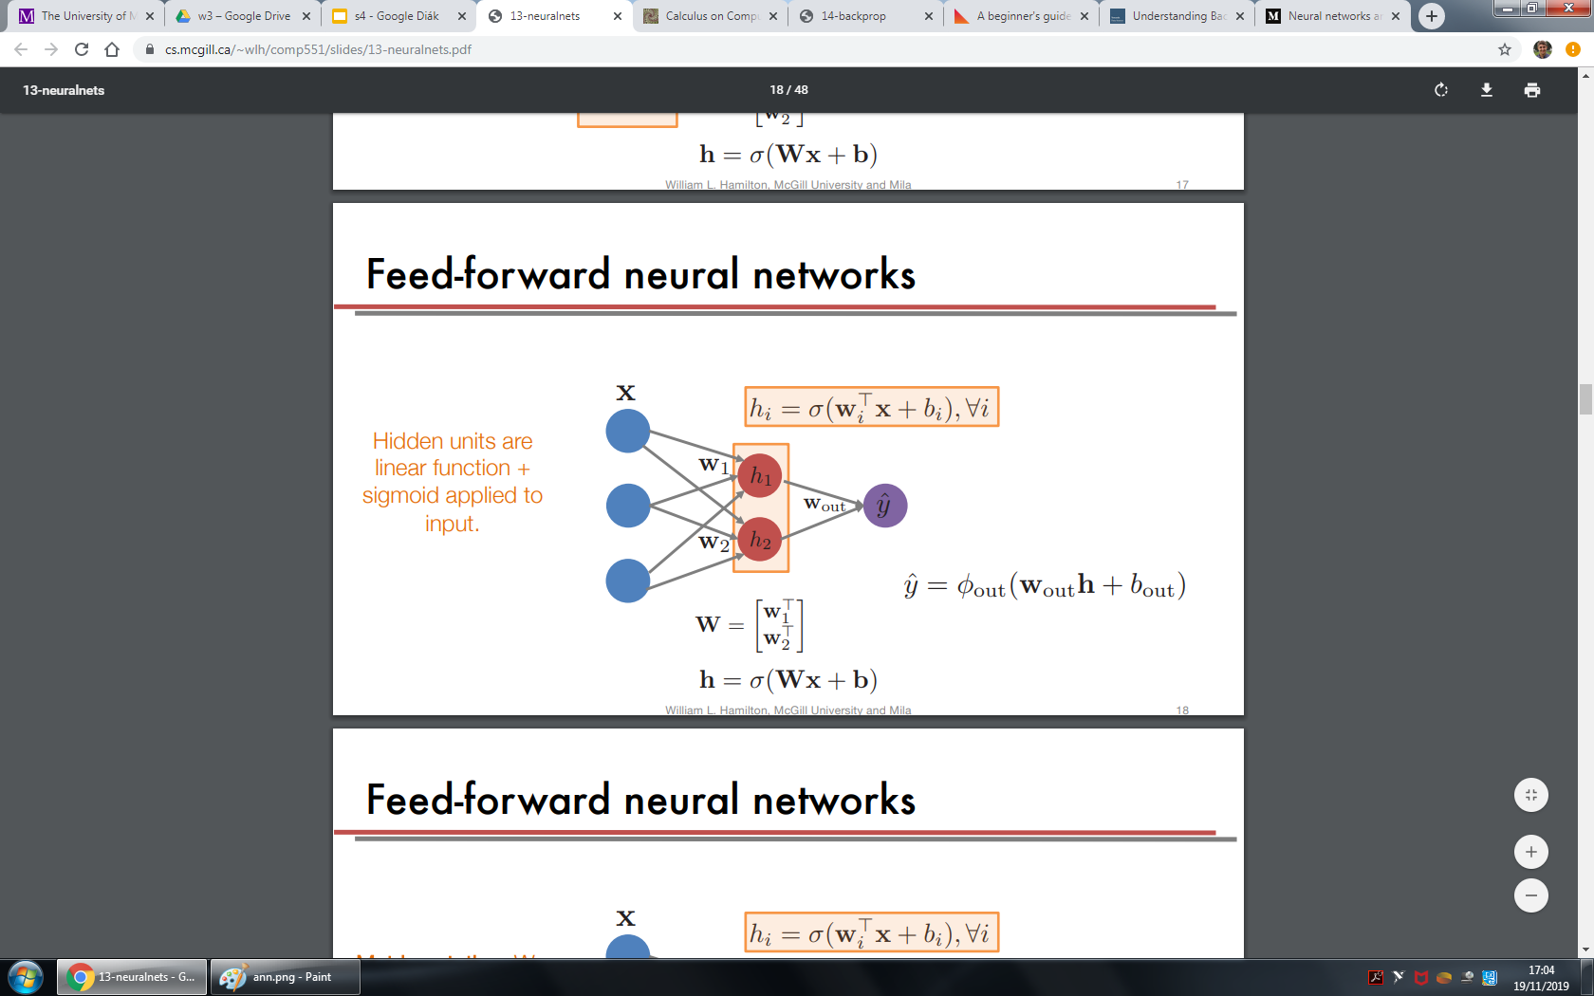
ANN - hidden layers
Notes:
then we have something called as hidden units. basically we are doing a linear function with input x and the bias b and then apply sigmoid to the output.

Slide 12
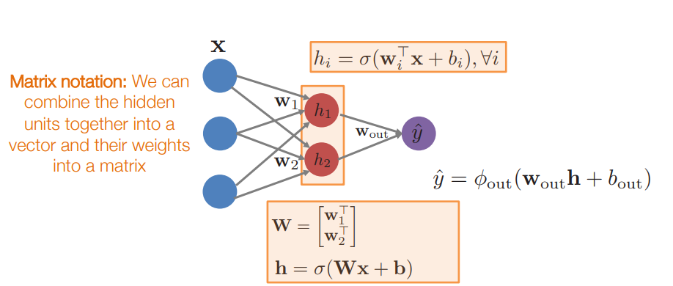
ANN - hidden layers
Notes:
and then we can just use a matrix notation for this

Slide 13
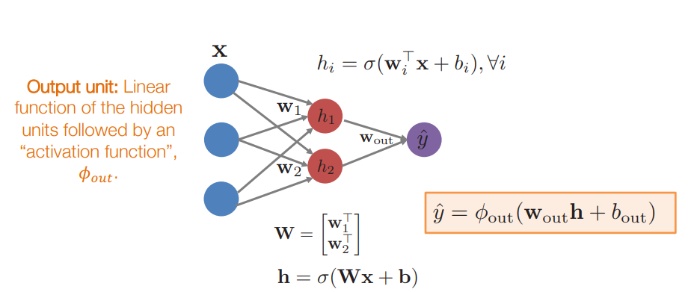
ANN- output layer
Notes:
and we use the matrix notation in the output which is the last nodes

Slide 14
Output’s activation funciton
We can use ANNs for linear regression out(z) = z
Or for binary classification out(z) = sigmoid(z)
Or for multi label classification with multiple output nodes
Notes:
so we cna use the ANN for linear regression, binary classification and multi label classification
Then for regression we dont apply any function at the last node
for binary classification we apply the sigmoid funciton again and take probability 0.5 if its more than that then we say its class one, otherwise it’s class 2
and we can also have multiple output nodes which will be used for multiple classes. nte that we need as many output nodes as many labels we have

Slide 15
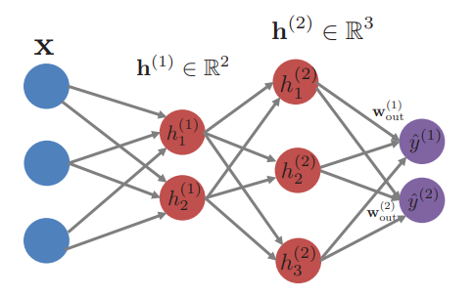
Architecture properties
We can have multiple hidden layers
No cross connection between nodes in a layer
No backward connection
Usually fully connected
Notes:
So here we have 2 hidden layers, and for the second layer we use the matrix multiplication and acttivatin function for the output of the firdst layer

Slide 16
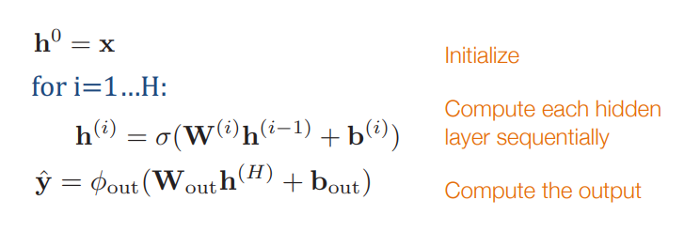
Multiple layers
So now we only left one thing to do and that finding the optimal weights
Optimal weights = lowest error
-> use gradient descent
Notes:
So in multiple hidden layers we haveand for the next layer we use the matrix multiplication and acttivatin function for the output of the previouslayer

Slide 17
Backpropagation

Slide 18
Recall Gradient descent
Calculates error, takes the derivative
Modifies the weight by the gradient times a number
ANN: each layer depends on the previous one
If we change something, it will have a domino effect
Want to calculate each edges share to the error
How can we do this fast?
Notes:
last node produces the actual errors
each edge modifies the error by a tiny bit
if we want to get each node’s share and how it modifies the error then we have to take every derivatie
but that is very expensive
how can we do that fast?

Slide 19
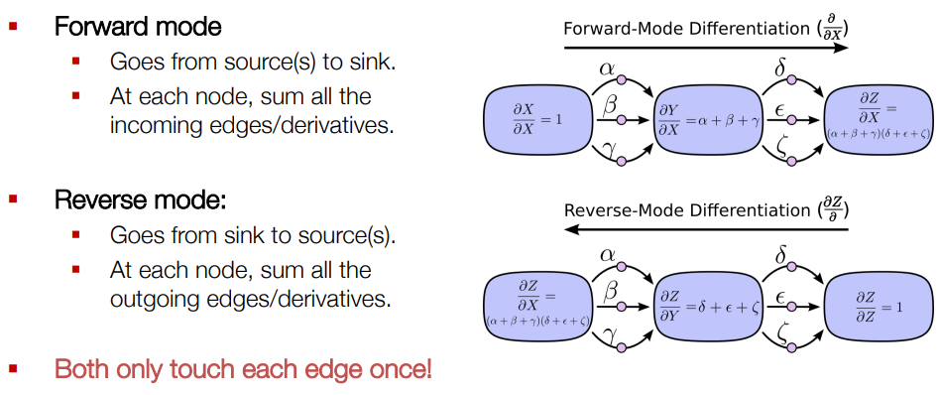
Backpropagation
Notes:
on RHS we have an ANN where each blue is a layer, greek letters are nodes
we want to calculate how each node modies the error -> so have to find the derivative
find X’s effect on Z and Z goes through Y before it gets to Z
if we do a forward differentiation we will ha loads of loads of erivatives (left -> right)
but we can factor them
and if we do a backward differentiation we will eventually get the same thing but with less computation
and in the backward node each node is the sum of all the prevoius derivatives
and each mode only touches one edge at once

Slide 20
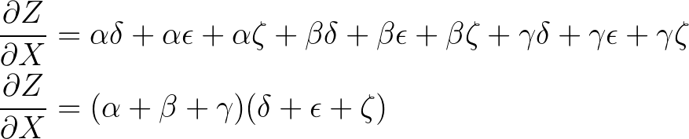
Derivatives
Calculate X’s effect on Z:

Slide 21
Backpropagation
Notes:
if we do a forward differentiation we dont know this refactoring
but if we do a backward differentiation it gives the same thing but refactored
so it is much less expensive than the forward mode differentiation
backpropagation calculates every nodes derivative in on go

Slide 22
Putting everything together

Slide 23
What we have so far
Multiple logistic regressions
Lot of nodes and layers
Backpropagation
We can use backpropagation for calculating every derivative in one go
We just put everything together and use gradient descent for the optimization

Slide 24
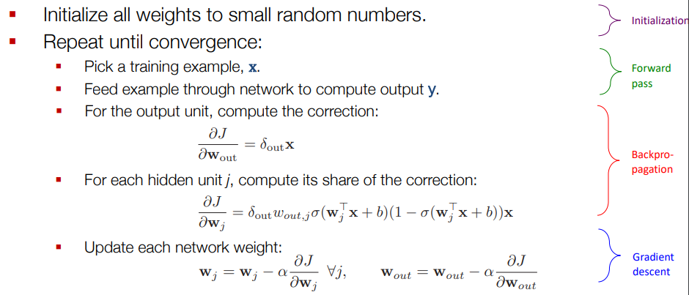
Putting everything together

Slide 25
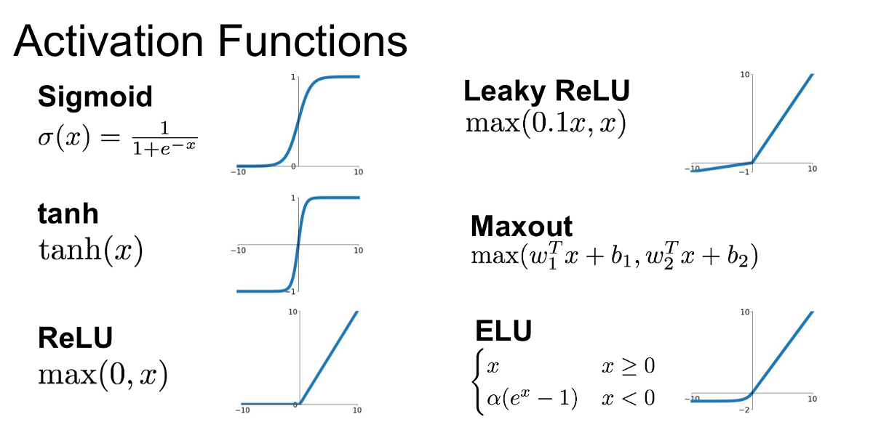
Activation functions
Notes:
important is not to be linear as a sum of linear functions is just a linear function

Slide 26
Batches
How often we update the weights?
Every training example?
After the whole data-set
In between : mini-batch
Notes:
So how often we want to update the weights
we can do it after every traning example but that have a big effect
after the whole data set : too little effect
mini-batch : for exampe after 100 traning examples selected randomly

Slide 27
Questions?
Multiple logistic regression
Trained together
By gradient descent
Using backpropagation
Batches
Activation functions

Slide 28
Thank you!
Resources:
http://colah.github.io/posts/2015-08-Backprop/
https://www.cs.mcgill.ca/~wlh/comp551/

