Slide 1

University of Manchester AI ML Society - Introduction to ML
Workshop 3
6th of November 2019
By Botond Maros
Notes:
ok I think we should get started
Hi everyone, My name is Botond Maros and welcome to our third workshop of the series, intro to ML
So as usual I am going to start with a presentation and then you will do some coding with Antoine

Slide 2
Intro to ML timetable
Workshop 1 - Introduction to Machine Learning
Workshop 2 - Data preprocessing
Workshop 3 - Fundamental Algorithms I
Workshop 4 - Fundamental Algorithms II
Workshop 5 - Neural Networks Part I
Workshop 6 - Neural Networks Part II
Notes:
What we will do today is dive into fundamental ML algos. Today Workshop will be heavier on the theory side since this is the basics of every ML algos and then we will implement something called a gradient descend.

Slide 3
Today’s session
Linear regression
Logistic regression
Gradient descent
Decision tree

Slide 4
What are we doing?
Come up with a model that describes data
Measure how it describes the data
Calculate error = difference of real data vs model
Find model with lowest error
Notes:
So far we did data preprocessing an now we want to get into modelling the data

Slide 5
Two main types of ML algos
Regression : - input maps directly to a continuous output space - involves estimating or predicting a response
Classification: - input maps to a class label - identifying class membership
Notes:
Okay, so we mentioned earlier in the workshops that there are two types of Ml algos, namely regression and classification.
regression outputs a continuous variable from some continuous and/or discontinuous features. By discontinuous I mean that some kind of integer, for example 0 or 1
and it is estimating or predicting a response
classification on the other hand, outputs a class label and can have the same inputs as the regression, ie continuous or discontinuous. So so far the two examples we saw were predicting the handwritten digits, and the prediction of salary, these where both classification examples. And in these examples had groups such as <50k earning and more than 50k earning and we identified group memberships.

Slide 6
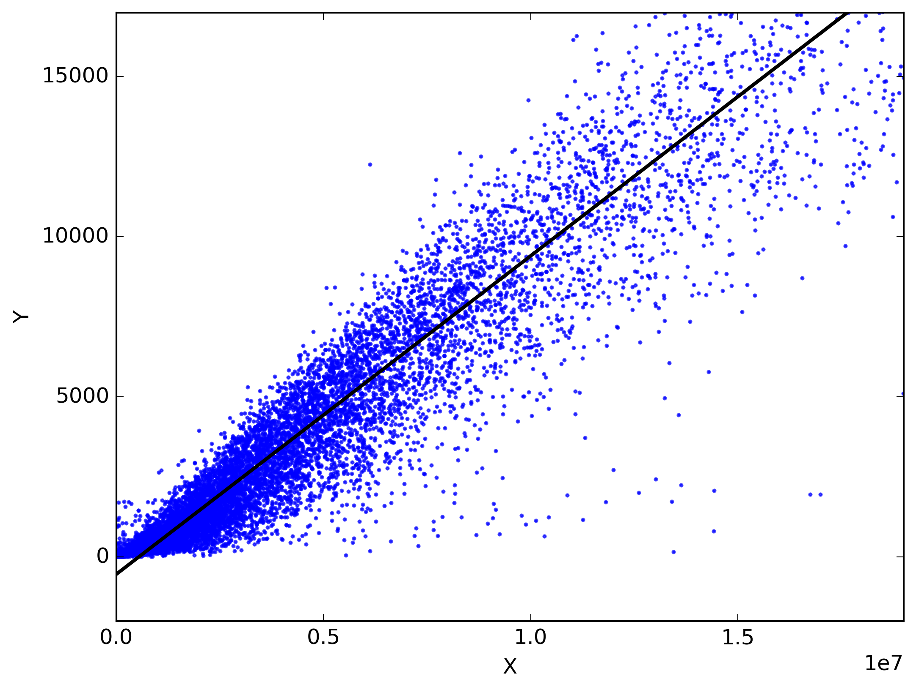
What is linear regression?
Notes:
Linear regression is regression model that assumes data is coming from a linear distribution.
Now derive the linear regression

Slide 7



Linear regression
General form of the linear regression problem:
Where
In vector form:
Probabilistic form:
Notes:
Assume data is linear
describe it by linear line equation of the form: b+a*x+noise
write it in matrix with only varibale theta, so we assume data is acting like this, what we want is approximate theta

Slide 8

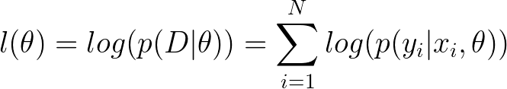
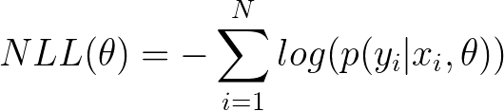
Linear regression
We want to solve the optimization problem: Where Negative log likelihood
Notes:
and how we formalize that, is a maximization problem
We have to do this because the problem is stochastic, there is no guarantee that the solution will be correct, instead, we form the problem as a maximum likelihood estimate problem, that is,
finding the solution with the maximum likelihood of being correct
we transform this equation to make it easier to compute.
We do a log transform because log is monotonically increasing so it doesnt change the properties of our function, and then solve the negative of that which is the negative log likelihood, because most software are doing minimization. and thats how we arrive to the negative log likelyhood
-max = minimization

Slide 9
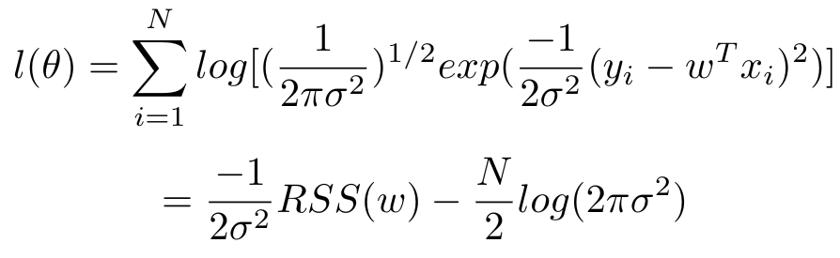
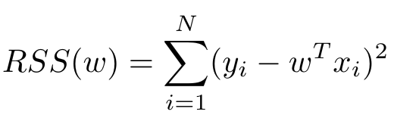
The optimization
and
Notes:
so in the last line, we don't consider that because that is constant, does not depend on theta
So we arrive to RSS, And that is the residual sum of the square tht of the difference of the actual output and the output generated by the model. that is the error, want to minimize rss
this is also known as the least squares error, as we are attempting to minimize the squared distance between the predicted values, and the values provided in the training (data) set.

Slide 10
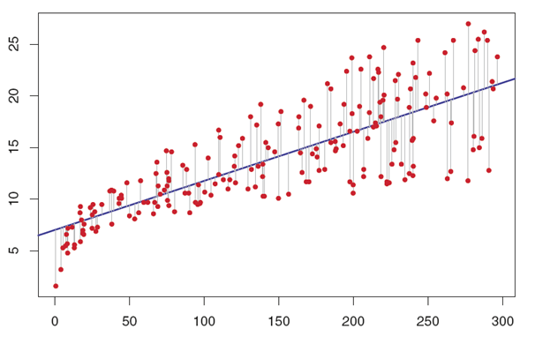
Distances:
Notes:
coming up with the line = min the overall distance

Slide 11
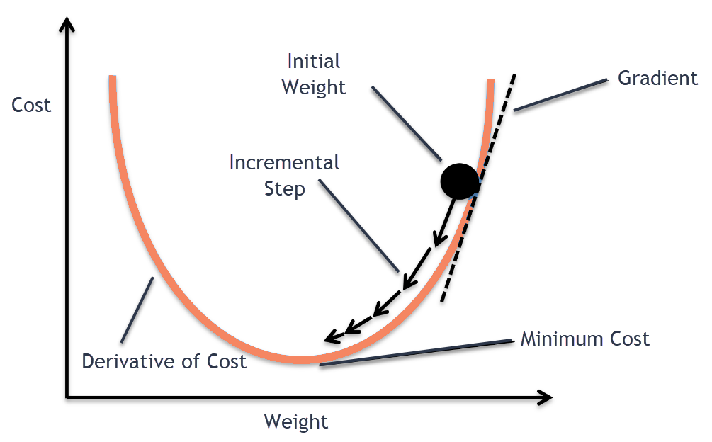
Gradient descent
Notes:
so we created this function RSS that depends on w, and outputs some kinf od cost, want to find minimum of this function
how to find min?
dradient descent, start somewhere, approach min by steps

Slide 12
The optimization
and

Slide 13
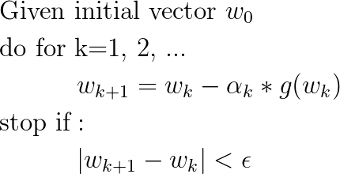
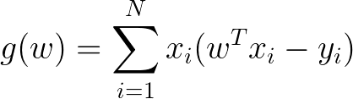
Gradient descent
Derivative:
Notes:
initialize w0,
iteratively update weightd
how we update is previous + derivative of cost
why derivative? it gives us the direction where to move
stop if weights are close to each other
so initialize, update, stop if close,
update by derivative

Slide 14
Summary
Fit a linear hyperplane
Calculate errors
Iteratively minimize errors by gradient descent

Slide 15
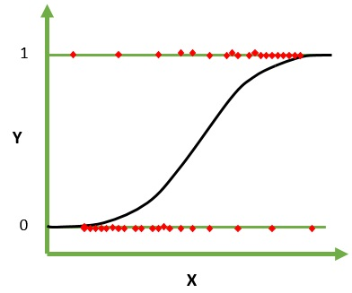
Logistic regression
linear model + threshold function
sigmoid f(x) is in [0, 1]
take 0.5 as threshold
f(x) > 0.5 -> class 1
f(x) <= 0.5 -> class 2
Notes:
Logistic Regression is actually a classification model that uses a linear model that best fits a the data, and then use a thresholding function called a sigmoid function to determine which class each point should be. A sigmoid function, is a function that goes between 0and 1, so if it returns a value greater than 0.5, we believe it to be in the first class, and if it returns a value less than 0.5, we believe it to be in the second class.

Slide 16

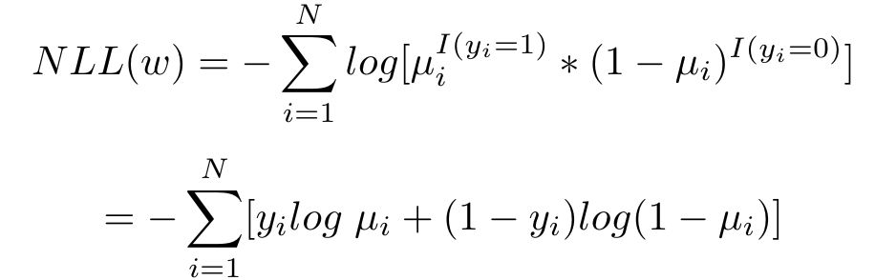

Logistic regression derivation
Logistic regression corresponds to this binary classification model: Where the negative log likelihood is: Where
Notes:
we are going to derive the logistic regression problem and minimize the errors
so we get the negative log likelyhood and minimize that

Slide 17
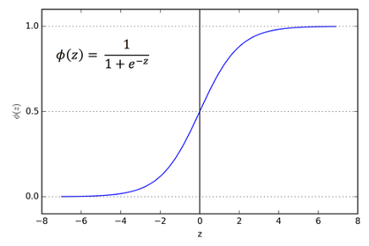
Sigmoid function

Slide 18
Logistic regression derivation
Logistic regression corresponds to this binary classification model: Where the negative log likelihood is: Where
Notes:
we get the negativ elog likelyhood, minimize that by gradient descent

Slide 19
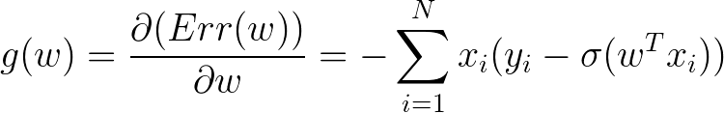
Gradient descent for logistic regression
Notes:
there are several other optimization methods which migh be more efficint then the ones we presented so far

Slide 20
Notes
There are other optimization algorithms that might be better
Minimum of errors != accuracy
Classification accuracy: misclassified/all

Slide 21
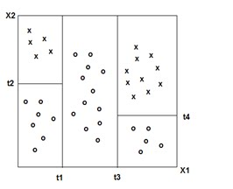
CART - Classification and regression trees
What if we want a richer partitioning?
Notes:
what if we want a richer partionining?
Decision trees - classification and regression trees
these can be used for both regression and classification

Slide 22
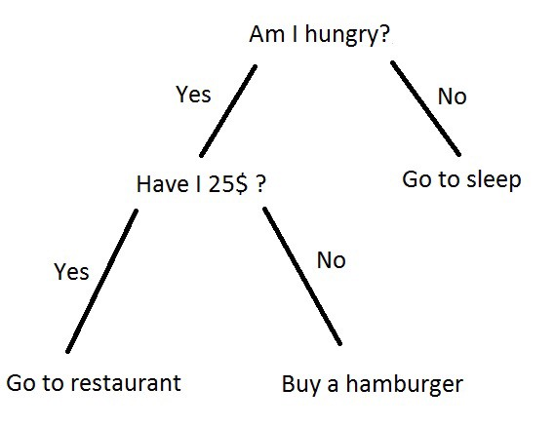
Decision trees
Nodes partition the data
Internal node: test on values
Leaf node: training example that satisfy each branch
Notes:
i am sure you saw a dec tree before
it has nodes that partiotion the data
---
i only go to the restaurant if i have 25 dollar and i am hungry

Slide 23
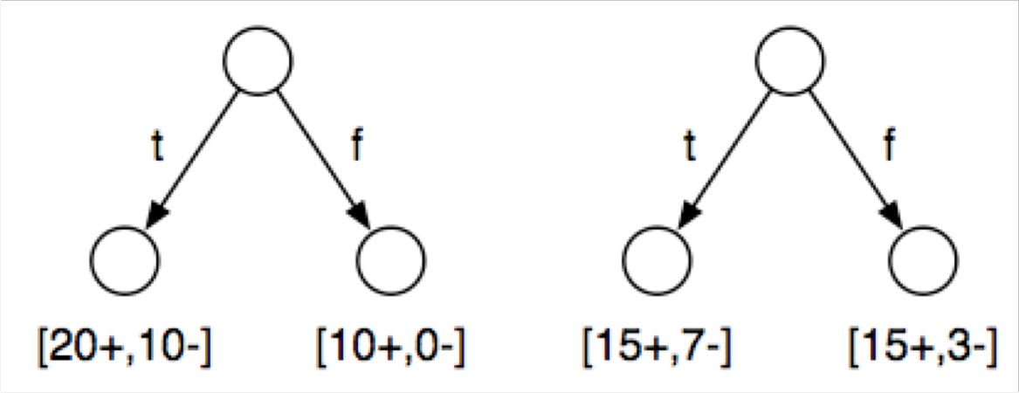
How to grow a tree
At each node, we want to maximise the information gain
Example - 40 examples: 30 positive, 10 negative
Which test is better? One with more information
Notes:
how to formalise a test
How can we measure performance of a test?
example:
which one is better, T1 or T2
T1 ask a question and 20+ and 10- examples gave true as answer for that test

Slide 24
Information
Dataset entropy (information): -p*log2(p) - q*log2(q)
p = positive/positive+negative
q = negative/positive+negative
Conditional entropy: probability of arriving to a node * entropy

Slide 25
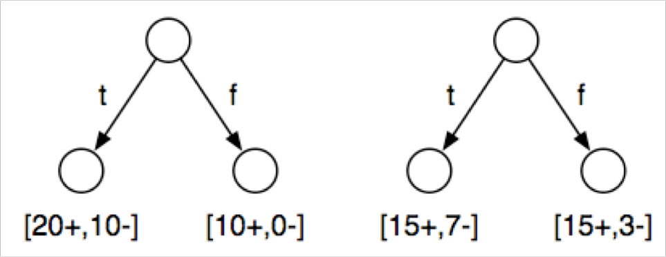
Which is best?
Dataset entrop: 30+ and 10- => p=3/4 , q = 1/4 H(D) = -(3/4)log2 (3/4)-(1/4)log2 (1/4) = 0.811
Test 1: H(D|T1 ) = (30/40)[-(20/30)log2 (20/30)-(10/30)log2 (10/30)]+(10/40)[0] = 0.688
Test 2: H(D|T2 ) = (22/40)[-(15/22)log2 (15/22)-(7/22)log2 (7/22)] + (18/40)[-(15/18)log2 (15/18)-(3/18)log2 (3/18)] = 0.788

Slide 26
Growing a tree
Pick best test to split the data
Split the data
Repeat for each subset
Stop if: 4. If all the training instances have the same class

Slide 27
Summary
Linear regression
Gradient descent
Logistic regression = linear regression + sigmoid
Decision trees
Information gain

