Slide 1
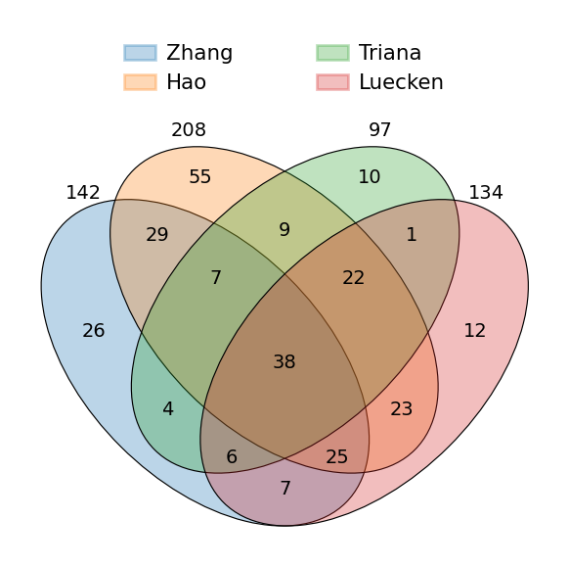
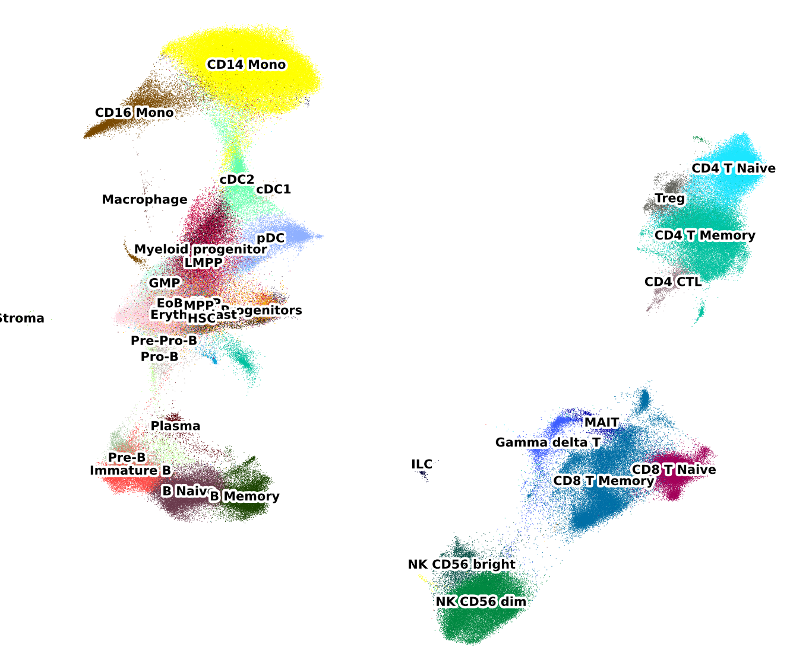
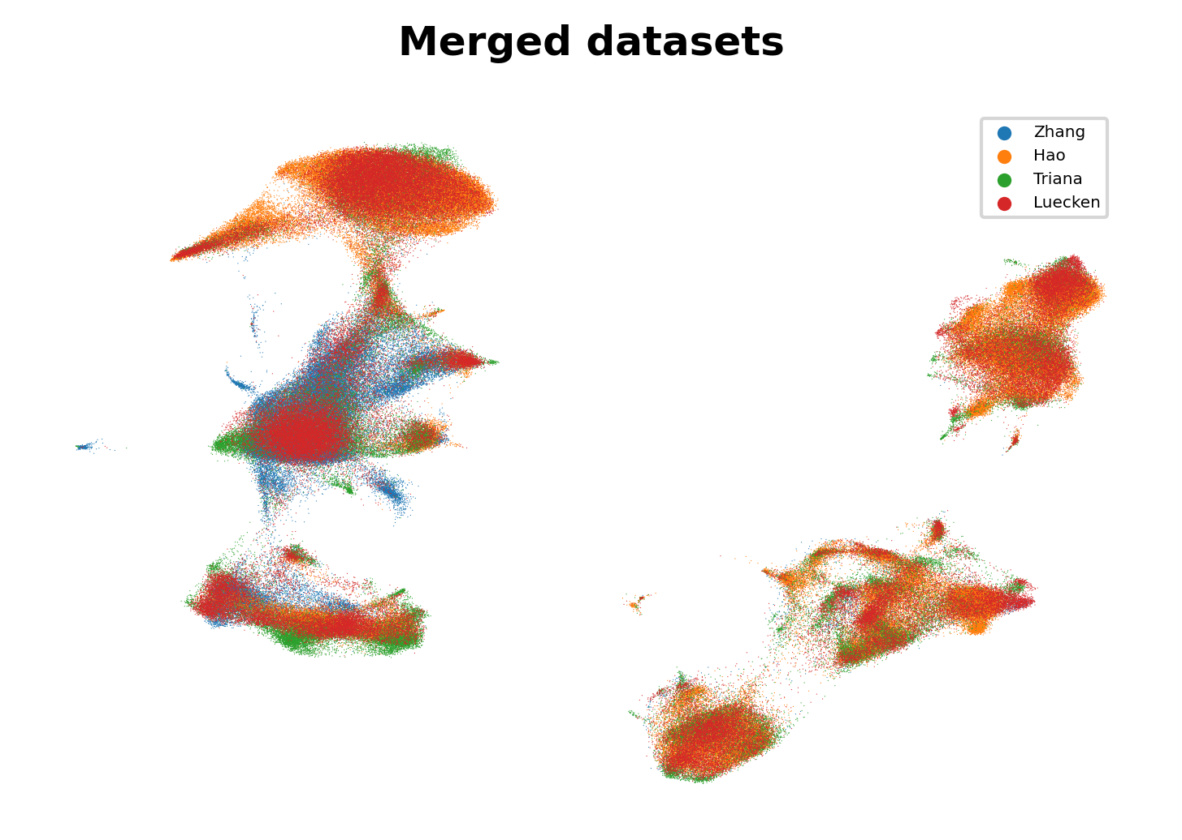
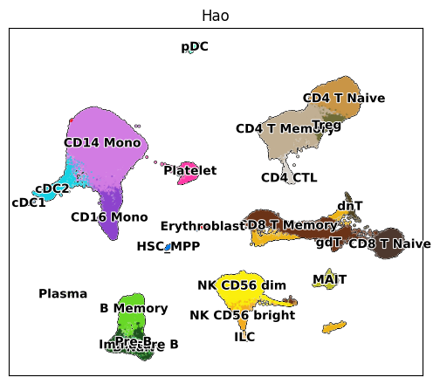
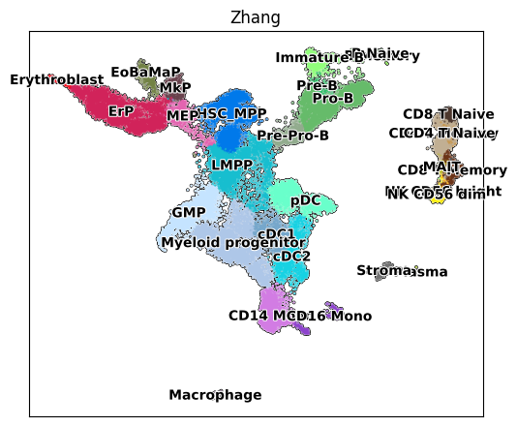
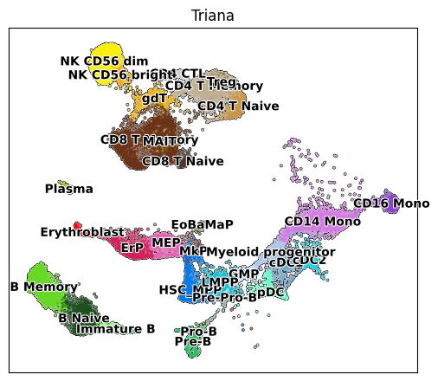
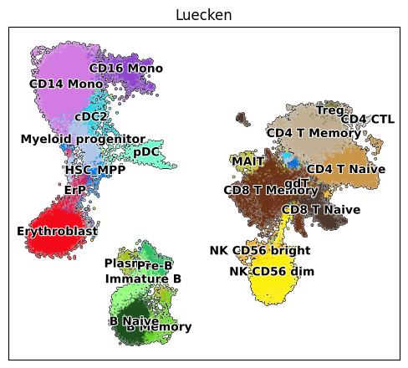
A
B
C
Hao
Zhang
D
Triana
Luecken

Slide 2
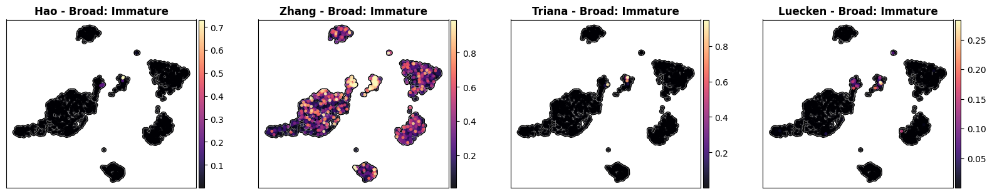
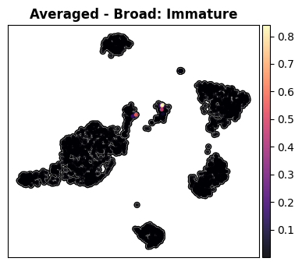
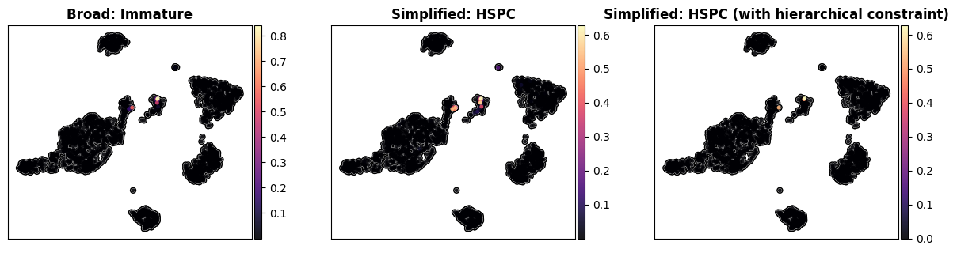
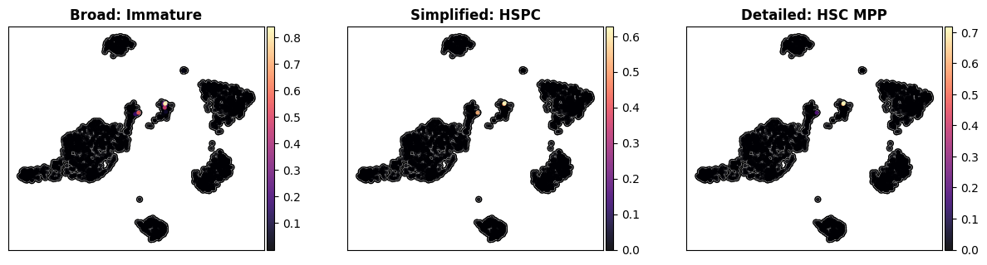
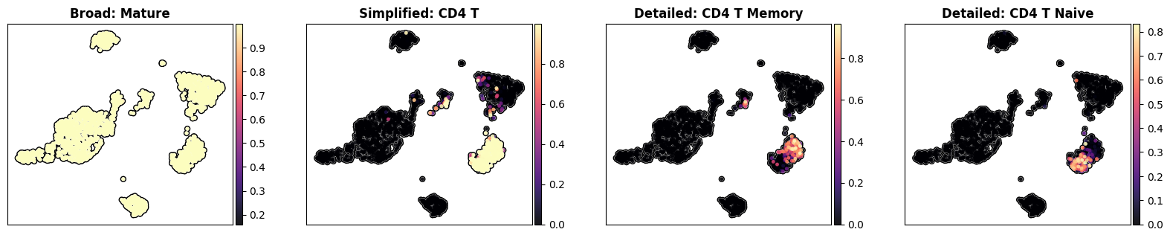
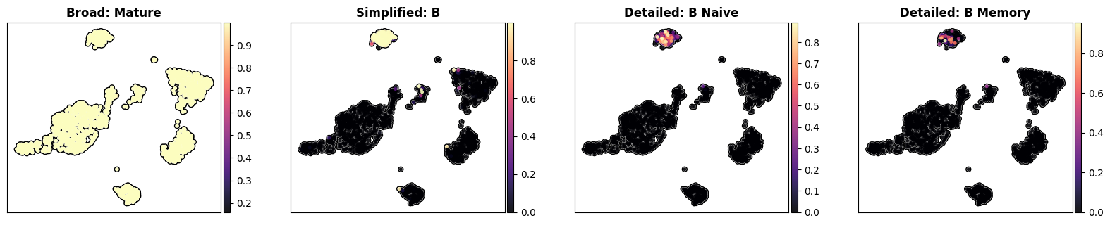
A
Hao – Broad: Immature
Zhang – Broad: Immature
Triana – Broad: Immature
Luecken – Broad: Immature
Averaged - Broad: Immature
B
Simplified: Immature
(with hierarchical constraint)
Broad: Immature
Simplified: Immature
C
(i)
Broad: Immature
Simplified: HSPC
Detailed: HSC_MPP
(ii)
Broad: Mature
Simplified: CD4_T
Detailed: CD4_T_Memory
Detailed: CD4_T_Naive
(iii)
Broad: Mature
Simplified: B
Detailed: B_Naive
Detailed: B_Memory
1
2
3
3

Slide 3
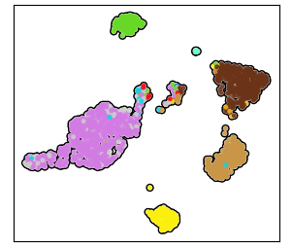
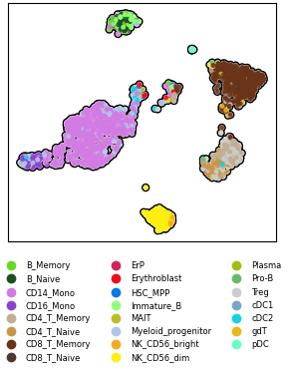
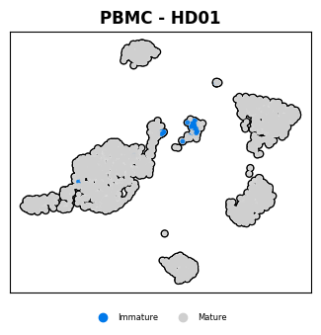
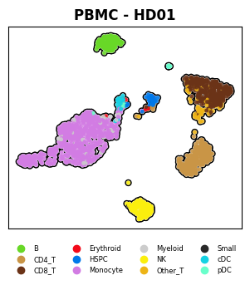
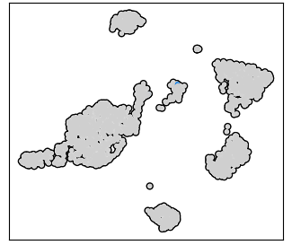

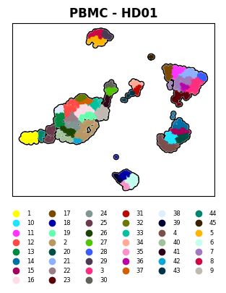
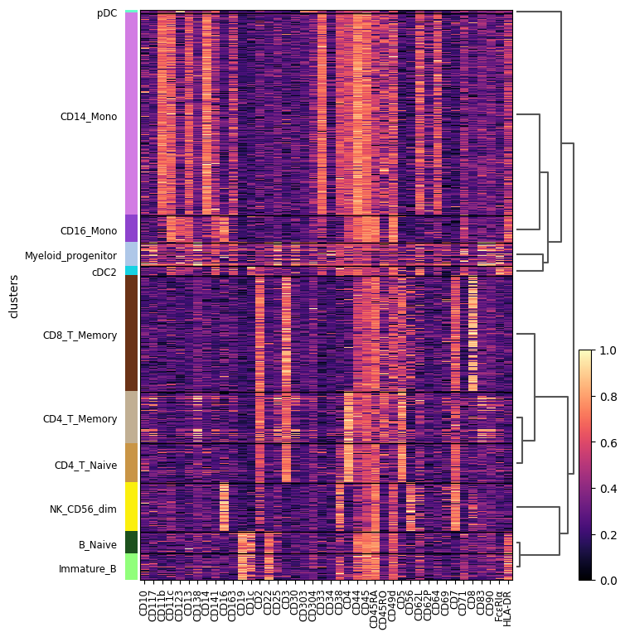
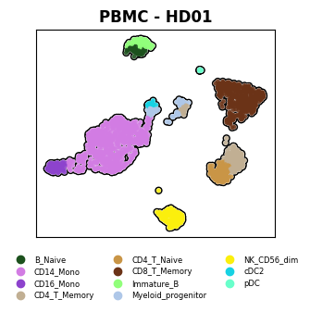
A
Broad annotation
Simplified annotation
Detailed annotation
B
High resolution
Leiden clustering
C
Dominant annotation
across clusters

