Slide 1
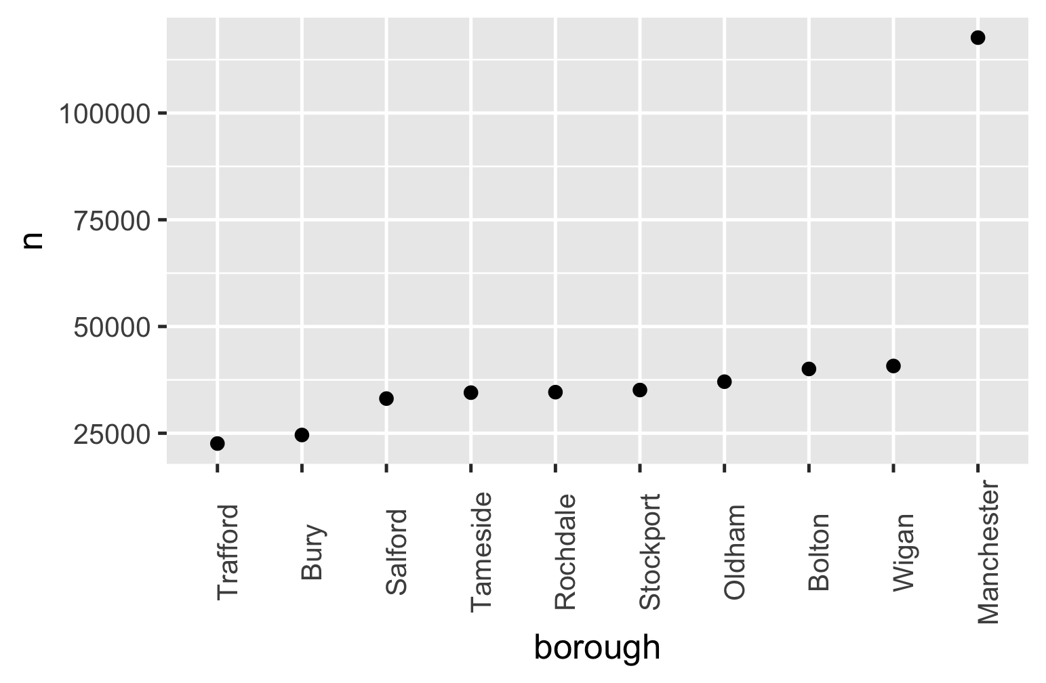

Slide 2
Min
Max
Median

Slide 3
Min
1Q
2Q
3Q
Max
25%
25%
25%
25%
Median

